Slide 1
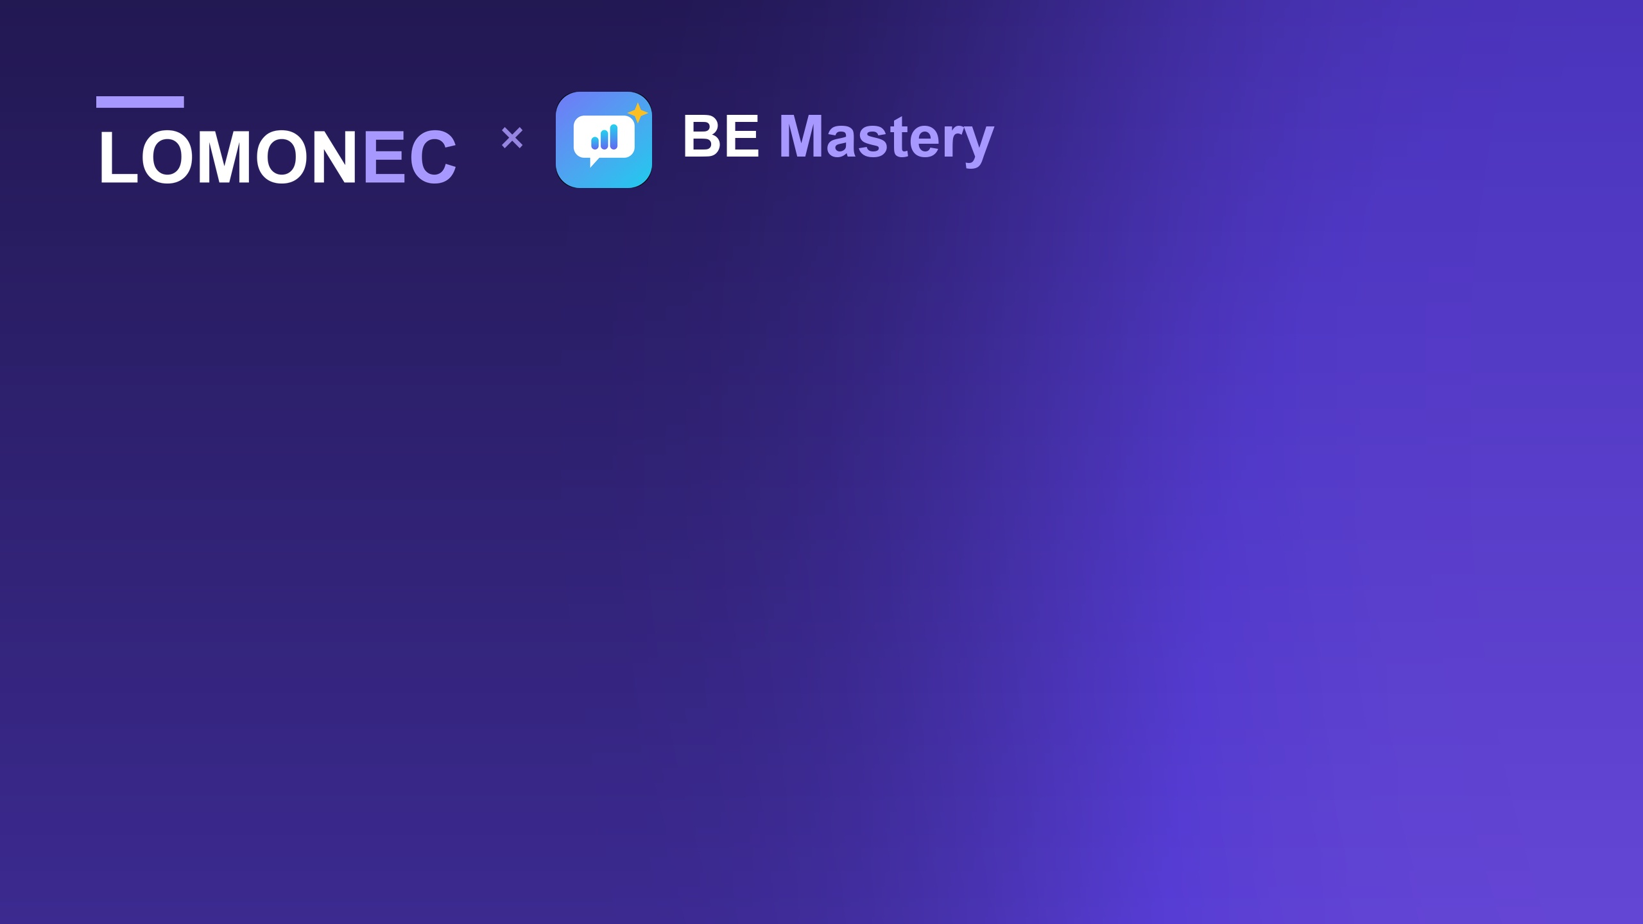
PARTNERSHIP VALUE
What this adds to
Petrocertif Construction Academy
A communication layer for programmes you already run
Notes:
This room is not the room you pitched. These partners were not at the first meeting, they have no reason to care about a product tour, and their question is simpler: what does this add to our academy?
Open on that, not on yourself:
"I am not here to sell you software. I am here to show you what a communication layer adds to programmes you already run — and to ask for four weeks to prove it at no cost."

Slide 2
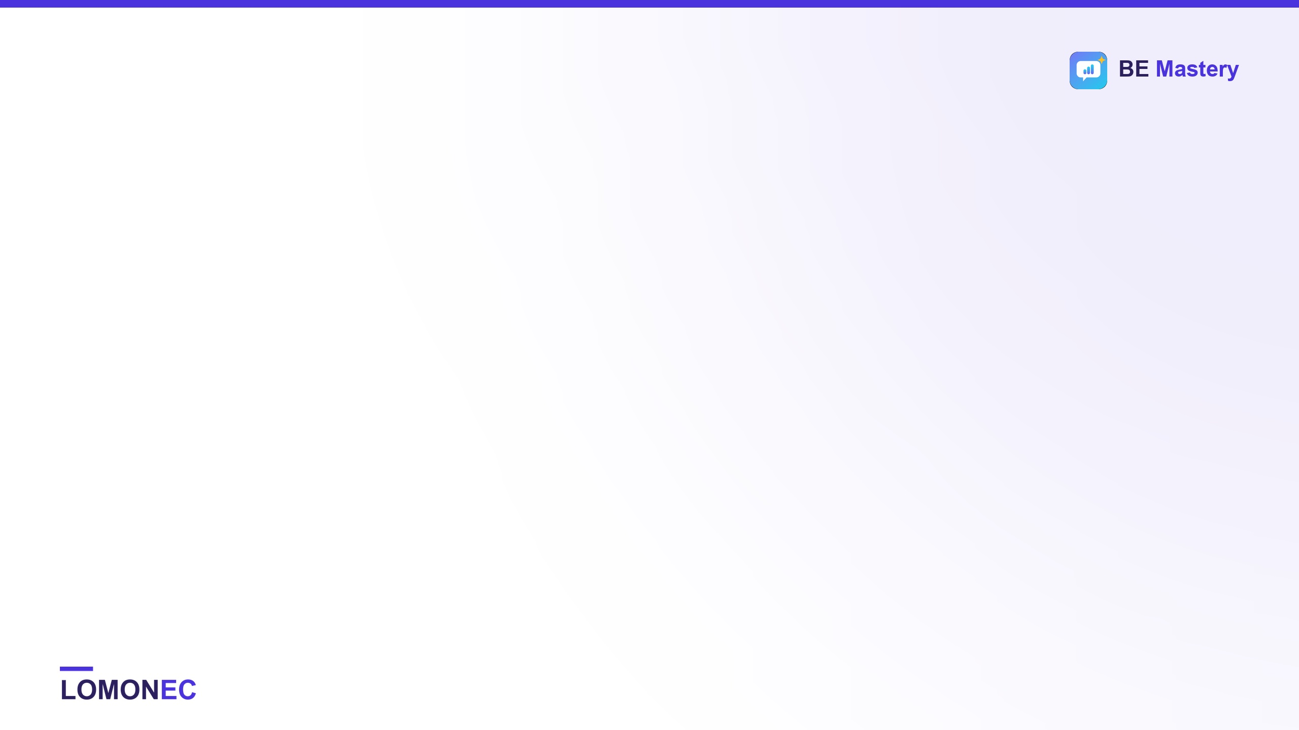
WHERE YOU ALREADY ARE
You build technically competent people
THE OFFER
THE PATHWAY
THE HORIZON
Nine specialised programmes
Supervisory progression
International certification
Reading and interpretation of plans across piping, civil, electrical, instrumentation, renewables, metal structures and storage tanks.
Storage tank, boiler and pressure vessel, industrial piping, welding production — the roles your graduates are actually aiming at.
A Pearson VUE route toward CMIT, CCM and CIOB. Your learners are being prepared for a market beyond Cameroon.
None of that needs fixing. This is about the one step after it.
app.lomonec.com · contact@lomonec.com
Notes:
Start with them, not with you. Say what they are good at, accurately, and mean it.
"You train people to read a P&ID, an isometric, a metal-structure drawing. Nine programmes, supervisory pathways, a Pearson VUE centre, a route to CMIT and CIOB. That is a serious technical offer and none of it needs fixing."
You are establishing that you have done your homework and you are not about to tell them their business.

Slide 3

THE STEP AFTER
The market you prepare them for
runs in English, out loud.
A drawing read perfectly is worth nothing if the supervisor cannot brief the crew from it, answer the inspector, or get through the interview that puts them on the site in the first place.
app.lomonec.com · contact@lomonec.com
Notes:
Say it slowly. Then stop and let it sit.
"That market is English-speaking. Your graduate can read the drawing perfectly — and then has to brief a crew from it, tell a fabricator the fit-up is wrong, answer an inspector, and sit an interview. In English, out loud, under pressure."
Then: "Reading is taught. Saying it is not." Pause. If one of them nods, you have the room.

Slide 4
YOU HAVE ALREADY DECIDED THIS MATTERS
It is on your course page today
“Enhance your professional English skills, with certification in written and spoken English and a shadowing approach via our LomoneC App — app.lomonec.com”
— Petrocertif Construction Academy, published course offer
The decision is made. What is missing is delivery and proof.
Today that line is a promise with nothing behind it. Four weeks from now it can be a number you are willing to publish.
app.lomonec.com · contact@lomonec.com
Notes:
Their own words. Do not say it accusingly — whoever wrote it believed it, and they were right to.
"You already tell learners this. It is on the course page today. So the question is not whether English belongs in your offer — you decided that. The question is whether it is delivered and evidenced, or just promised."
This is the slide that makes the rest of the meeting easy, because you are arguing from their decision, not yours.

Slide 5
WHAT IS IN THE PACKAGE
Everything your learners would get
12 workplace conversations — with a five-person crew: HR, supervisor, coworker, safety officer, QA inspector
Starts where the learner is — a one-minute check, then Foundations: three sentences a day, French under every line
12 interview coaches — one per part of the professional story, repeatable without limit
Evidence they can show — answers spoken, coverage, trade words actually used
A report on every answer — what was covered, what was missed, the better sentence
A career centre and 84 daily sessions — CV and LinkedIn coach; 15 languages; offline after first load
No per-seat fee, no platform fee, no contract for the pilot. Your learners install it from a browser — there is nothing for your IT to deploy.
app.lomonec.com · contact@lomonec.com
Notes:
Do not walk through this item by item — they will read it. Name the shape of it:
"This is the whole package, and it is not a subscription to a vocabulary app. It is workplace conversation practice, an interview room, a report that names what was missing, and a record the learner can show an employer. Free for your learners during the pilot, and free for the academy permanently — there is no platform fee in this model."
Point at 'Starts where the learner is' and say where it came from: "Your own students told us the app opened above their level. This was built from that, in a week. That is how this partnership will work."
If someone asks the cost question here, take it: 'Nothing during the pilot. After it, whatever the pilot shows is fair — and you would help set that.'

Slide 6
THE COMMERCIAL CASE
Three things you cannot claim today
01 YOUR OFFER
02 YOUR GRADUATES
03 YOUR EVIDENCE
A differentiator, not a feature
Placeable, not just qualified
Outcomes you can publish
Every academy in the region teaches drawings. None of them can say their graduates rehearse the interview and the site conversation in English. That is a reason to choose you, and it is defensible.
The certificate gets them shortlisted. The interview decides it. This is the only part of the journey nobody currently prepares them for.
A report on what the cohort actually did — spoken answers, coverage, improvement — that you can show employers, funders and the next intake.
app.lomonec.com · contact@lomonec.com
Notes:
This is the commercial slide and the one the partners actually came for. Slow down.
"Three things this adds that you cannot currently claim. Your offer gets a differentiator no competing academy in the region has. Your graduates get placeable in English-speaking markets, which is the outcome they are paying you for. And you get evidence — not attendance, evidence — that you can put in front of an employer or a funder."
If they only remember one slide, this is it.

Slide 7
BEING STRAIGHT ABOUT THE LIMIT
Three of your programmes today
COVERED NOW
WHAT THE LEARNER REHEARSES
Plans in Boiler Making
Briefing a crew from the drawing; clarifying with the fabricator
Industrial Piping Supervisor
Walking a contractor through an isometric
Welding Production Supervision
A weld-quality concern with a QA inspector; stop-work
NOT BUILT YET
Electrical, civil, instrumentation, renewable energy, metal structures, storage tanks. The pilot decides which is built next — and you choose it.
app.lomonec.com · contact@lomonec.com
Notes:
Be straight about the limit before anyone finds it. In a room of partners this earns more than a feature would.
"Three of your programmes are covered today. Six are not. I am not going to stand here and tell you otherwise."
Then hand them the decision: "The pilot decides which one is built next, and you choose it." A partner who picks the roadmap is a partner, not a customer.

Slide 8

THE DOWNSIDE, HONESTLY
What this costs you if it fails
$0
0
20 min
Any day
MONEY
IT WORK
OF YOUR TIME
YOU CAN STOP
Your technical teaching, your assessments and your certification are untouched. Recordings never leave the learner's phone, nothing is published without your written approval — and no learner is put in front of English they cannot yet follow.
app.lomonec.com · contact@lomonec.com
Notes:
Partners think about downside before upside. Get there before they do.
"Let me do the risk assessment for you. It costs nothing. It commits you to nothing. It touches none of your technical teaching or your certification. No learner data leaves the learner's phone. And either side can stop it on any day for any reason."
Then be quiet for a beat. This slide is designed to end objections, not to start them.

Slide 9
THE EXCHANGE
What we ask, and what we bring
WHAT WE ASK OF YOU
WHAT WE BRING
✓ One cohort — 20–30 learners from three programmes
✓ Full access — every learner, free, pilot plus 30 days
✓ Twenty minutes — one induction slot, once
✓ Onboarding — guide in French and English, we run the induction
✓ One instructor — 10 minutes in week 2 and week 4
✓ All support — learner questions come to us, never to your staff
✓ Permission — to write the result up jointly
✓ The report — yours to show, with the data behind it
app.lomonec.com · contact@lomonec.com
Notes:
Read the left column slowly. It is short on purpose — that shortness is the offer.
"Four things from you, three of which take under an hour in total. Everything else is mine, including the measuring and every learner support question."
Get a name for the instructor before you leave the room. A pilot with a named instructor happens; one without drifts.

Slide 10
IF IT WORKS
Four ways this can grow — you choose
Student access
Individual learner licences attached to your technical programmes, priced so they sit inside an existing course fee.
Cohort licensing
Access for a class, an intake or a centre, with the cohort reporting you would have seen in the pilot.
Bundled programmes
BE Mastery included as the communication layer of a named Petrocertif course — part of what the learner buys from you.
Custom pathways
A discipline built to your curriculum: your scenarios, your terminology, your assessment language.
None of this is decided today. The pilot is free either way.
app.lomonec.com · contact@lomonec.com
Notes:
Partners want to know where this goes, not just what it is. Be clear that nothing here is decided today.
"If the pilot works, there are four ways this can grow, and you would pick. If it does not work, we both learned something for the price of four weeks and no money."
Do not price anything in this room. If pushed: 'I would rather set that from what the pilot shows than guess in front of you — and I would want your view on what is fair.'

Slide 11
SCOPE AND INTEGRITY
What this is not
Not a trade qualification
It does not certify that anyone can weld. AWS, ASME, IIW and your own assessments are untouched by it.
Not an English proficiency certificate
The certificate is for completing the app's own 84-session programme. It is not IELTS, not a CEFR level, and written English is not assessed at all.
Not a replacement for your teaching
One layer on top of your programme: professional English, workplace communication practice, and evidence of both.
Your course page currently promises certification in written and spoken English. Worth correcting before a cohort starts — a suggested sentence is in the proposal.
app.lomonec.com · contact@lomonec.com
Notes:
Never let a partner discover this on their own. Saying it yourself is the difference between a partner and a vendor.
"Three things this is not, and I would rather you heard them from me. It is not a trade qualification. It is not a recognised English proficiency certificate — the certificate is for completing the app's own programme, and written English is not assessed at all. And it replaces nothing you teach."
Then raise the course-page wording. Frame it as protecting them: if a learner enrols expecting a written-English certificate, the complaint arrives at Petrocertif, not at you. A suggested replacement sentence is in the proposal.

Slide 12
THE DECISION
One cohort. Four weeks. Free.
Not a contract. Not a price. Not a commitment to anything after it.
If yes — we need a start date and one instructor's name.
If no — I would like to know what would have had to be true.
Lomonec LLC · contact@lomonec.com · app.lomonec.com
Notes:
One decision, stated plainly, then silence. Do not fill it.
"The only decision today is whether one cohort tries this for four weeks. Not a contract, not a price, not a commitment to anything after it."
If you get a yes, ask for the week-0 date and the instructor's name before you leave the room. If you get a no, ask the one question worth more than the pilot: "What would have had to be true for this to be a yes?"

