Slide 1

Image Classification with CNN and MLP
This presentation explores image classification using convolutional neural networks (CNNs) and multi-layer perceptrons (MLPs). We will train and evaluate these models on the MNIST and FashionMNIST datasets, comparing their performance.
by Saloni

Slide 2
Objective of Making Model
The primary goal of this project is to classify images from two well-known datasets: MNIST (digits) and Fashion-MNIST (clothing items). The task involves training and evaluating two distinct neural network architectures—Multi-Layer Perceptrons (MLP) and Convolutional Neural Networks (CNN)—to understand their performance differences and suitability for image classification tasks.

Slide 3
About the Dataset
MNIST:
A dataset of 70,000 grayscale images representing handwritten digits (0-9).
Each image is 28x28 pixels, resulting in 784 features when flattened.
Contains 60,000 training images and 10,000 test images.
A benchmark dataset for simple image classification tasks
Fashion-MNIST:
A dataset of 70,000 grayscale images representing 10 categories of fashion items (e.g., shirts, shoes, bags).
Also consists of 28x28 pixel images (same format as MNIST).
A more challenging dataset due to complex patterns and textures.

Slide 4
Machine Learning Libraries used
Matplotlib
Numpy
Pandas
Tensorflow
Keras

Slide 5





Convolutional Neural Network (CNN)
Input layer
1
Accepts the image data.
Convolutional layers
2
Extract features from the input images.
Pooling layers
3
Downsample the feature maps, reducing dimensionality.
Dense layers
4
Perform classification based on learned features.
Output layer
5
Produces probabilities for each class.

Slide 6
Multi-Layer Perceptron (MLP)
Input layer
1
Accepts the flattened image data.
Hidden layers
2
Learn complex non-linear relationships.
Output layer
3
Produces class probabilities.

Slide 7
Training and Evaluation
1
Compile model
Define the loss function, optimizer, and metrics.
2
Train model
Feed the training data to the model and update its weights.
3
Evaluate model
Measure the model's performance on the testing data.

Slide 8
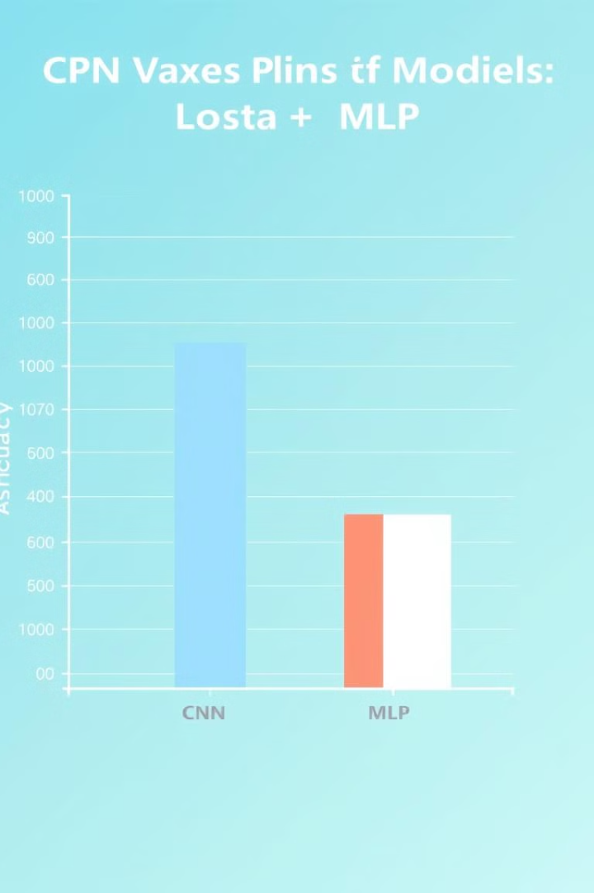
Performance Comparison
95%
90%
CNN
MLP
Achieves higher accuracy.
Shows good performance, but lower than CNN.

