Slide 1

Stock Market Prediction Model Using LSTM
Welcome! Today, we'll explore a powerful approach to predicting stock market movements using LSTM networks. This model leverages past trends to forecast future price fluctuations, providing valuable insights for investors and traders.
by Saloni

Slide 2
Libraries Used
NumPy
Matplotlib
Keras
For visualizing data, creating graphs, and presenting insights.
Keras is used to build and train deep learning models with a simple and intuitive API
For Numerical computation and array manipulation.
SciKit Learn
Pandas
TensorFlow
For data analysis, manipulation, and loading datasets.
For building, training, and evaluating deep learning models.
For Making Linear Regression Model

Slide 3
Dataset – Yahoo Finance
Wide Data Range: Provides historical and real-time data for stocks, indices, currencies, and more, including financial metrics like earnings and dividends.
Ease of Use: Accessible via the yfinance programming library..
Free Access: Offers free data for basic analysis, with advanced features available through Yahoo Finance Premium.
Integration: Compatible with Python, R, and other tools for data analysis, making it ideal for backtesting, visualizations, and predictive modeling.
Limitations: May have delays in real-time data and restricted customization for intervals in free usage, making it less suitable for high-frequency trading.

Slide 4
Model Used
LSTM (Long Short-Term Memory): A type of RNN designed to learn long-term dependencies in sequential data, addressing the vanishing gradient problem.
RNN (Recurrent Neural Network): A neural network architecture for processing sequential data by maintaining a memory of previous inputs through recurrent connections.
Linear Regression: A simple machine learning algorithm for modeling the relationship between a dependent variable and one or more independent variables by fitting a straight line.
KNN (K-Nearest Neighbors): A non-parametric algorithm that classifies data points based on the majority class of their k-nearest neighbors in the feature space.

Slide 5
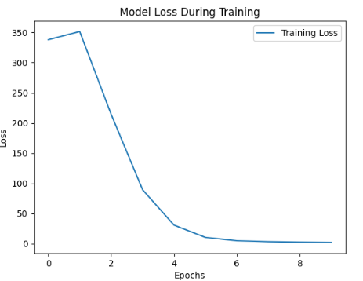
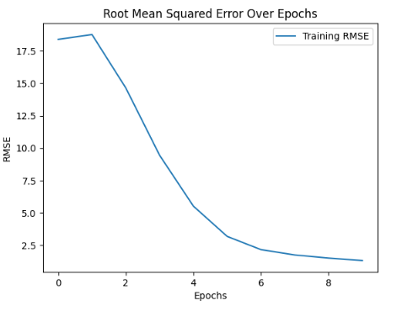
Model Training and Evaluation
1
Splitting the dataset into training and validation sets allows us to evaluate the model's performance on unseen data.
2
The model learns from the training data, adjusting its parameters to minimize prediction errors.
3
Evaluating the model on the validation set gives us an unbiased measure of its generalizability.

Slide 6
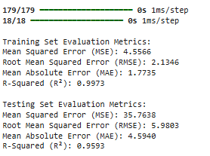
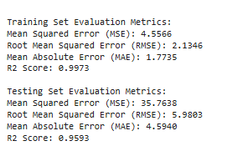
LSTM vs RNN model Metrics

Slide 7
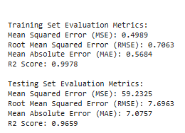
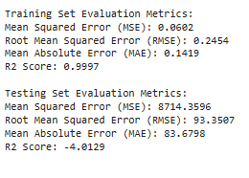
Linear Regression vs KNN model Metrics

Slide 8
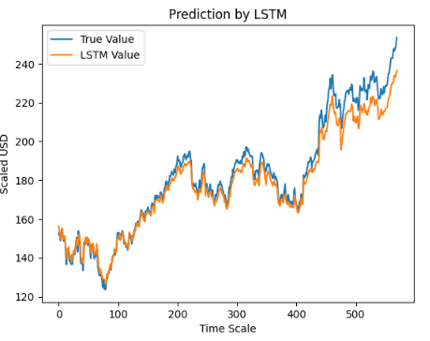
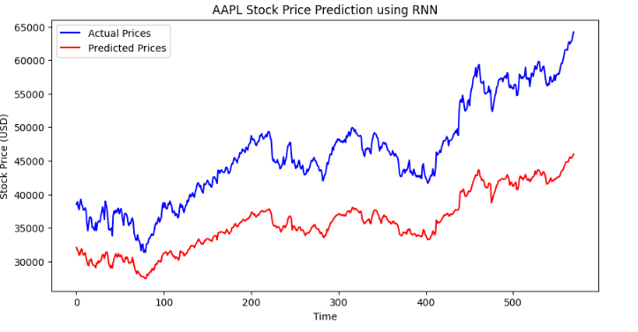
LSTM vs RNN model Prediction Graph

Slide 9
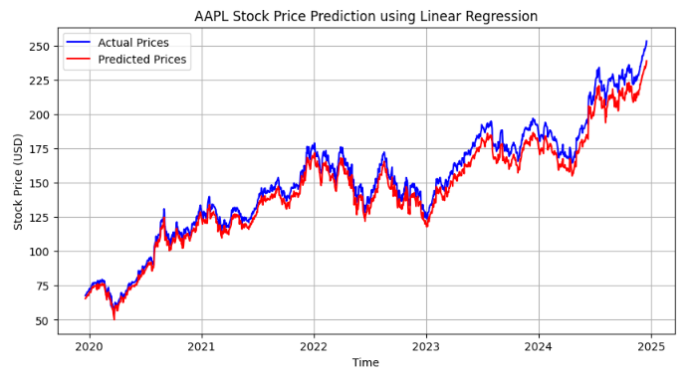
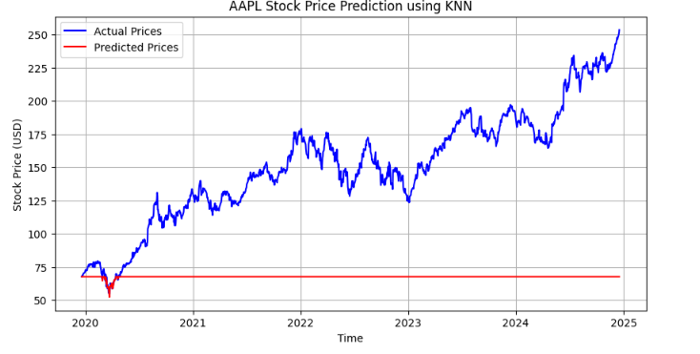
Linear Regression vs KNN model Prediction Graph

Slide 10
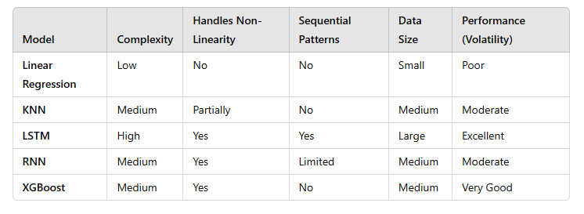
Comparison Summary

Slide 11
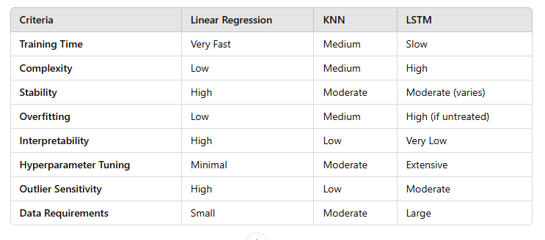
Model Differentiation Table

Slide 12

Conclusion and Future Considerations
Our LSTM model demonstrates the potential for accurate stock market prediction. Future work could involve exploring different model architectures, incorporating external data sources, and fine-tuning hyperparameters to improve accuracy.

