Slide 1

Data Driven Education
Natural Language Processing (NLP) Subteam
Presentation 3 - 4/15/2020
Nine Sub-meetings: 2/7 2/14 2/21 2/28
3/6 3/13 3/31
4/3 4/10

Slide 2
Team Members
Yuntian Zhang
Project Manager
Data Scientist
Xinran Yu
Data Scientist
Morgan Powers
Project Manager
Web Developer
Researcher
Lindsey Blackmore
Web Developer
Researcher
Erin Wrobel
Researcher
Notes:
All

Slide 3
Data Science Team
Team Focus:
edX data
  Shifted focus from Piazza data to edX data
  2 tables: forum_thread_ferpa & forum_comment_ferpa
  2667 comments in total: includes online classes such as CS1301, ISYE6501, etc
  Focus on CS1301-Online - 2137 comments in total
Cognitive presence
  Four phases of cognitive presence
  Created a document on categorizing cognitive presense
  Labeled 500+ comments for model training
  Next step: build a automatic categorizing model (Still undergoing…)
NLP analysis
  Basic statical analysis on different phases
  Overall NLP analysis on each phase of cognitive presence
  Word frequency and word cloud analysis

Slide 4
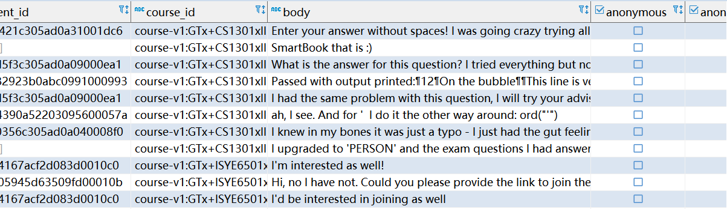
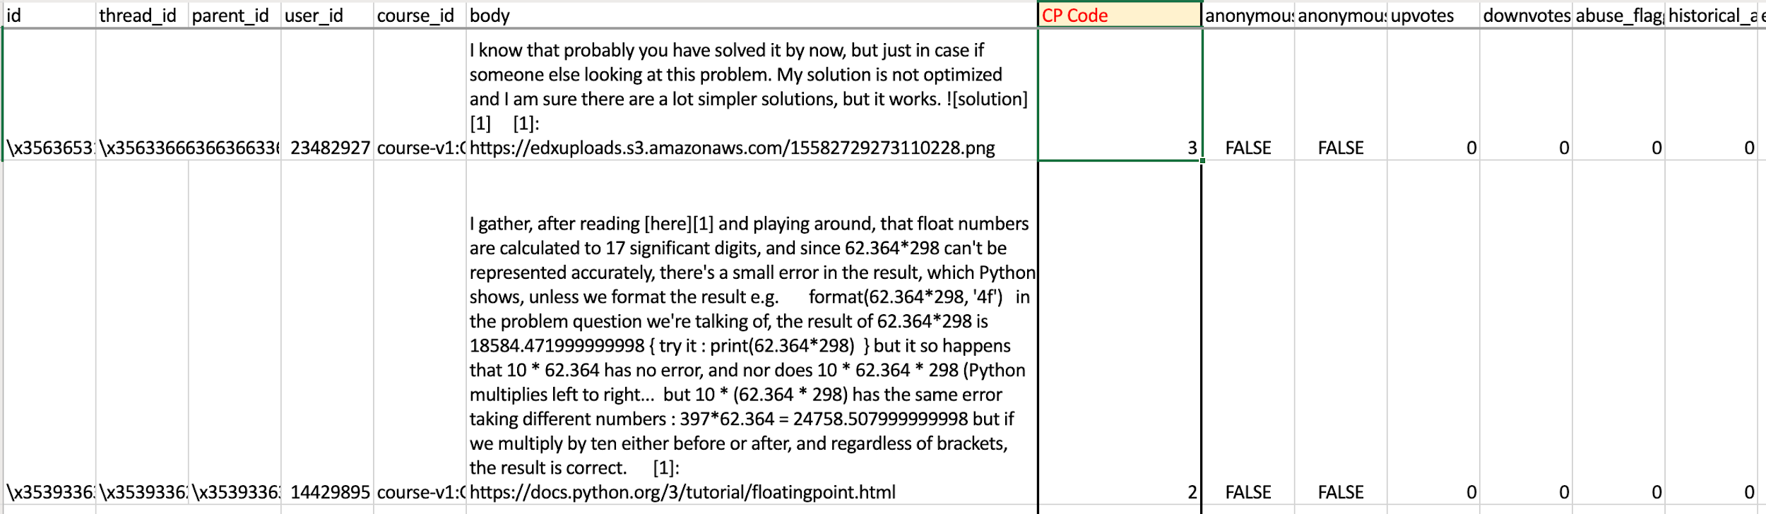
Data Science Team
edX data
  Shifted focus from Piazza data to edX data
  2 tables: forum_thread_ferpa & forum_comment_ferpa
  2667 comments in total: includes online classes such as CS1301, ISYE6501, etc
  Focus on CS1301-Online - 2137 comments in total

Slide 5
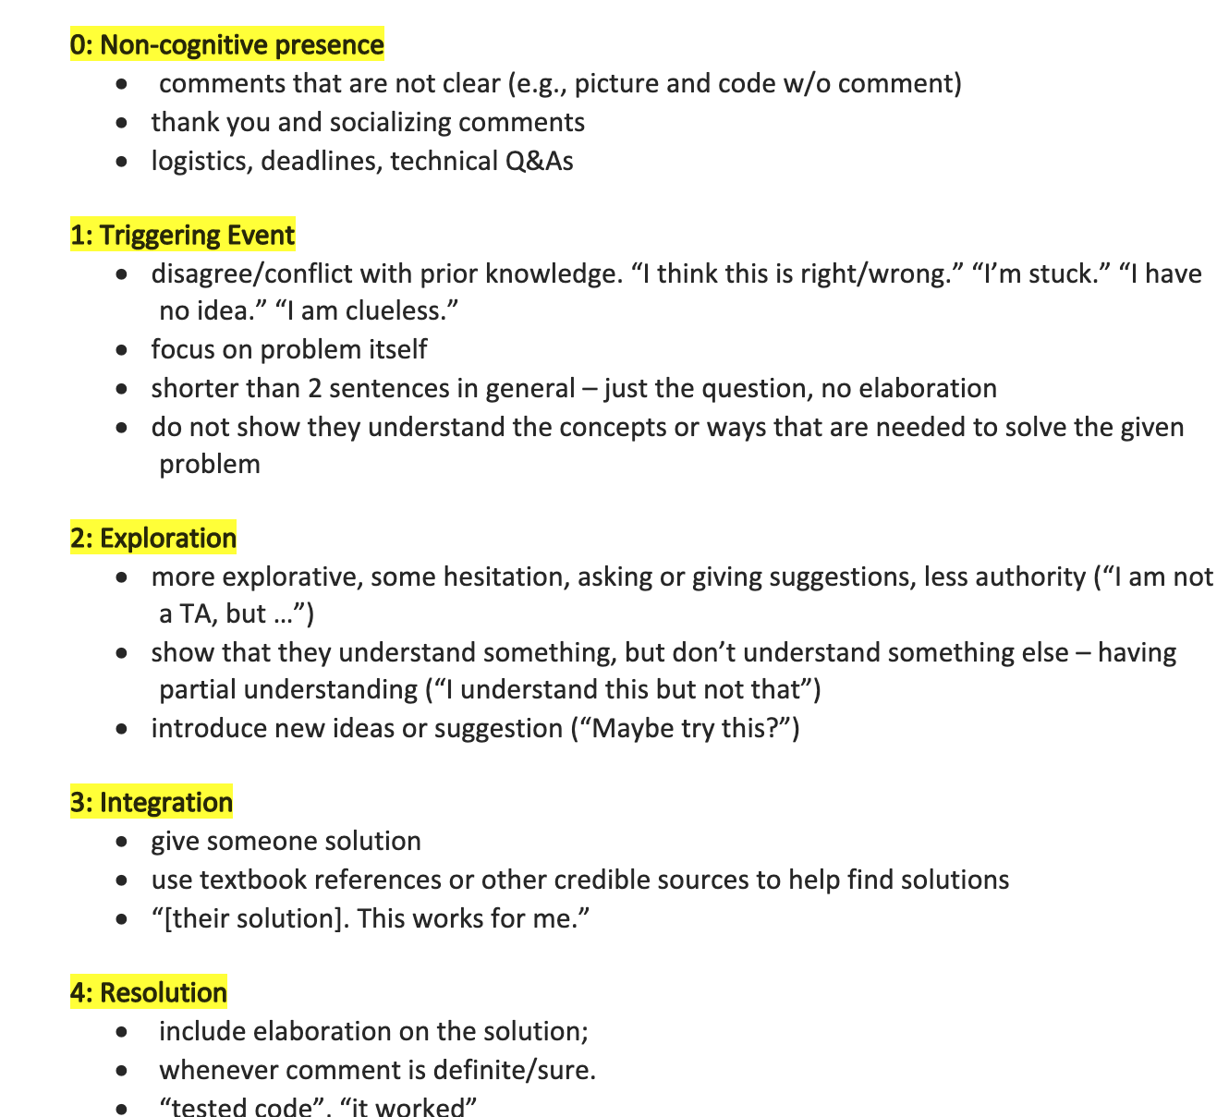
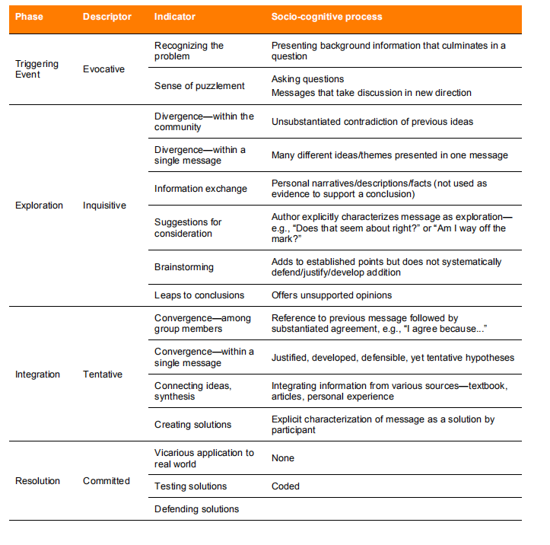
Data Science Team
Cognitive presence
  Four phases of cognitive presence
  Created a document on categorizing cognitive presense
  Labeled 500+ comments for model training
  Next step: build a automatic categorizing model (Still undergoing…)

Slide 6
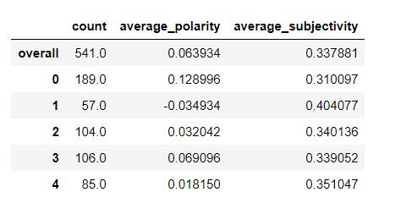
Data Science Team
NLP analysis
  Basic statical analysis on different phases
  overall NLP analysis on each phases
  Word frequency and word cloud analysis

Slide 7
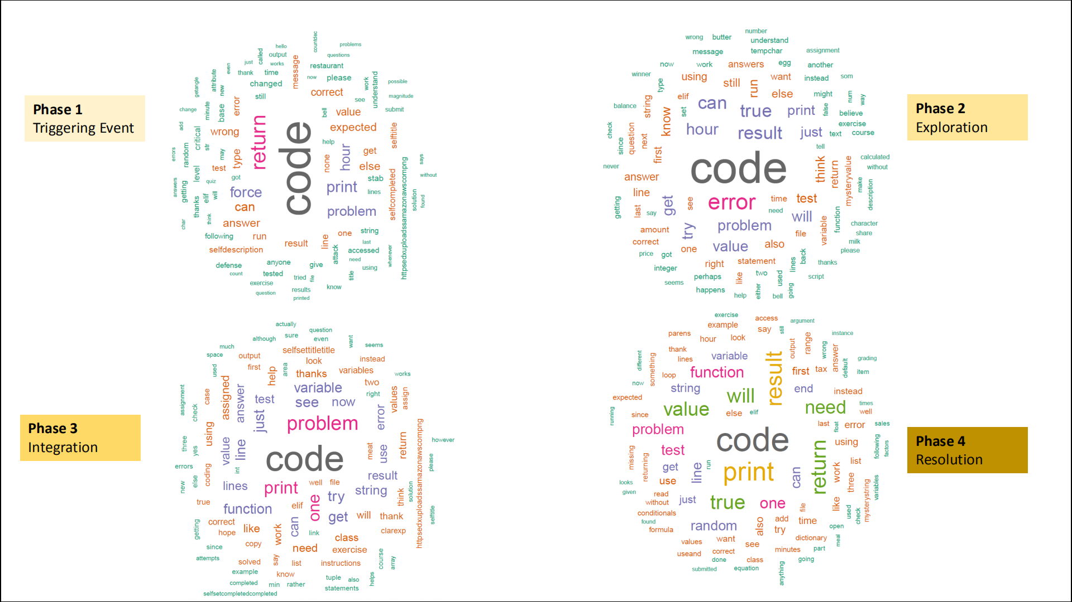
Data Science Team

Slide 8
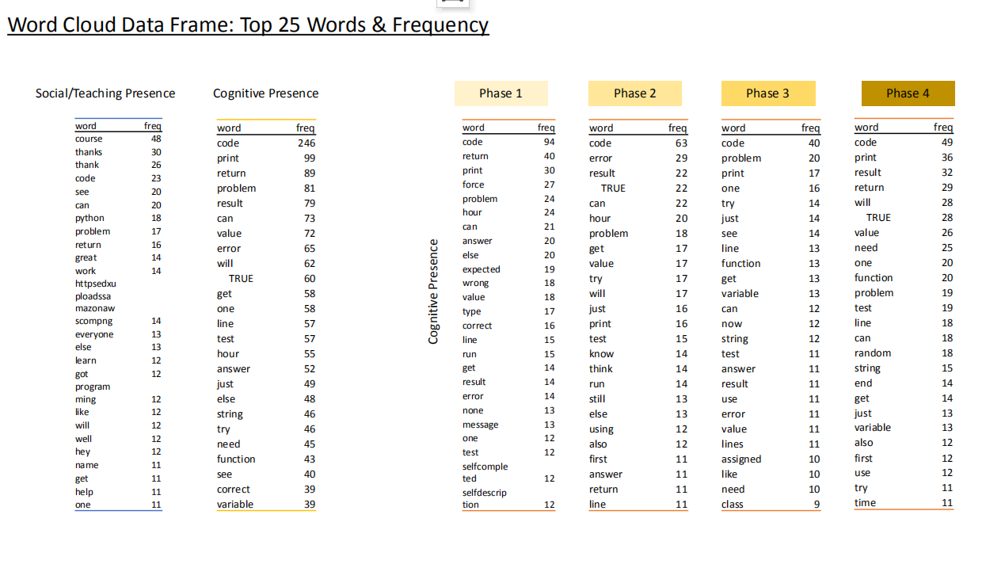

Slide 9
Data Science Team
Future job
  Keep building the model for automatic categorizing
  Generalize the model & Categorize document
  More NLP analysis (using NLTK, etc)
  Visualizations on the results
  More integration with the web-app development team
Special Thanks to Jonna for her prefessional help!!!

Slide 10
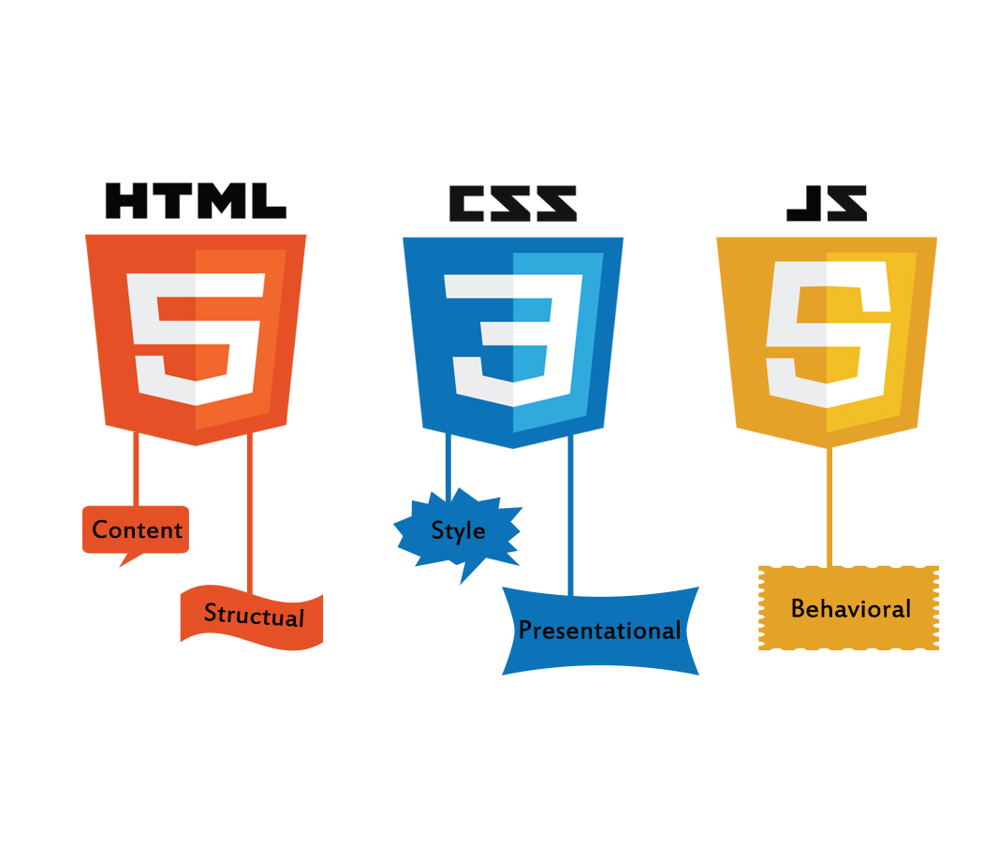



Web Application Development Team
Became familiar with Flask, HTML, CSS, Javascript, React, and SQL
Established the file/folder organization for the web app
Designed UI mockups
Developed a preliminary web app
Created a unified design document

Slide 11
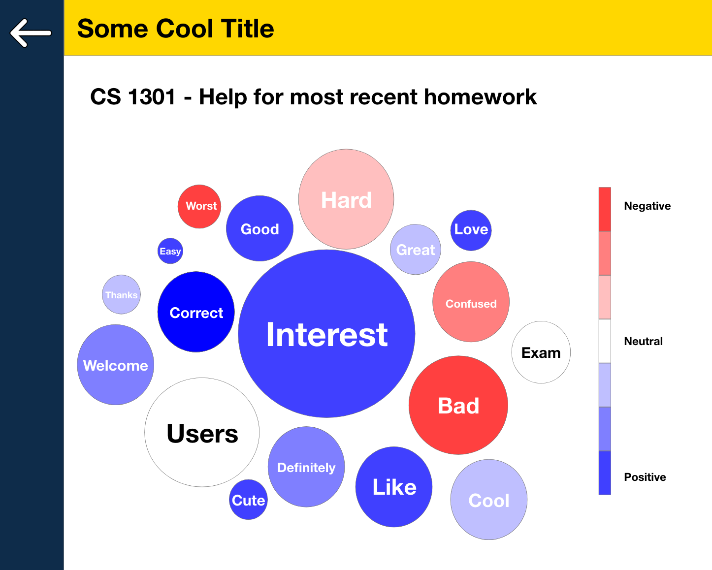
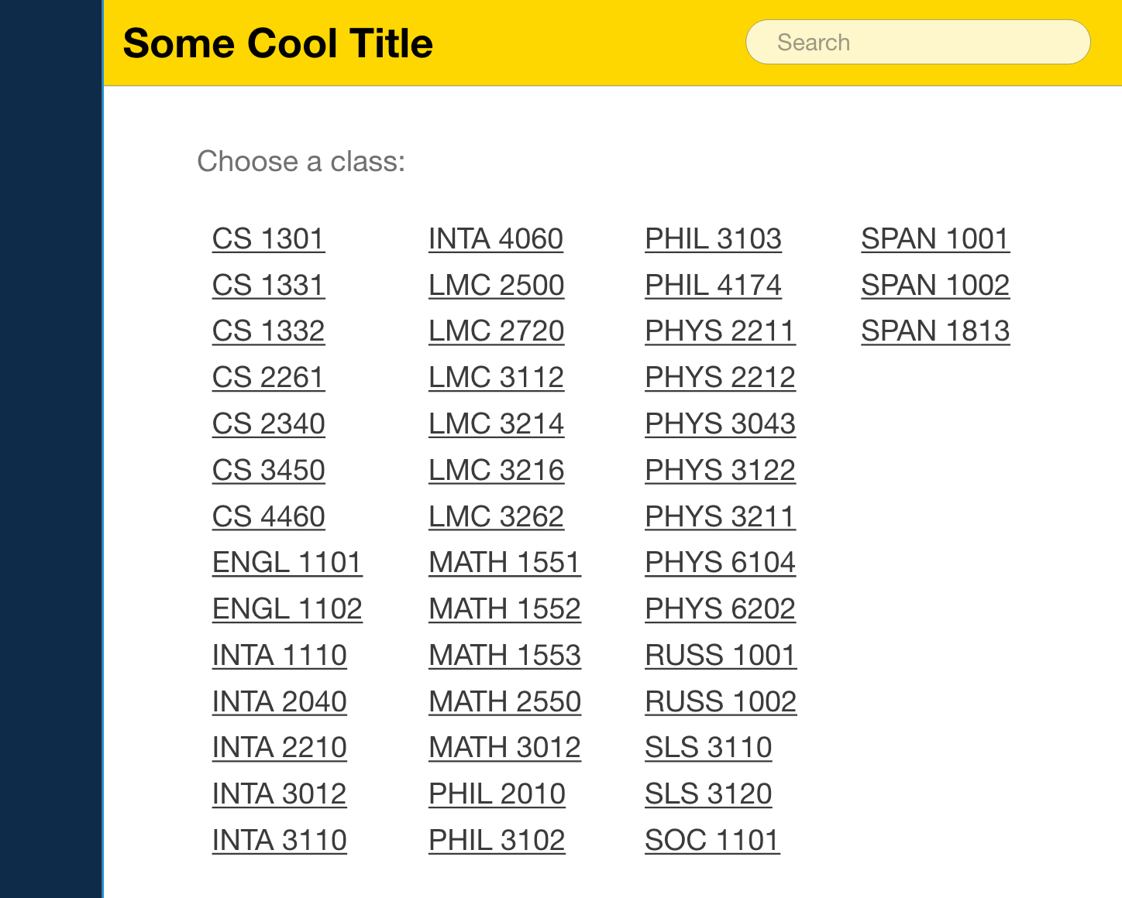
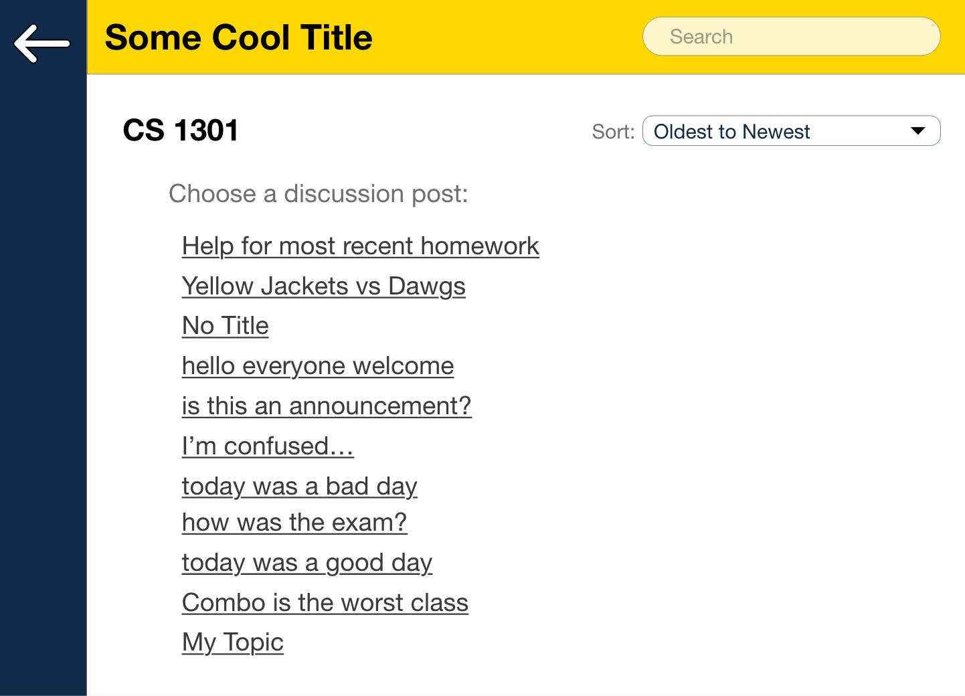
Mockups - Modular

Slide 12
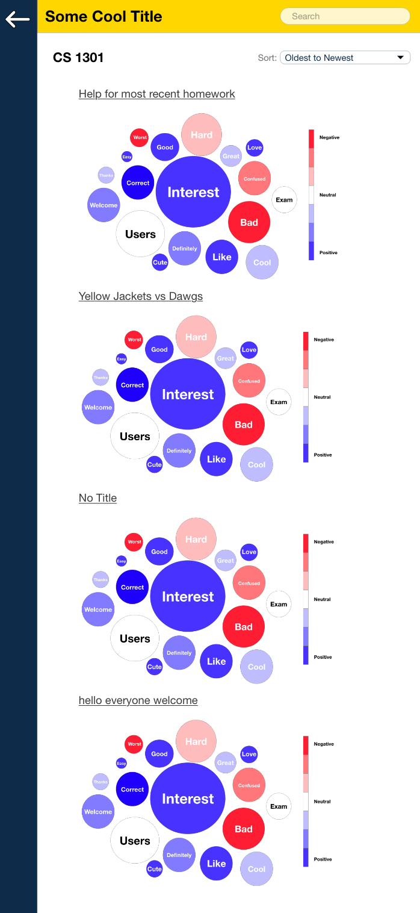
Mockups - Data Dump

Slide 13
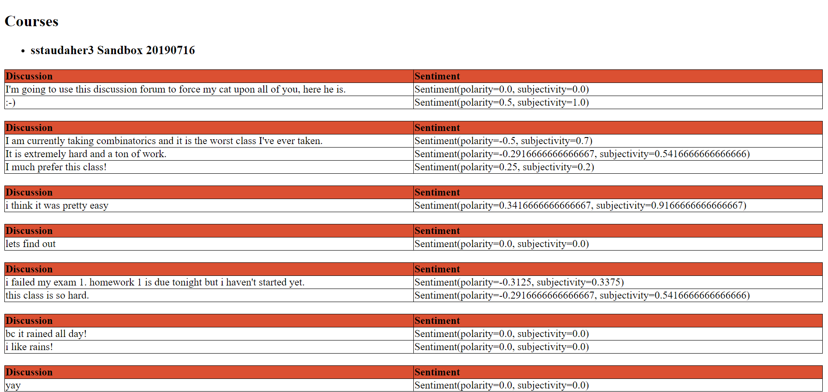
Preliminary Web App

Slide 14
Web Application Development Team Goals for Fall 2020
Continue development of web application based on the results of the survey
Incorporate Dash for data visualization
Construct a relational database for discussion data

Slide 15
Education Research: Gathering Opinions
Goal: determine usefulness and possible improvements for Canvas web app
Audience: Professors and TAs in CS, Psychology, Math, and other disciplines
Method: Qualtrics survey with app mockups
Obstacles: Later launch and lower participation than intended due to moving online

Slide 16
Education Research: Results
4 responses
3 out of 4 responded positiviely to Navigable format
2 out of 4 responded positively to Waterfall format
2 out of 4 said they could see using the app in the classroom
General Complaints:
  Use of bubbles and visualizations were unclear
  Not capturing use case of students using forums
  Don’t like extra complications

Slide 17
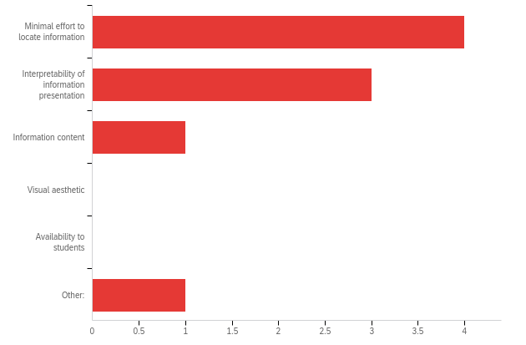
Education Research: Results
Importance of Factors
Most important: accessibility and interpretability of information
Not important: aesthetic and student accessibility
Other: “ease of installation into Canvas

Slide 18
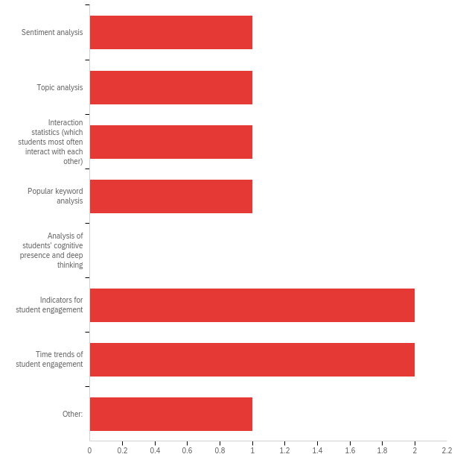
Education Research: Results
Importance of Features
Most important: student engagement analysis
Not important: Cognitive Presence and Deep Thinking

Slide 19
Education Research: Moving Forward
Collect more data!
For future surveys:
  Make it clear that filler text is, in fact, filler text
  Explain the included visualizations more clearly
  Emphasize app as a statistics/ course information aid, not a discussion tool itself
Development Recommendations:
  Tentative focus on navigable format over waterfall
  Look into Student Engagement metrics

Slide 20
Questions
?

