Slide 1
Natural Language Processing
Zachary Abraham
Lindsey Blackmore
Atush Dhakal
Jianin Jin
Xinran Yu
1

Slide 2
Recap: Goals
FOUNDATION
1
Lay strong foundations with progress that helps future sub teams scale the application
SCALE
IMPACT
2
3
Ensure that the application is scalable beyond OMSA and benefits all undergraduate/graduate courses at GT and beyond
Develop tools to help instructors understand students better through real-time reports which ultimately resulting in improving student academic performance
2

Slide 3
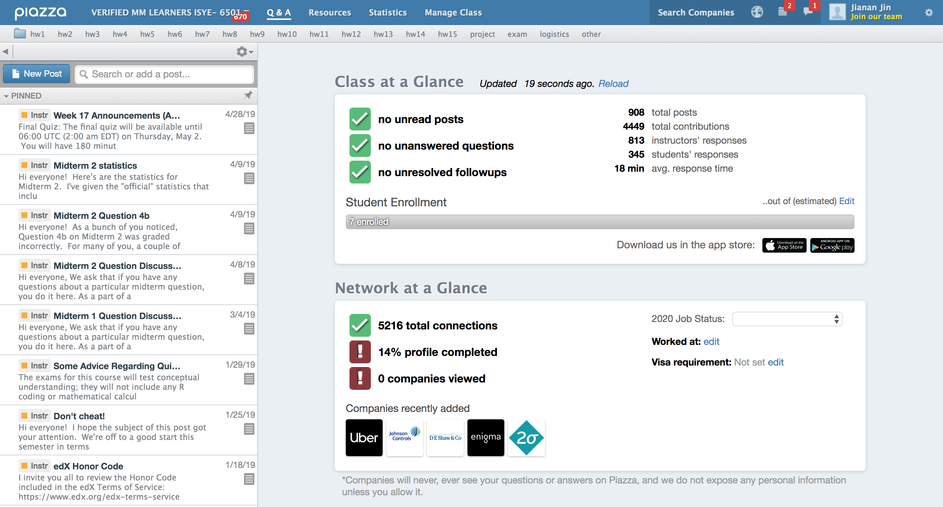
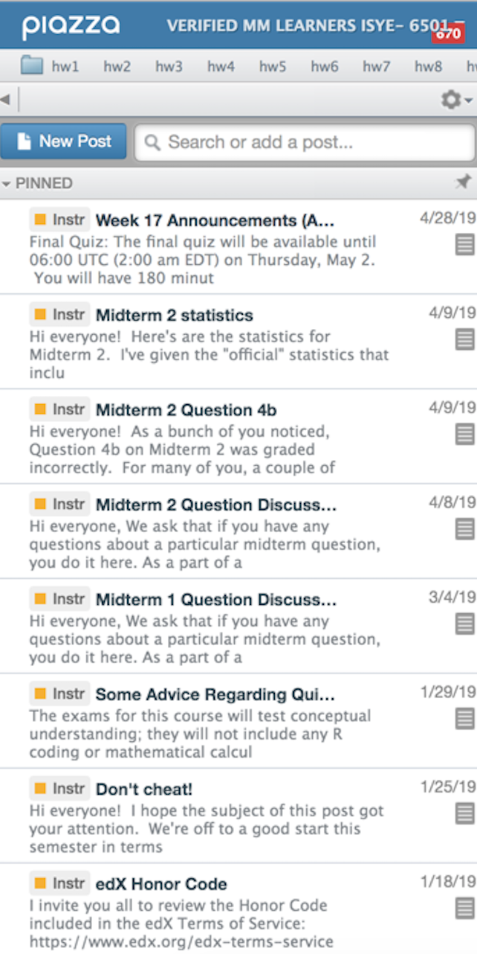
Phase 1: Data Collection (Completed)
ISYE 6501
Fall 2018 and Spring 2019
OMSA and Verified Learners
Python Piazza API
JSON File - 5623 Posts
3

Slide 4


Phase 2: Data Analysis
Data Engineering
NLP Analysis
Statistical Visualization
80%
30%
15%
Statistical analysis and representation of
sentiment analysis results
Visualized the Python JSON blob
Performed basic sentiment analysis
Extracted text data from JSON file
Identified the posts with negative
sentiment and words with top frequency
Cleaned text data
4

Slide 5
Phase 2: Remaining Steps
Data Engineering
NLP Analysis
Statistical Visualization
80%
30%
15%
Extract more information from
JSON file
Perform topic and similarity analysis
Perform more basic statistical analysis
Test quality of data to determine
if trained models are viable
Perform statistical analysis on NLP
parameters
Determine how to store results
from NLP analysis
5

Slide 6
Phase 3: Scaling the Project
An easy to use, scalable application to perform sentiment analysis on posts
Platforms
B
Web App with or without LTI Desktop App
Command Line Tool
A
Deliverable
6

Slide 7
Potential Challenges
Technical Aspect
Server for web app and LTI integration
Data Quality
Meaningful results and viable models
Completion
Timeframe and transition into next semester
7

Slide 8
Questions
8

