Slide 1
Prevention Against Shoulder Surfing Attacks
Review 1

Slide 2
Team Members
Divyang Arora 18BCE2251 Saloni Anand 18BCE2276 Sukriti Jaitly 18BCE0250 Arnav Sharma 18BCE0868

Slide 3
Abstract
In computer security, shoulder surfing is a type of social engineering technique used to obtain information such as Personal Identification Number (PIN), login passwords and other confidential data by looking over the victim’s shoulder, either from keystrokes from a device or sensitive information being spoken and heard, also known as eavesdropping.
This attack can be performed either at close range (by directly looking over the victim's shoulder) or from a longer range, for example by using a pair of binoculars or similar hardware.
This attack can also be performed by the use of key logging where the attackers track the key presses the user does on the keyboard instead of looking over one’s shoulder.
In this project, we hope to develop a system immune to these techniques.

Slide 4
Objective
In this project, we intend to completely remove the chances of any type of Shoulder surfing attack. We introduce a new algorithm, which is effortless to implement but very effective. The algorithm along with the way the information is stored and fetched from the database makes it so much secure, that even if a user tells the person his/her login password, he will never be able to log in to the system.

Slide 5
So as my teammates mentioned before and as we are already familiar with, passwords are our main source of authentication and nowadays are used everywhere, especially for computer security and privacy.
Textual passwords are considered strong enough to resist against brute force attacks, However, us humans don’t make a very strong arbitrary textual password usually as its hard to memorize and recollect. human actions such as choosing bad passwords and keeping the same password for various accounts is regarded as “the weakest link” in the authentication chain.
With web applications and mobile apps piling up, people can access these applications anytime and anywhere with various devices. This evolution brings great convenience but also increases the probability of exposing passwords to shoulder surfing attacks. Attackers can observe directly or use external recording devices to collect users' credentials.

Slide 6
All the research papers that we went through, are all recent journal papers and articles from ieee mainly and they are mainly talking about the various ways of incorporating graphical passwords to overcome this problem and resist shoulder surfing attacks
some talked about using clouds, but that could cause a problem if the virtual delivery agent is damaged due to some situation and it would be impossible to check the password authentication (since the encrypted password from either internal or external workspace cloud connector would not reach the other.)
there was another which talked of how visual authentication protocols by itself is not very sure, but when incorporated with two factor authentication scheme, it eliminates the deficiencies if present.
And this way the whole system is secure, efficient and has a high level of usability which makes it easier for the user also to understand the system and keep their data secure.
So, Based on the analysis and getting inspiration from these research papers and keeping in mind the problem of shoulder surfing and key logging, we are gonna make a project on the same lines.

Slide 7
Literature Review
Title | Year | Methodology | Advantage | Limitation
Password Encryption for hybrid cloud services | 2019 | A workspace cloud connector internally residing with an entity may intercept user credentials associated with an internal application being transmitted to an external cloud service. | Since a workspace cloud connector is used for generating the encryption key, it provides an extra layer of encryption to the password that other methods do not. | If the path of the virtual delivery agent is damaged due to some situation then it would be impossible to check the password authentication since the encrypted password from either internal or external workspace cloud connector would not reach the other.

Slide 8
A Shoulder Surfing Resistant Graphical Authentication System | 2018 | This paper’s main concern is to prevent the shoulder surfing attacks and smudge attacks – which happen when the attacker is able to identify the smudges caused by the repetitive pattern making the user to unlock his/her mobile device. | As password is not a text-based password, instead an image-based password, this reduces the chances of a person identifying the password from naked eye or through video capture only once which is easy to use. | Since the whole model is based on the user’s visual perceptive and his/her memory, this model would fail if the user is either confused or forgets the positioning of the segments on the image. To rectify this the user will have to re-register
Keylogger Is A Hacking Technique That Allows Threatening Information On Mobile Banking User | 2018 | In registration phase the user provides a unique username and selects a colour from the 8 options given by the website. | Results were good by using and typing on the virtual keyboard in the smartphone device. | Perpetrator can still exploit the process when the victim is unaware of the surveillance of his smartphone.

Slide 9
A Novel Friendly Jamming Scheme in Industrial Crowdsensing Networks against Eavesdropping Attack | 2018 | Crowdsensing is a technique leveraging the crowd power to accomplish sensing tasks collaboratively at a low cost | The results show that our scheme can significantly decrease the eavesdropping risk compared with the no friendly jamming scenario and meanwhile that it maintains low decrease on the transmission probability. | The whole system depends on the crowdsensing, that is depending on the people for the success of your system, which can include the human error possibility.

Slide 10
Improved keylogging and shoulder-surfing resistant visual two-factor authentication protocol | 2018 | In this paper, the deficiencies of two visual authentication protocols are demonstrated, then a two factor authentication scheme that eliminates these deficiencies is presented. | The analysis of the whole system shows that the system is secure, efficient and has a high level of usability which makes it easier for the user to understand the system and keep their data secure. | The attacker will be able to penetrate through the authentication process if the attacker is in possession of the two-factor authentication device.
IllusionPIN: Shoulder-Surfing Resistant Authentication Using Hybrid Images | 2017 | Addresses the problem of shoulder-surfing attacks on authentication schemes by proposing IllusionPIN (IPIN), a PIN-based authentication method that operates on touchscreen devices. | Based on the analysis, it seems practically almost impossible for a surveillance camera to capture the PIN of a smartphone user when IPIN is in use. | Makes a number of simplifying assumptions that limit the accuracy of our calculations.

Slide 11
Revolving Flywheel PIN Entry Method to Prevent Shoulder Surfing Attacks | 2018 | Proposes a new scheme named revolving flywheel PIN-Entry method to prevent from shoulder-surfing attack. | Proposed method is easy to adapt and does not have any cognitive burden. This method will be easy to follow by ATM machines or wherever PIN is used for authentication. | In this method they have not used middle layer, which could have been used to provide more security.
Keylogging Resistant Visual Authentication Protocols | 2018 | Their approach to determination the matter is to introduce associate degree intermediate device that bridges an individual's user and a terminal. | A lot of specifically, their approach visualizes the safety method of authentication employing a smartphone aided increased reality. | This paper is not focused on authentication security and user experience thus making it easy for attacker to enter the system by breaking the authentication process.

Slide 12
Text based graphical password system to obscure shoulder surfing | 2018 | This paper focuses on providing a solution based on text-based graphical password techniques, a combination of Déjà vu and Moveable Frame scheme | Since Déjà vu is further replaced by text-based images than purely graphics, this takes away the keylogging advantage of the attacker. It minimized the search time of pass images on the login screen | Human Error is very high in this process.
EvoPass: Evolvable graphical password against shoulder-surfing attacks | 2017 | Transforms a set of user-selected pass images to pass sketches as credentials. Users are required to identify their pass sketches from a set of challenge images for user authentication. | Improves password strength gradually over time through continually degrading pass sketches without annoying users to reselect pass images. The evolving feature makes it difficult for observational adversaries to identify the pass sketches, over time. | This strategy may work poorly for passwords that are not used frequently as a degrade in the pass sketch may lead to the user forgetting it.

Slide 13
An Improved Graphical Authentication System to Resist the Shoulder Surfing Attack | 2017 | Smart way to authenticate the user bank account through the pictorial password and by injecting the indirect pin to the system. | Secures the bank account from hackers by blocking, when the mobile was lost. The forget password module and banking service module is also very effective. | The Existing paper does not safeguard the user's account from hackers, when the password is misused.
Image based authentication using zero-knowledge protocol | 2018 | They propose and examine the usability and security of zero-knowledge protocol, where users prove they know the graphical passw. w/o sending it. | Hackers who try to eavesdrop the password will be failed since the password is not sent over the insecure channel such as Internet. Therefore it is a secured approach to prevent interception by unwanted parties. | Since the whole system depends on the memory of the user knowing where each point on the image was located, there is a possibility that the user forgets the precise points location on the

Slide 14
 |  |  |  | image and will have to re-register or reset the image points by some method.
DyGazePass: A Gaze Gesture-Based Dynamic Authentication System to Counter Shoulder Surfing and Video Analysis Attacks | 2018 | This paper presents DyGazePass: Dynamic Gaze Passwords, an authentication strategy that uses dynamic gaze gestures. | The static-dynamic interface with a transition speed of two seconds is one of the most effective authentication method with an accuracy of 97.5%. | Users with colorblindness will have limited set of colors to choose from as they can not distinguish few colors.
Preventing Shoulder Surfing using Randomized Augmented Reality Keyboards | 2017 | In this paper, we propose keyboard randomization as a simple, yet effective, countermeasure | Acts as an effective countermeasure against both side-channel and visual-channel based | The camera resolution of the EPSON BT-200 is extremely low (640 × 480

Slide 15
 |  | against various types of keystroke inference attacks. | keystroke inference attacks. | pixels), which makes marker recognition error prone and difficult, especially if the user is at a distance from the keyboard.
Graphical password: Prevent shoulder-surfing attack using digraph substitution rules | 2017 | A user is only required to click on one of the pass-image instead of both pass-images shown in each challenge set for three consecutive sets. | While this activity is simple enough to reduce login time, the images clicked appear to be random and can only be obtained with complete knowledge of the registered password along with the activity rules. | An adversary can also perform a shoulder surfing attack as an authentication takes place to obtain the right credentials by memorizing it.

Slide 16
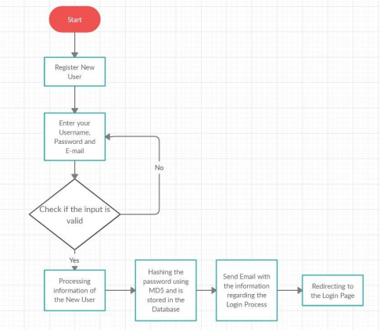
System Flow

Slide 17
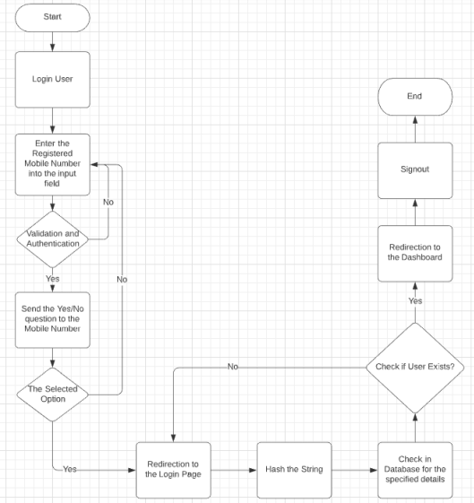

Slide 18
Detailed Architecture Components
1) Input username, email and password. We have included the following constraints on the user details.
Username should be unique.
Password must be an eight digit number.
For example, Username: Divyang Password: 12345678 Email Id: divyang2000@gmail.com
2) Check if entered details are valid.

Slide 19
3) Convert password into a string. Following is the algorithm to do that
Divide the 8-digit number into four, two digit numbers .
E.g. 12345678 = [12, 34, 56, 78]
Convert each chunk into corresponding character to generate a string of four characters. Below is the list of conversions:
[ 0-5: ‘a’, 6-11: ‘b’, 12-17: ‘c’, 18- 23: ‘d’, 24-29: ‘e’, 30-35: ‘f’, 36-41: ‘g’, 42- 47: ‘h’, 48-53: ‘i’, 54-59: ‘j’, 60-65: ‘k’, 66-71: ‘l’, 72-77: ‘m’, 78-83: ‘n’, 84-91: ‘#’, 91-99: ‘*’]
Therefore: 12345678 = [12, 34, 56, 78] = ‘cfjn’
4) Compute every permutation of the string
[ ‘cfjn’, ‘fcjn’, ‘jcfn’, ‘cjfn’, ‘fjcn’, ‘jfcn’, ‘nfcj’, ‘fncj’, ‘cnfj’, ‘ncfj’, ‘fcnj’, ‘cfnj’, ‘cjnf’, ‘jcnf’, ‘ncjf’, ‘cnjf’, ‘jncf’, ‘njcf’, ‘njfc’, ‘jnfc’, ‘fnjc’, ‘nfjc’, ‘jfnc’, ‘fjnc’ ]
Total 4! = 24 permutations.

Slide 20
5) Generate hash of each permutation using any hashing algorithm. We have used MD5 hash algorithm in this project.
[‘501a93259d8f00aa7e4c2e9eda8e561e’, ‘7edea98f68d1d1e69ba39b6c6788dc45’, ‘2b5444b24e15b955a7455fcd49d7b897’, ‘c3dff954f4b96447ae2dfa96b95d0c17’, ‘99dde74f2613c8a304e0d02a8aeb5907’, ‘f46b40c76c99accb81cee28e01c7af4f’, ‘1ebe262273b1d93cb165726b19051b1b’, ‘439acea80e1d0124b1caf7fdbebc690f’, ‘ff9f526a2d7aed1da71d767d41445409’, ‘5d8999eb19e557dd865d4e5114fb06b9’, ‘cf83685381e1384c721ad9fd1a4879a4’, ‘b5b5e2088cd03f62b3a1d34e12568353’, ‘ac670e2a0e7de505f6f6b02d0949b966’, ‘f5e56809a788ec7baac614b21e6ac6ea’, ‘5398b787cb9e80c2c29c171d7c5f531f’, ‘a7a290d301d09f8aab46d440c1c0bc45’, ‘0f8698e809e4205ae5441f94dfa4b00d’, ‘b6b66056736b722b5e512f0492e1e36e’, ‘3dd8d0eb7c4d67179dd1c22c3d777a8e’, ‘12008658a74e6974ba34ddda2f2eda0a’, ‘3353f6fc45c701c655ad648ef7857815’, ‘545d3e0ae7566fb264df9d02f6cf49d6’, ‘097ee3281992b6f025cbc9a3f5e3b973’, ‘3475bb0f27f3a9614a79eae11cec1cf8’]

Slide 21
6) Save the username, email, and each hash in the database.
7) Send a mail to the user on the registered email-id informing the user about the process on how to login to the system.
8) When the user tries to login, they will be required to put in the password using a virtual keyboard where all the keys will be jumbled. In this keypad, a different pattern will be followed every time. For example, if a vertical pattern is being followed, the first column of keys will represent ‘a’, ‘b’, ‘c’, ‘d’ from top to bottom. For demonstration purposes, we have used horizontal and vertical patterns for now.

Slide 22
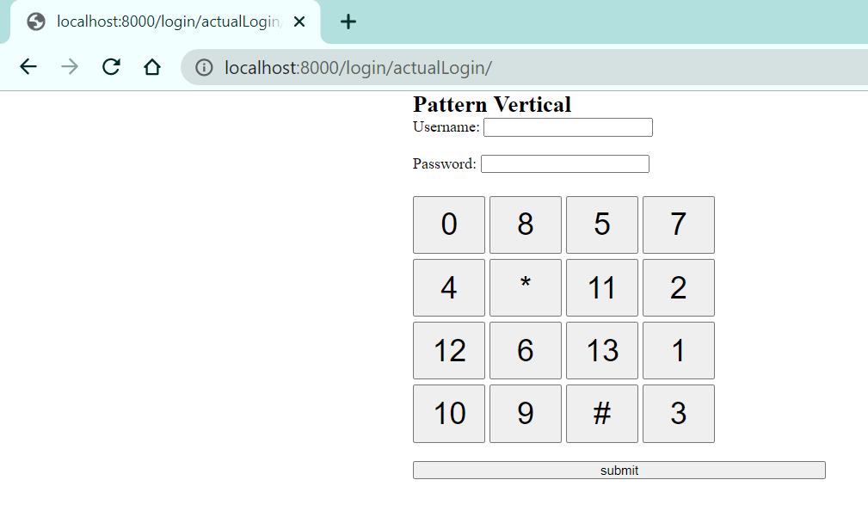
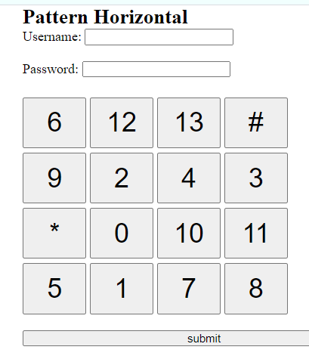
9) For example, in the first keypad below, the keys with the digits/symbols ‘5’, ‘*’, 6’, and ‘9’ represent ‘c’, ‘f’, ‘j’, and ‘n’ respectively. Since the hash value of all 24 permutations of ‘cfjn’ are stored in the database, these keys can be pressed in any order. Any person trying to shoulder surf will only remember the pattern or the characters on the keys pressed, none of which are of any significance. These patterns and the way these keys are jumbled will be changed every time.

Slide 23
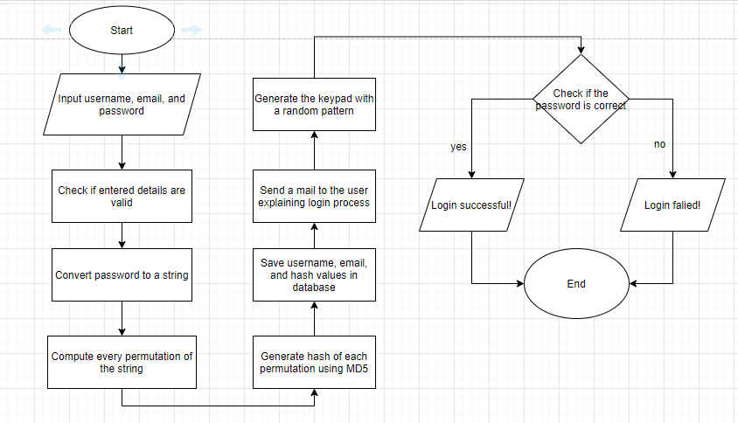

Slide 24
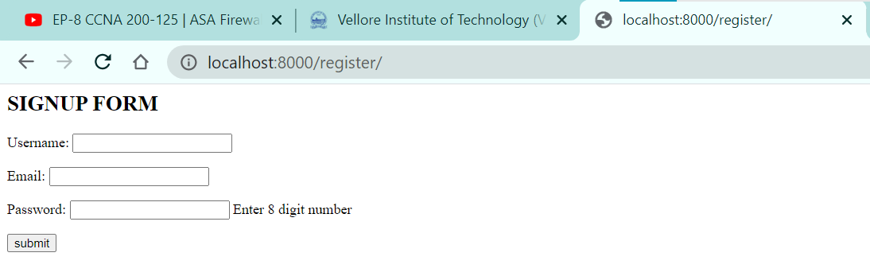
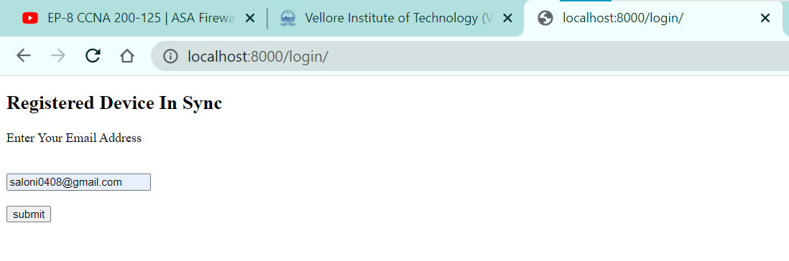
Implementation Screenshots

Slide 25
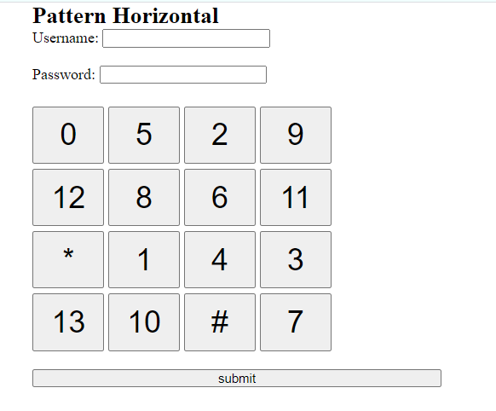
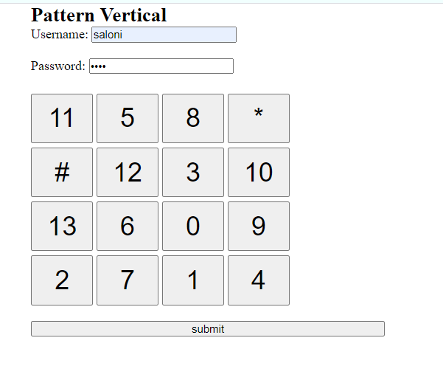

Slide 26
References
Password Encryption for hybrid cloud services, Singleton IV, L. C., & Cooper, A. (2019). U.S. Patent No. 10,432,592. Washington, DC: U.S. Patent and Trademark Office.
H. Sun, S. Chen, J. Yeh and C. Cheng, "A Shoulder Surfing Resistant Graphical Authentication System," in IEEE Transactions on Dependable and Secure Computing, vol. 15, no. 2, pp. 180-193, 1 March-April 2018, doi: 10.1109/TDSC.2016.2539942.
A. P. Kuncoro and B. A. Kusuma, "Keylogger Is A Hacking Technique That Allows Threatening Information On Mobile Banking User," 2018 3rd International Conference on Information Technology, Information System and Electrical Engineering (ICITISEE), Yogyakarta, Indonesia, 2018, pp. 141-145, doi: 10.1109/ICITISEE.2018.8721028.
Li, Xuran & Wang, Qiu & Dai, Hong-Ning & Wang, Hao. (2018). A Novel Friendly Jamming Scheme in Industrial Crowdsensing Networks against Eavesdropping Attack. Sensors. 18. 1938. 10.3390/s18061938.
Khedr, Walid. (2018). Improved keylogging and shoulder-surfing resistant visual two-factor authentication protocol. Journal of Information Security and Applications. 39. 41-57. 10.1016/j.jisa.2018.02.003.
A. Papadopoulos, T. Nguyen, E. Durmus and N. Memon, "IllusionPIN: Shoulder-Surfing Resistant Authentication Using Hybrid Images," in IEEE Transactions on Information Forensics and Security, vol. 12, no. 12, pp. 2875-2889, Dec. 2017, doi: 10.1109/TIFS.2017.2725199.
O. K. Kasat and U. S. Bhadade, "Revolving Flywheel PIN Entry Method to Prevent Shoulder Surfing Attacks," 2018 3rd International Conference for Convergence in Technology (I2CT), Pune, India, 2018, pp. 1-5, doi: 10.1109/I2CT.2018.8529758.
D. Nyang, A. Mohaisen and J. Kang, "Keylogging-Resistant Visual Authentication Protocols," in IEEE Transactions on Mobile Computing, vol. 13, no. 11, pp. 2566-2579, Nov. 2014, doi: 10.1109/TMC.2014.2307331.
K. Irfan, A. Anas, S. Malik and S. Amir, "Text based graphical password system to obscure shoulder surfing," 2018 15th International Bhurban Conference on Applied Sciences and Technology (IBCAST), Islamabad, Pakistan, 2018, pp. 422-426, doi: 10.1109/IBCAST.2018.8312258.
Yu, Xingjie & Wang, Zhan & Li, Yingjiu & Li, Liang & Zhu, Wen & Song, Li. (2017). EvoPass: Evolvable graphical password against shoulder-surfing attacks. Computers & Security. 70. 10.1016/j.cose.2017.05.006.
R. Sudha and M. Shanmuganathan, "An Improved Graphical Authentication System to Resist the Shoulder Surfing Attack," 2017 International Conference on Technical Advancements in Computers and Communications (ICTACC), Melmaurvathur, 2017, pp. 53-55, doi: 10.1109/ICTACC.2017.23.
Z. Mohamad, L. Y. Thong, A. H. Zakaria and W. S. W. Awang, "Image based authentication using zero-knowledge protocol," 2018 4th International Conference on Computer and Technology Applications (ICCTA), Istanbul, Turkey, 2018, pp. 202-210, doi: 10.1109/CATA.2018.8398683.
V. Rajanna, A. H. Malla, R. A. Bhagat and T. Hammond, "DyGazePass: A gaze gesture-based dynamic authentication system to counter shoulder surfing and video analysis attacks," 2018 IEEE 4th International Conference on Identity, Security, and Behavior Analysis (ISBA), Singapore, 2018, pp. 1-8, doi: 10.1109/ISBA.2018.8311458.
A. Maiti, M. Jadliwala and C. Weber, "Preventing shoulder surfing using randomized augmented reality keyboards," 2017 IEEE International Conference on Pervasive Computing and Communications Workshops (PerCom Workshops), Kona, HI, 2017, pp. 630-635, doi: 10.1109/PERCOMW.2017.7917636.
Por, L.Y., Ku, C.S., Islam, A. et al. Graphical password: prevent shoulder-surfing attack using digraph substitution rules. Front. Comput. Sci. 11, 1098–1108 (2017) https://doi.org/10.1007/s11704-016-5472-z

