Slide 1

IBM University Engagement Project Submission
“Exploring the Power of Agentic AI with IBM Granite and LangFlow”

Slide 2
Project Tile – Golden Corridor Industrial Pollution Monitor
Domain of Project – Environmental Sustainability
Student Name | Recent Passport Photo | Email ID | Mobile number [WhatsApp]

Slide 3
Problem Statement -
Problem Statement : Smart Industrial Pollution Monitoring for Golden Corridor (Vapi–Ankleswar)
The Challenge
The industrial belt along Vapi, Ankleshwar, and Vatva faces significant air and water pollution from chemical and manufacturing units, with limited real-time monitoring and slow regulatory response to violations.
The Objective
.Develop an AI-powered real-time telemetry and escalation system that:
  Factory Grid Tracking: Ingests live environmental streams across multiple industrial units.
  RAG-Based Compliance: Compares live metrics against GPCB/WHO safety standards.
  Autonomous Multi-Agent AI: Uses specialized agents to calculate public health risk scores, log events in real time, and trigger automated regulatory notices.
  Interactive Simulation: Enables regulatory bodies to simulate toxic spikes and test rapid response workflows.

Slide 4
Proposed Solution -
Proposed Solution: Multi-agent industrial monitoring system
  The proposed solution is a multi-agent industrial monitoring system built using IBM Granite models and the IBM Bob Orchestration framework to provide continuous, real-time pollution tracking.
  Live Factory Grid: Tracks key metrics (AQI, PM2.5, SO₂, pH, COD) across 4 core units: Vapi Chemical Complex A, Vapi Pharma Unit B, Ankleshwar Dyes Unit 4, and Ankleshwar Specialty Chemicals C.
  Spatial Corridor Map: Displays a ~130 km route schematic from Vapi to Ankleshwar, dynamically highlighting active node status (NORMAL, WARNING, CRITICAL, BREACH).
  Multi-Agent Pipeline:
  MonitoringAgent: Scans telemetry streams every few seconds.
  ComplianceAgent: Detects parameter breaches (e.g., AQI > 100 on ANK-4).
  HealthRiskAgent: Computes dynamic health risk scores (e.g., 18/100 LOW) and identifies primary risk drivers.
  Actionable Control Center: Features interactive controls to simulate toxic spills, reset baselines, generate regulatory notices, and dispatch automated SMS/alerts to GPCB officials.

Slide 5
Technology Used
  Langflow platform -For visually designing and orchestrating multi-agent workflows
  IBM Granite model - (Granite-4.0-8B-Instruct): Powers core reasoning, multi-agent logic, threshold assessment, and risk summarization.
  IBM Cloud & watsonx.ai: Provides enterprise infrastructure, model deployment, embeddings, and AI governance
  RAG Layer (Vector Database): Stores WHO bylaws and GPCB regulatory compliance standards for accurate threshold verification.
  IBM Bob Orchestrator: Manages agent flow execution, error handling, and terminal logging.

Slide 6
Langflow component Used -
1) Telemetry Data Input Component: Ingests real-time air and water sensor payloads (AQI, PM2.5, SO₂, pH, COD).
2) IBM watsonx AI Agent - Processes telemetry vectors using Granite models to evaluate safety thresholds.
3) Name of IBM Granite model -Granite-4.0-8B-Instruct (Fast, lightweight reasoning engine for real-time risk assessment)
4) Terminal & Notice Output Component: Displays live agent logs in the Agent Terminal and generates formal regulatory notices.
5) File/RAG Database Component: Stores GPCB legal thresholds and historical factory baseline data.

Slide 7
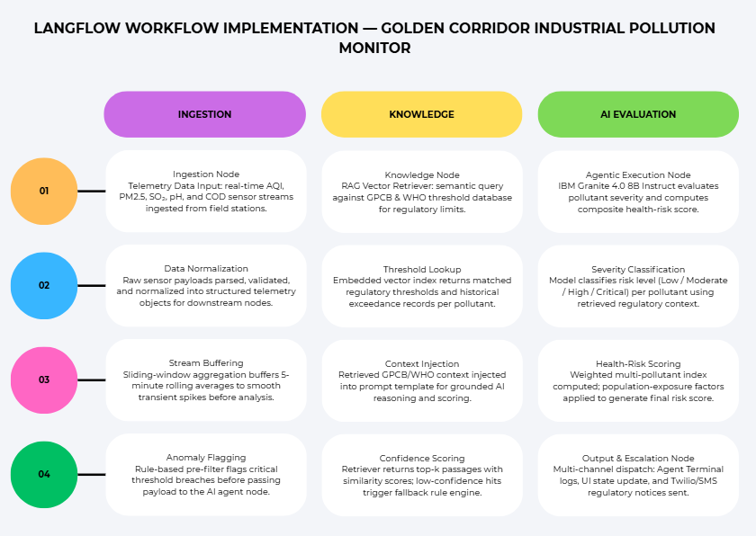

Slide 8
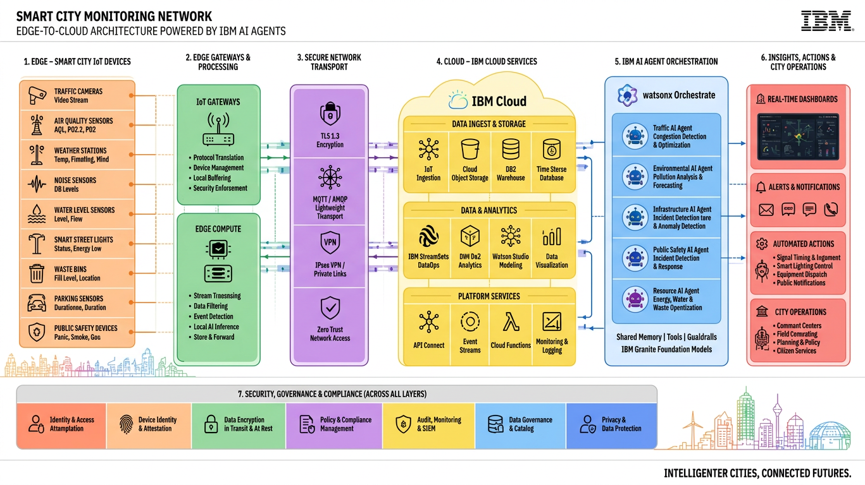
Architecture blueprint

Slide 9

Role of Agentic AI in the solution
  Agentic AI elevates this platform from a passive monitoring dashboard into an autonomous, self-executing escalation system.
  Autonomous Task Execution: Agents run continuously without requiring human triggers to evaluate data cycles.
  Contextual Collaboration:
  MonitoringAgent scans 4 factories simultaneously.
  ComplianceAgent evaluates breaches against stored legal standards.
  HealthRiskAgent calculates overall population risk indices and logs structured updates.
  Proactive Protection: Automatically generates compliance notices and dispatches alerts the moment critical thresholds are crossed.

Slide 10
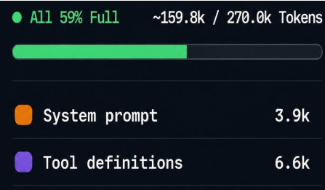
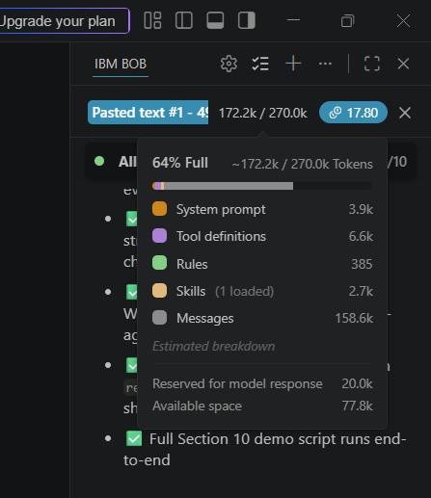
Token Usage
12400 tokens are used
Before Prompt
After the Prompt
·
·
·

Slide 11
Novelty and Uniqueness
  Multi-Agent Governance: Replaces static charts with active agents that continuously evaluate compliance.
  RAG-Backed Accuracy: Cross-references factory emissions with official GPCB and WHO legal limits to reduce false alarms.
  Interactive Disaster Simulation: Enables environmental officers to run stress tests using the "Simulate Toxic Spill" module.
  Transparent Terminal Logging: Full agent transparency through the CLI Agent Terminal log.

Slide 12
Git Hub Link
https://github.com/saloni-mishra/golden-corridor-pollution-monitor
·
·
·

Slide 13
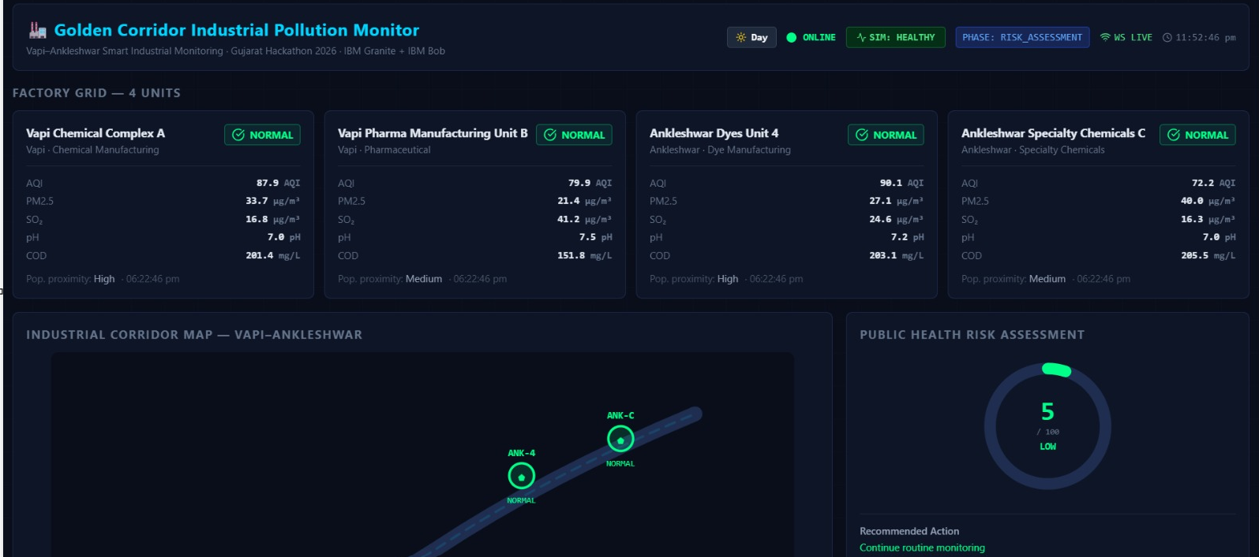

Slide 14
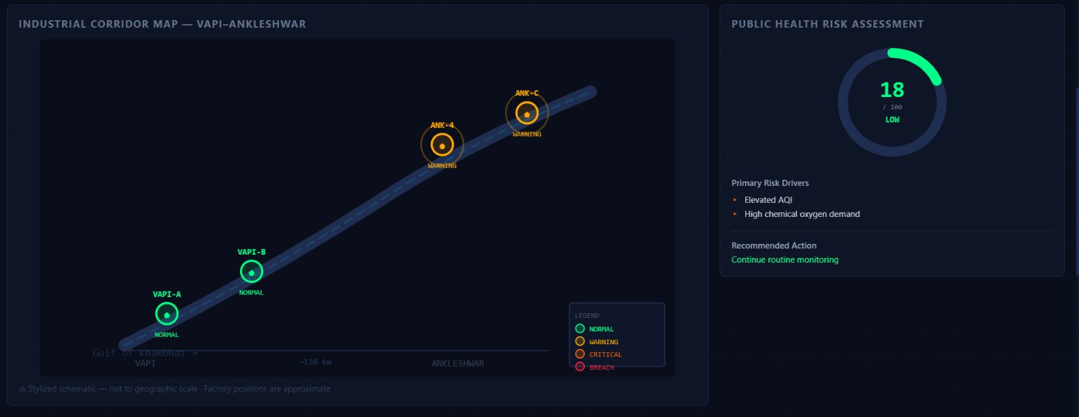

Slide 15
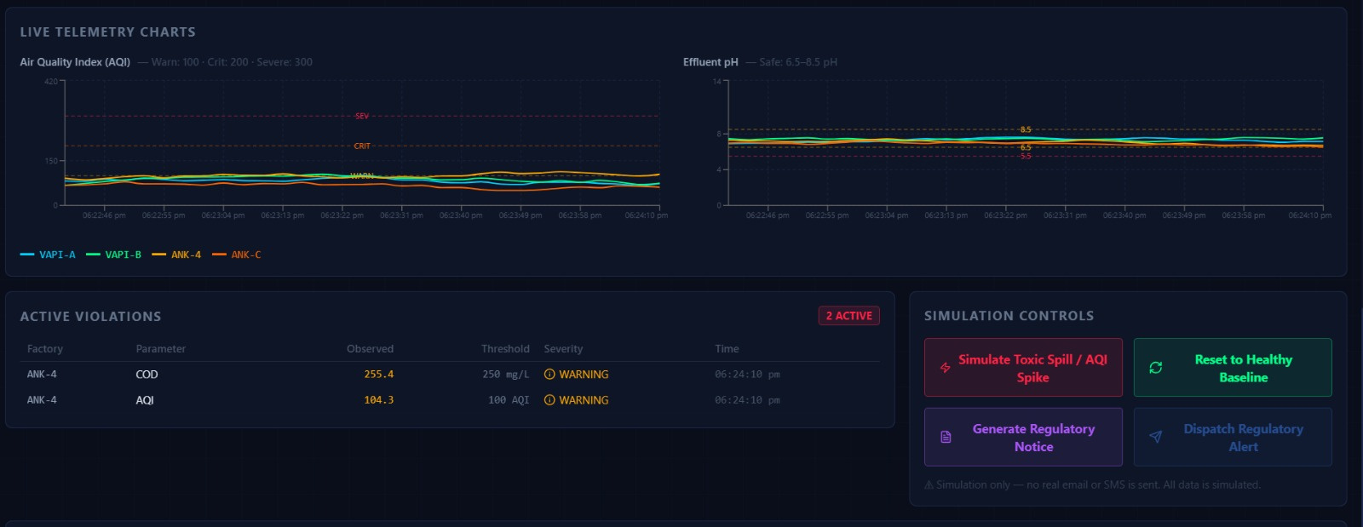

Slide 16
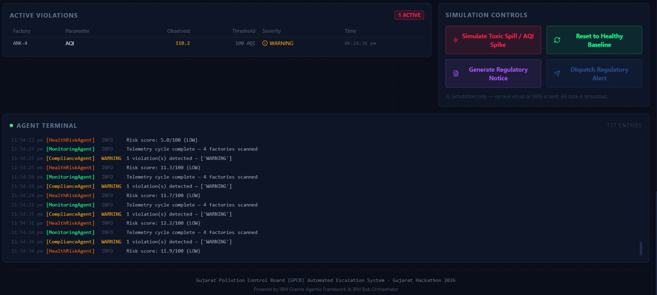

Slide 17
Future Scope
Hardware Stack Sensor Integration: Direct integration with chimney hardware sensors (ESP32 / MQ135) for direct telemetry streaming.
Predictive Plume Modeling: Incorporate wind vector and meteorological data to predict toxic plume dispersion along the corridor.
Automated Legal Escalation: Automated drafting and digital signature of legal notices directly sent to non-compliant factory management.
·
·

Slide 18
Certificates Earned:

Slide 19
Certificates Earned:​

Slide 20


