Slide 1
Project Presentation of FullStack Engineering Project
On
FOOD DELIVERY APPLICATION
Saloni (2210992231)
Saloni Kumari (2210992232)
Samreen Kaur (2210992240)
Samridhi Sachdeva (2210992243)
Supervised By
Mr. Sudeep
Department of Computer Science and Engineering,
Chitkara University, Punjab

Slide 2

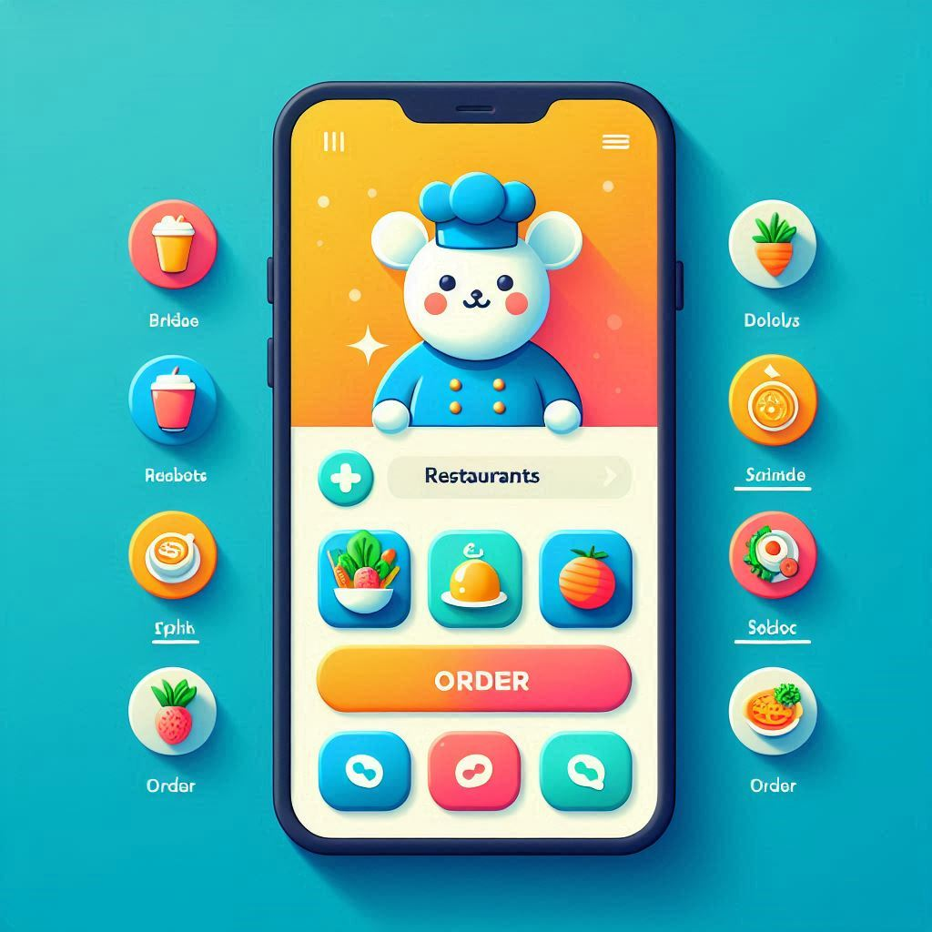
INTRODUCTION
In today’s fast-paced world, convenience is key, and food delivery apps have revolutionized the way we enjoy our meals. Our food delivery app is designed to bring a wide variety of cuisines right to your doorstep with just a few taps on your smartphone.
Our app not only simplifies the dining experience but also supports local businesses by providing them with a platform to reach more customers. Join us in transforming the way people experience food, making dining-in a delightful and hassle-free experience.

Slide 3
OBJECTIVE
The objective of this presentation is to introduce our innovative food delivery app, highlighting its key features, benefits, and the value it brings to both customers and restaurants.
We aim to demonstrate how our app enhances the dining experience by providing a convenient, efficient, and enjoyable way to order food, while also supporting local businesses and fostering a vibrant food community.
By the end of this presentation, we hope to convey the transformative impact of our food delivery app on the dining landscape and inspire confidence in its potential to become a leading platform in the food delivery industry.

Slide 4



TECHNICAL DETAILS
HTML:
Markup language for creating the structure of web pages.
Utilizes elements like <div>, <p>, <img> to organize content.
Forms for user input, with various input types like text, password, etc.
CSS:
CSS styles HTML elements (layout, colors, fonts, spacing).
Enables responsive design with media queries and Flexbox/Grid.
Uses selectors, pseudo-classes, and pseudo-elements for targeting
Supports transitions and animations for dynamic effects.
REACT.js:
Allows dynamic rendering of HTML content based on real-time data.
Uses a component-based architecture for reusable UI elements.
Seamlessly integrates form handling for actions like login and data submissions.
Utilizes a virtual DOM for efficient rendering and performance optimization.

Slide 5


TECHNICAL DETAILS
BACKEND
MongoDB:
NoSQL database designed for handling large volumes of data.
Uses flexible, JSON-like documents to store data.
Supports dynamic schemas, allowing easy updates to data structure.
Provides horizontal scaling for managing distributed data.
Facilitates fast queries and indexing for efficient data retrieval.
Express:
Express is a minimal and flexible Node.js web application framework that provides a robust set of features for web and mobile applications.
Express is a lightweight and flexible routing framework with minimal core features meant to be augmented through the use of Express middleware modules.

Slide 6
CHALLENGES & SOLUTIONS
Challenge: High Competition
Solution: Differentiate your app by offering unique features such as personalized meal recommendations, exclusive deals, and superior customer service. Focus on building strong relationships with local restaurants to offer exclusive partnerships and promotions.
Challenge: Delivery Logistics
Solution: Implement advanced logistics algorithms to optimize delivery routes and reduce delivery times. Use real-time tracking and predictive analytics to manage delivery personnel efficiently. Partner with reliable third-party delivery services to expand coverage.
Challenge: Maintaining Food Quality
Solution: Work closely with restaurant partners to ensure proper packaging and handling of food. Provide guidelines and training for delivery personnel on maintaining food quality during transit. Offer insulated delivery bags to keep food at the right temperature.
Challenge: Customer Retention
Solution: Introduce loyalty programs and reward systems to encourage repeat orders. Use personalized marketing strategies to engage customers based on their preferences and order history. Regularly gather feedback and make improvements based on customer suggestions.

Slide 7
KEY FEATURES
User-Friendly Interface:
Intuitive design for easy navigation.
Simple search and filter options to find favorite dishes and restaurants quickly.
Real-Time Order Tracking:
Live updates on order status from preparation to delivery.
GPS tracking to monitor the delivery driver’s location.
Secure Payment Options:
Multiple payment methods including credit/debit cards, digital wallets, and cash on delivery.
Secure encryption to protect user data and transactions.
Personalized Recommendations:
AI-driven suggestions based on user preferences and order history.
Customizable profiles to save favorite orders and restaurants.
Promotions and Discounts:
Exclusive deals, discounts, and loyalty programs for regular users.
Push notifications for special offers and promotions.
Ai Chatbot assistant:
1. 24/7 support for queries , order help and personalized foos suggestions.

Slide 8
SYSTEM ARCHITECTURE
FRONTEND
(React.js)
BACKEND
(Express.js)
DATABASE
(MongoDB)
-- UI interaction
-- Handle requests
-- Store/retrieve user/orders/menu
-- State Management
-- API Routes
-- Axios Requests
-- Middleware (JWT)
(Data Handling)
(Backend: Process requests, Data Validation, Auth)
(User Actions: Browse menu, order food, track orders)

Slide 9
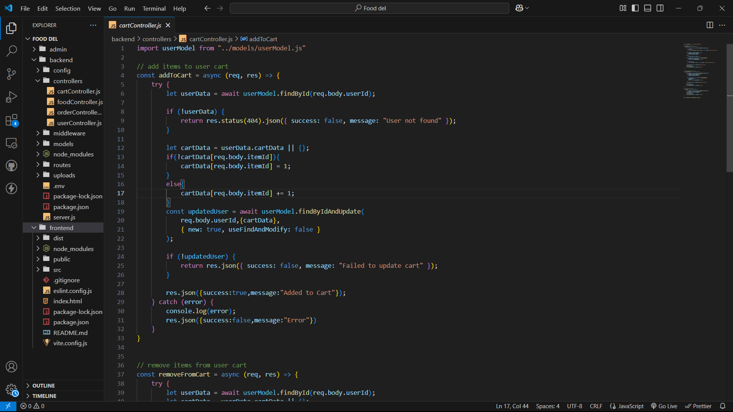
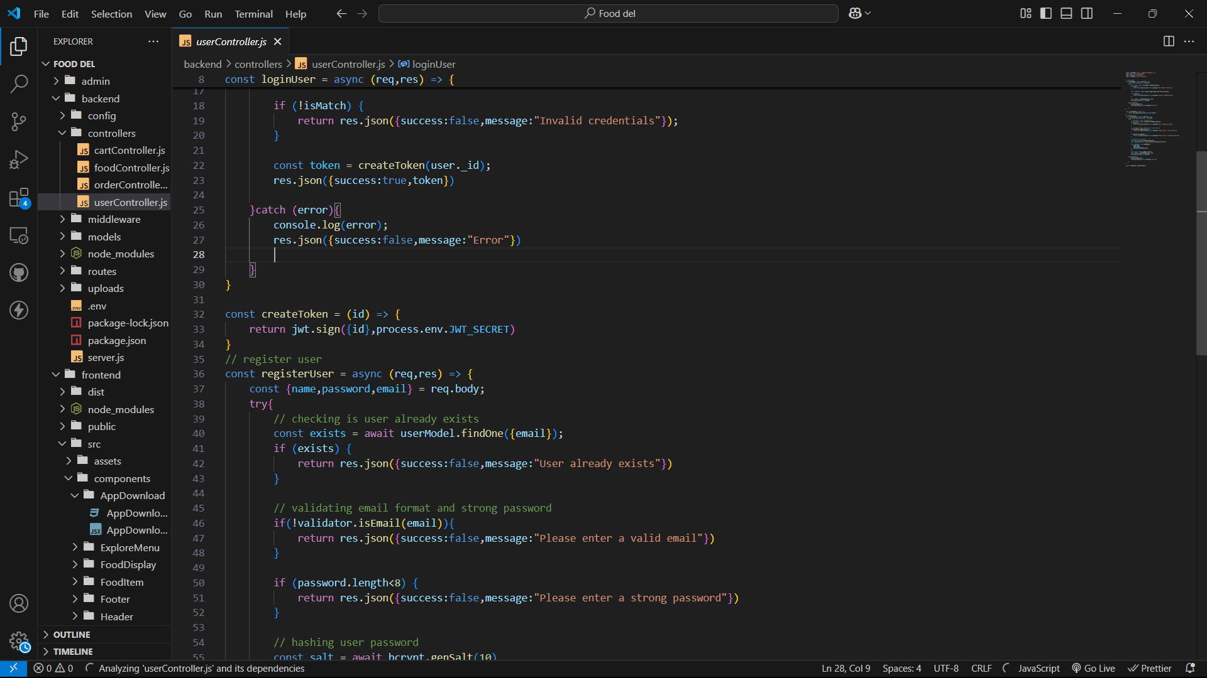
CODE SNIPPETS

Slide 10
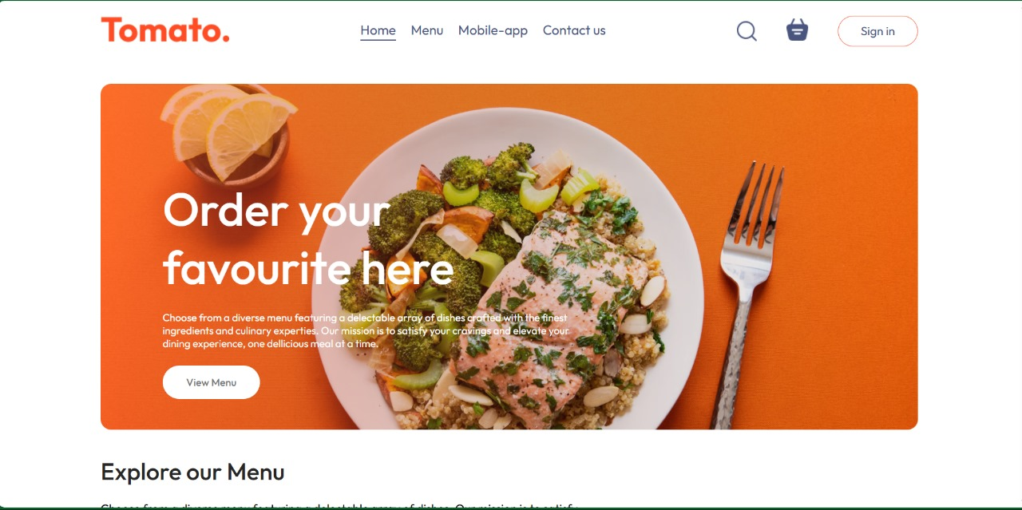
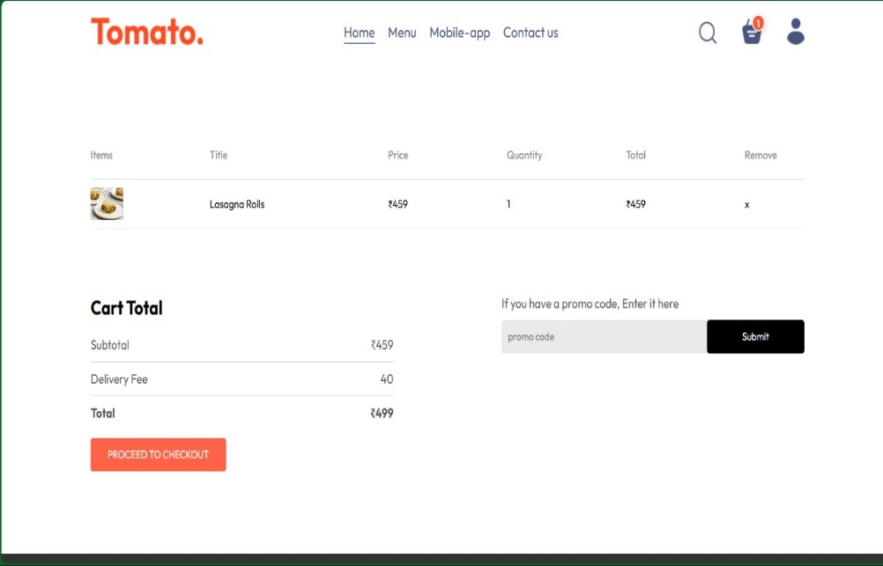
DEMONSTRATION

Slide 11
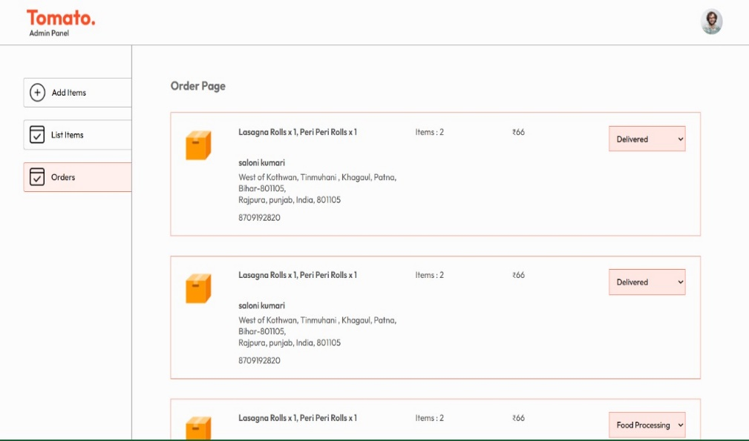
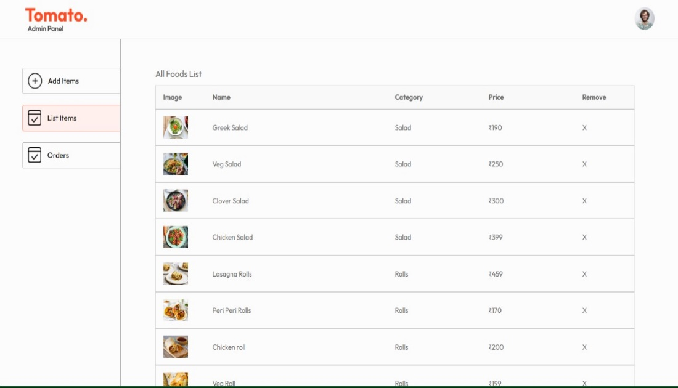
DEMONSTRATION

Slide 12
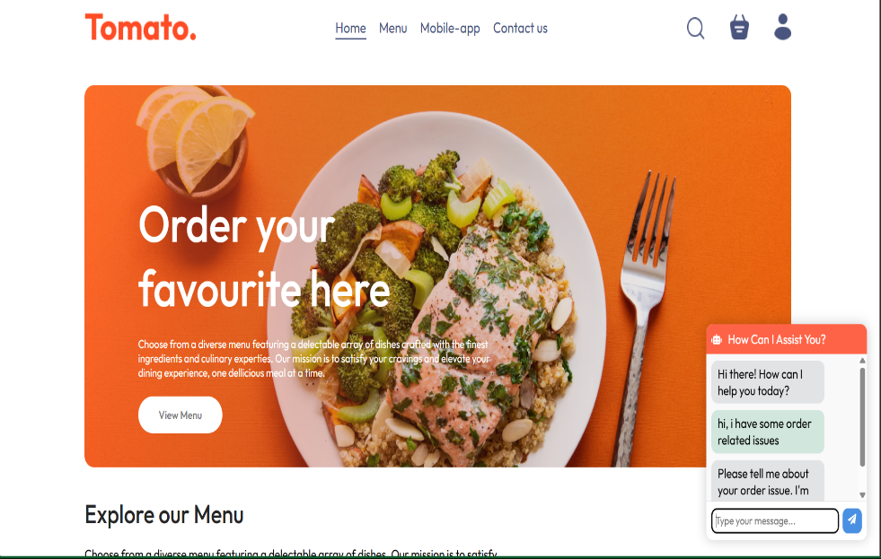
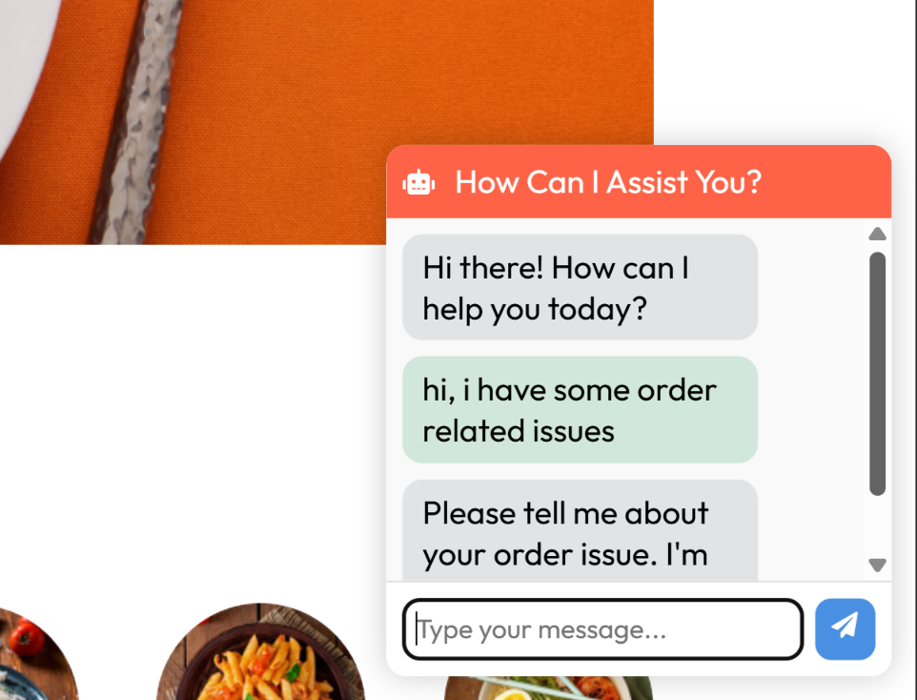
DEMONSTRATION

Slide 13
CONCLUSION
Revolutionizing Convenience: The app transforms how users order food, making it easy and efficient to enjoy meals from their favorite restaurants without leaving their homes.
Market Expansion: It provides restaurants with a platform to reach a broader audience, increasing their customer base and revenue.
User Satisfaction: By offering a seamless and user-friendly experience, the app ensures high customer satisfaction and repeat usage.
Future Prospects: Emphasize the potential for continuous improvement and innovation, keeping up with technological advancements and user needs.
13

Slide 14
Thank You
14

