Slide 1
Prototyping Tools
An intro session

Slide 2
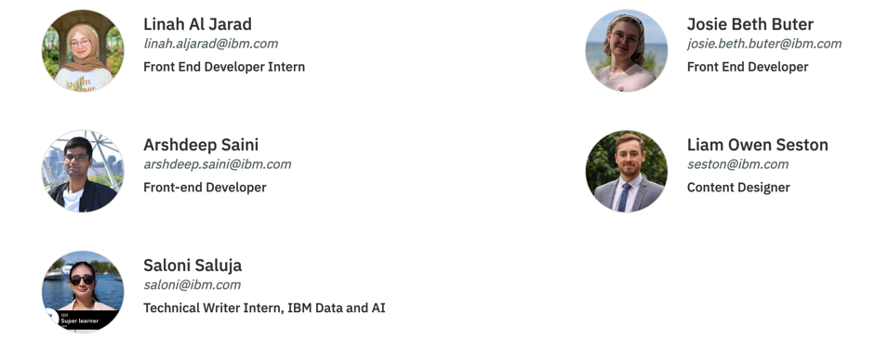

Slide 3
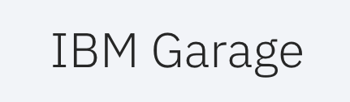
methodology

Slide 4
Prototyping and design during product development
Requirements
Low-fidelity design
High-fidelity design
Evaluate and refine

Slide 5


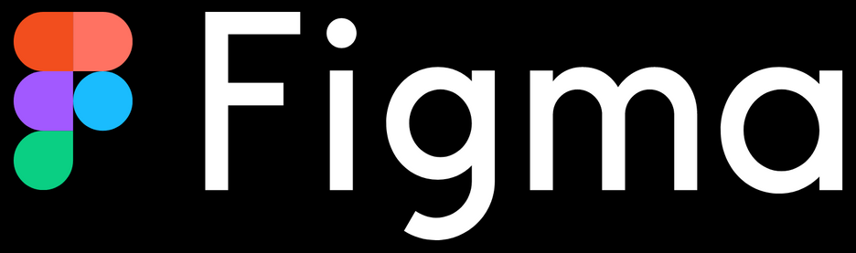
Prototyping/wireframing tools
Low-fidelity
Or
High-fidelity
High-fidelity

Slide 6
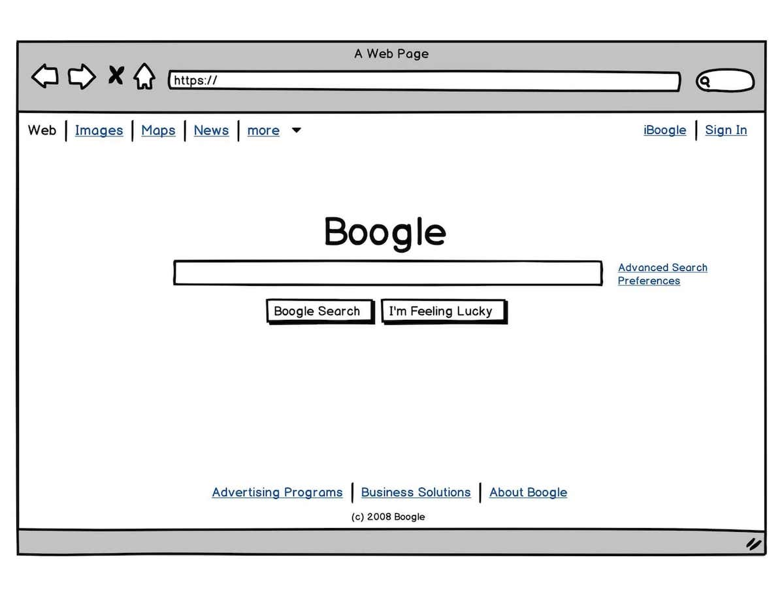
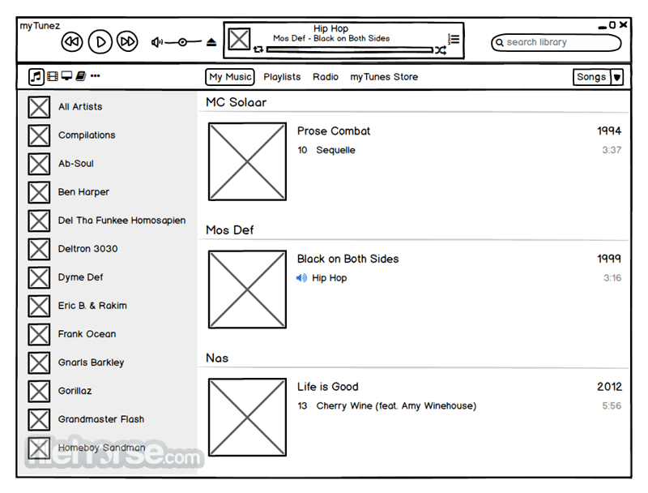
Low-fidelity prototyping tool optimized for speed and simplicity
Highlights ✅
Drawbacks ❌
Rapid prototyping
Easy-to-use interface
Focus on the basic design and structure
Good first UX tool for anyone interested in UX design
Limited to creating low-fidelity mockups only
Difficult to test with real users as it does not provide the actual app experience

Slide 7
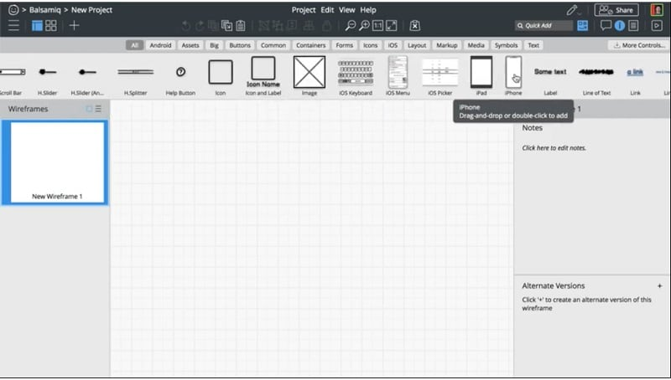
Emphasis on flow/structure of the app, rather than colours and elements
Alternative to sketching on a notepad or whiteboard – drag and drop UI interaction
Used for iterations – easy to modify and reuse wireframes
Convert to PDFs to present the wireframes with others
Easy to collaborate with team members

Slide 8
Quick Balsamiq demo
Switch to Balsamiq demo to preview UI

Slide 9
Getting a License
30 day free trial for cloud version at: https://balsamiq.com/wireframes/
Required for Balsamiq workshop scheduled for May 11
IBM license available

Slide 10
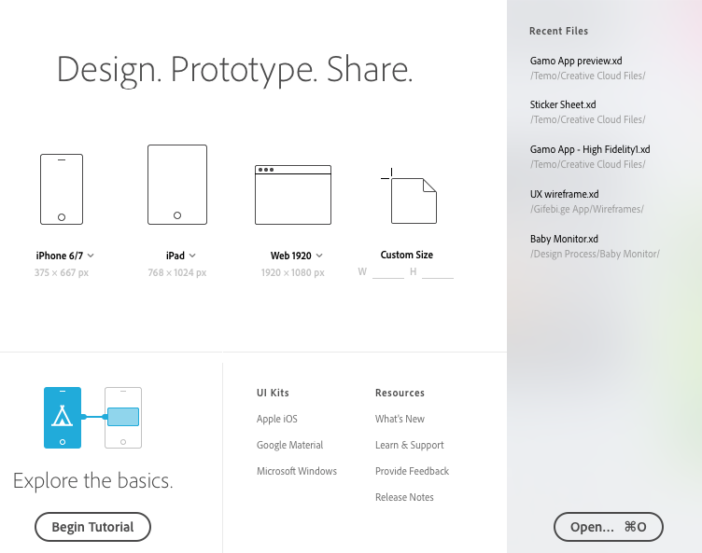
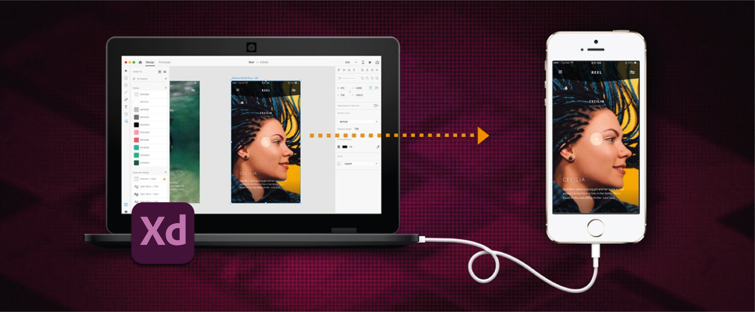
High-fidelity prototyping tool that is useful for designing interfaces
Highlights ✅
Drawbacks ❌
Canvas sizes available for different devices.
Drag-and-drop to fill object placeholders with images.
Repeat grid.
No additional plug-ins needed to create a high-fidelity prototype.
Prototype live preview for smartphone works only with Mac.
Real-time collaboration not possible.

Slide 11
Getting a License
IBM Approved software – available at PC@IBM Store and Mac@IBM Store.
2 – 3 business days to get approval.
Free version also available.

Slide 12
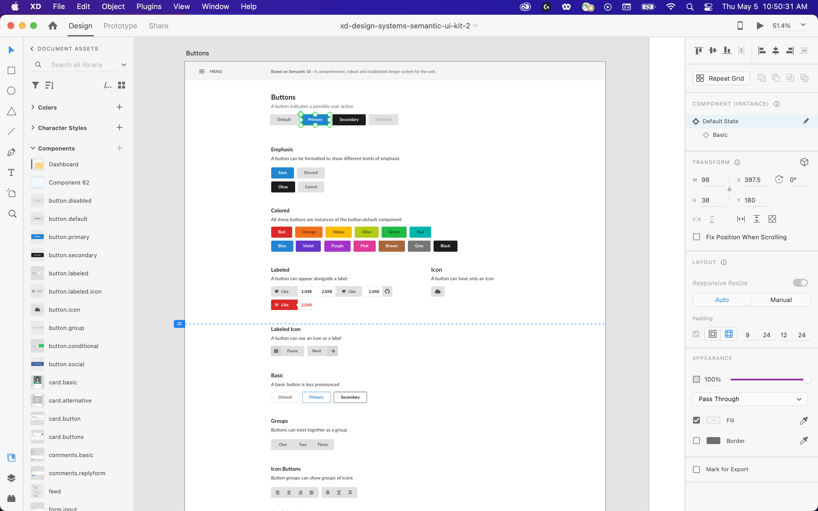
Focus on components and their states
Able to use various triggers and inputs to simulate user interaction
Can create scroll groups and anchor links for project animations

Slide 13
Accessible prototyping tool with many collaboration features.
Highlights
Drawbacks
Web based
Real time collaboration
Built-in, shared design system
Easy file sharing
Useful plugins
Must be always online
Uses browser cache
Files are in the cloud
Needs more resources

Slide 14
Our next steps…
Ideate an example software product
List out user goals, software requirements
Host a session on creating a low-fidelity design prototype with Balsamiq
Host two sessions where we iterate on and design two high-fidelity prototypes, one with Adobe XD and another with Figma

Slide 15
Next week...
workshop
Wednesday, May 11 @ 12:30pm – 1:30pm EST

Slide 16
In the coming weeks...

