Slide 1
LANGUAGE TRANSLATOR
PATEL SALONI SANJAY
17ITUOS006
IT-084
PATEL SHIVAMKUMAR GHANSHYAMBHAI
17ITUOS067
IT-085

Slide 2
LANGUAGE DESCRIPTION
My language perform two operations deposite into the available amount and withdraw from the available amount.
Deposite: Deposit refers to the money an investor transfers into a savings or checking account held at a bank or credit union.
Withdraw:A withdrawal is money you take out of your banking, brokerage firm, or other accounts.
But before operation I cheak certain conditions like:
1]Final_Amount must be greater than 500 after any of
the operation.
2]Withdrawal and deposite amount should be +ve.

Slide 3
Continue..
For Example:
If the current amount is 1500 and we want to withdraw 700 than the amount is withdrawed and amount in account is deducted by the amount we withdraw.
Similar for deposite,the amount we want to deposite is added to the account amount.

Slide 4
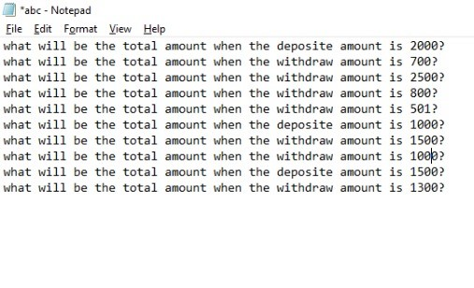
INPUT

Slide 5
COMPILATION
The compilation steps are written below:
lex <filename>.l
yacc -d <filename>.y
gcc lex.yy.c y.tab.c
./a.out <filename>.txt

Slide 6
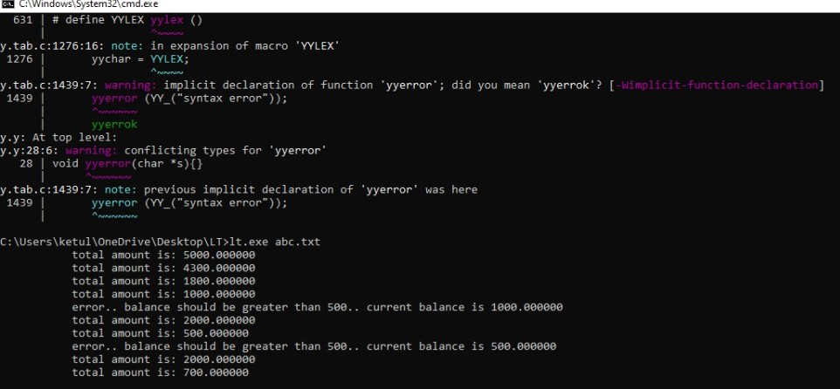
OUTPUT

Slide 7
THANK YOU

