Slide 1


YELP DATA ANALYSIS
Saloni Agrawal
University of Illinois at Urbana-Champaign

Slide 2
INDEX
About the dataset
Files Used
Objective
Steps
Data Analysis
Challenges faced
Next Steps
AGENDA

Slide 3
https://www.kaggle.com/yelp-dataset/yelp-dataset/data
Information on 174567 businesses.
10,000 business reviews.
Star ratings & reviews for the businesses.
DATASET

Slide 4
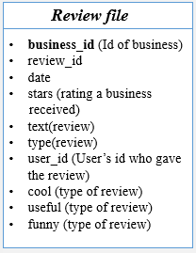
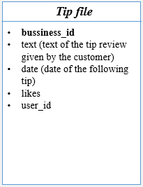
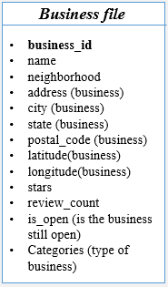
FILES USED

Slide 5
Business File
Calculate frequency count of each star rating.
Cities with most business reviews.
Tip file
Analysis of skewness of tips towards positive or negative side.
Review file
Finding out the correlation between funny, cool and useful types of tip reviews.
Sentiment Analysis of weather a review is good or bad by applying various classification algorithm and determining the accuracy of those algorithms.
OBJECTIVE

Slide 6
Data Cleaning
Data Exploration
Applying strategies
Data Analysis
STEPS TAKEN

Slide 7
Visual Analysis
Sentiment Analysis
DATA ANALYSIS

Slide 8
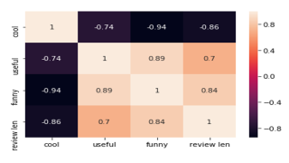
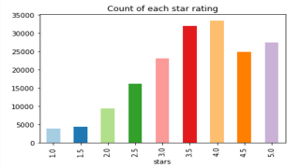
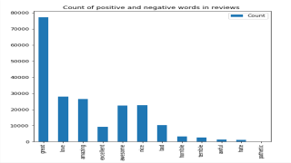
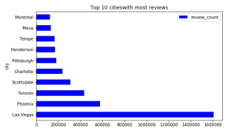

Slide 9
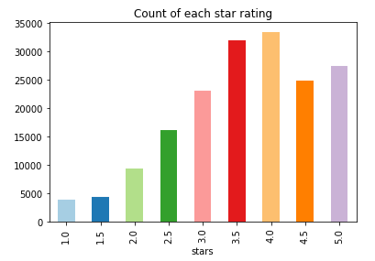

Slide 10


Slide 11


Slide 12


Slide 13

The dataset was to large to handle. There were 7 files of around 5GB of raw data.
The processing time taken to perform data analysis was too large.
CHALLENGES FACED

Slide 14
Slicing the data to create a movie in Tableau.
Predict the number of useful votes a review will receive.
NEXT STEPS

Slide 15
THANK YOU

