Slide 1

DAIKIN - Industry Visit Project
Project: Industry Visit at Daikin Industries
Objective: Create an Entity Relationship Diagram (ERD) for Daikin Industries
Focus: Modeling key business processes and data flow
SALONI GUPTA (055039)

Slide 2
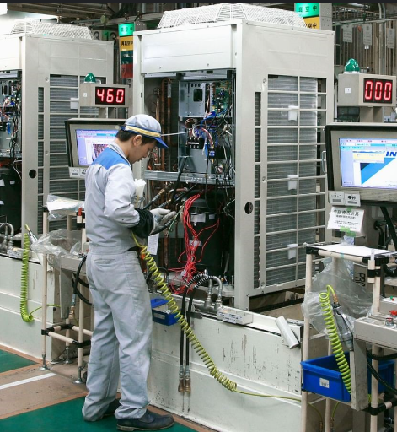
PROBLEM STATEMENT
During the industry visit to Daikin Industries, the goal was to understand the company's operations and data management practices.
The challenge was to design an ERD that accurately reflects the company's data flow, including order processing, inventory management, customer interactions, and supplier coordination.
The ERD helps in identifying data relationships and streamlining operational efficiency.

Slide 3
Data and Analysis
DATA AND ANALYSIS
The ERD consists of the following key entities:
Employee – Captures employee information, including ID, name, and position, facilitating role-based operations.
Customer – Stores customer details such as ID, name, and contact number for order processing and service management.
Order – Represents customer purchases, linking to order details and processing timelines.
OrderDetails – Contains specific product information related to each order.
Product – Stores details of items offered, categorized and linked to suppliers.
Supplier – Manages supplier records, ensuring a streamlined procurement process.
Inventory – Tracks stock levels and product availability, supporting efficient warehouse management.
ServiceRequest – Links customers to products requiring service or maintenance, improving after-sales support.
Relationships include one-to-many (1:M) and many-to-many (M:N) connections to accurately model Daikin’s business operations.

Slide 4
Observations
OBSERVATIONS
Comprehensive Order Processing: Seamless tracking from order placement to fulfillment.
Optimized Inventory Control: Accurate monitoring of stock levels reduces inefficiencies.
Enhanced Supplier Coordination: Direct supplier-product links ensure smooth procurement.
Integrated Employee Management: Employee roles are mapped to relevant business functions.
Customer-Centric Service Handling: Service requests are effectively linked to customers and products.

Slide 5
Insights and Recommendations
INSIGHTS AND RECOMMENDATIONS
Process Automation: Implementing automated order tracking can reduce delays and errors.
Real-Time Inventory Management: Enabling live stock updates prevents shortages and overstocking.
Supplier Relationship Optimization: Strengthening supplier collaboration ensures timely procurement.
Data Integrity Measures: Establishing validation rules improves data accuracy and system efficiency.
Scalability and Future Growth: The ERD design allows for easy expansion across departments.

Slide 6
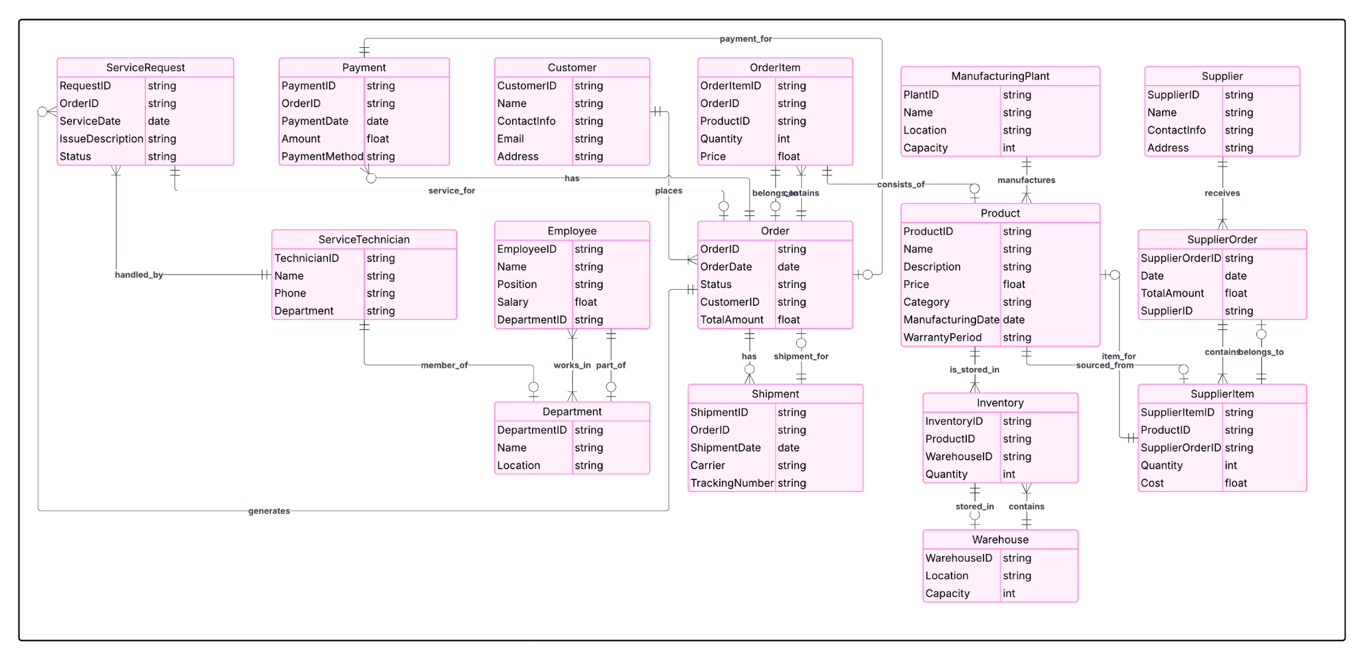
ERD Diagram
ENTITY-RELATIONSHIP DIAGRAM (ERD)

