Slide 1
Gym Management System
Presented by -
Group 13
Saloni Doshi (IIT2020059)
Anjali Sahu (IIT2020063)
Yash Chaurasia (IIT2020091)
Mudit Agarwal (IIT2020092)

Slide 2
Gym Management system is a java based Android application which basically helps the Gym manager to manage the gym including list of members, trainers, equipments, exercise plans, etc.
Technologies Used : Java and MySQL

Slide 3

Here’s the list of classes which are used while making the project
Login Class
Members Class
Coaches Class
Equipment Class
Payment Class
Exercise Class

Slide 4
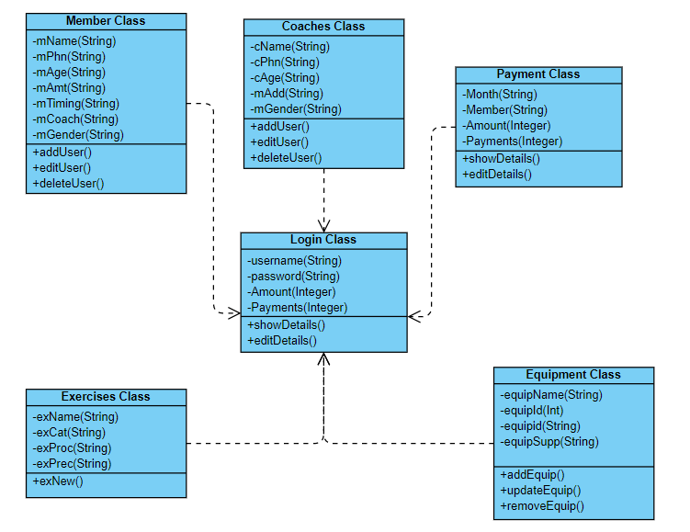
Class Diagram

Slide 5
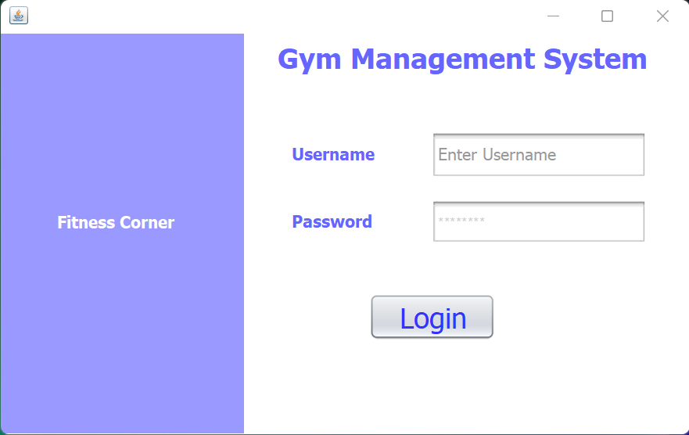
Login Class
By entering correct credentials admin can login into the application

Slide 6
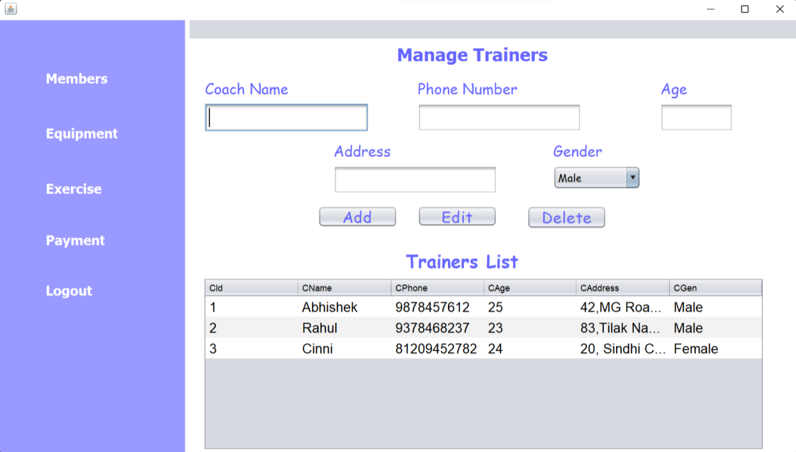
Coaches Class
Admin can add details of new coaches, can edit the details of existing coach, and can delete any existing coach of the Gym.

Slide 7
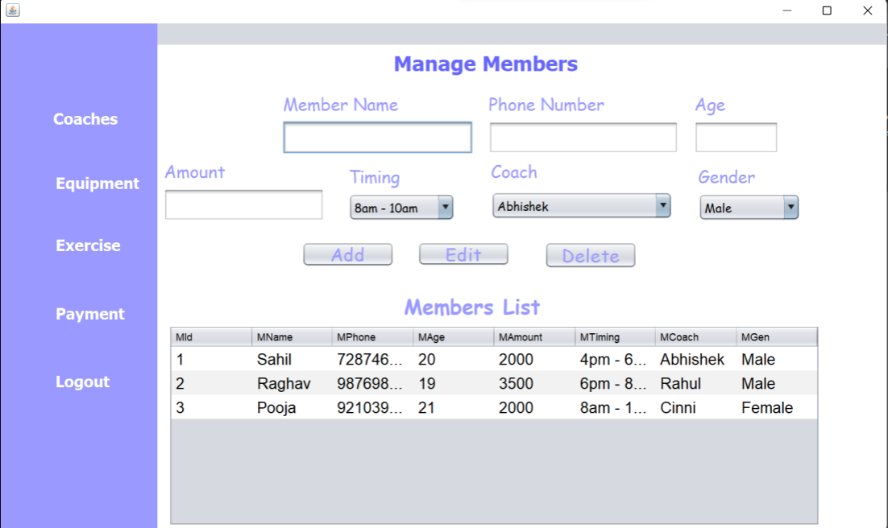
Members Class Admin can add details of new users, can edit the details of existing users, and can delete any existing member

Slide 8
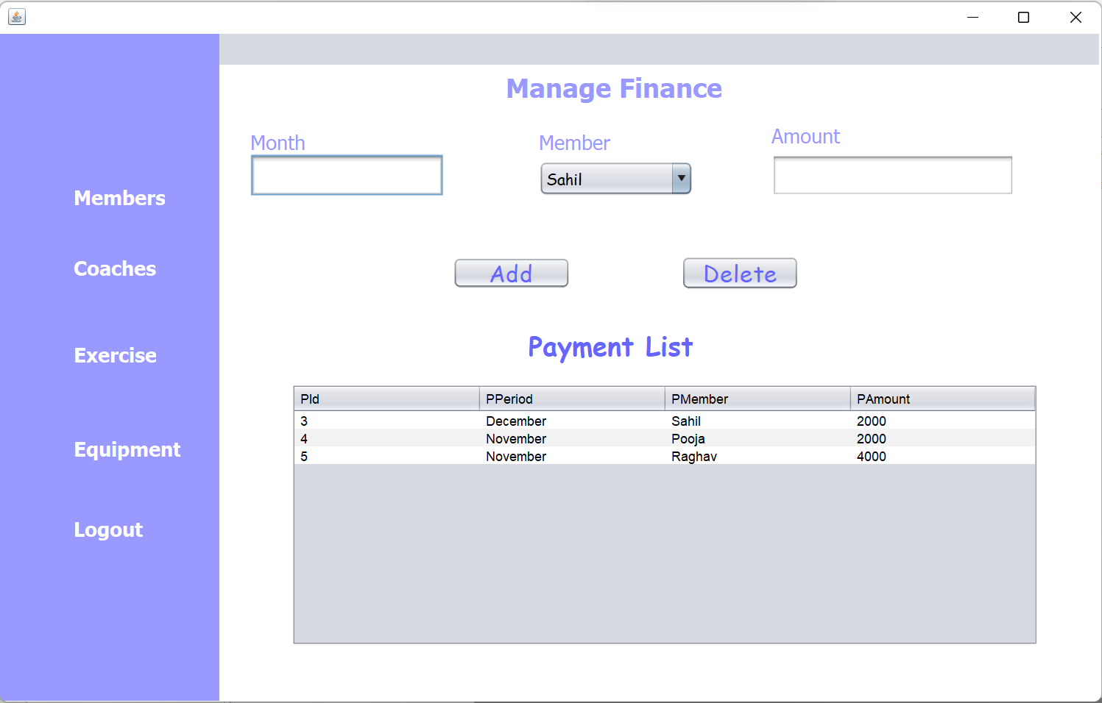
Payment Class
Admin can store the record of each member’s due payment.

Slide 9
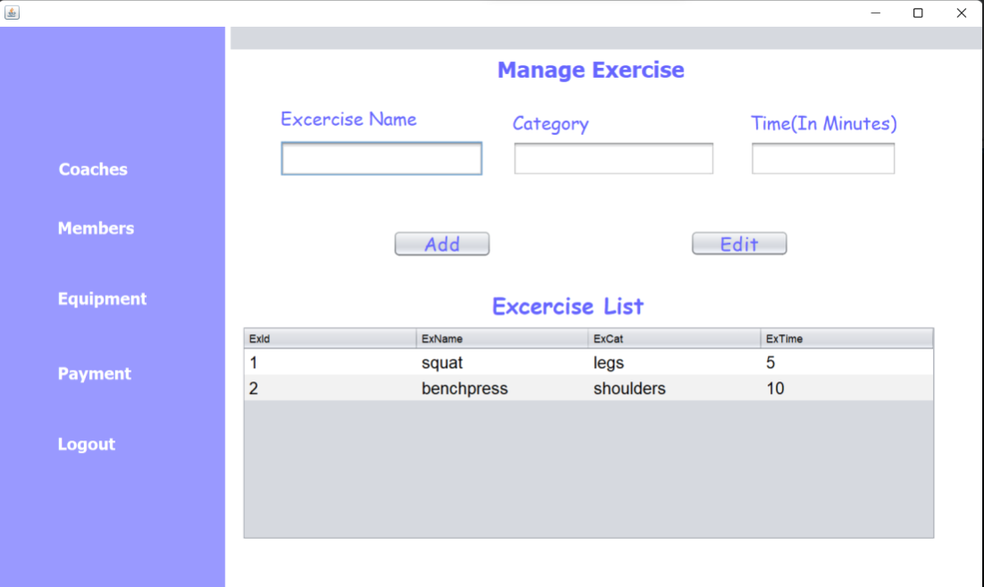
Exercise Class
Admin can make changes of the exercises which are performed in his gym and can store the details of each exercise.

Slide 10
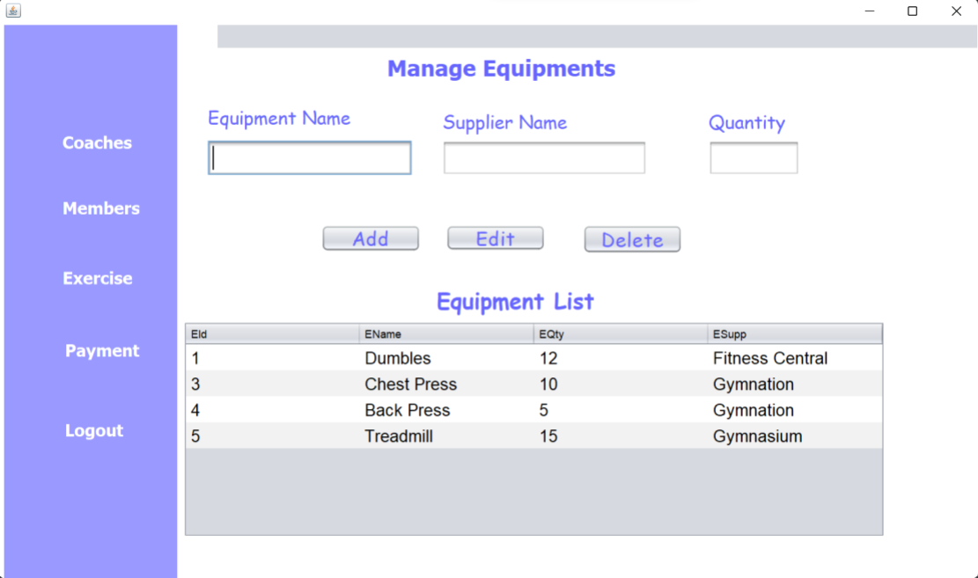
Equipment Class
Admin can keep the records of equipments in his gym by this functionality. Also he can store the name of supplier from where he bought equipments.

Slide 11
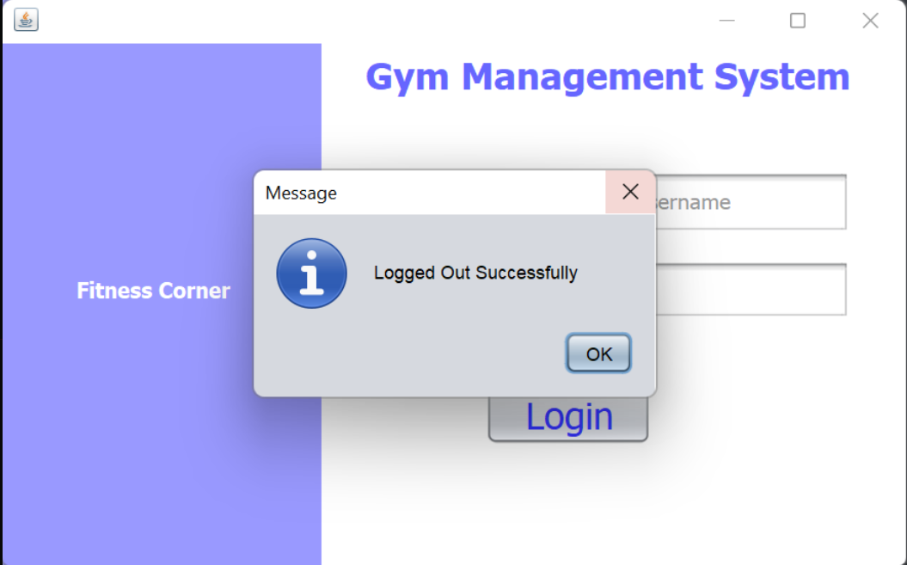
Logout

Slide 12
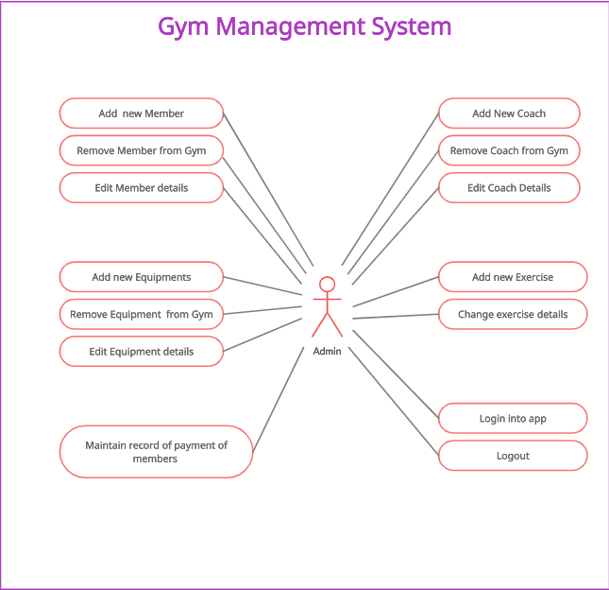
USE CASE Diagram

Slide 13
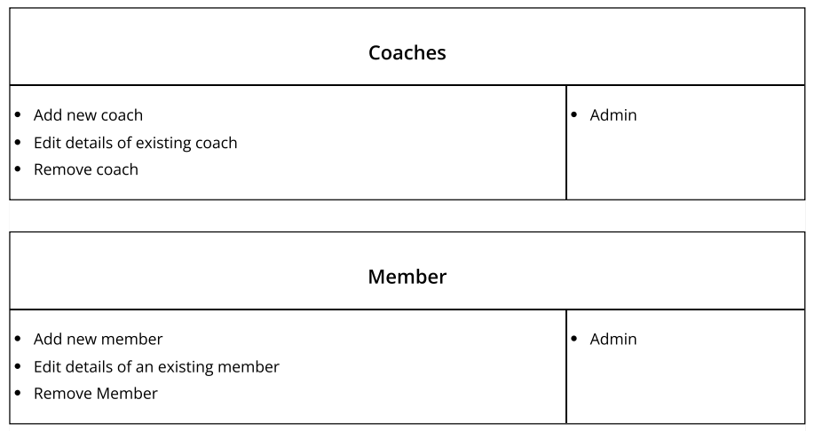
CRC diagram

Slide 14
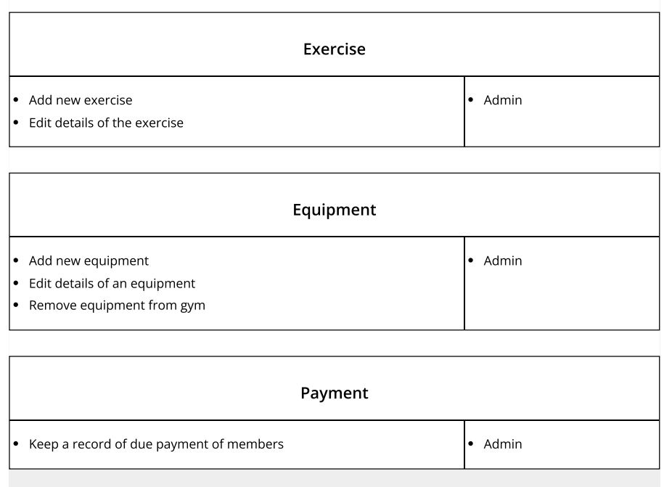

Slide 15
THANK YOU

