Slide 1








Rajasthan Rainfall Analytics Database (RRAD)
DBMS – TAE 2 Project
B.Tech CSE (Data Science)
G H Raisoni College of Engineering and Management, Pune
Database Technology: MySQL

Slide 2
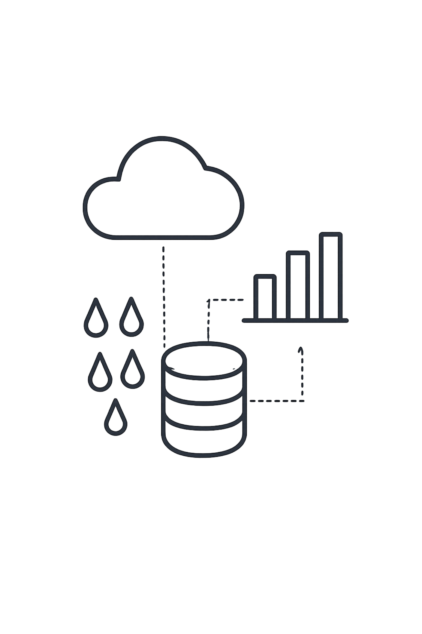
Project Overview
Database for Rajasthan rainfall analysis
Organizes data by region and district
Stores actual and normal rainfall
Maintains data consistency using constraints
Supports SQL-based analysis

Slide 3
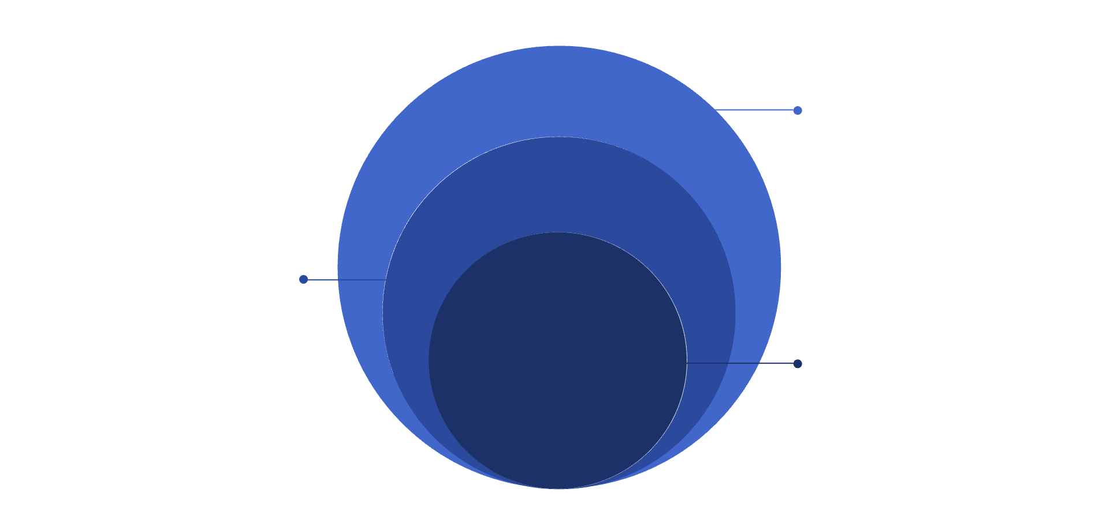
DATABASE ARCHITECTURE
Database Architecture
REGION represents East Rajasthan and West Rajasthan
RAINFALL_RECORD
Stored rainfall observations
DISTRICT contains 33 Rajasthan districts
RAINFALL_RECORD stores rainfall observations
DISTRICT
33 districts of Rajasthan
REGION
Foreign keys connect the tables
East Rajasthan, West Rajasthan

Slide 4
Relational Schema
The database schema is designed to efficiently store and link rainfall data, ensuring data integrity across different geographical levels of Rajasthan.
REGION Table
Column Name | Data Type | Key/Description
RegionID | INT | Primary Key, Unique Identifier
RegionName | VARCHAR(50) | e.g., 'East Rajasthan', 'West Rajasthan'
DISTRICT Table
Column Name | Data Type | Key/Description
DistrictID | INT | Primary Key, Unique Identifier
DistrictName | VARCHAR(50) | Name of the district (e.g., 'Jaipur')
RegionID | INT | Foreign Key (references REGION.RegionID)
RAINFALL_RECORD Table
Column Name | Data Type | Key/Description
RecordID | INT | Primary Key, Unique Identifier
DistrictID | INT | Foreign Key (references DISTRICT.DistrictID)
RecordDate | DATE | Date of rainfall recording
ActualRainfall | DECIMAL(5,2) | Actual rainfall recorded in mm
NormalRainfall | DECIMAL(5,2) | Normal expected rainfall in mm
Primary keys ensure unique identification for each record, while foreign keys establish the hierarchical relationship between regions, districts, and their respective rainfall data, maintaining referential integrity.

Slide 5
Relational Schema
Three-table parent-child hierarchy with clear keys and foreign-key relationships.
REGION
DISTRICT
RAINFALL_RECORD
region_id PK
region_name
district_id PK
district_name
region_id FK
record_id PK
district_id FK
actual_rainfall
normal_rainfall
REGION 1→MANY DISTRICT · DISTRICT 1→MANY RAINFALL_RECORD

Slide 6
Data & Integrity Constraints
2 regions
33 districts
33 rainfall observations currently loaded
District names are unique
Actual rainfall cannot be negative
Normal rainfall must be greater than zero
Primary Key
Foreign Key
Validation

Slide 7
Advanced SQL Implementation
JOIN
SUBQUERY
VIEW
TRIGGER
Combines data from 3 tables.
Finds districts above average rainfall.
Creates reusable summary results.
Prevents invalid rainfall values.
STORED PROCEDURE
INDEX + EXPLAIN
Retrieves rainfall by region.
Supports query optimization.

Slide 8

SQL Views
Two reusable virtual tables simplify rainfall analysis and reporting.
View 1: rainfall_summary
View 2: region_rainfall_summary
District
Region
Actual rainfall
Normal rainfall
Percentage Departure
Region
District count
Average actual rainfall
Average normal rainfall
Percentage Departure is calculated dynamically using SQL.

Slide 9


Trigger & Stored Procedure
TRIGGER
STORED PROCEDURE
check_rainfall_values
get_region_rainfall()
Runs before INSERT on RAINFALL_RECORD.
Takes a region name and returns district rainfall details.
Rejects Negative Rainfall
Input
actual_rainfall < 0
region_name VARCHAR
Rejects Invalid Baseline
Returns
normal_rainfall ≤ 0
District name, actual rainfall, and normal rainfall for the region.
Tested Successfully
Example
Invalid input was rejected with a clear error.
CALL get_region_rainfall('East Rajasthan');

Slide 10
Query Optimization
Created index on district_id
Created index on actual_rainfall
Used EXPLAIN to inspect query execution
Observed MySQL indexing behavior
Indexes support faster data lookup
EXPLAIN
type: range
key: idx_actual_rainfall
rows: fewer

Slide 11

Conclusion
RRAD Demonstrates
LIVE DEMO FLOW
Normalized Relational Database
01
02
Show database tables
Demonstrate JOIN
Primary and Foreign Key Relationships
03
04
Show both views
Execute stored procedure
Advanced SQL Operations
05
06
Views and Dynamic Calculations
Demonstrate trigger
Show indexes and EXPLAIN
Thank You
Questions?
Trigger-Based Validation
Stored Procedure Implementation
Indexing and Query Optimization

