Slide 1

Sangram
e-Panchayat Project

Slide 2
About the Project
The ePanchayati Raj Institution (ePRI) Mission Mode Project holds great promise for the rural masses as it aims at streamlining the delivery of government services to them through Panchayats. This is a one of its kind nation-wide IT initiative initiated by Ministry of Panchayati Raj, Government of India.
PRIs function at the Village, intermediate (Block) and District level.
In PRIs all accounting of 3 tier is online. viz. Gram Panchyat, Panchayat Samiti & Zilla Parishad.
All Gram Panchayats are internet connected, thus easily accessible from the Mantralaya.

Slide 3

About the Project
Through ePRI G2C services provided at Gram Panchayat.
Most of the Gram Panchayats are ISO 9001:2008 Certified.

Slide 4
About the Project
Detailed Project Report (DPR) was carried out by NIC for State of Maharashtra. It provides details of the estimated cost for implementing the MMP in Maharashtra, which includes ICT infrastructure requirements, state specific software applications, data digitization requirements, project management cost etc.
Thus Mahaonline Ltd came into the picture, Mahaonline is the JV between Govt of Maharashtra & Tata Consultancy Services (TCS).

Slide 5
About the Project
Mahaonline provides technical manpower for implementation of ePRI project in Maharashtra.
Mahaonline provides technical consultancy for procurement of hardware, software and deployment of the same.

Slide 6

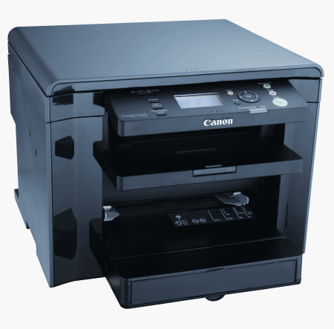
Procurement of Hardware
All ePRIs institutions have procured ThinkCenter all in one computer from Lenovo.
Each ZP-4 PS-1 GP-1
The printers have been procured from Canon.
Each ZP-1 PS-1 GP-1

Slide 7
SANGRAM ePRI Project
Govt. of Maharashtra gave Sanganakiya Gramin Maharashtra as the name of the ePRI project.
SANGRAM

Slide 8
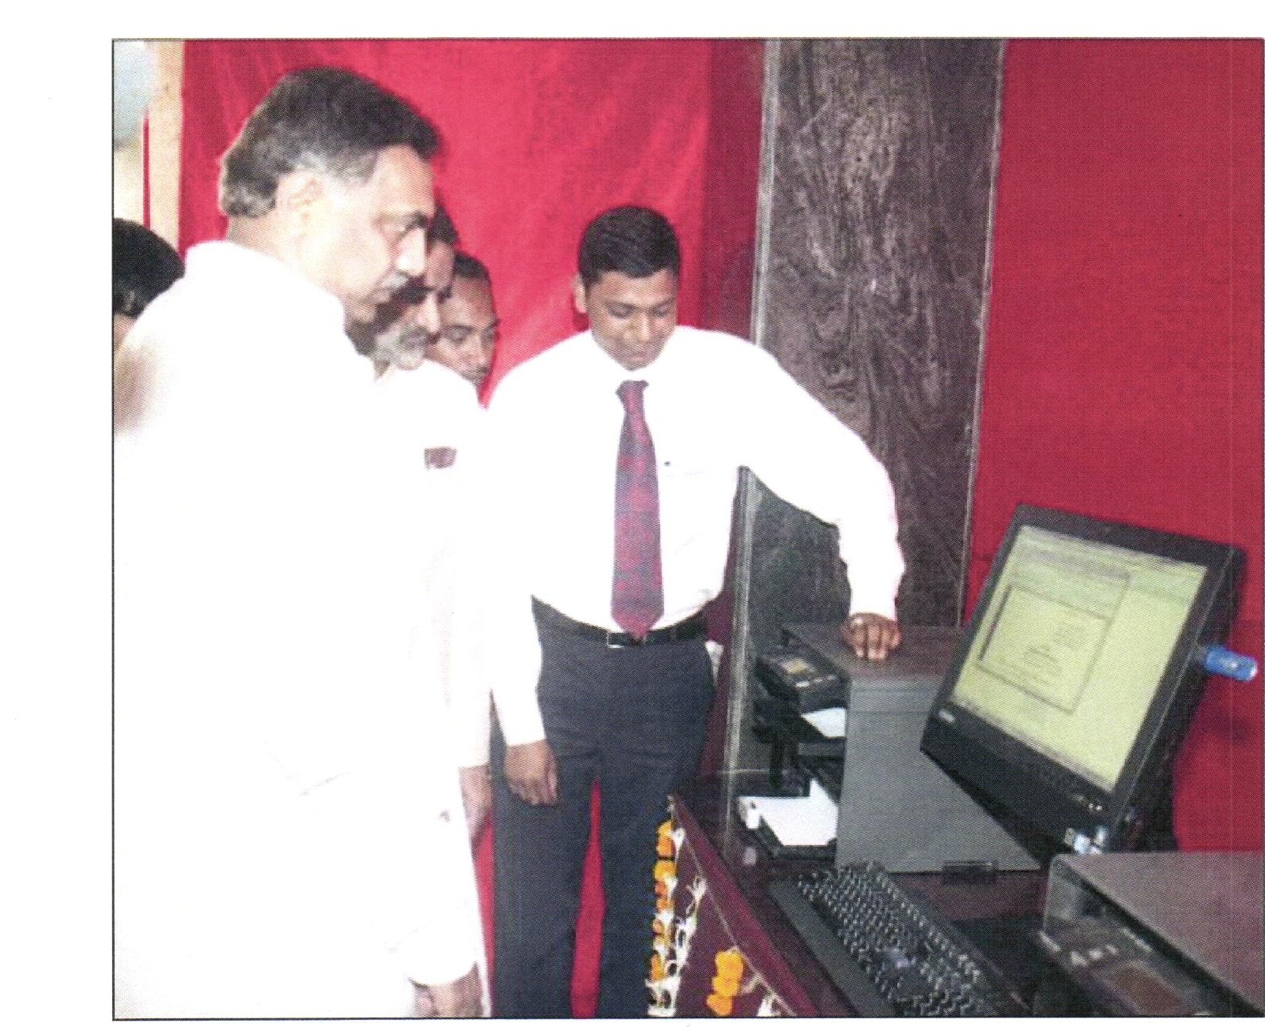
Inauguration of the Project
GR issued on 26th & 30th April, 2011
Project inaugurated on 1st May, 2011 with the hands of Hon. Minister Shri Jayant Patil (Rural Development) at Kalamboli, Navi Mumbai.

Slide 9
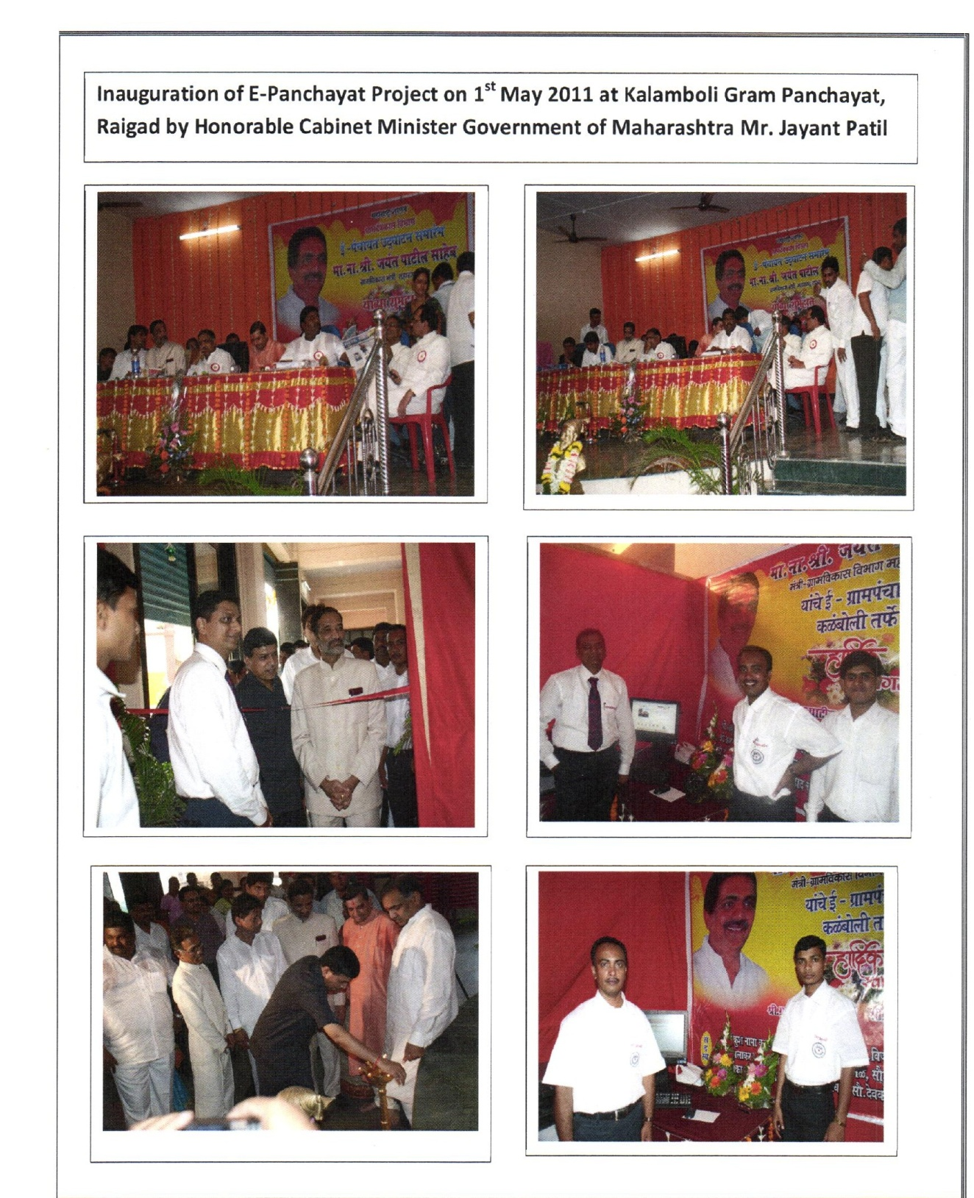

Slide 10
Implementation of ePRI Project
Supply of Hardware to ZP, PS & GP took 3 months to complete.
Deployed 33 ZP level Software Engg. carried out in the month of Jun-Jul 2011.
Deployed 351 Taluka level Computer Experts carried out in the month of Jul-Aug 2011.
Deployed all GP level Computer Operators carried out in the month of Aug-Sep 2011.

Slide 11
SANGRAM
Deployment of Manpower
ePRI | Govt. approved Manpower | Deployed by Mahaonline
ZP | 1 Software Engineer 5 Computer Operators | 1 Divisional Manager 1 District Manager 1 District Coordinator 5 Computer Operators
PS | 1 Computer Expert 2 Computer Operators 1 Hardware Engineer (Per 25 GPs) | 1 Taluka Coordinator 1 Computer Expert 2 Computer Operators
GP | 1 Computer Operator (per 1000 Population) 1 Computer Operator (per 3 GPs, below 1000 Population) | 1 Computer Operator (per 1000 Population) 1 Computer Operator (per 3 GPs, below 1000 Population)
Software Engg./ZP Coordinators 33, Hardware Engg. 251, Computer Experts 349, Computer Operators at ZP = 157, PS = 679, GP = 21781. Total Manpower Deployed = 23,250

Slide 12
SANGRAM
11 core Software Applications
MoPR with the help of NIC has developed 11 software applications which are adopted by Govt of Maharashtra.
SN | Application | Focus Area | Introductory features/Software
1 | Local Government Directory (LGD) http://panchayatdirectory.gov.in http://lgdirectory.gov.in lgdirectory@googlegroups.com | Management of list of local government | Assigning & maintaining Unique Ids for Panchayats & Urban Local Bodies
2 | Area Profiler http://areaprofiler.gov.in areaprofiler@googlegroups.com | Socio-economic data-base of rural areas | Area Profiler for capturing details related to Socio-economic information, demographic details, public infrastructure and amenities elected representative. Staff of Panchayat etc.
3 | Plan Plus http://planningonline.gov.in Planplus_epri@googlegroups.com | Planning | To facilitate data and process management related with decentralized and participatory Planning
4 | PRIASoft http://accountingonline.gov.in priasoft@googlegroups.com | Panchayat Accounting | To facilitate management of Panchayat Accounting
5 | Action Soft http://assetdirectory.gov.in action@googlegroups.com | Works/Scheme Progress Reporting | Scheme/Works Implementing & Monitoring

Slide 13
11 core Software Applications Contd..
SN | Application | Focus Area | Introductory features/Software
6 | National Asset Directory http://assetdirectory.gov.in nad@googlegroups.com | Asset Management system | Assigning unique coder to Assets & utilities created/owbed by Panchayats, ULB, Line Dept National Asset Directory (NAD)
7 | Serviceplus http://serviceonline..gov.in serviceplus@googlegroups.com | eService Delivery & Public Grievance Management System | Service Plus to manage the service delivery processees and data, including Public Grivence in a transparent and efficient manner
8 | Training Skill http://trainingonline.gov.in trainingmgmt@googlegroups.com | Training demand & supply management | Skill/Training Management to facilitate effective development and managaement of skill sets at all levels of Panchayats
9 | Social Audit & Meeting Management http://socialaudit.gov.in socialaudit@googlegroups.com | Social Audit by Gram Sabha and meeting management | A module do facilitate processes of Social Audit and Meetings
10 | National Panchayat Portal http://panchayat.gov.in http://panchayatportals.gov.in npp@googlegroups.com | A dynamic website of Panchayat | Dynamic Web Portals of Panchayats to facilitate content management and publishing
11 | GIS layer | GIS presentation of basic data in generic manner | Spatial Presentation of some of the key reports from other PES modules

Slide 14
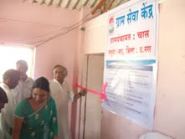
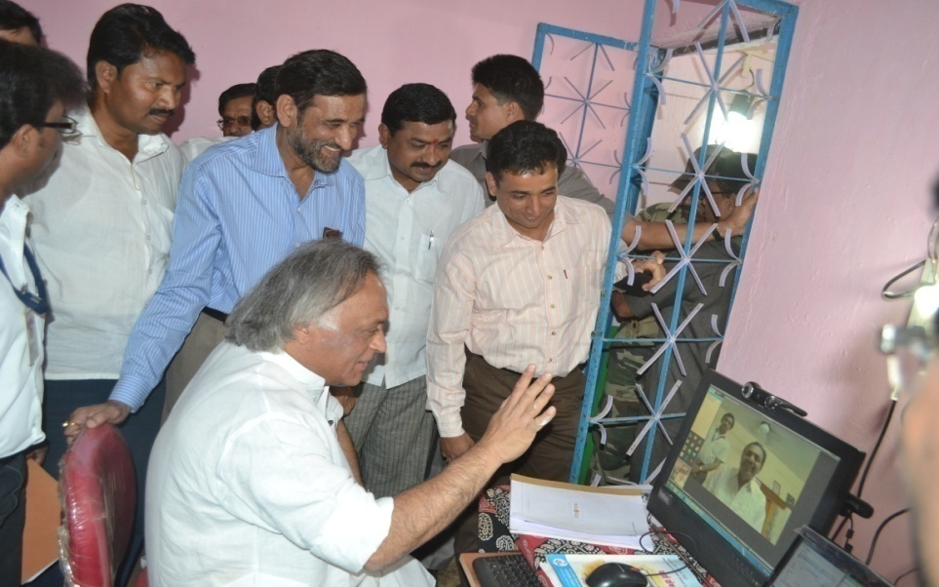
SANGRAM
Services - GSK
GSK (Gram Seva Kendra) – Dept of Information & Technology Govt of Maharashtra declared all Internet enabled Sangram Kendra as Maha-e-Seva Kendra i.e. CSC (Citizen Service Centre) as per GR dated 23rd May 2012. As on date @25000 Sangram Kendras located in PRIs will be able to deliver various services to the citizens.

Slide 15
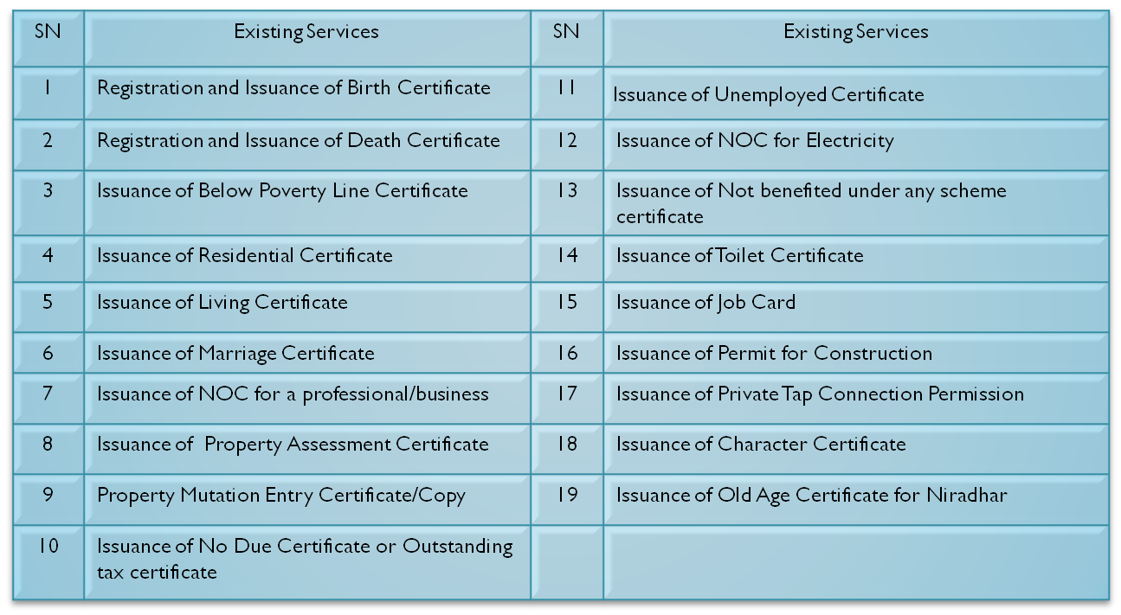
SANGRAM
Services - GSK

Slide 16
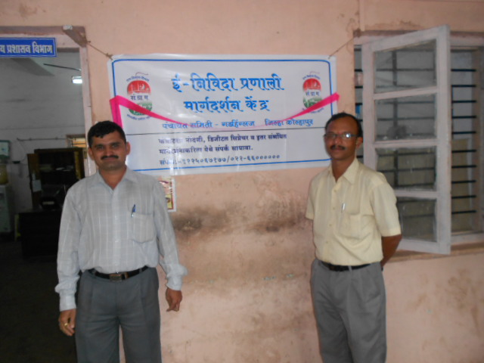
SANGRAM
Services - eTendering
eTendering – Training has been completed at all Taluka Places (351). eTendering already commenced at all ZP & PS level and shortly will be commencing at GP level.

Slide 17
SANGRAM
Services - Sangram Soft
Sangram Soft – This software is used to run ePRI Institutions day-today business smoothly & efficiently. All types of records and financial transactions are stored using this software with the help of Form No.1 to 27.

Slide 18
Challenges
Electricity : There is load shedding problem in rural Maharashtra. To overcome this challenge we have hired local manpower, Village Level Entrepreneur (VLE) on work basis rather than time basis, so the VLE completes the work as and when the electricity is available.
Internet Connectivity : There was internet connectivity issue in rural Maharashtra. So to get internet connectivity at GP level we have negotiated with various ISP’s and most of the GP’s got internet connectivity. We have formed the group of nearby GPs and all these GPs worked from one location with good net connectivity, thus all GPs started working.
Quality of Technical Manpower : We have conducted various trainings to groom VLE’s and invested heavily on the same and generated local employment in rural Maharashtra with social responsibility.

Slide 19
Outcome of Project
Transparency in utilization of Govt. fund for the betterment of public at all levels.
G2G, G2C, G2B & G2E Services at common mans locality.
Easy access to each ZP, PS & GP information.
Government services accessible to the common man in his locality, through common service delivery outlets, and ensure efficiency, transparency, and reliability of such services at affordable costs to realize the basic needs of the common man.

Slide 20

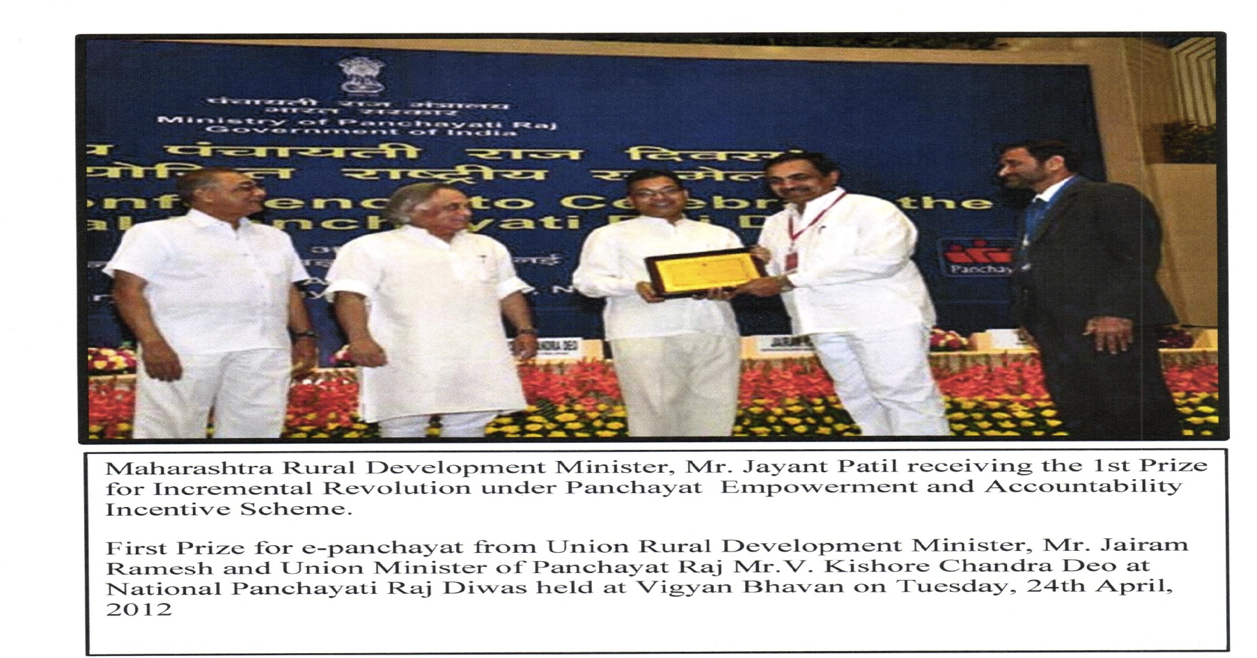
Achievement
Online accounting of all GPs.
Received First Prize from Union Govt. for best ePanchayat Roll-Out in Rural India.

Slide 21

Sangram
Thank You

