Slide 1
Carzy
Presented By
Shruti Majale & Saloni Bodhe

Slide 2
Introduction:-
The Main purpose of developing the “Carzy” is to provide online facility to book cars online within few clicks only. Some people cannot afford to have a car, for those people this system becomes very helpful. This system includes various cars, as per the customer order and comfort, it place the order and book the car as per the location within the area and booking can be done via internet service only.
“Carzy” will automate the manual car reservation process. It will be easy to admin for handling customer registrations, present the car details, handling reservations.

Slide 3
Technology Used :-
We used Java Spring-Boot as backend and React JS as Frontend in our Project.
The main goal of the Spring Boot framework is to reduce overall development time and increase efficiency. React has become the first choice for frontend because it gives developers the ability to work with a virtual browser.
React allows developers to create large web applications that can change data, without reloading the page. The main purpose of React is to be fast, scalable, and simple.

Slide 4
User classes:-
Admin:-
Customer:-
Admin will be able to login to system & verify car info. Database. Also he can handle payment system to finalize or cancel order
Customer will be able to login to website then search for his desired car according to his favorable location and can book a car with or without Driver .
Car Owner:-
Driver:-
Car Owner will be able to login to website, feed the car information and also provide rent details.
Driver will have choice to either accept or reject the ride that has been allocated to him.

Slide 5
Product Function:-
The system provides efficient way to use the services by Customer and Car owner.
System provides easy ways for searching cars and driver for customer so that easily they can connect with them.
The system must allow the customers to select specific car using different search category while reservation.

Slide 6
Admin Module
After successful registration ,
Admin can login to the system
Verify the car information database
Generate price strategy
Handle the payment system.
Finalize the order.
Cancel the order.

Slide 7
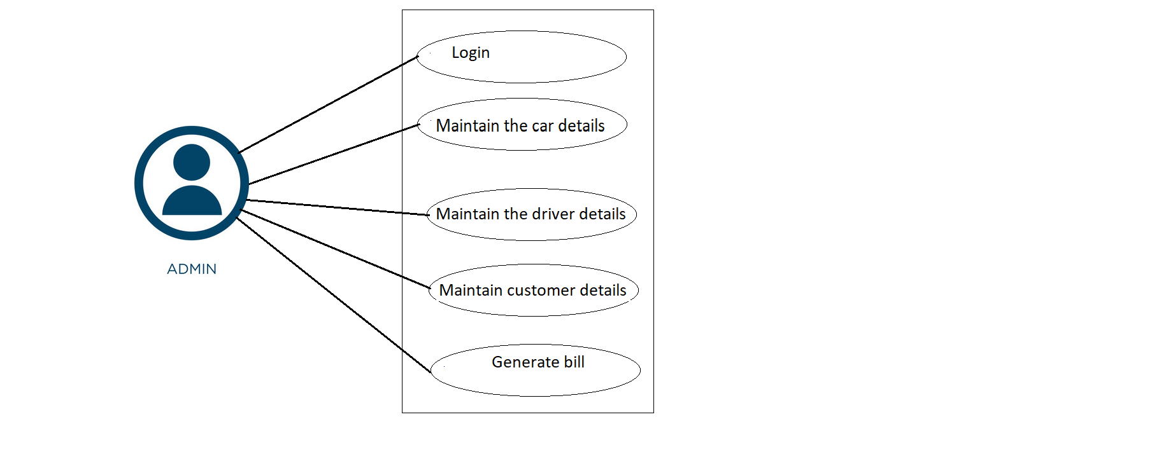
Use case Diagram For Admin:-

Slide 8
Customer Module
After successful registration and authentication from customer ,
Customer can login to the system.
Visit the website.
Search for car
Search for driver
Book ride.
Cancel the ride.

Slide 9
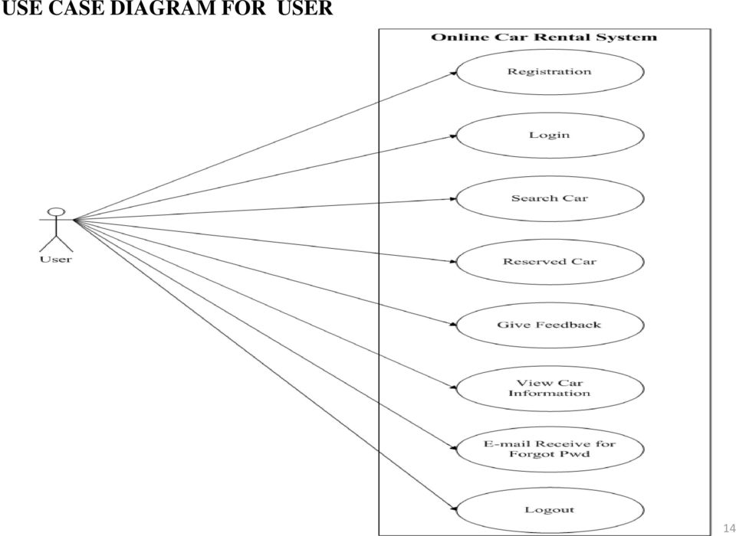
Use case Diagram For Customer:-

Slide 10
Driver Module
The driver can ,
Driver can login to the system
Comfirm the ride
Cancel the ride.

Slide 11
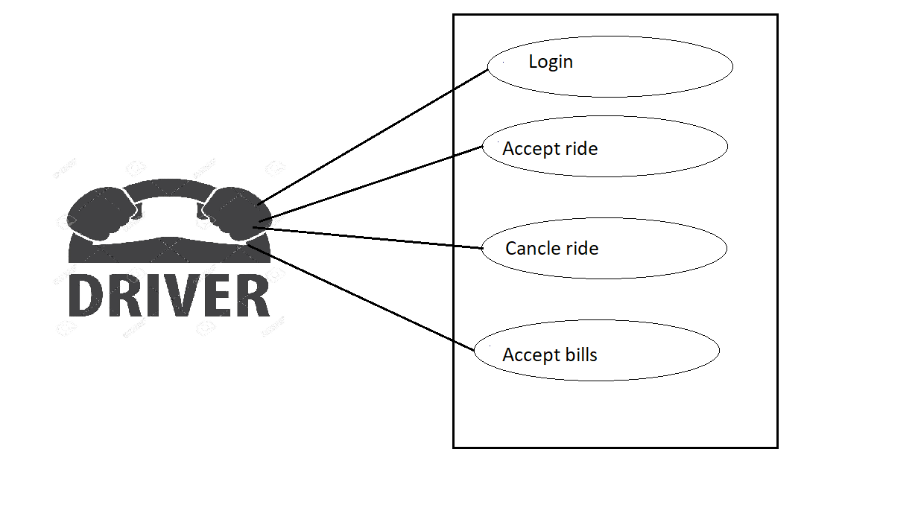
Use case diagram for driver:-

Slide 12
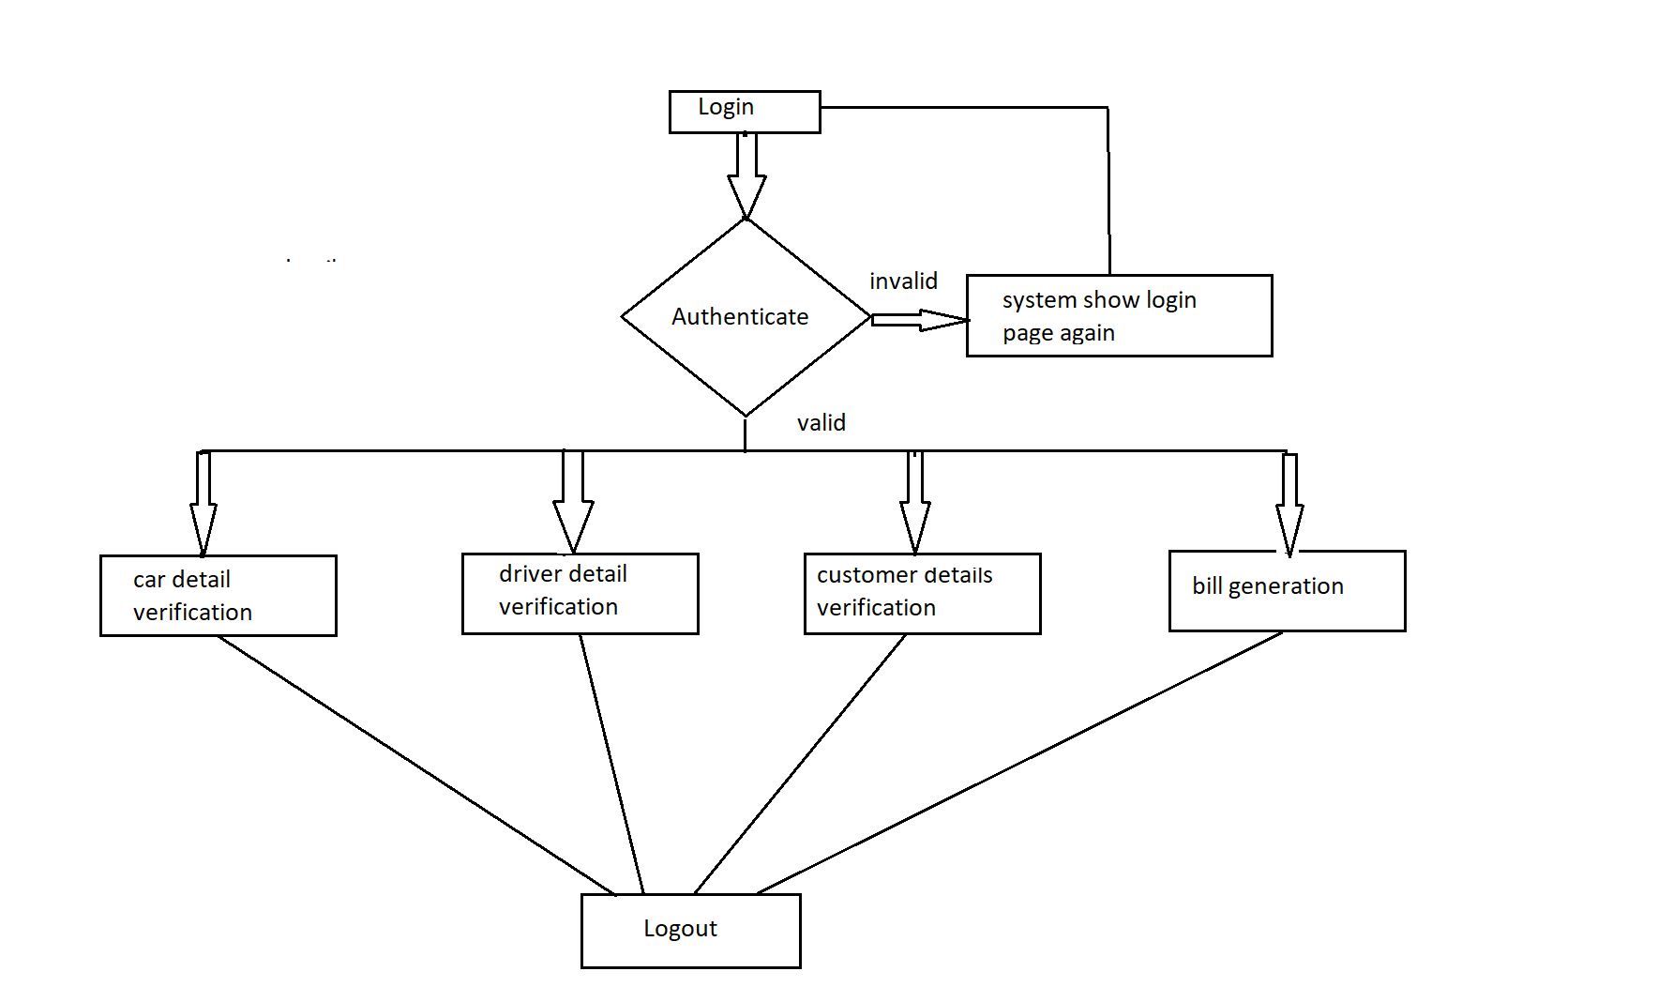
Activity diagram for admin

Slide 13
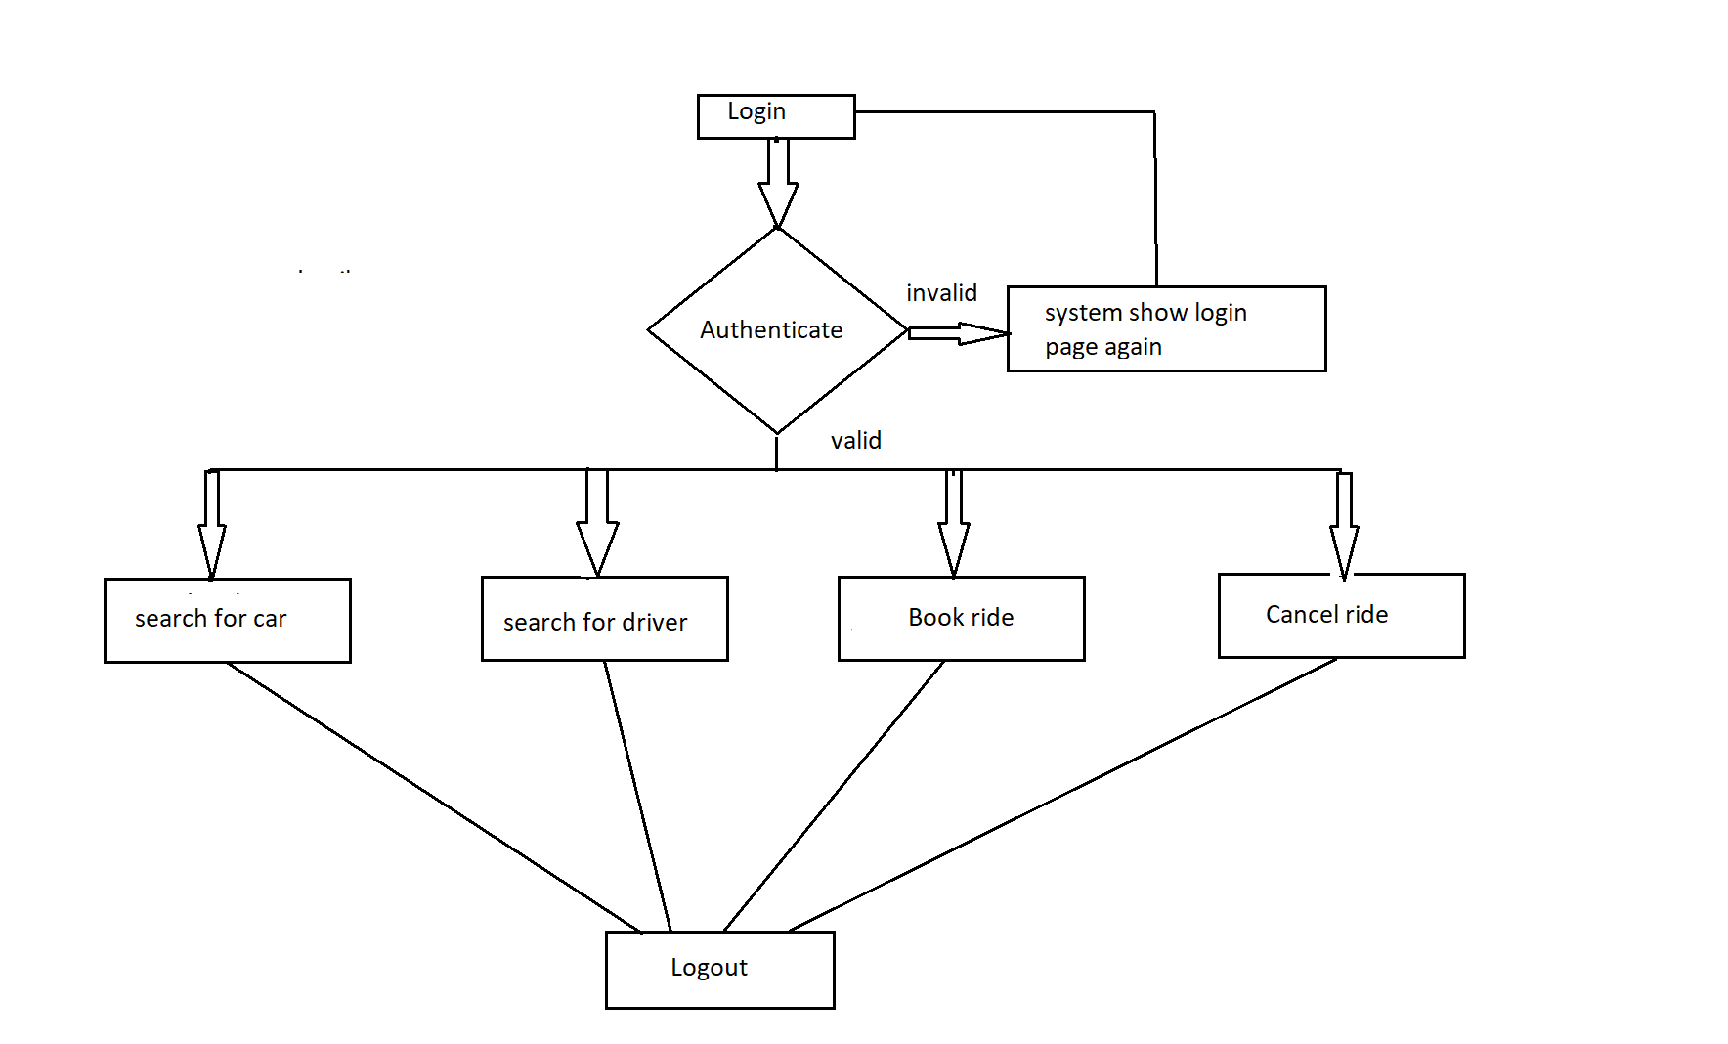
Activity diagram for customer

Slide 14
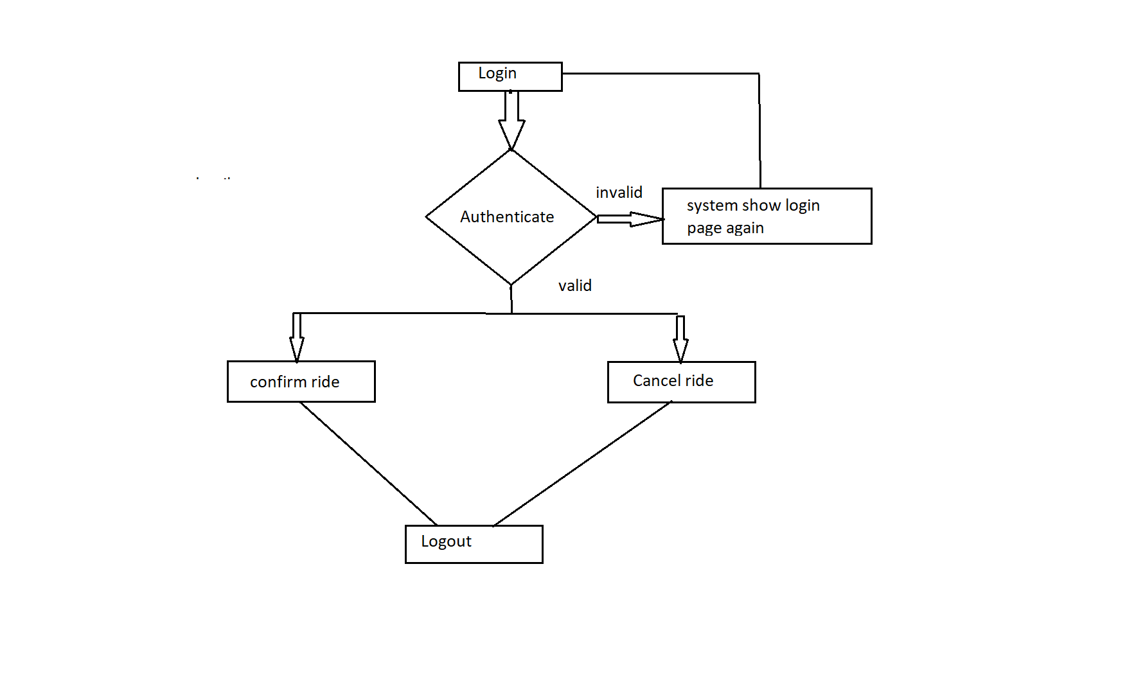
Activity diagram for driver

Slide 15
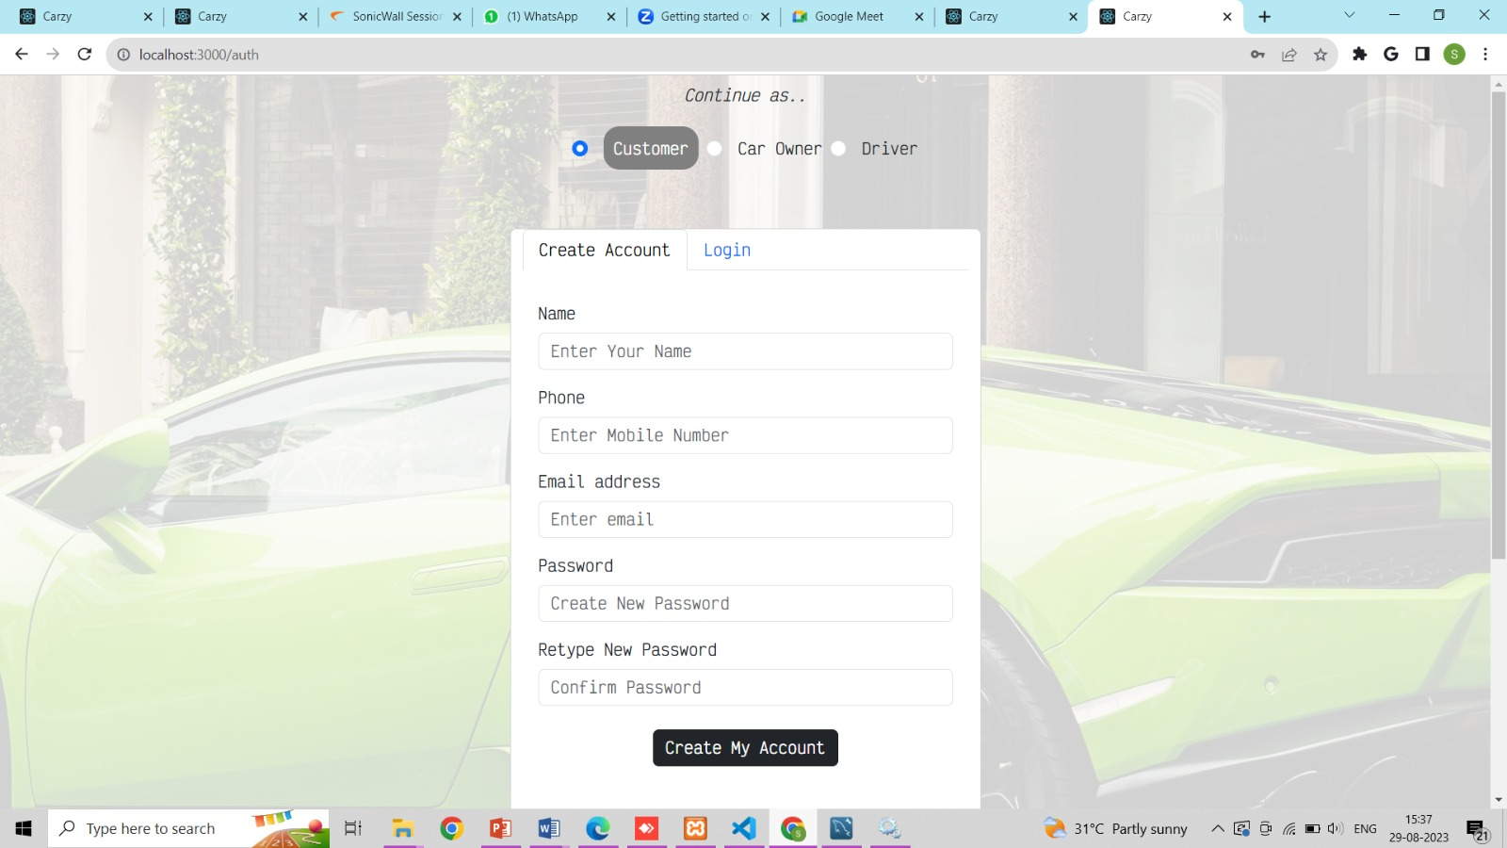

Slide 16
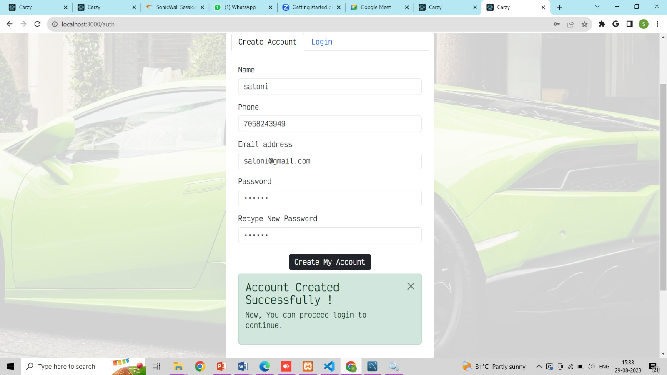

Slide 17
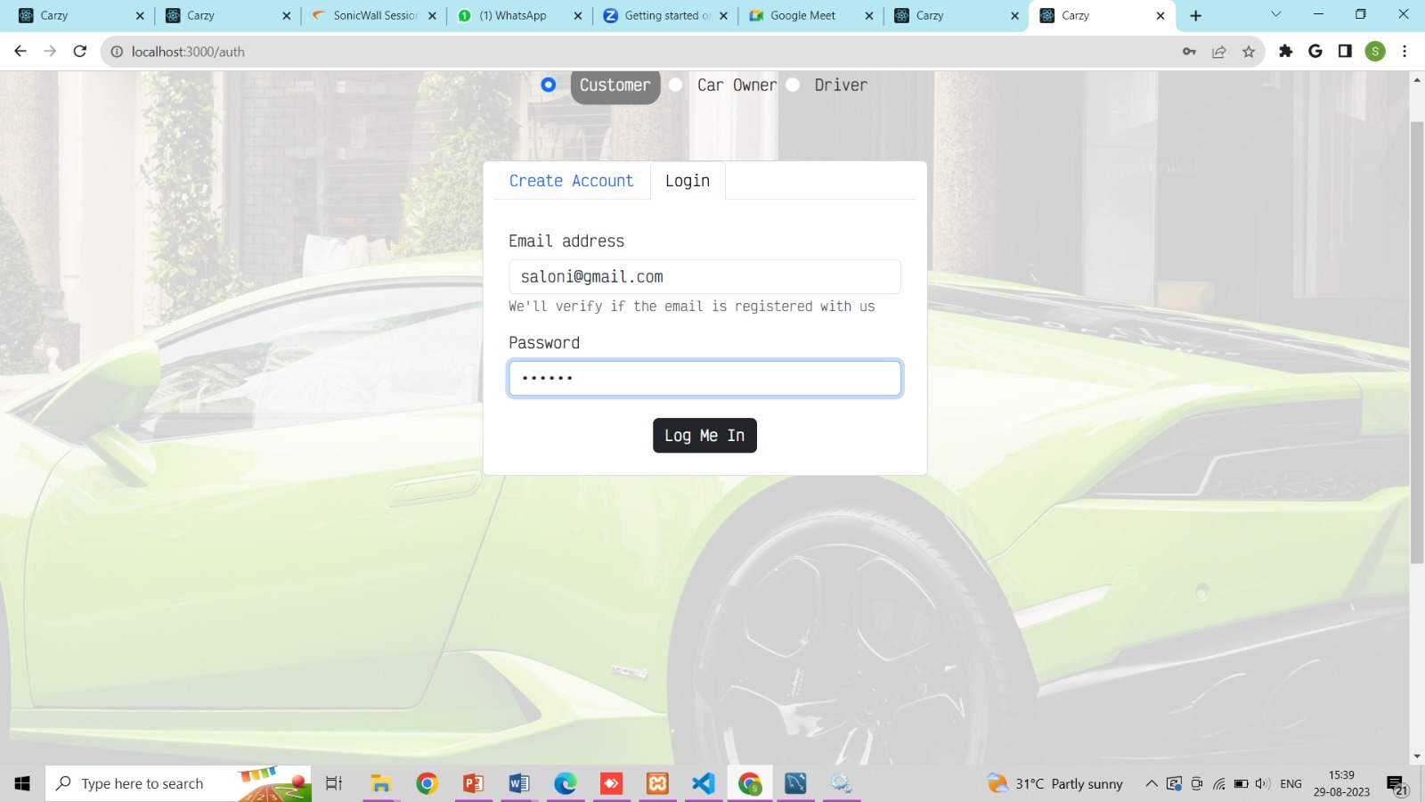

Slide 18
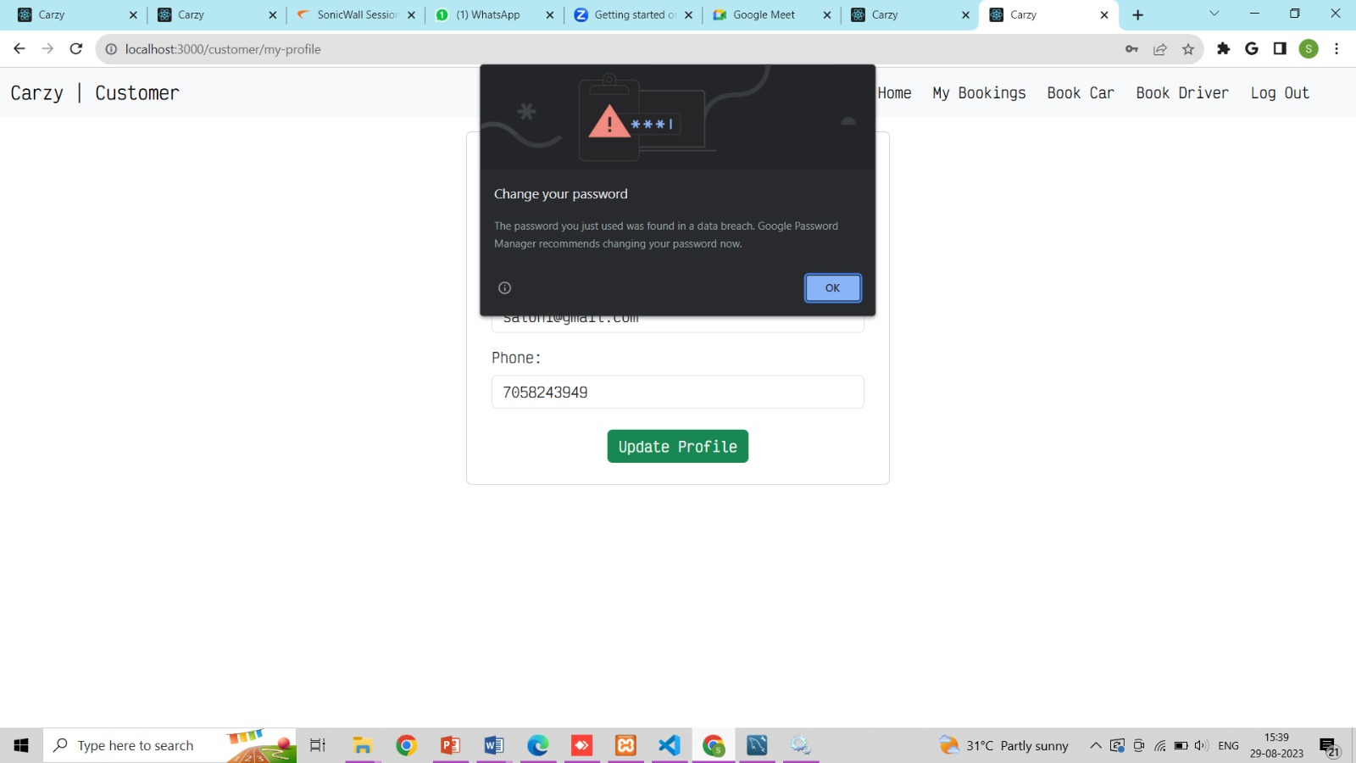

Slide 19
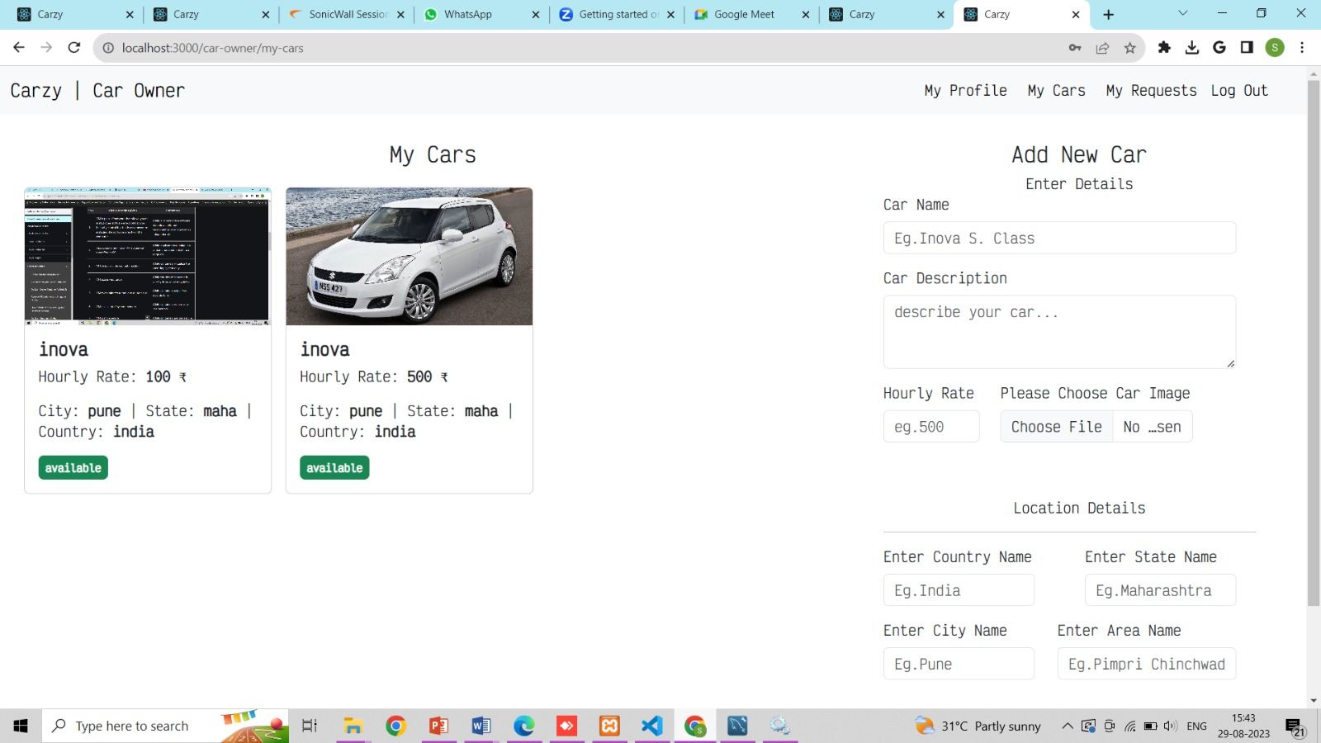

Slide 20
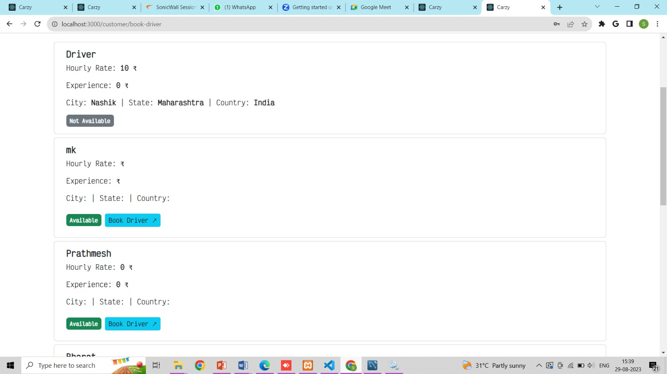

Slide 21
THANK YOU…!

