Slide 1

Payroll Management System
Submitted By:- Submitted to:-
Saloni Jaiswal Dr. Shaligram Prajapat Sir
IT-2k19-50
M.Tech (IT)

Slide 2
Payroll Management System Project Documentation Report
Payroll Management System Project Report - deals with the financial components of an employee’s salary, allowances, deductions, gross pay, net pay, and pay-slip generation for a given time. The simplicity with which the Payroll Management System Project can be implemented as one of its most appealing features with its complete proposal report on documentation (doc).
Payroll systems take care of everything related to paying employees and filing employment taxes. They’re used to keep track of hours worked, calculate earnings, withhold taxes and other deductions, print and deliver checks, and pay government employment taxes.

Slide 3
List of Modules for Payroll Management System proposal
The payroll system modules manages an employee’s financial records, such as salary, bonuses, deductions, benefits, and costs, among other things. Payroll administration is one of the most important tasks that any organization undertakes, but it is also one of the most complicated and time-consuming.
1.Employee Information Management: This module provides a consolidated database for application tracking, employee demographics, compensation and benefit options, time tracking, and more. It’s also the central location for all of your personnel data, including the most up-to-date statistics on your organization’s hiring and retention patterns.
2.Report Monitoring: Its role is to accurately calculate compensation including overtime. Withholding the appropriate amount of payroll taxes from each applicable payroll tax’s wages.

Slide 4
3. Generate Performance Reports: It’s useful for keeping track and securing the leave information of the employees. This can also can assist in problem solving and avoid conflicts. Generating these reports will assist the admin in updating details regarding important payroll information. 4. Salary Monitoring: This module will help the admin to oversee the creation and distribution of paychecks or electronic bank transfers. It will also resolve the payroll inconsistencies to bring the payroll accounts into balance. 5. Deduction Management: The deduction management will help the admin in managing all the deductions from the salary of their Employees. These deduction were done payment for the employees’ benefits and taxes.

Slide 5
6. Generates Payroll Reports: This module will automatically secure the system’s payroll transactions for monitoring all of their activities.

Slide 6
Important Diagrams for Payroll Management System Project Proposal and Modules
Here are the essential Diagrams and Modules for Employee Management System Project Proposal
Payroll Management System ER Diagram
This Payroll management system database design was made based on managing payroll requirements. The system can encode employees’ information. Payroll admin can have access to the employees’ status and information in terms of working performances and salaries. They can handle the data needed in managing payrolls as well as the ranges of labors made by the employees. The features included in the system ER diagram were the security and monitoring of the employees’ work and leave records, job information and status. These features were also listed and recorded in reports that served as the history of transactions done in the system.

Slide 7
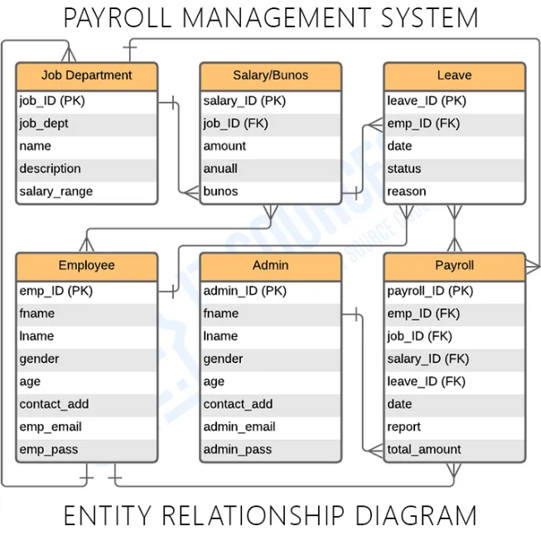
j

Slide 8
2. Payroll Management System Use Case Diagram This discusses the meaning of the Payroll Management System project UML as well as its use case diagram using include and extend. A use case diagram is a visual representation of how a user might interact with a program. A use case diagram depicts the system’s numerous use cases and different sorts of users. The circles or ellipses are used to depict the use cases. By creating the use case of the Payroll Management System, you must determine first the possible features to identify the flow of the system. After that you can now create the blueprint or core of the system function.

Slide 9
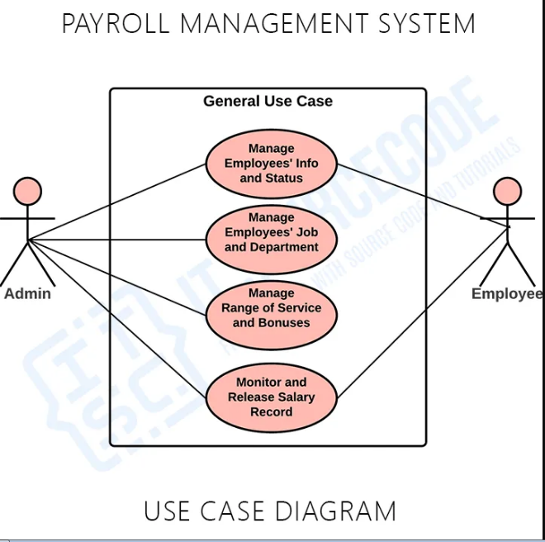

Slide 10
3.Payroll Management System DFD Level 0, 1 and 2 The Data Flow Diagram (DFD) represents the flow of data and the transformations in Payroll management system. These transformations occurs as data enters and exits a system. DFD let’s you know the ideas on where does the data inputs goes and inputs comes within the Payroll management system. Considering the the dataflow levels, you can determine well the role of breaking the processes into more specific manner.

Slide 11
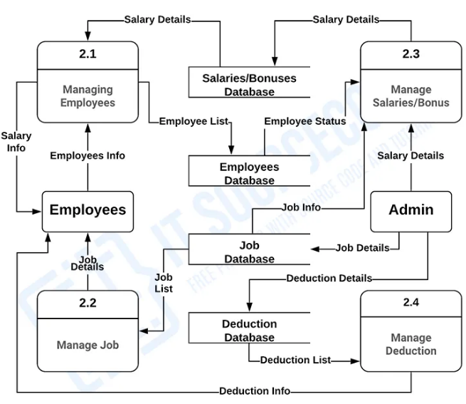

Slide 12
Payroll Management System Project In Python With Source Code
The Payroll Management System Project In Python was developed using python programming, this project was design using Graphical User Interface (GUI), this project is easy to manipulate and understand by the users, also this system is good for the beginners or the students who wants to learn python programming.
A Payroll Management System Project In Python Code is a system used by companies to help manage the computation, disbursement, and reporting of employees’ salaries efficiently and accurately. A Payroll Management software helps streamline and centralizes the salary payments of your organization. The software calculates salaries, tax deductions, incentives and bonuses etc by itself, sorts out the issues related to payments and deductions and records it digitally into its database.

