Slide 2
A PROJECT ON “ATM BANKING SYSTEM” DEPARTMENT OF COMPUTER SCIENCE
SUBMITTED BY
1.Saloni Bajrang Kamble

Slide 3
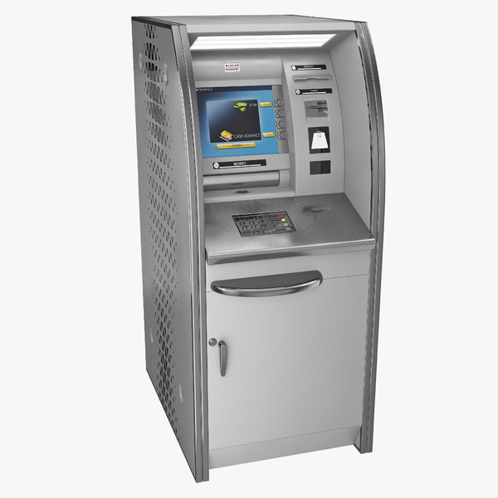
A PRESENTATION ON ATM BANKING SYSTEM

Slide 4
CONTENTS
ABSTRACT
INTRODUCTION
OBJECTIVE
FEATURES
FLOW CHART
ALGORITHM
SYSTEM REQUIRNMENT
ADVANTAGES
LIMITATIONS
CONCLUSION
FUTURE SCOPE
REFERENCE

Slide 5
ABSTRACT
In the growing technological world, people want their work to be very simple in order to save their time. As we know some new technology is becoming popular in banking sector, which is referred as ATMs. It makes the work of people as well as the banking sectors to be easy. ATMs help in providing money to the people nearer to the living area by saving their time so that it becoming very popular.
ATM BANKING SYSTEM:
The ATM BANKING SYSTEM is the project which is used to access their bank accounts in order to make cash withdrawals. Whenever the user need to make cash withdrawals they can enter their PIN number (personal identification number) and it will display the amount to be withdrawn in the form of 500’s, 1000’s and 2000’s. once their withdrawn was successful, the amount will be debited in their account.

Slide 6
INTRODUCTION
ATM (Automated Teller Machine) or a cash point is a computerized machine.
ATMs plays a vital role in facilitating the banking services to banks as well as customers.
ATM is the back bone of retail banking sector.
Automated Teller Machine is a computerized that provides the customers of banks the facility of accessing their accounts for dispensing cash and to carry out other financial transactions without the need of actually visiting a bank branch.
Services available through an ATM includes :
Make deposits of cash and checks.
Withdraw cash.
Transfer money between accounts.
Obtain account balance.

Slide 7
OBJECTIVE
Our main objective is to speed up the transactions done by customers. No manual transactions needed generally.
The second objective is to save the time which is very important now a days.
It will include other objectives such as :
To render accurate services to customer.
The reduction of fraudulent activities.
To achieve speedy processing of customer data.
To reduce error processing, the guarantee of increase security.

Slide 8
FEATURES
Transfer funds between linked bank accounts.
Receive account balance.
Prints recent transaction list.
Change your pin.
Deposit your cash.
Prepaid mobile recharge.
Bill payments.
Cash withdrawal

Slide 9
FLOW CHART
START
INSERT A CREDIT/DEBIT CARD
IS CARD VALID
YES
NO
INSERT PIN CODE
HOLD CARD
EXIT
CHOOSE ACTION
CHOOSE THE AMOUNT OF MONEY TO WITHDRAW
SHOW ACCOUNT BALANCE
DEPOSITE AMOUNT
EXIT
END
SUFFICIRNT FUNDS ON ACCOUNT
YES
RELEASE MONEY

Slide 10
ALGORITHM
Start
Insert credit / Debit card
Is card valid ?
Insert pin code
Hold the card
Choose action
a) Withdraw money
b) Account balance
c) Deposit amount
d) Exit
Choose the amount of money to withdraw
Show account balance
Deposit amount
Sufficient fund in the account
Release money
End

Slide 11
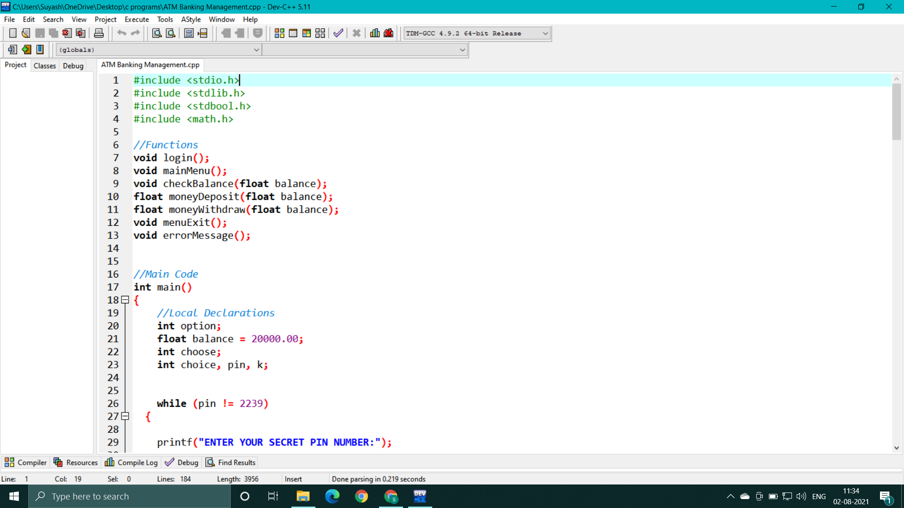
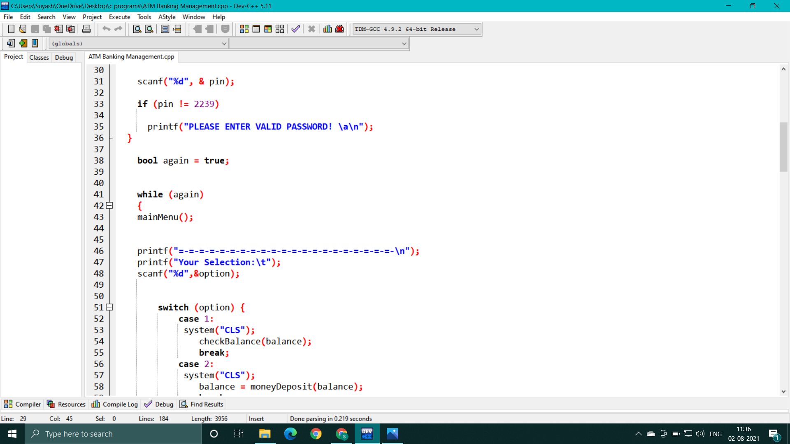
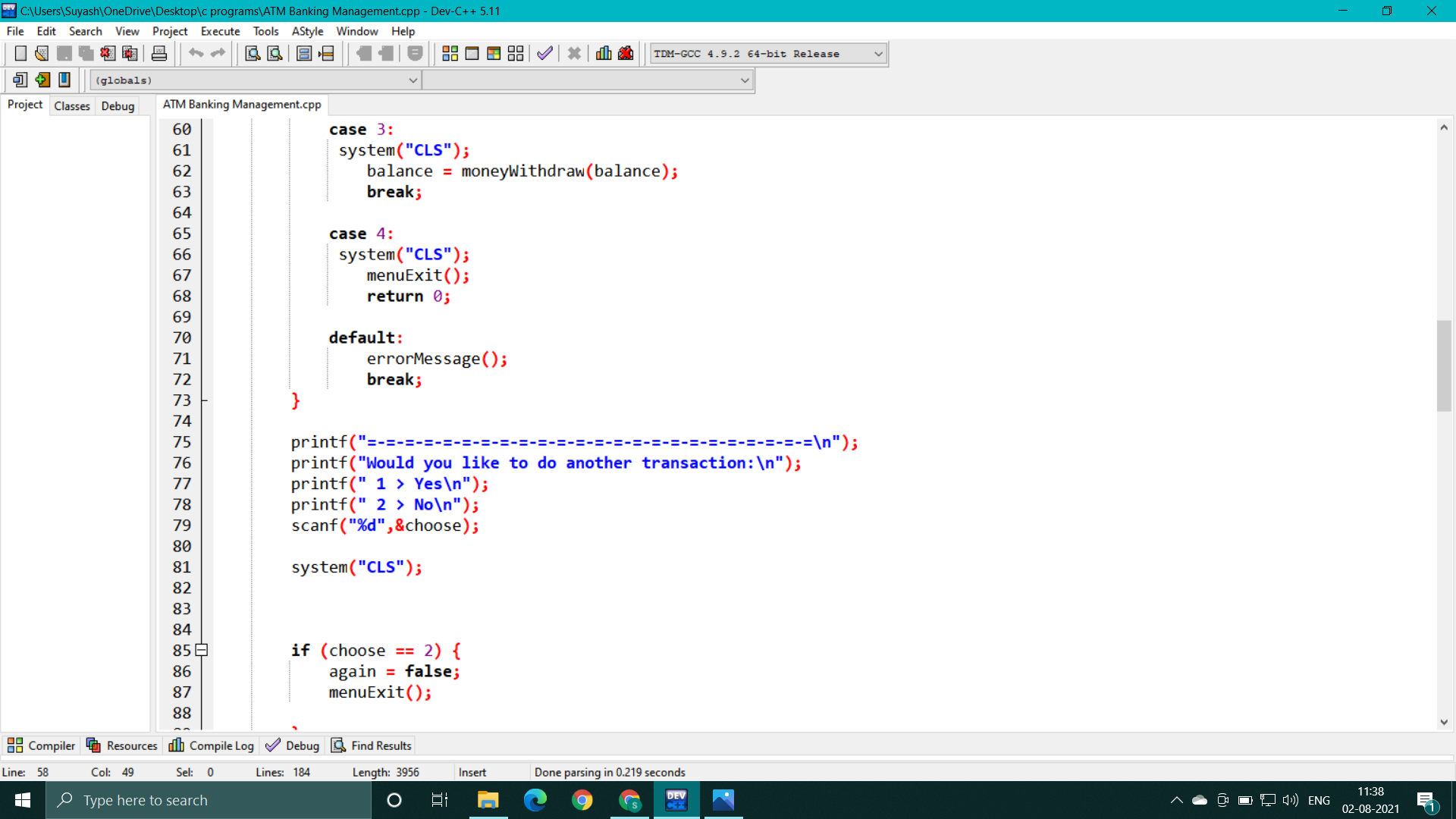
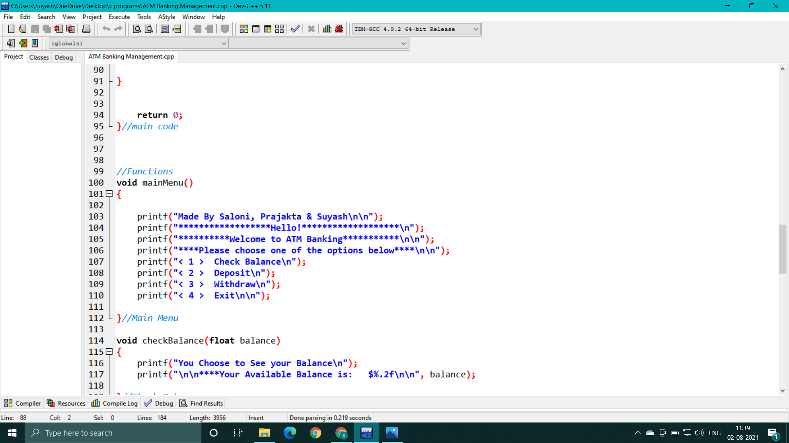
Code:-

Slide 12
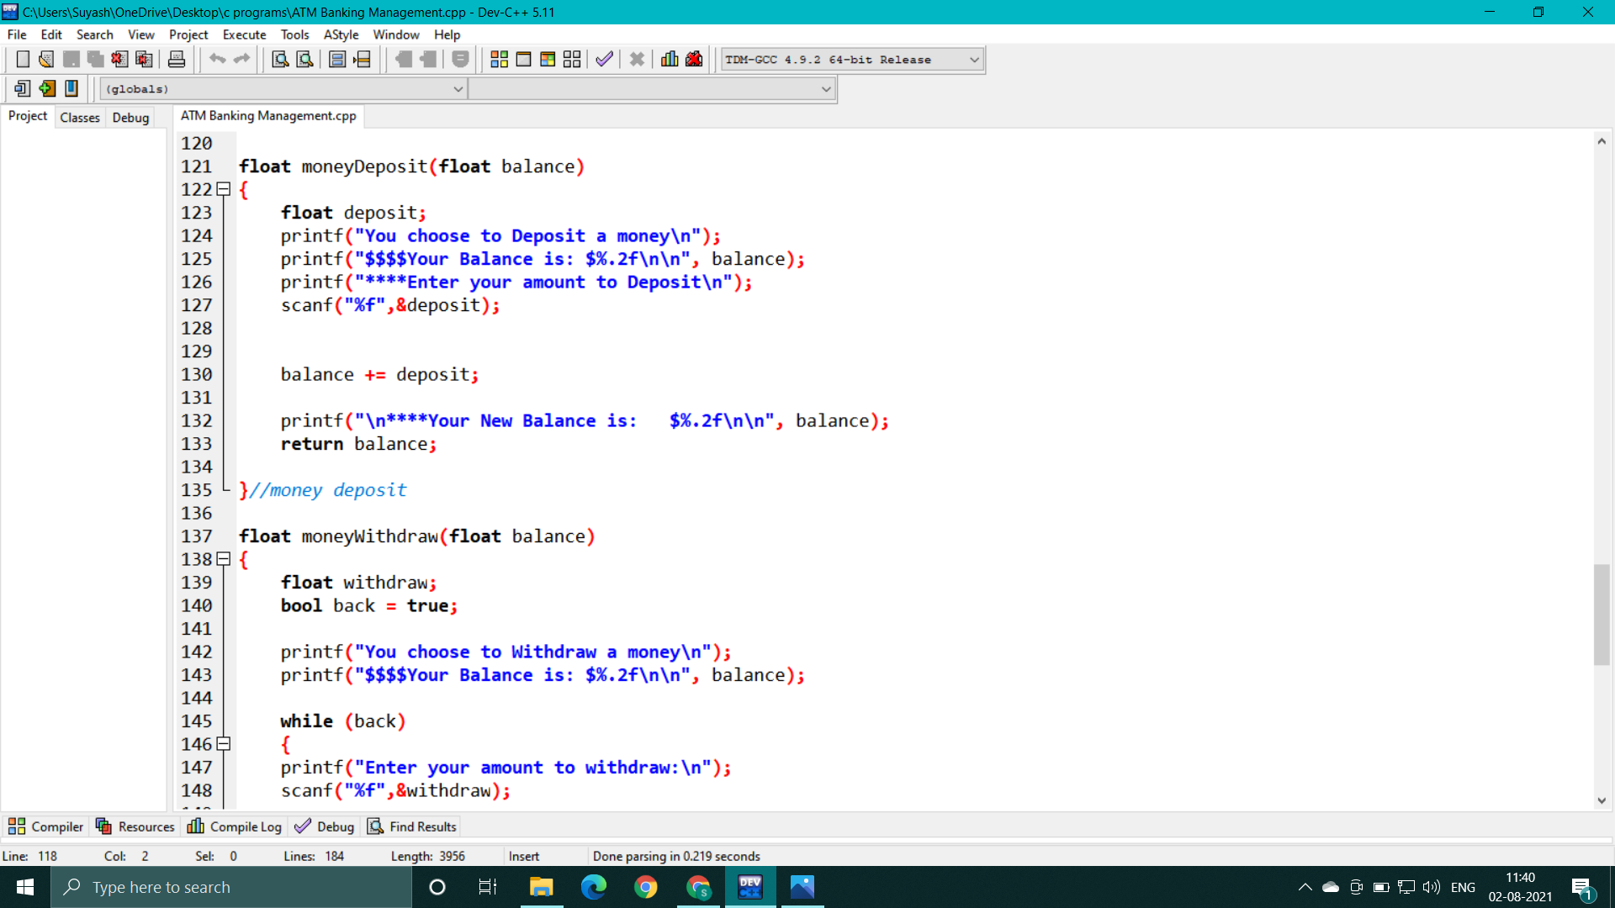
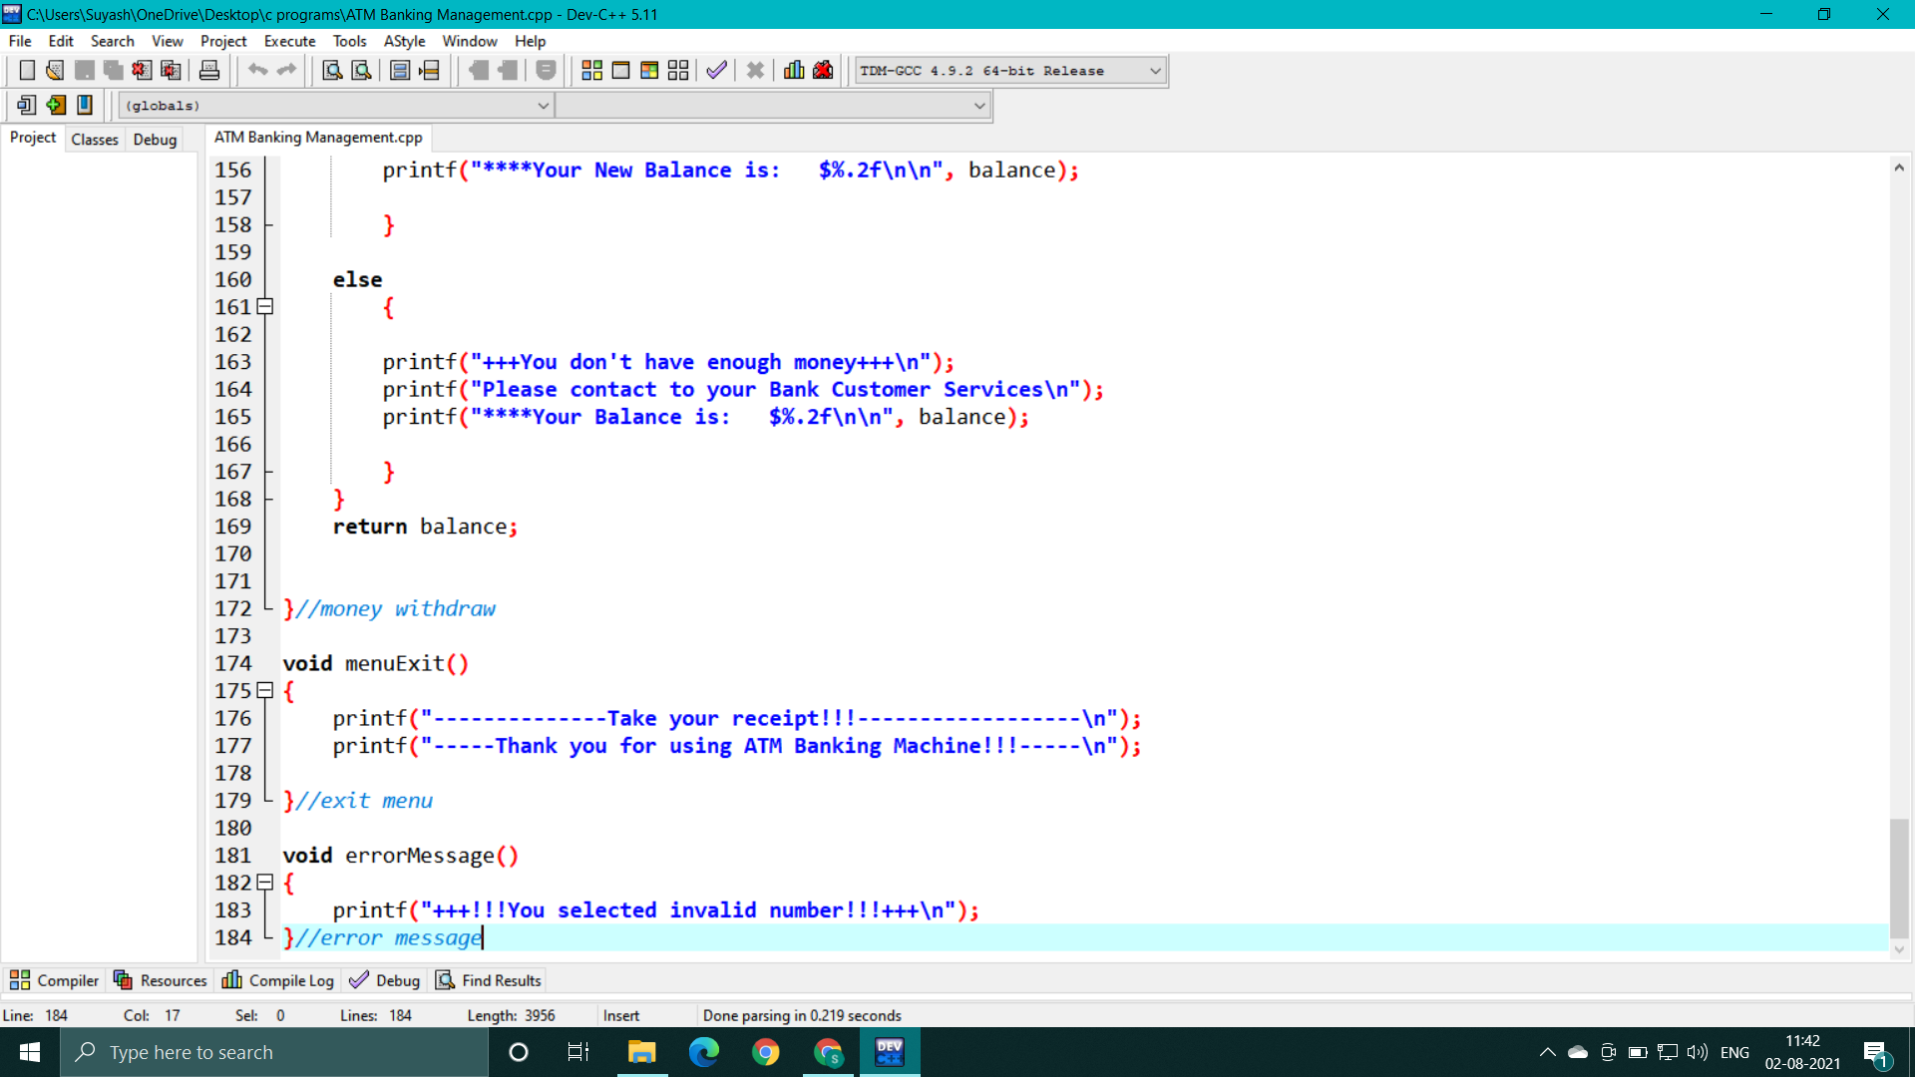

Slide 13
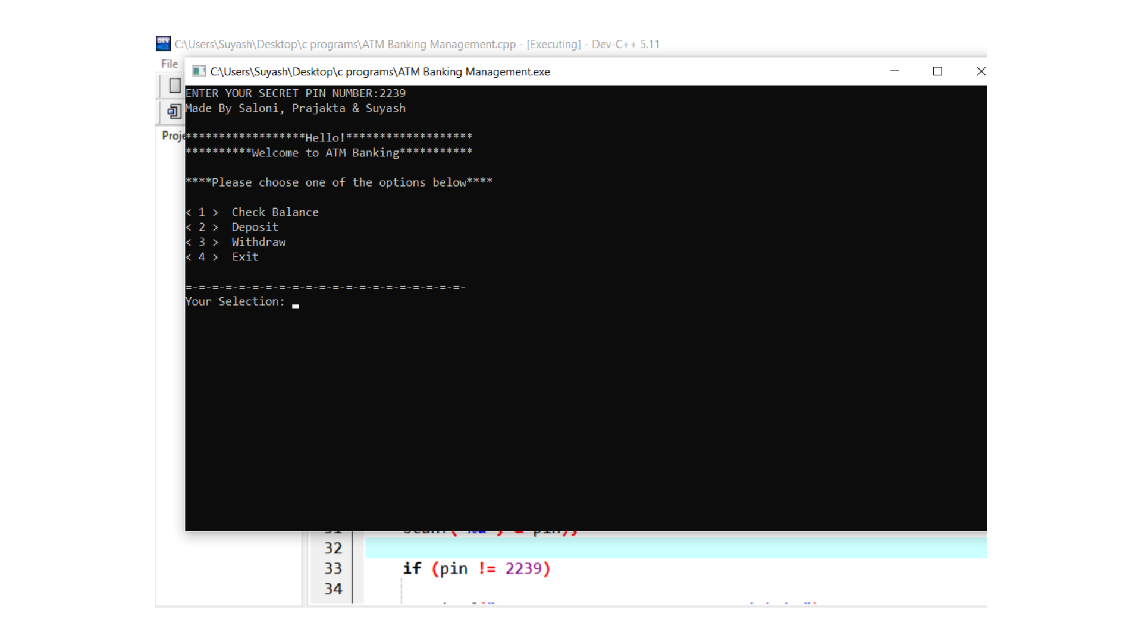
OUTPUT

Slide 14
SYSTEM REQUIREMENTS
Hardware Requirement :
Ram – 4 GB Ram
Processor – intel core i5
Software Requirement :
Operating system – Windows 10
Internet connection
Dev c++

Slide 15
ADVANTAGES
24 Hours Availability : Service is available 24 hours a day and seven days a week.
Convenient Place : It can be placed in convenient off branch location like shops,. factories, offices.
Privacy of Operation : It ensures privacy of operation through self-service.
No Need of RBI’s Permission : Banks need not obtain RBI’s permission for installing ATMs in their branches /extension counters.
No Time Limit for Transaction : One can do the transaction while going to office or while returning home or while going to shopping or on holidays the choice of time is unlimited

Slide 16
LIMITATIONS
Limitation on withdrawals : Cash withdrawals for large amount are not permitted. It is restricted by the amount fixed for the card.
Restriction on cash dispensations : Cash dispensations are generally restricted to certain denominations of currency. As such, withdrawals are to be made only in certain multiples.
Limited functioning : The automated teller machine perform only the limited functions. For other banking activities like credit limits, locker facilities, etc. the customer has to approach the bank in person or by other means.

Slide 17
conclusion
As the banking sector computerize day to day, and ATM have became a part of modern banking system.
The banks in developing country adopt ATMs to improve their own internal process and also for increase facilities and services of their customers.
Now customers become aware about this machine.
The growth of ATM rapidly high at the world wide level also in India.
This technology is simple, safe and secure and people feel satisfaction to use this.

Slide 18
FUTURE SCOPE
Using an ATM, customers can access their bank deposit or credit accounts in order to make a variety of financial transaction.
Most notably cash withdrawals and balance checking, as well as transferring credit to and form mobile phones.
ATMs can also be used to withdraw cash in a foreign country.

Slide 19
REFERENCE
www.google.com
www.codewithc.com
www.pptsearch.net
www.slidescarnival.com

Slide 20
.
THANK YOU

