Slide 1
SECURE DATA HIDING IN IMAGES USING STEGANOGRAPHY
CAPSTONE PROJECT
Presented By:
Student Name : Saloni Mishra
College Name & Department : ITM college of management , BCA department

Slide 2
OUTLINE
Problem Statement
Technology used
Wow factor
End users
Result
Conclusion
Git-hub Link
Future scope

Slide 3
Problem Statement
IMAGE BASED DATA HIDING
DATA ENCRYPTION USING PASSWORD
DATA DECRYPTION AND UNHIDING FROM THE IMAGE USING PASSWORD

Slide 4
Technology used
Libraries:
Opencv library
Python OS library
Python string library
Platform:
Windows 11/10
x86_64 based processor(intel,amd)

Slide 5
Wow factors
User friendly: its easy to use for any user.
High capacity: it can hide so much data.
Invisible security: data hidden can’t be seen with naked eye.
Double layer of security: it uses both data hiding in image and password so its quite secure.

Slide 6
End users
Common individuals who want to hide their data and share over internet or any sensitive medium.
New developers or programmers can take it as basis for their project.

Slide 7
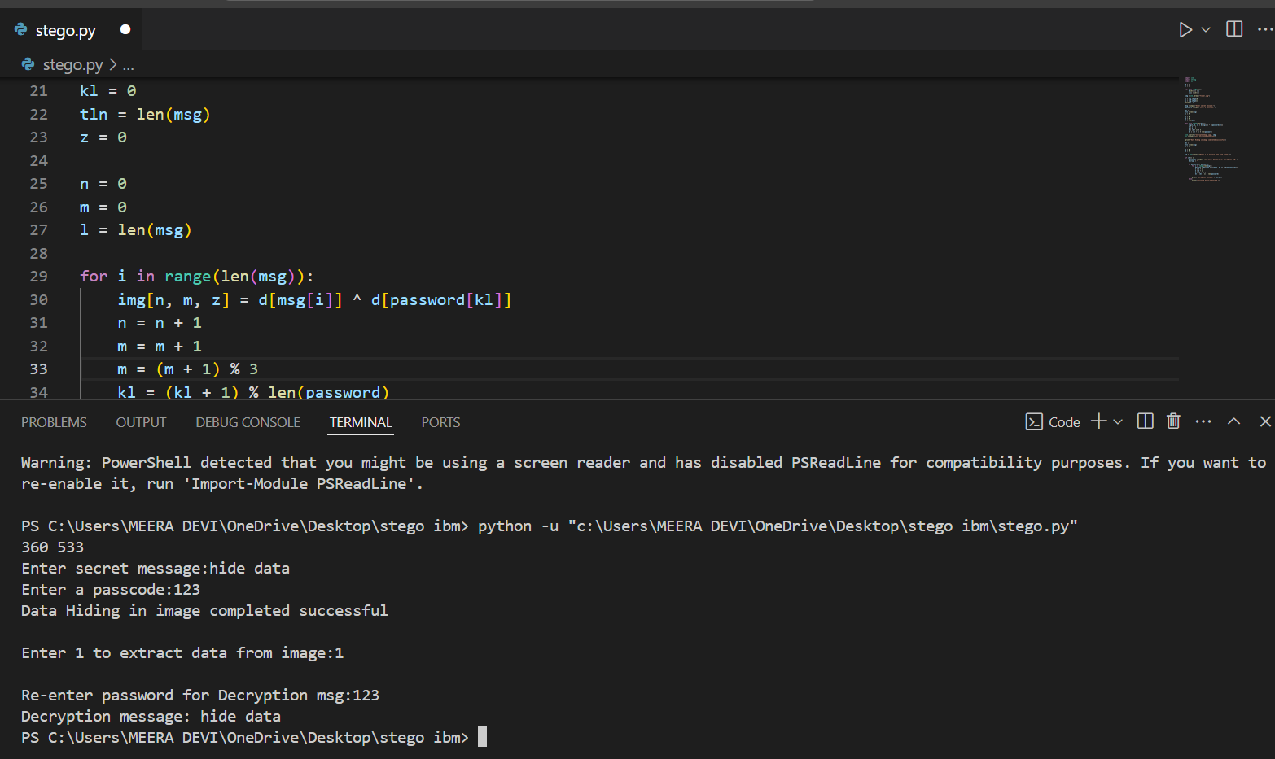
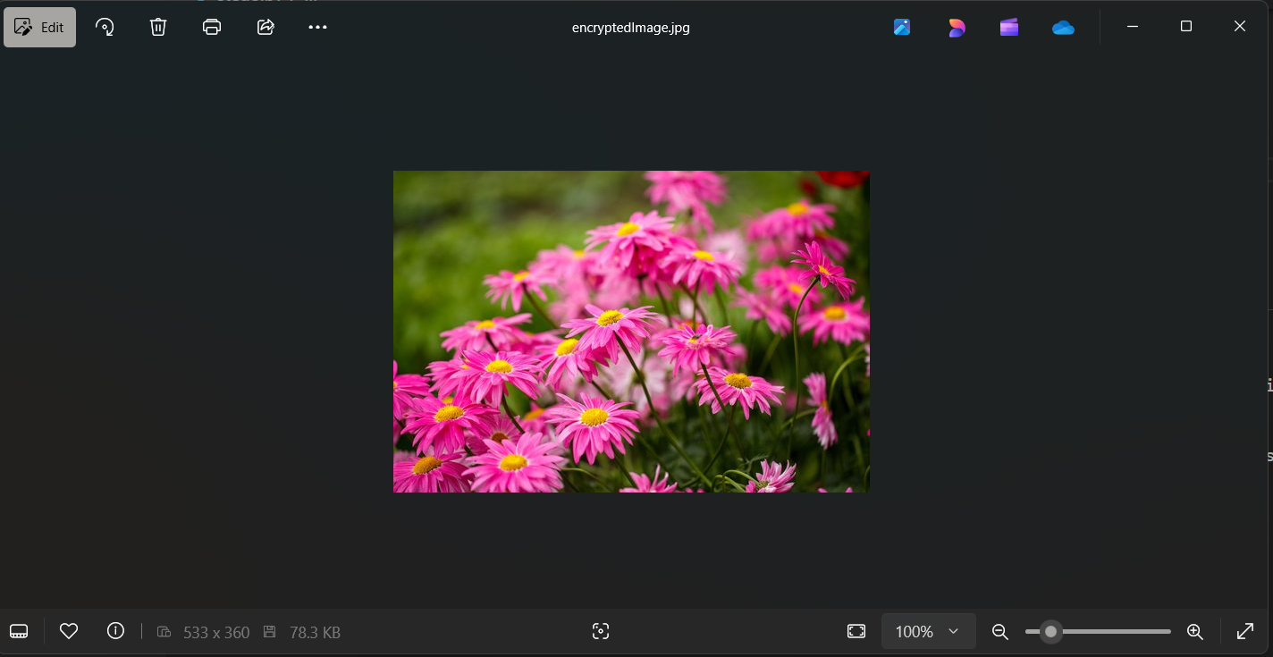
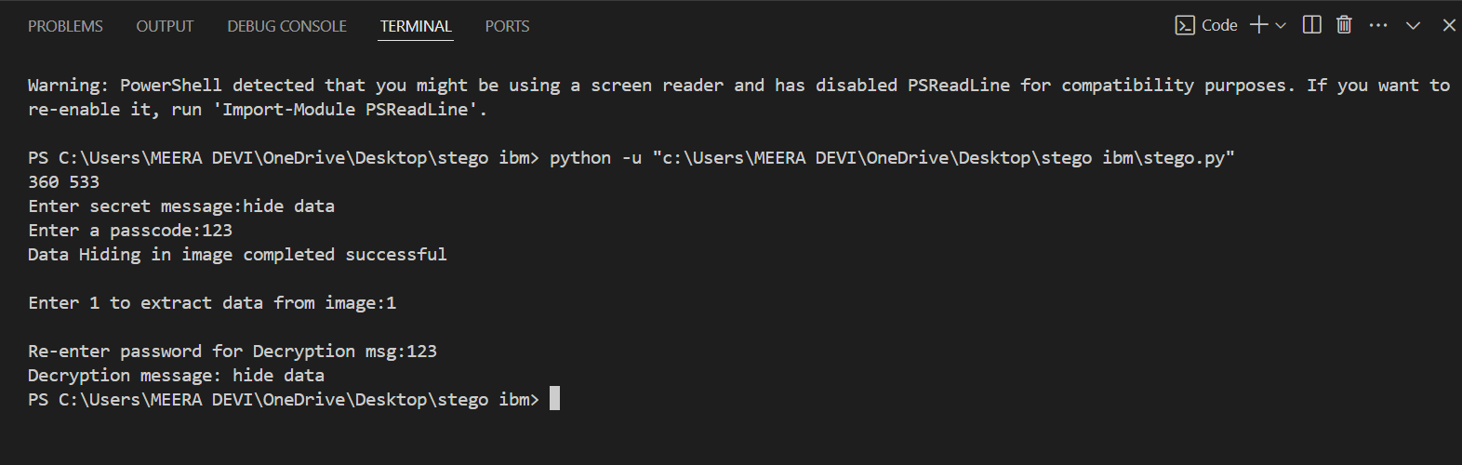
Results

Slide 8
Conclusion
The project provides a very robust and user friendly method for hiding and encrypting it with password.
It combines both stenography and password encryption for unparalleled security.
It provide stealthy way of communication.

Slide 9
GitHub Link
https://github.com/salonimishra8187/Stenography.git

Slide 10
Future scope(optional)
Advanced encryption algorithm : integrating stronger encryption algorithm for stronger security.
Multi formate data hiding: hiding the data in different type of files like video files, image files, pdf etc.
Cross platform support: making it work on different platform like macOS, Android, Linux.

Slide 11
THANK YOU

