Slide 1
IT-562 Recommendation Engine and Applications
Welcome To Pandora’s JukeBox!
Presented to you by :
Saprem Shah (201401107)
Saloni Mundra (201501016)
Shubham Annadate (201501020)
Kruti Sheth (201501180)
Aashka Kapadia (201501187)

Slide 2
Features and USP of our model
Pandora’s Jukebox is a personalized recommendation engine based on multi armed bandit with content based filtering.
Recommendation is mainly based on genre and artist.
Pulls out songs based on your past history.
Let’s you explore different music.
Takes into account the cold start problem.
Takes into consideration the current mood of the user upto certain extent.

Slide 3
Dataset
Genre
Track-ID
Artist
Title
Tempo
Loudness
Time Signature
Key
Mode
Duration
Avg-timbre (1-12)
Var-timbre (1-12)
Source: Subset of Million Song Dataset(~50K entries)

Slide 4
Data Preprocessing
Two separate text file where converted into csv files and then were concatenated on basis on common field track-id.
Artist which had less than 10 songs were filtered out.
Songs which had duration less than a minute were filtered out.

Slide 5
Decision Parameters
Genres (Main Arms)
Artist (Sub Arms)
Current user preference for each genre
History of ignored recommended items

Slide 6
Basic notations
a_{i} : i^{th} genre arm
b_{j} : j^{th} artist sub arm
E(a_{i_t’}) : estimated value of i^{th} genre arm after t’ pulls
𝛂 : weight for genre arm
𝜷 : weight for artist sub arm
R : Reward
𝝴 : probability of exploration
t : round of recommendation
A : user action
t’ : t^{th} pull of arm

Slide 7


Model
𝝴_{t} =
E(a_{i_t’}) =𝛂.E(a_{i_t’-1}) +(1-𝛂).R(A)
E(b_{j_t’}) =𝜷 .E(b_{j_t’-1}) +(1-𝜷 ).R(A)
a_{i}=argmax(E(a_{i_t’}))
b_{j}=argmax(E(b_{j_t’}))
cos(S_{i}.S_{j})=

Slide 8
Modified ε - greedy policy
Initial Exploratory phase : ε =
Normal phase (After converging) : ε = 0.3
Why different ε ?

Slide 9
Actions
Played
Stopped
Liked
Disliked
Ignored

Slide 10
Reward Policy
For artist sub-arms:
R(Played)=0.5
R(Played and Liked)=1
R(Played and Disliked)=-1
R(Stopped)=0.25
R(Stopped and Liked)=0.75
R(Stopped and Disliked)=-1
R(Ignore)=0
where R is the reward function
New estimated value for artist subarm is calculated according to the following formula:
E(b_{j_t’}) =𝜷 .E(b_{j_t’-1}) +(1-𝜷 ).R(A)
𝜷 = 0.6

Slide 11
Reward Policy
For genre arms:
R(A) = (Cumulative reward for the artist) / 3
New estimated value of genre arm is calculated according to the following formula:
E(a_{i_t’}) =𝛂.E(a_{i_t’-1}) +(1-𝛂).R(A)
𝛂 = 0.8
Why different weights for genre and artist?

Slide 12
Learning Algorithm
while input==y:
if exploratory:
ε = 1 / sqrt(t+1)
else:
ε = 0.3
x = rand(0,1)
rec_songs = []
if x > ε: // go greedy
top_genres = top3(E(a_{i}))
top_artist = arg_max(E(b_{i}(top_genres[0]))), arg_max(E(b_{i}(top_genres[1]))), arg_max(E(b_{i}(top_genres[2])))
rec_songs[0]=user_pref(top_artist[0]), rec_songs[1]=user_pref(top_artist[0]), rec_songs[2]=user_pref(rand(b_{i}(top_genre[0])))
rec_songs[3] = user_pref(top_artist[1]), rec_songs[4] = user_pref(rand(b_{i}(top_genre[1])))
rec_songs[5] = user_pref(top_artist[2])
recommend(rec_songs)

Slide 13
Learning Algorithm
else : // go exploratory
top_genres = top2(E(a_{i}))
top_artist = arg_max(E(b_{i}(top_genres[0]))), arg_max(E(b_{i}(top_genres[1])))
rec_songs[0] = user_pref(top_artist[0]), rec_songs[1] = user_pref(rand(b_{i}(top_genre[0])))
rec_songs[2] = user_pref(top_artist[1]), rec_songs[3] = user_pref(rand(b_{i}(top_genre[0]))
rec_songs[4] = user_pref(rand(a_{i})), rec_songs[5] = user_pref(rand(a_{i}))
recommend(rec_songs)
A=get_user_action()
calulate_rewards_artist(A)
update(b_{i})
calulate_rewards_genre()
update(a_{i})
update(user_pref)
input y to continue and n to stop.

Slide 14
Accuracy calculation ?
Accuracy calculations were not possible with our model because:
We had defined the actions that the user could do with the recommended songs.
It was not possible to get test data for the same.
Even if we relied on practical testing of the model (like requesting our friends to use the model) then the obtained accuracy results would not have been satisfactory given the inherent bias.

Slide 15
References
https://pdfs.semanticscholar.org/c659/b6eb0cb73aede002e27f4c2ba6804e1bb0ce.pdf
https://arxiv.org/pdf/1003.0146.pdf

Slide 16
DEMO

Slide 17
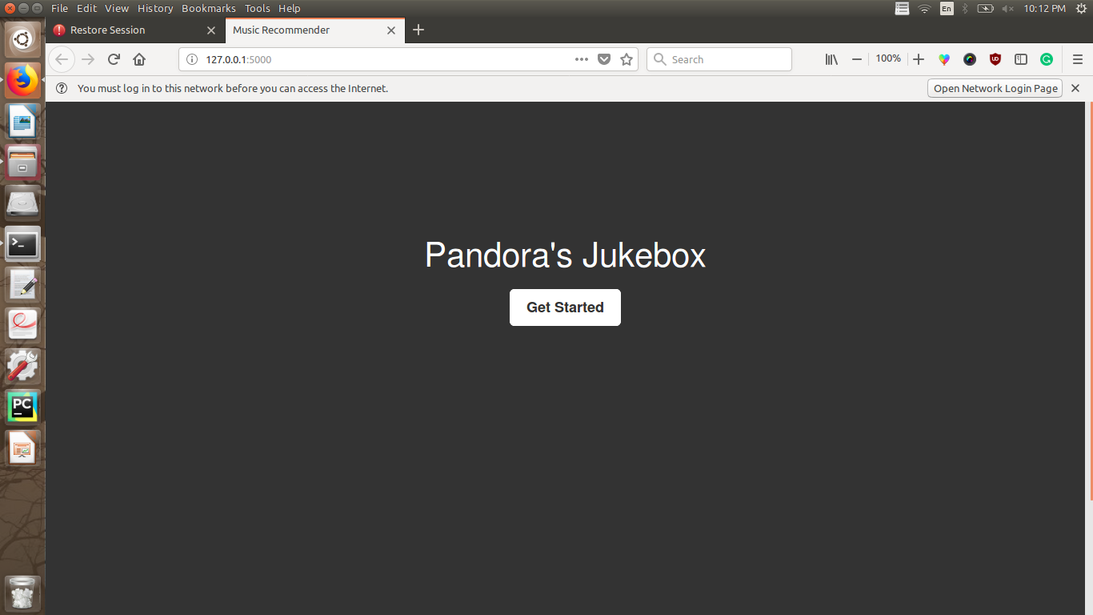

Slide 18
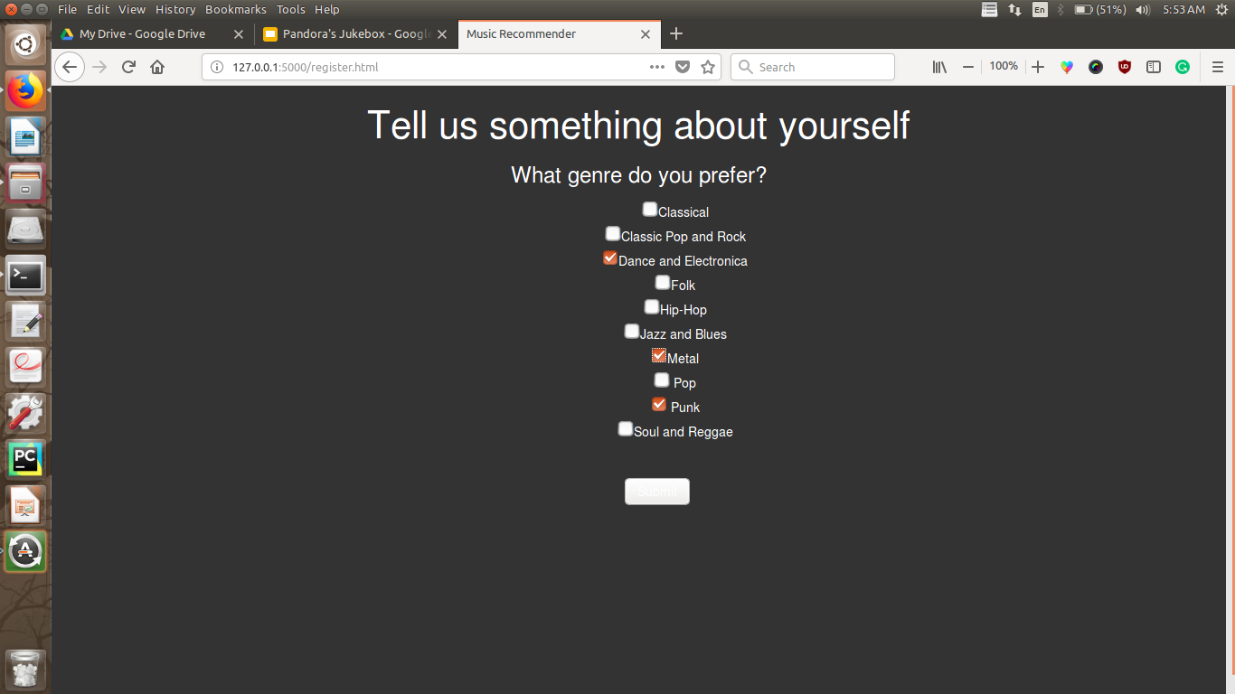

Slide 19
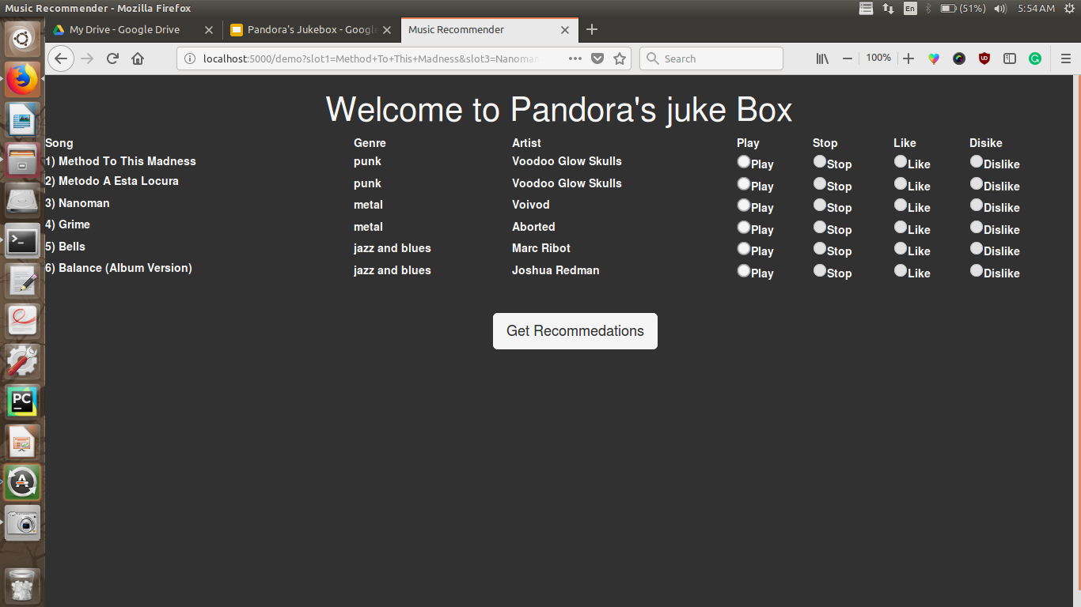

Slide 20
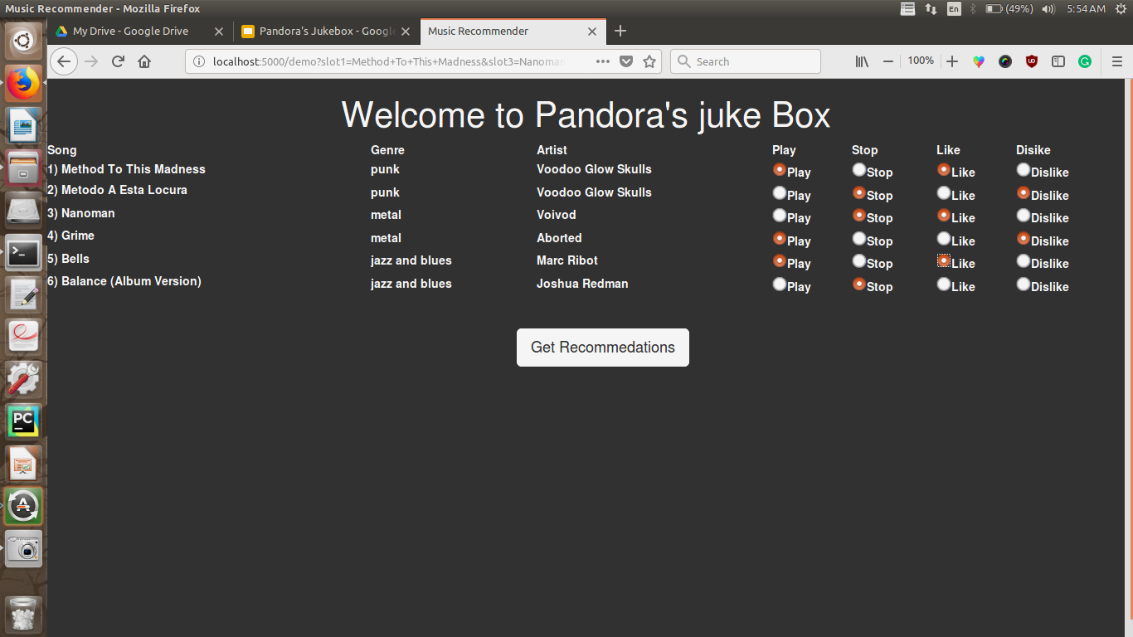
Users take actions on recommendations

Slide 21

New recommendations !

Slide 22
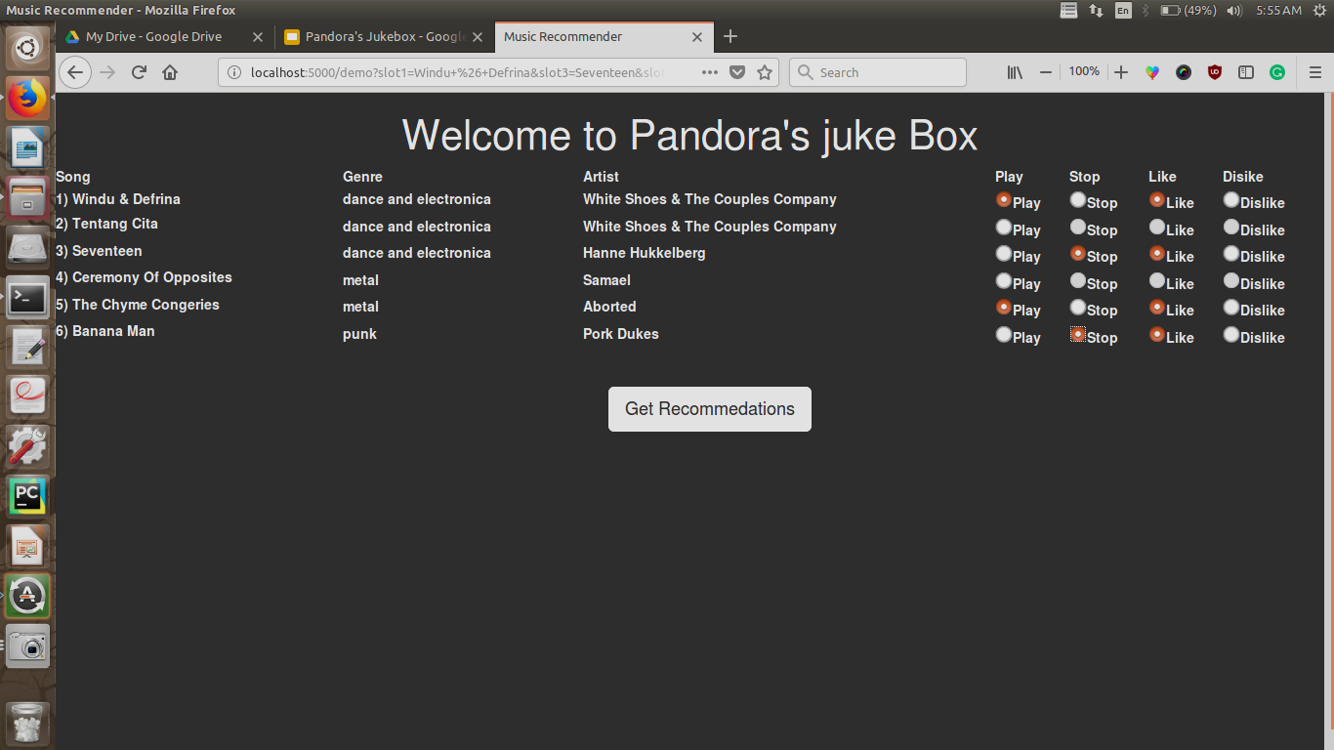
Actions on new recommendations

Slide 23
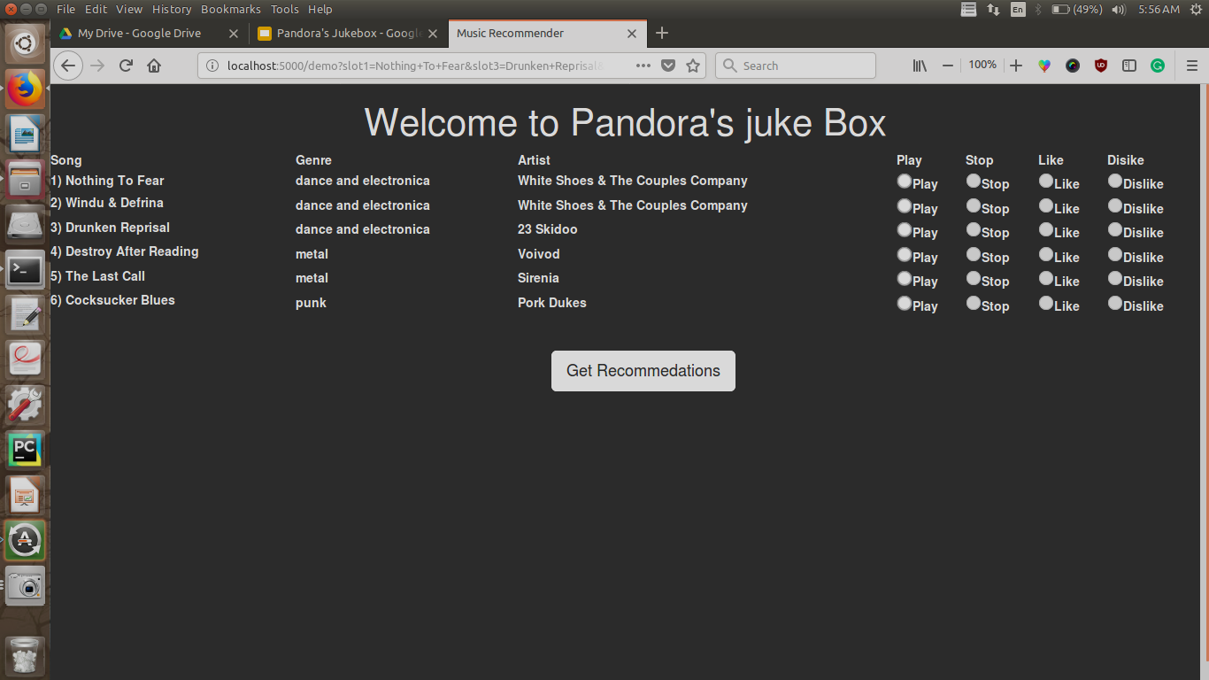
New Recommendations !

Slide 24
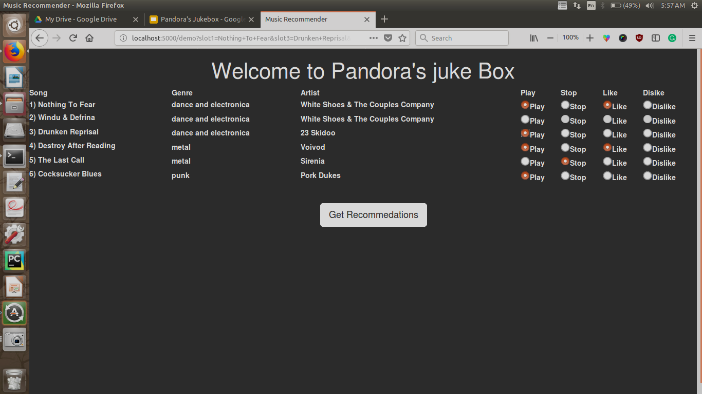
Actions on new recommendations

Slide 25
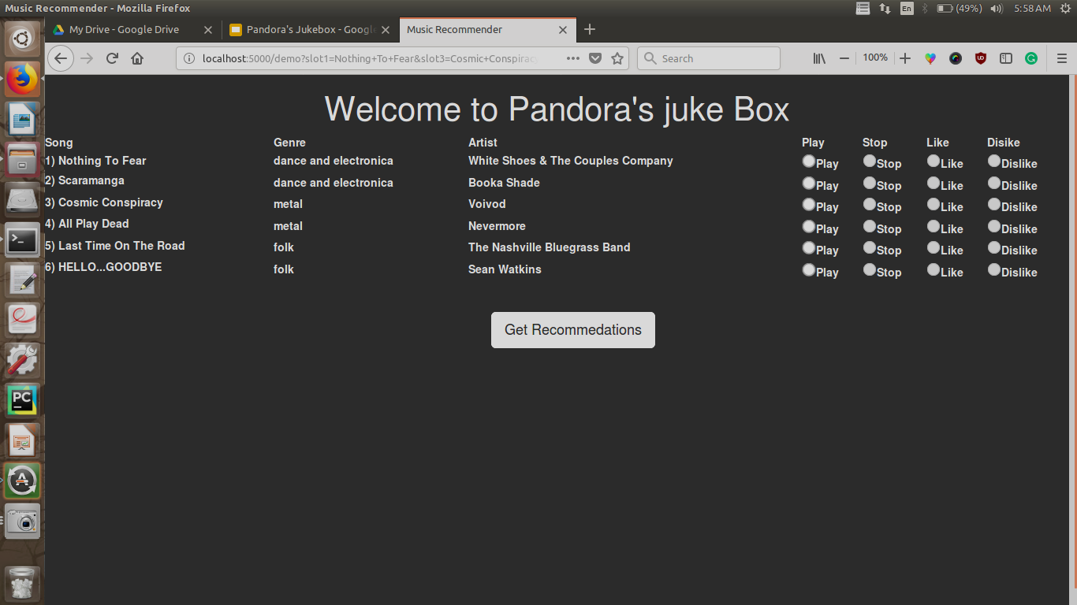
New Recommendations !

Slide 26
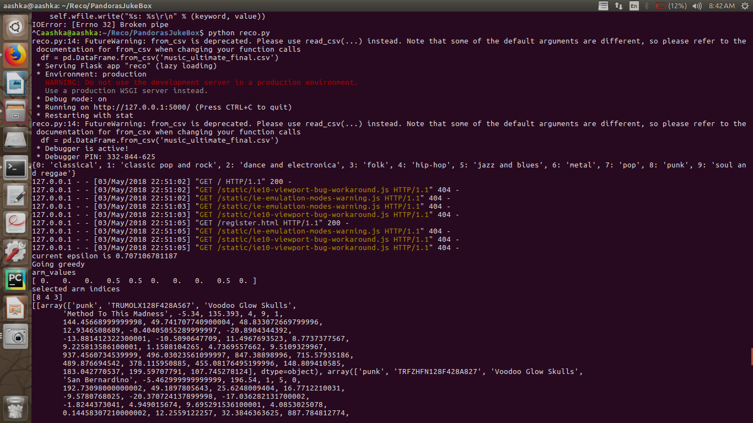
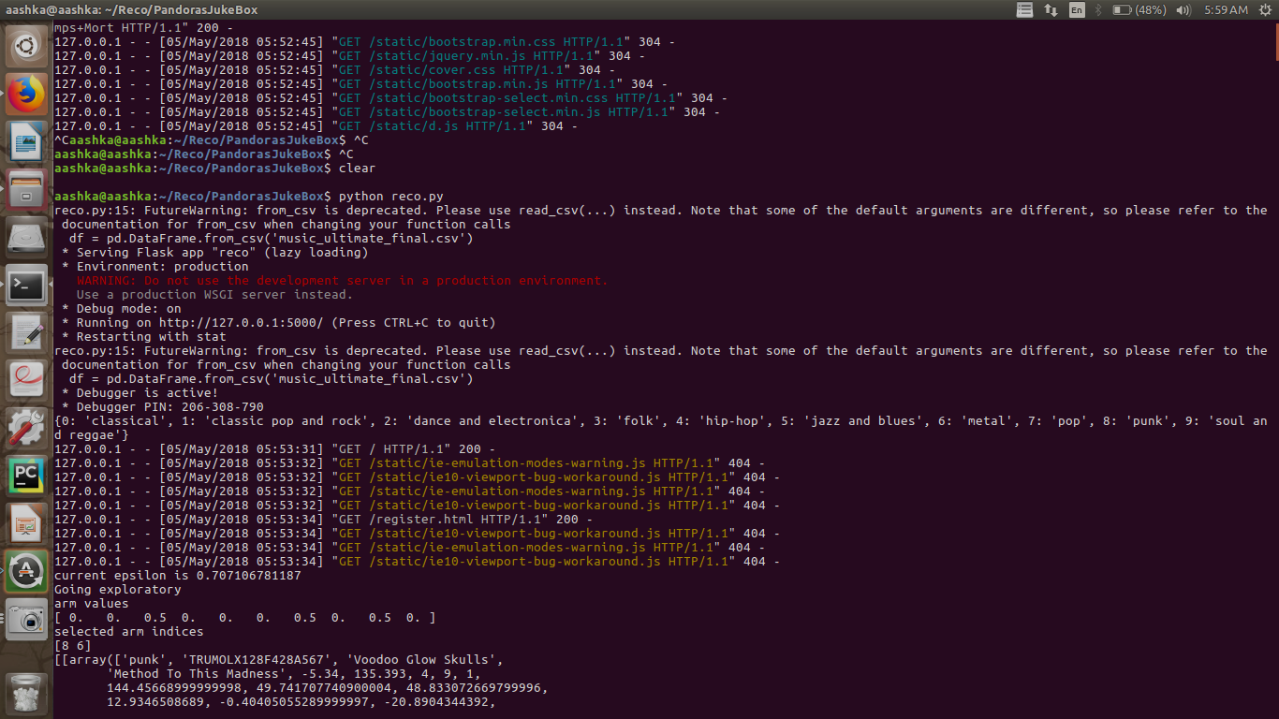
Backend calculations
Genres from which user selects.
In above demo user selected Dance and electronica, metal and punk. So estimated_value of that genre gets initialized with 0.5 as can be seen below.
In the first round(t = 1) epsilon is 1/sqrt(t+1)= 0.707
It went exploratory in the first round taking two maximum estimated_value arms that is 8[Punk] and 6[Metal] and one random genre_arm.

Slide 27
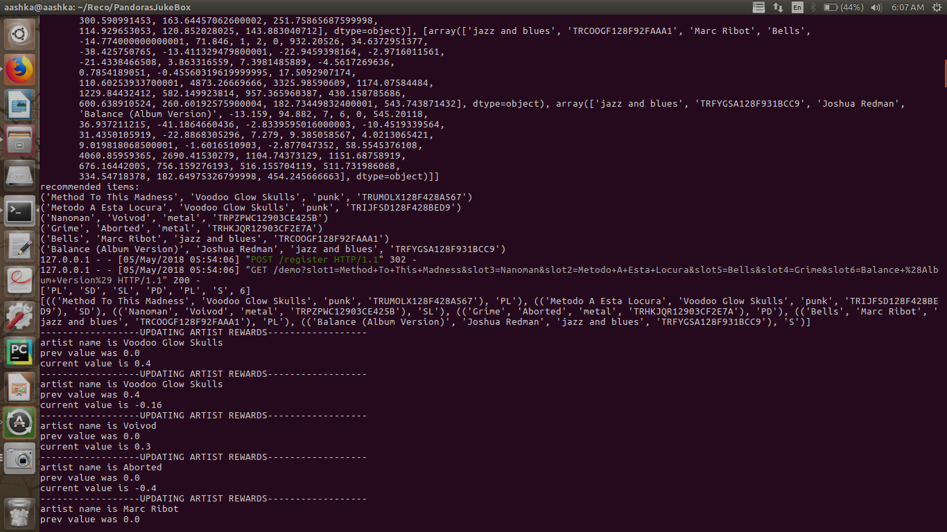
Thus below shows the recommendation result of the first exploratory phase with jazz and blues arm selected randomly.

Slide 28
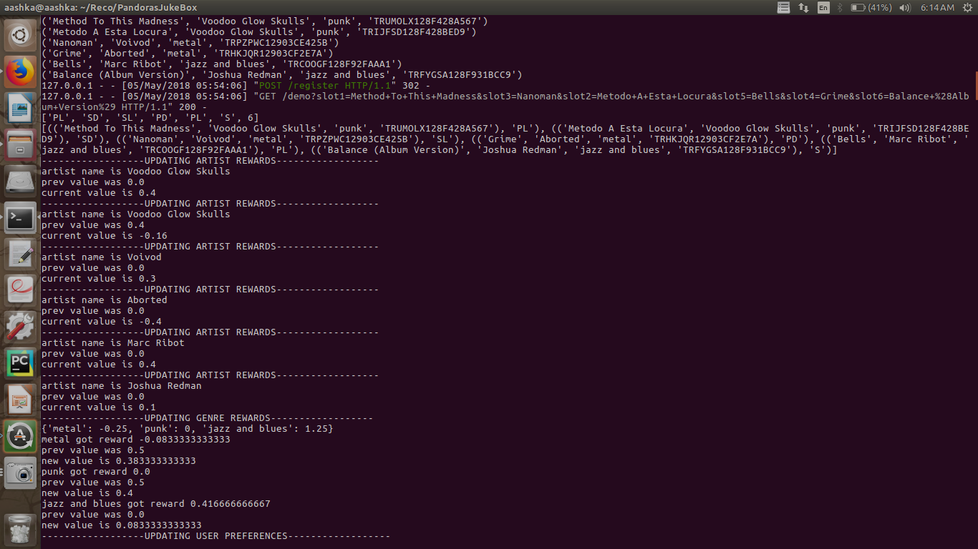
Based on the action of user for each song artist_arm_value is updated as can be seen below.

Slide 29
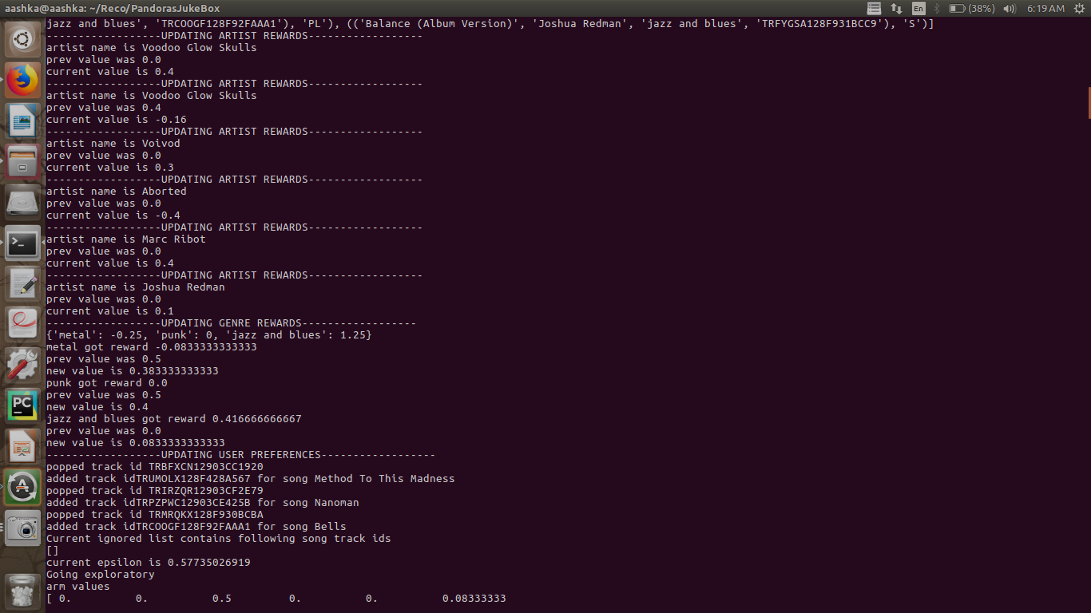
Genres_est_arm_value is updated as 1/3rd of the reward or penalty awarded to artist_arm_value belonging to that genre.
And user preferences are updated which are further used in next rounds for recommendations.
As in this round user didn’t ignored any item and reacted to every song, ignore list is empty.

Slide 30
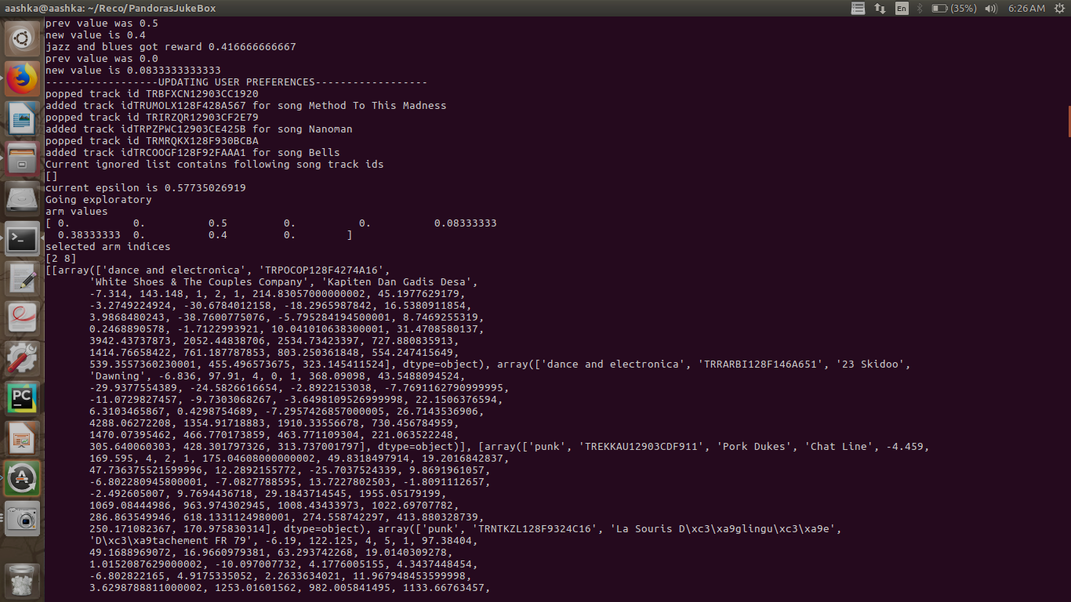
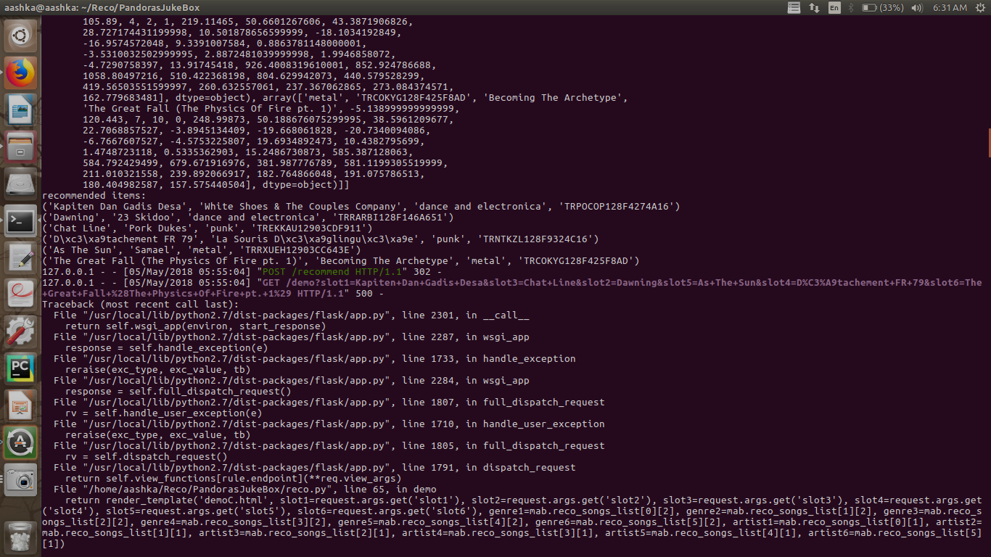
For the second round of recommendation, value of epsilon becomes 1/sqrt(3) = 0.577
It again went exploratory taking two maximum estimated_value arms that is 2[Dance and electronica] and 8[Punk] and one random genre_arm metal.
Similar to last round it first updates artist_arm_values and than corresponding genre values.

Slide 31
Thank You!

