Slide 1

Learning Reduced-Round Cipher Behavior using Machine Learning
Testing how well 5 machine learning models can learn 8 different ciphers.
👥 Team Members
Saloni
Amisha Patel
MT25081
MT25061

Slide 2




Project Architecture
Four core components power the experiment pipeline: ciphers, models, training rounds, and evaluation metrics.
8 Ciphers
5 ML Models
Experiment Rounds
AES, SIMON, SPECK, PRESENT, KATAN, XOODOO, TRIVIUM, TinyJAMBU
Logistic Regression, MLP, CNN, MINE, Random Forest
1 to 5 reduced-round settings for testing
Evaluation Metrics
Correct predictions per bit, number of different bits, training time

Slide 3

Testing Ciphers and Models
We evaluate how 5 machine learning models learn 8 ciphers.
8 Ciphers
AES, SIMON, SPECK, PRESENT, KATAN, XOODOO, TRIVIUM, TinyJAMBU
5 ML Models
Logistic Regression, MLP, CNN, MINE, Random Forest
5 Rounds
Reduced-round settings from 1 to 5
What We Measure
Correct bits, different bits, and training time
We compare leakage and learning behavior across ciphers, models, and rounds.

Slide 4
Machine Learning Models
We tested 5 machine learning approaches to see which could best learn cipher patterns.
🧠 Logistic Regression
🎯 Multi-Layer Perceptron (MLP)
🧬 Convolutional Neural Network (CNN)
🔍 MINE (Mutual Information Neural Estimation)
Linear classifier for pattern detection
Deep neural network with multiple layers
Specialized for spatial pattern detection
Fast and computationally efficient
Information-theoretic approach
Captures non-linear cipher relationships
Designed for local feature extraction
Good baseline for cipher analysis
Measures statistical leakage
Highest accuracy but slower training
Underperformed on cipher tasks
Complementary to other methods
📊 Random Forest
Ensemble of decision trees
Robust and stable performance
Excellent for complex pattern recognition

Slide 5
Cipher Types
A quick comparison of common lightweight and block cipher families by structure and block size.
Cipher
Type
Block Size
AES
SPN
128-bit
SIMON
Feistel
32-bit
SPECK
ARX
32-bit
PRESENT
SPN
64-bit
KATAN
NLFSR-based
32-bit
XOODOO
Round-based
64-bit
TRIVIUM
NLFSR
64-bit
TinyJAMBU
NLFSR-based
64-bit

Slide 6


AES: How It Works
AES is a symmetric-key block cipher established by NIST in 2001.
How it works
1. Sub-bytes (Substitution)
2. Shift-rows (Permutation)
Every byte in the state is replaced using the S-BOX lookup table, providing confusion and making the key-ciphertext relationship complex.
Rows of the 4×4 state matrix are shifted left by different offsets (0, 1, 2, 3 bytes), spreading bytes across columns.
3. Mix-columns (Linear Mixing)
4. Add-round-key (Key Mixing)
Each column is transformed using Galois Field arithmetic, providing diffusion so single-bit changes spread to many output bits.
The state is XORed with the Round Key, where the secret key actually interacts with the data.
AES processes data in repeated rounds that combine substitution, permutation, mixing, and key addition to achieve strong security and efficient implementation.
Key sizes: 128, 192, 256 bits
Rounds: 10, 12, 14
Use: NIST standard since 2001

Slide 7
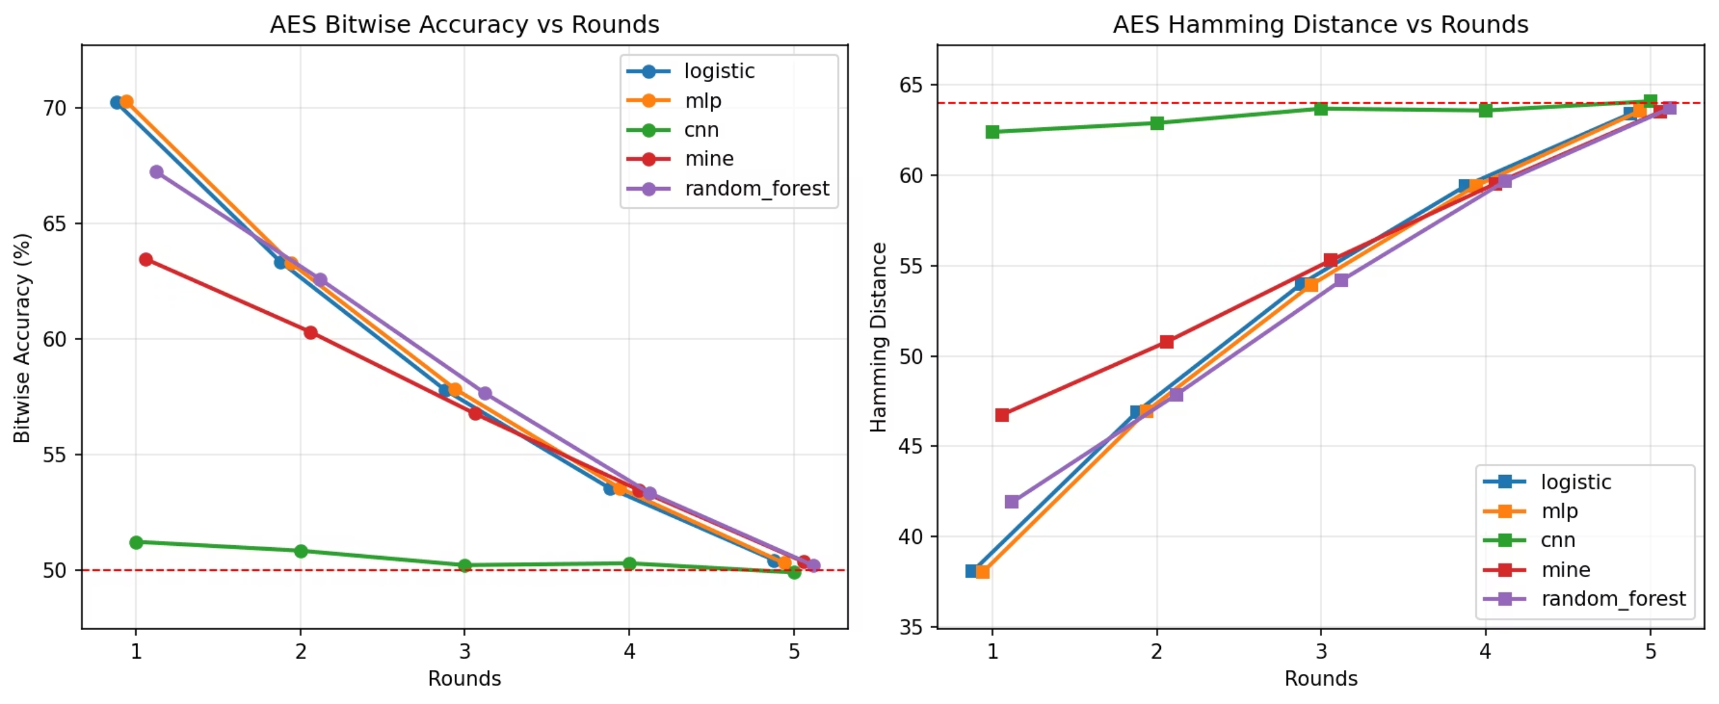
AES Results
AES showed the strongest resistance of all the ciphers we tested. Round 1 accuracy was 70.30% with MLP, then it fell to about 50% by Round 5.
Top Model
Simple Patterns
CNN Results
Max Bit Difference
MLP performed best, but was slowest
Logistic regression matched MLP on simple patterns
CNN was close to guessing
63.72 bits

Slide 8
SIMON Cipher
A lightweight block cipher built for speed in hardware.
How it works
What it does
Round step
Key setup
Splits data into two halves and scrambles them round by round.
Uses rotations, AND, and XOR to mix the bits.
Creates round keys with simple rotations and XOR.
Performance

Slide 9
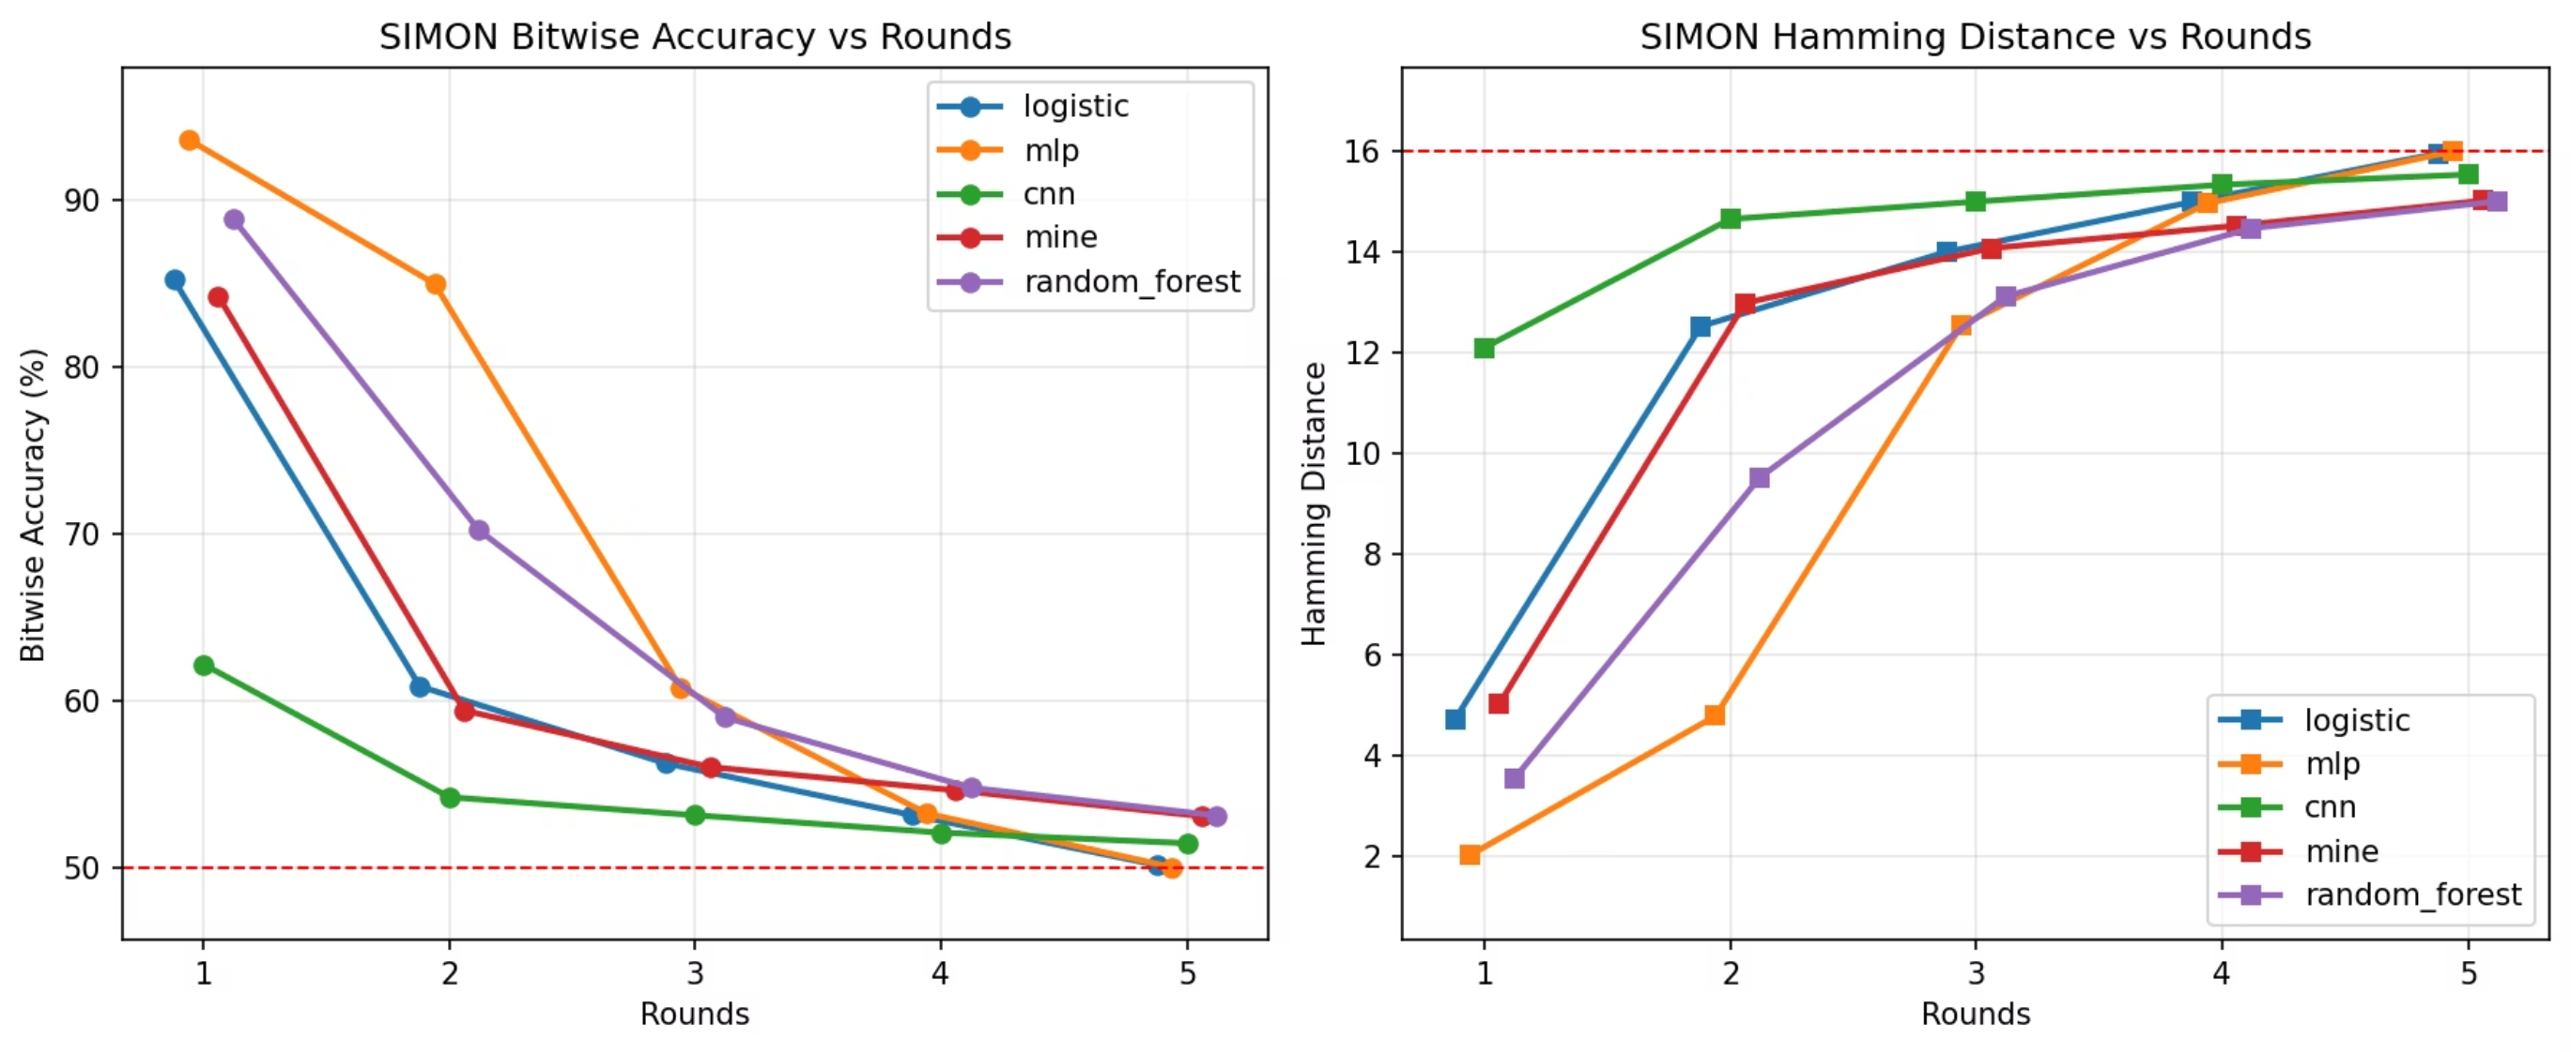
SIMON Performance
SIMON shows stronger early-round learning than AES, with accuracy declining more gradually over time.
Round 1
By Round 5
Best on Hamming Distance
MLP reaches 93.65% accuracy
Accuracy drops to around 50%
MLP performs best, but is slowest

Slide 10
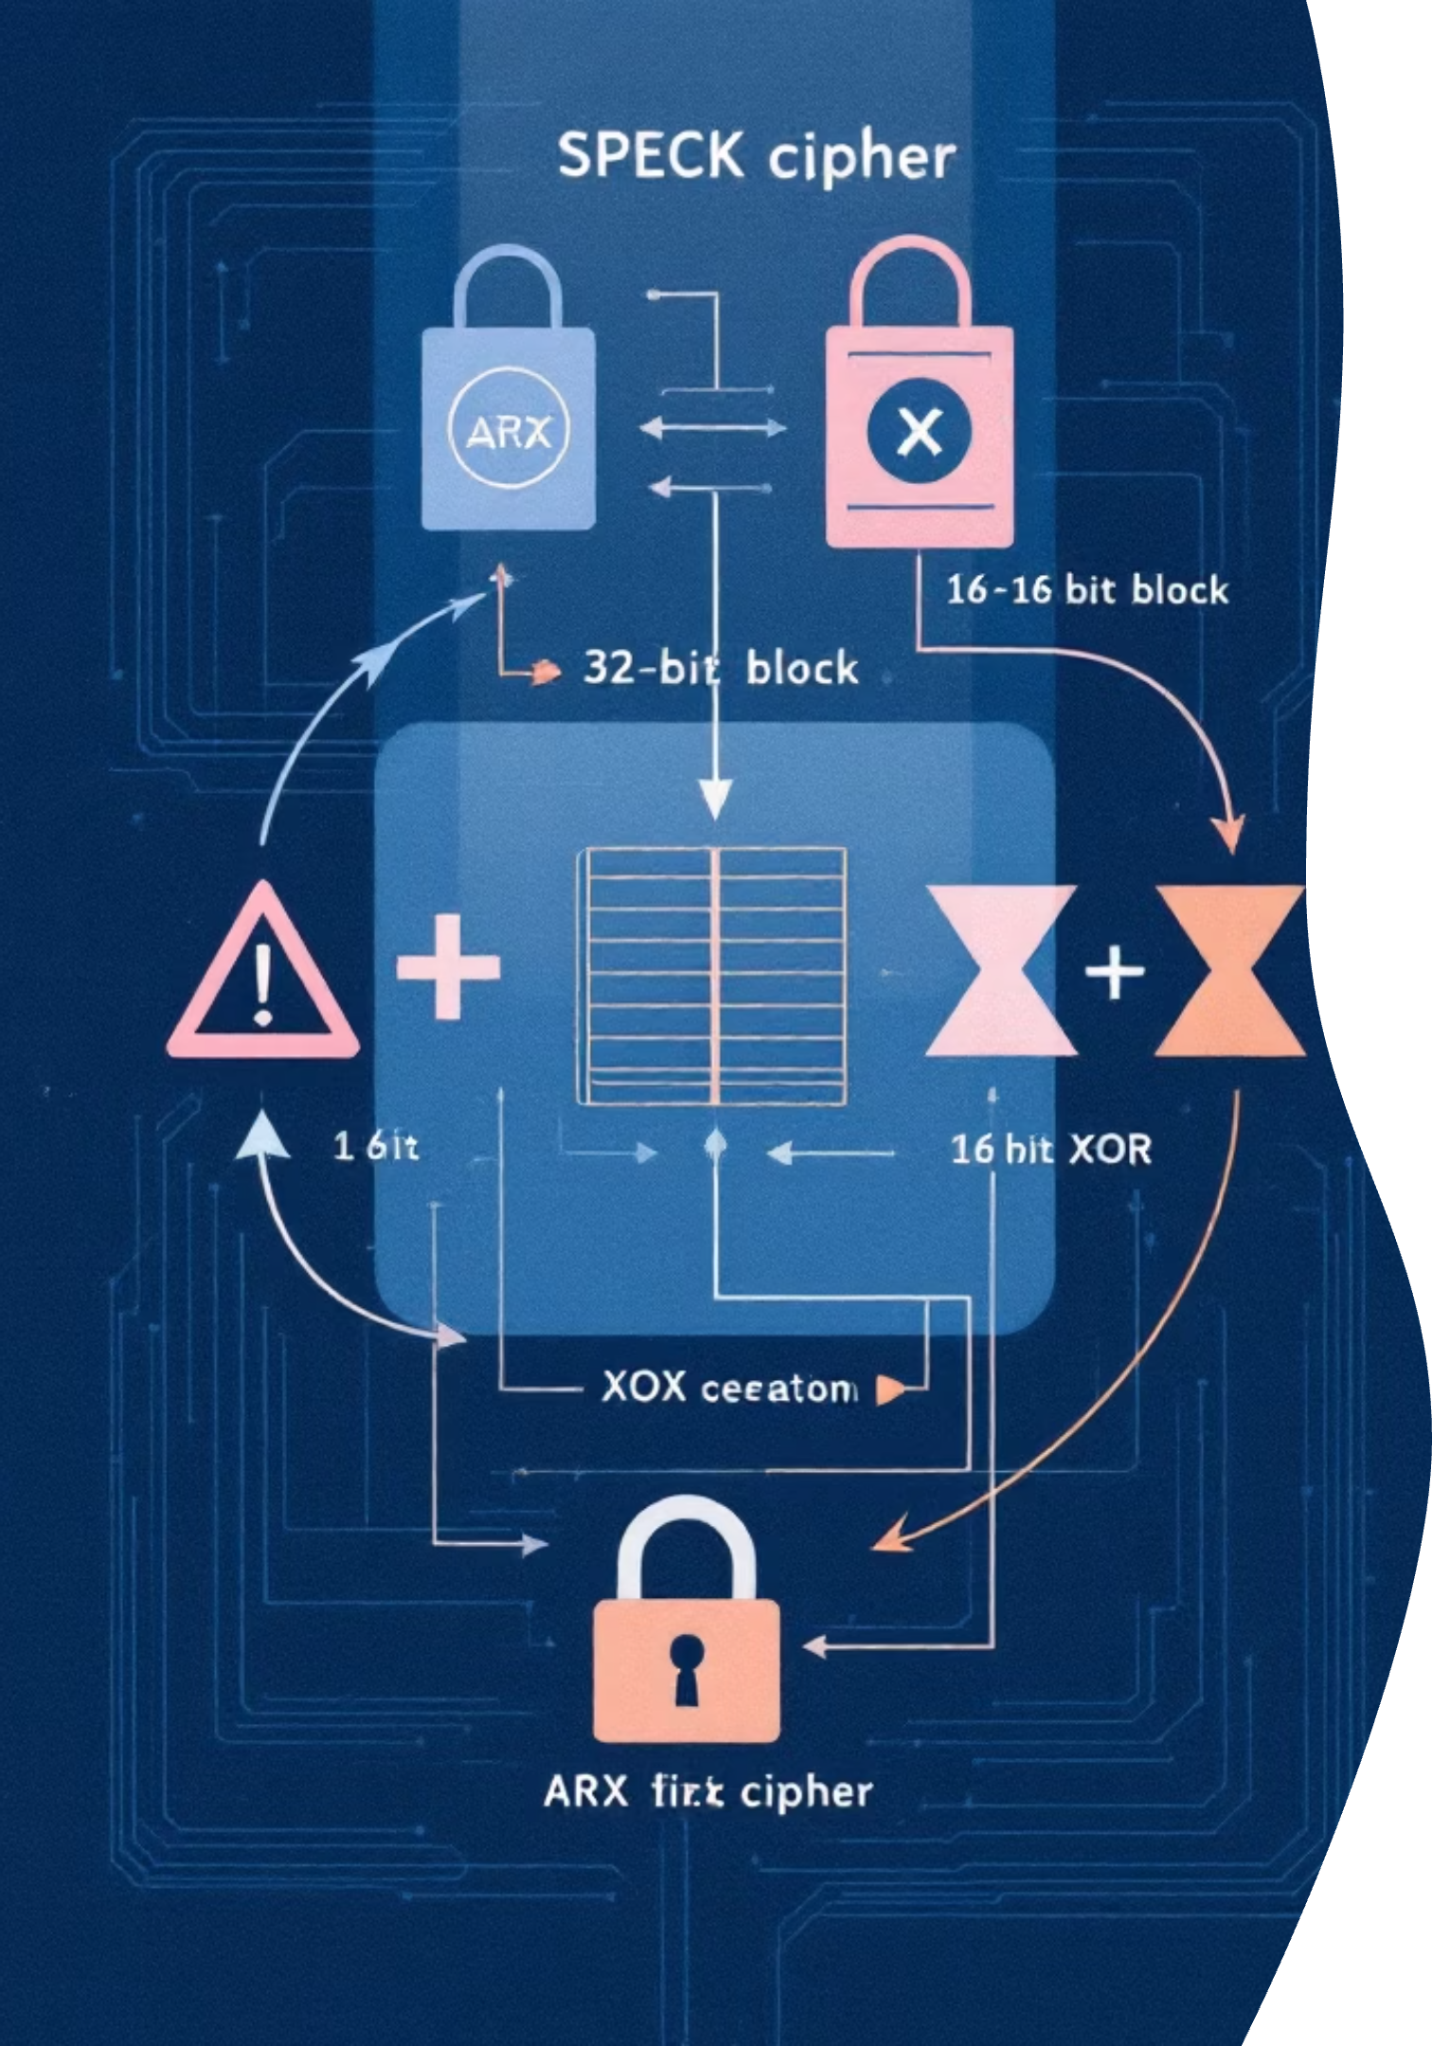
SPECK Cipher
SPECK is a software-friendly lightweight ARX cipher built for fast, efficient implementation.
How it works
Block Structure
Round Function
A 32-bit block is split into two 16-bit words.
Each round applies rotate-add-xor transformations.
Key Schedule
Learning Effect
Key expansion generates a subkey for every round.
More rounds increase diffusion and make the cipher harder to learn.

Slide 11
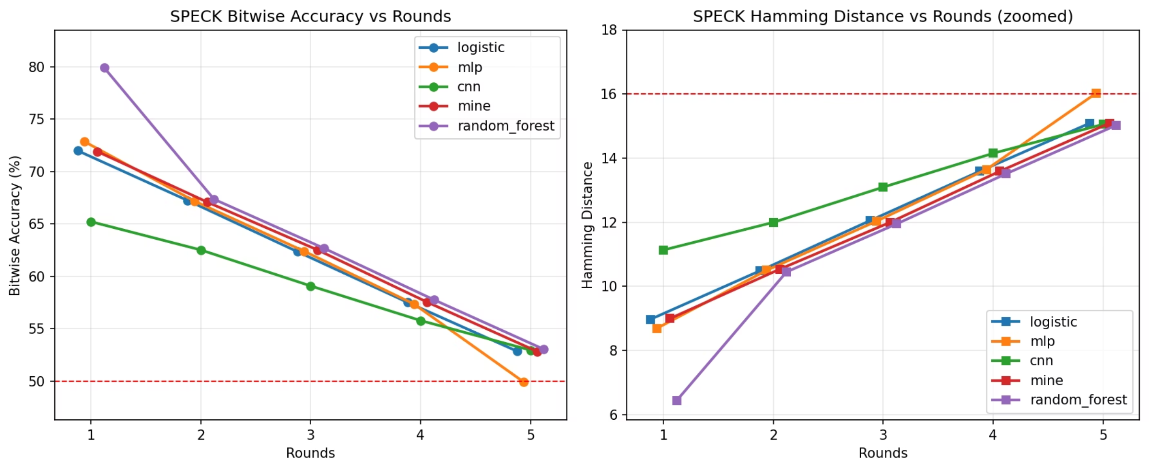
SPECK Analysis
How model accuracy and Hamming distance change as SPECK rounds increase.
1
2
3
4
Round 1 Peak
Accuracy Decline
Hamming Distance
Key Insight
Random Forest reaches 79.91% accuracy, showing SPECK still contains learnable patterns.
Accuracy drops as rounds increase, approaching 50% by Round 5 — close to random guessing.
It rises steadily with rounds, confirming stronger diffusion and improved cipher security.
More rounds make SPECK harder to learn.

Slide 12
PRESENT Cipher
PRESENT is an ultra-lightweight SPN cipher designed for constrained hardware, with a compact implementation optimized for minimal area and low power consumption, making it well suited for IoT and embedded systems.
How PRESENT Works
01
02
03
04
AddRoundKey
S-box Layer
Permutation Layer
Repeat + Final Round
XOR the plaintext with the round key to introduce the secret key material into the cipher state.
Apply a 4-bit S-box substitution to each nibble, adding non-linearity and confusion so the relationship between input and output becomes harder to predict.
Rearrange bit positions to spread changes across the block, providing diffusion so that a single-bit change influences multiple output bits in later rounds.
Run 31 rounds total, with the last round omitting the permutation layer to optimize the final step while still preserving the cipher structure.

Slide 13
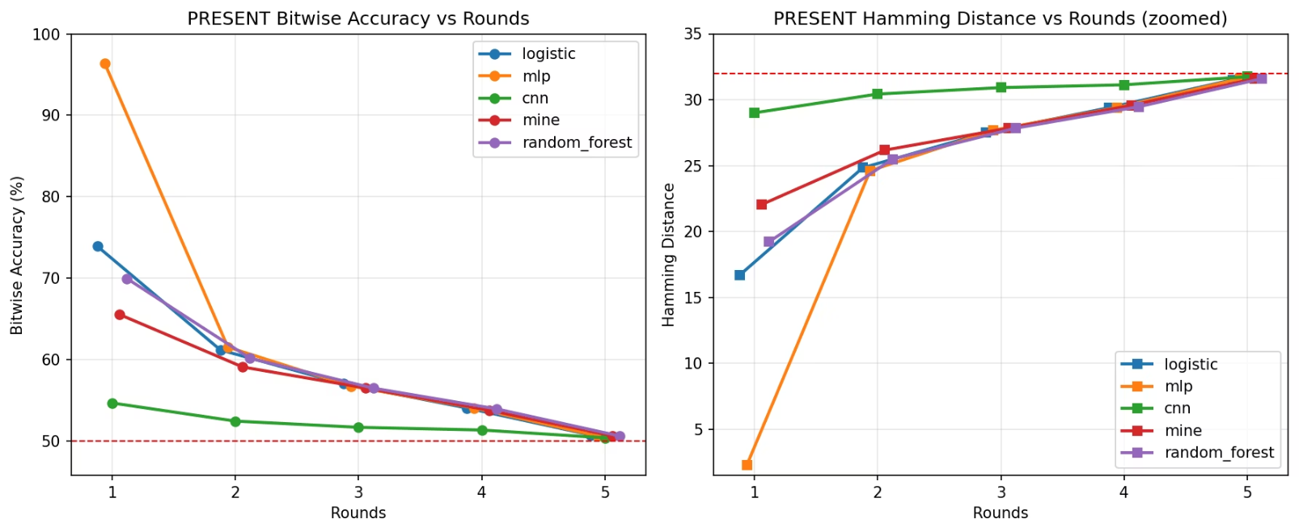

PRESENT: Leaks Fast
PRESENT is a lightweight SPN cipher that looks strong at first, but its performance drops sharply as rounds increase.
Why the Drop?
Why the Drop?
Round 1: Patterns exposed
Round 2+: Bits get mixed
More rounds = stronger cipher
Model fails fast
Performance Snapshot
96.40%
Cliff Drop
Divergence
Highest accuracy
96% → 50%
Grows with rounds

Slide 14
KATAN Cipher
KATAN is a lightweight, hardware-oriented block cipher built for constrained devices.
How it works
Register Structure
Round Updates
Key Injection
Update Steps
Input state split into two registers (L1, L2)
Uses XOR, AND, shifts, and IR sequence bits
Two key bits injected per update step
Many update steps grouped into each round level

Slide 15
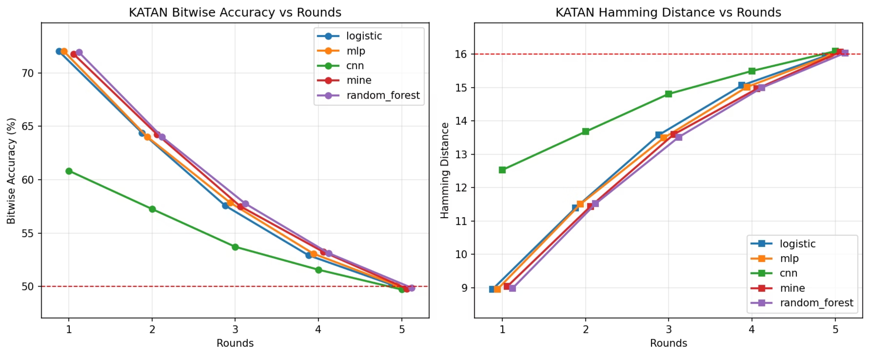
KATAN Performance
KATAN’s results show strong initial accuracy, then a sharp decline as rounds increase—alongside steadily rising Hamming distance.
72% Accuracy
Accuracy Drops
Hamming Rises
Logistic regression starts strong
Slides to 50% by Round 5
Distance climbs with rounds

Slide 16
XOODOO
Xoodoo is a 384-bit permutation core built on iterative mixing and non-linear transformations.
State Structure
Round Operations
Security Constant
Output Mapping
State is arranged as lanes in a 3×4 structure.
Each round applies Theta, Rho, Iota, Chi, and Pi-like operations.
Round constants break symmetry and stabilize security.
This project maps plaintext/key into state and extracts 64-bit output.

Slide 17
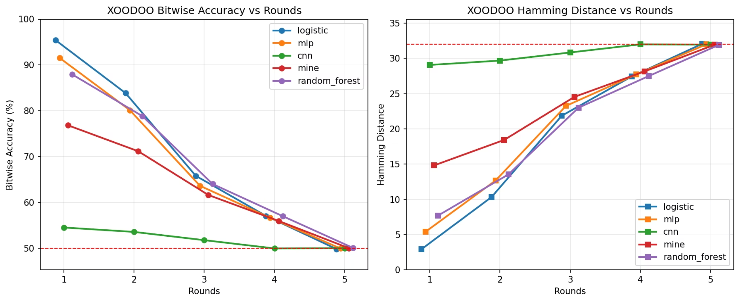
XOODOO Performance
95.46% 🔥
Sharp Cliff
Rising Hamming
CNN Struggles
Logistic Regression peaks in Round 1
Accuracy drops as rounds increase
Distance grows, showing stronger diffusion
Near random guessing; Logistic Regression dominates

Slide 18
TRIVIUM
Stream-cipher design with non-linear register feedback and progressive diffusion.
How it works
Update rule
Diffusion
Performance impact
Multiple interacting registers evolve step by step.
XOR, AND, and rotations combine to produce new state.
Each step feeds non-linear terms into the next state.
Higher rounds significantly reduce predictive leakage.

Slide 19
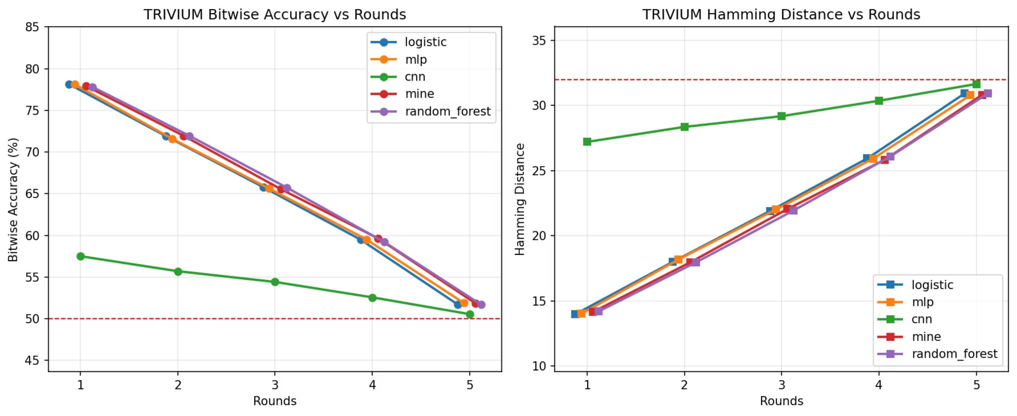
TRIVIUM Results
📈 78% Round 1
⚡ Sharp Drop
📊 Rising Hamming
🤖 CNN Weak
All models learn well in early rounds
Accuracy falls to 50% by Round 5
Distance increases with rounds
Near random guessing; Logistic Regression & MLP lead

Slide 20
TinyJAMBU
TinyJAMBU is a lightweight AEAD design built around non-linear feedback state updates.
How it works
128-bit state
Key-controlled feedback
Non-linear mixing
Round-dependent output
Maintains a compact internal state for efficient processing.
XOR and AND operations drive the state transitions.
Uses the secret key to influence each update step.
More rounds increase mixing depth and randomness.

Slide 21
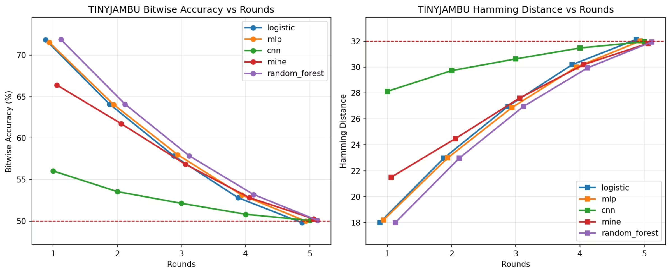
All Models Comparison
Compare the full set of models side by side to quickly see the differences in scale, performance, and trade-offs.
TinyJAMBU Performance
🚀 High Learnability
📉 Gradual Decline
📈 Hamming Growth
🏆 Model Winners
Models achieve strong accuracy in early rounds
Accuracy decreases steadily as rounds increase
Distance rises with complexity
Logistic Regression and MLP perform best

Slide 22
Model Performance Comparison
How each machine learning model performed across all ciphers tested.
🏆 MLP: Highest Accuracy
⚙️ Logistic Regression: Most Efficient
🌲 Random Forest: Most Stable
🔍 MINE: Middle Tier
Best results but slower training
Best on SPECK, consistent across ciphers
Complementary leakage estimates, middle performance
Matched MLP on linear patterns, computationally efficient
🧠 CNN: Least Effective
Underperformed, 5-10% below best model

Slide 23
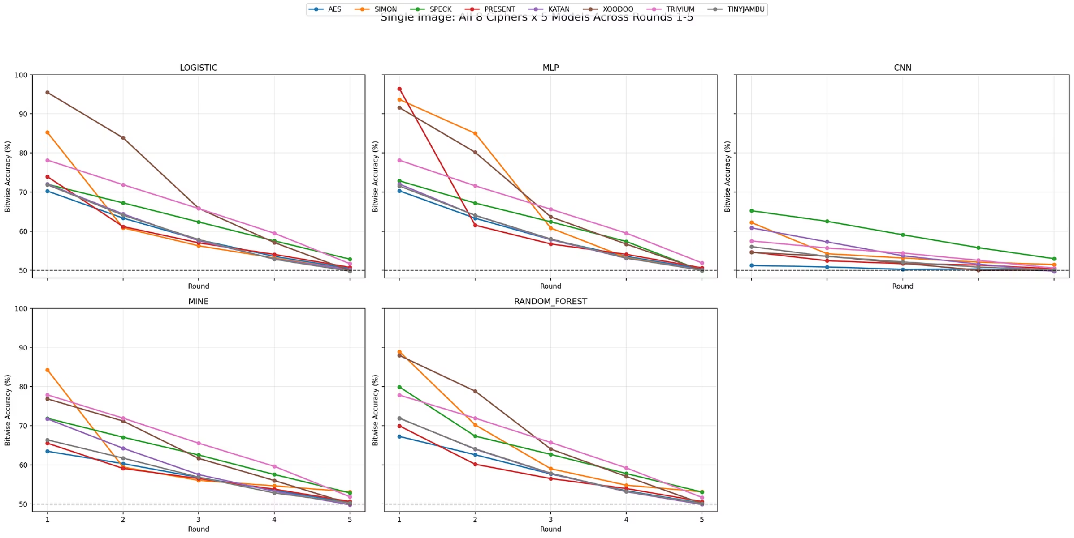
All Ciphers vs All Models: Complete Analysis
See how all 8 ciphers perform across all 5 machine learning models in one comprehensive view. Watch accuracy drop and Hamming distance rise as rounds increase.
🔓 Early Rounds Leak
🛡️ Diffusion Wins
📊 Model Hierarchy
🤖 CNN Struggles
All ciphers show learnable patterns in Round 1
More rounds = stronger security
MLP and Logistic Regression dominate
Consistently underperforms across all ciphers

Slide 24
Cipher Learnability Ranking
Ciphers ranked by Round 1 accuracy - from most to least learnable
1
🔴 PRESENT
Rank 1 • 96.40%
Highest learnability from 4-bit S-box insufficiency
2
🔴 XOODOO
Rank 2 • 95.46%
Very high linear learnability from single permutation
3
🔴 SIMON
Rank 3 • 93.65%
High learnability from slow Feistel diffusion
4
🟡 SPECK
Rank 4 • 79.91%
Moderate-high; ensemble methods outperformed others
5
🟡 Trivium
Rank 5 • 78.16%
High linear leakage from partial NLFSR initialization
6
🟢 KATAN
Rank 6 • 72.04%
Moderate, near-perfect uniformity across all models
7
🟢 TinyJAMBU
Rank 7 • 71.89%
Moderate, uniformly distributed across models
8
🟢 AES
Rank 8 • 70.30%
Lowest learnability; strongest resistance

Slide 25

Key Findings
What the data reveals about cipher security and machine learning
🌍
📉
✨
📏
Universal Trend
Reduced-Round Vulnerability
Round Impact
Hamming Distance
Bitwise accuracy was highest in early rounds, then decreased as rounds increased.
Increasing rounds introduces stronger diffusion and confusion.
Reduced-round lightweight ciphers retain learnable statistical structure.
Hamming distance increased steadily across rounds for all ciphers.
This progressively eliminates learnable structure.
All ciphers approached 50% by Round 5.
That structure remains exploitable by ML models.
This confirms improved diffusion and security.

Slide 26
Key Insights into ML-Driven Reduced-Round Analysis
Detecting Early-Stage Cryptographic Vulnerability via Neural Models
🔍
🏗️
⚡
🧠
Leakage Detection
Architectural Susceptibility
Iterative Strength
Model Superiority
Reduced-round ciphers expose statistical leakage
ML detects what traditional analysis misses
Increased rounds strengthen cipher security
Diffusion progressively eliminates patterns
MLP and CNN demonstrate effectiveness
Superior non-linear pattern extraction
Design choices directly impact learnability
Lightweight ciphers show higher vulnerability
🎯
Strategic Takeaway
ML serves as powerful cryptanalysis tool
Effective tool for early-round behavior analysis

Slide 27
Conclusion: What We Learned
🔬 The Experiment
📊 The Discovery
🏆 The Winners
💡 The Takeaway
Tested 8 ciphers with 5 machine learning models
Evaluated how reduced rounds affect cipher security
Reduced-round ciphers leak learnable patterns
More rounds = stronger diffusion = better security
Accuracy drops to 50% by Round 5
MLP: Highest accuracy, but slower
Logistic Regression & Random Forest: Fast and reliable
CNN: Struggled across all tests
ML-based cryptanalysis reveals cipher weaknesses
Reduced-round analysis is a powerful security evaluation tool
Round count directly impacts resistance to ML attacks
🎯 The Bottom Line
Increasing cipher rounds = stronger defense
Machine learning is an effective cryptanalysis method
Design choices matter for security

Slide 28

Thank You
Thank you for your attention and interest in our research on machine learning-based cryptanalysis of reduced-round ciphers.
🤔 Questions?
📧 Contact Us
We're happy to discuss our findings
Reach out for more information

