Slide 1

Blockchain-Based Issuance and Certification

Slide 2
What is Blockchain?
Blockchain is a decentralized, distributed digital ledger that records transactions in a secure, transparent, and tamper-proof manner. It consists of a chain of blocks, where each block contains a list of transactions, a timestamp, and a cryptographic hash of the previous block, ensuring immutability.
Key Characteristics:
✔ Decentralized – No single authority controls the data.
✔ Immutable – Once recorded, data cannot be changed.
✔ Transparent – All participants can verify transactions.
✔ Secure – Uses cryptography to protect data.

Slide 3
Executive Summary
India is progressing towards a $4 trillion economy, and technology plays a key role.
The education system must ensure the authenticity of degrees and certificates.
Fake certificates harm the reputation of institutions.
Blockchain technology offers a tamper-proof, decentralized solution for secure certificate issuance and verification.
Institutions like MIT have already adopted blockchain for digital certificates.

Slide 4
Challenges & Need for the Solution
Many universities issue certificates without verification of skills.
Employers struggle to validate the authenticity of certificates.
Fake certificates and forged grades create trust issues.
A digital and decentralized verification system is needed.

Slide 5
Blockchain-Based Solution Overview
Secure, tamper-proof, and automated certificate issuance.
Smart contracts ensure verification and prevent fraud.
No-touch QR code for instant verification.
Decentralized and scalable, integrating with third-party platforms like DigiLocker.

Slide 6
Solution Architecture
Public Portal (Web & Mobile): Candidates manage and share certificates.
Platform Server: Handles API interactions and authentication.
Issuer Portal: Allows universities to issue certificates securely.
Blockchain Infrastructure: Stores immutable certificate records.

Slide 7
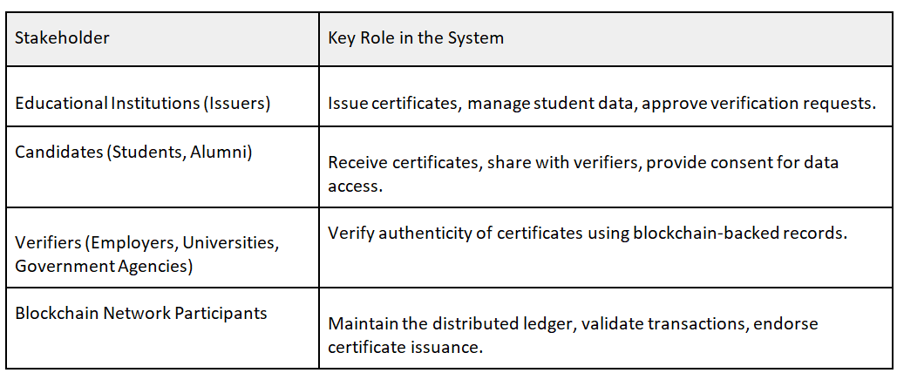
KEY STAKEHOLDERS & THEIR ROLES

Slide 8
Implementation Considerations
Building a Blockchain-Based Certificate
Issuance and Verification System
To develop this project, you need to focus on Blockchain Integration, Web Development, Smart Contracts, and Secure APIs.

Slide 9
Step 1: Define the Requirements
Certificate Issuance Process
Universities upload student data.
The system generates a cryptographic hash for each certificate.
The certificate is stored on the blockchain with a unique ID.
Certificate Verification Process
The issued certificate contains a QR Code with blockchain transaction details.
Employers and institutions can scan the QR code to verify authenticity.
The system cross-checks the hash value stored on the blockchain.
User Roles
Issuers (Universities, Institutions) → Upload & issue certificates.
Students → Access, download, and share certificates.
Verifiers (Employers, Government) → Scan and verify certificates.

Slide 10
Step 2: Choose the Tech Stack
Backend Development
Language: Python (Django/FastAPI) or Node.js (Express.js)
Database: PostgreSQL/MySQL for storing user details
Blockchain: Hyperledger Fabric or Ethereum (private blockchain)
Smart Contracts: Solidity (for Ethereum) or Chaincode (for Hyperledger)
APIs: RESTful API to connect with web & mobile apps
Frontend Development
Web App: React.js or Vue.js
Mobile App (optional): React Native / Flutter
• QR Code Generation: JavaScript library like qrcode.react

Slide 11
Step 3: Set Up Blockchain Network
Choose a Blockchain Framework
Hyperledger Fabric → Permissioned blockchain (suitable for universities & government).
Ethereum (Private Chain) → If using Solidity-based smart contracts.
Set Up Nodes & Smart Contracts
Create a Genesis Block for certificate transactions.
Write Smart Contracts to store and validate certificates.
Deploy nodes using Docker/Kubernetes.
Store Certificates Securely
Store only the hash of the certificate on the blockchain (not the entire document).
The actual certificate (PDF) remains in cloud storage (AWS S3, IPFS, or university servers).

Slide 12
DETAILS OF SOLUTION
Secure & Tamper-Proof Issuance
Certificates are cryptographically hashed, making them unalterable and verifiable.
Blockchain-Backed Proof of Authenticity
Each certificate’s hash is stored on the blockchain, ensuring proof of ownership and authenticity.
Instant Verification via QR Code
No-Touch QR Code enables instant verification by scanning.
The system retrieves and validates certificate data without institutional involvement.
Fraud Prevention & Immutable Records
Prevents fake or duplicated certificates using blockchain’s transparency.
Scalable & Automated Infrastructure
Smart contracts automate issuance and verification, reducing manual work.
Supports multiple institutions for seamless adoption.
lIntegration with Digilocker & Decentralized Contro
Users maintain full ownership of certificates.
No raw data storage—retrieves information on demand from issuing institutes.

Slide 13
PLATFORM CORE PROCESSES

Slide 14
1. Issuance Process
Educational institutions issue certificates using a template-driven system.
Student data is provided via a secure API, generating a PDF certificate.
A cryptographic hash of the certificate is recorded on the blockchain using smart contracts.
The certificate is issued to the candidate, and they are notified.
The blockchain ensures certificates are tamper-proof and verifiable.
2. Verification Process
Certificates have a No-Touch QR Code for instant verification.
When scanned, the system retrieves the blockchain-registered hash.
The system recomputes the certificate hash and compares it with the stored hash.
If the hashes match, the certificate is authentic; if not, it may be tampered with.

Slide 15
Role of Smart Contracts in Issuance
Certificate Hashing & Smart Contract Invocation
The platform generates a certificate and computes a cryptographic hash (e.g., SHA-256).
This hash and its identifiers are sent to a smart contract on the blockchain.
Smart Contract Execution & Blockchain Anchoring
The smart contract validates and stores the certificate hash on the blockchain.
It prevents duplicate or tampered certificates from being registered.
Each issuance is immutably logged for proof of authenticity.
Issuance Confirmation & Candidate Notification
The smart contract generates a unique blockchain transaction ID.
A No-Touch QR Code is created, embedding blockchain details.
A notification is sent confirming certificate issuance with a timestamp.

Slide 16
Role of Smart Contracts in Verification
1. QR Code-Based Initial Verification
When scanned, the QR code extracts the blockchain transaction ID.
The platform retrieves and compares the certificate hash with the stored hash.
If they match, the certificate is verified.
2. Dynamic Data Sourcing for Full Verification (Requires Candidate Consent)
If full details are needed, the platform requests candidate consent.
Upon approval, the system securely retrieves certificate data from the institution.
The retrieved data is used to confirm authenticity.
3. Fraud Detection & Alerting
If the hash does not match, the document is flagged as potentially tampered with.
The platform can notify the issuing institution for manual verification if needed.

Slide 17
SOLUTION ARCHITECTURE WITH THE REQUIRED INFRASTRUCTURE DETAILS AND DESCRIPTION

Slide 18
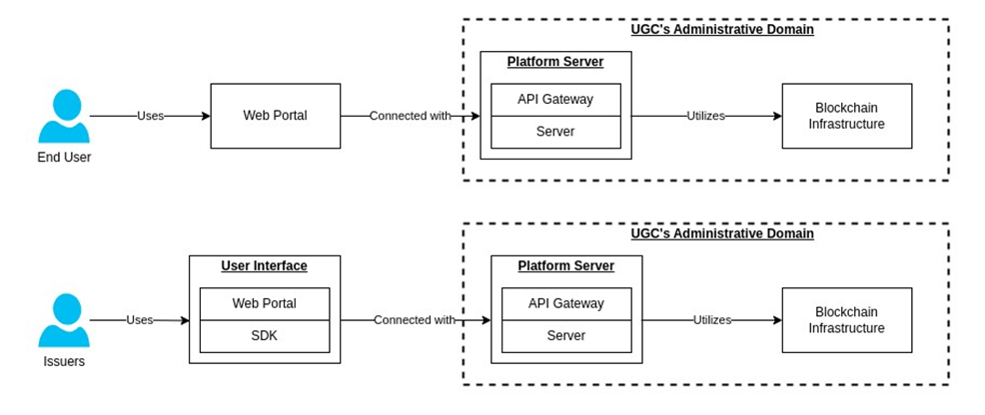

Slide 19
Public Portal (Web & Mobile App)
Candidate Access: Students can view certificates and manage sharing/verification permissions.
Verification Portal: Employers and others can instantly verify certificates using QR codes.
Secure Authentication: Digital identities are used for secure access.
Ease of Access: QR codes on certificates enable easy sharing and retrieval.
Platform Server
API Gateway: Routes requests and ensures secure communication.
Identity Provider: Manages authentication and access control.
Blockchain Gateway: Handles interactions with the blockchain for certificate validation.
Data-to-Document Converter: Converts institutional data into PDF certificates with QR codes.
Communication Channels: Sends notifications to candidates, institutions, and verifiers.
Issuer Portal (Issuer Client)
Data Sourcing: Retrieves certificate data on demand.
Request Processing: Institutions manage certificate issuance.
Access Control: Only authorized personnel can issue certificates.
Secure Transactions: Uses digital signatures for secure requests.

Slide 20
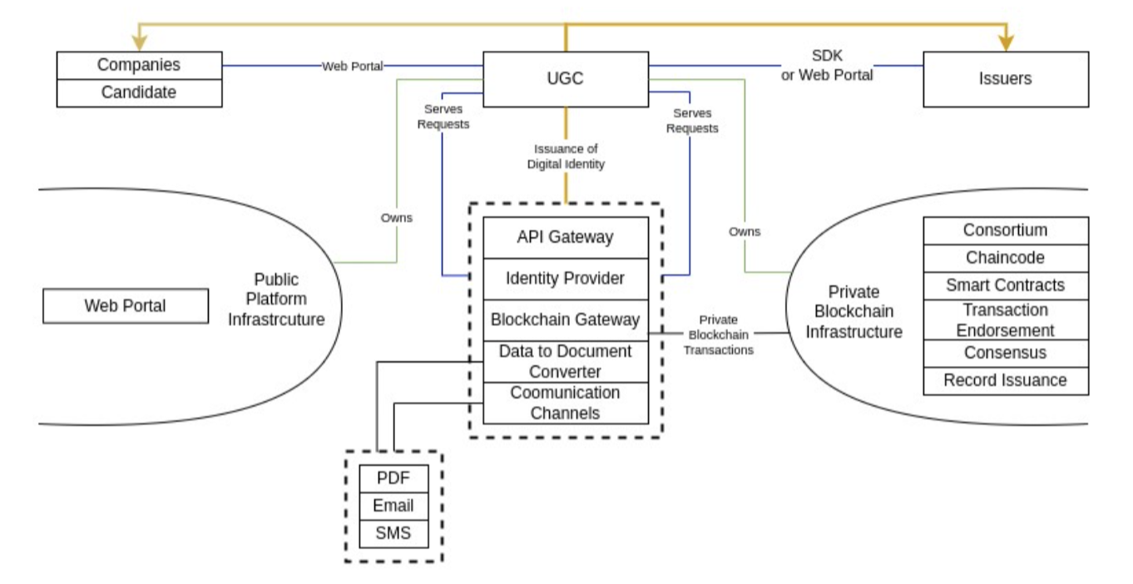
System Diagram - All the components together

Slide 21
1. Platform Server API Gateway – Routes system requests securely between users, institutions, and blockchain. Identity Provider – Manages user authentication, role-based access, and digital identity verification. Blockchain Gateway – Connects to the blockchain for secure certificate issuance and verification. Data-to-Document Converter – Converts institution data into PDF certificates with QR codes. Communication Channels – Notifies candidates and institutions via email, SMS, and push notifications. 2. Issuer Portal Data Sourcing – Retrieves certificate data from institutions securely. Request Processing – Allows institutions to issue and manage certificates. Access Control – Restricts certificate management to authorized personnel. Secure Transactions – Uses encryption for secure certificate issuance. 3. Blockchain Infrastructure Permissioned Blockchain – Only approved institutions and verifiers can access records. Consortium Model – Multiple institutions collaborate on a shared, secure network. Smart Contracts – Automate issuance and verification using cryptographic hashes. Transaction Endorsement – Validates certificates before storing them on the blockchain. Tamper-Proof Verification – Ensures authenticity by storing hashes securely on the blockchain.

Slide 22
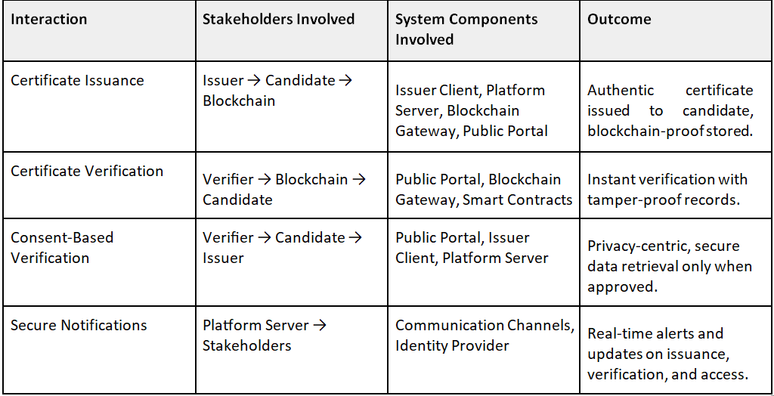
Use Cases

Slide 23
Certificate Issuance Process
Issuer
ERNET(server)
Blockchain Infrastructure
User(access)

Slide 24
The Issuer Client submits student data to the Platform Server via a secure API.
The Data-to-Document Converter generates a digitally signed PDF certificate.
The Blockchain Gateway computes the certificate’s cryptographic hash and records it on the Blockchain Infrastructure.
The Platform Server issues the certificate to the candidate via the Public Portal (Web & Mobile App).
A notification is sent to the candidate.
Outcome: A tamper-proof, verifiable digital certificate is issued and made accessible to the candidate.

Slide 25
Certificate Verification Process
Verifier
ERNET(server)
Blockchain Verification(QR Code)
Certificate

Slide 26
The Verifier scans the No-Touch QR Code embedded in the certificate.
The Public Portal retrieves the stored certificate hash from the Blockchain Infrastructure.
The system recomputes the certificate hash and compares it with the stored hash.
If the hashes match, the certificate is confirmed as authentic.
If a verifier requires additional details, the system requests candidate consent.
Upon approval, the Issuer Client provides the required data securely via API.
Outcome: Instant, trustless verification without issuer intervention, unless additional consent-based verification is required.

Slide 27
OWNERSHIP & CONSENT-BASED DATA ACCESS
User(Candidate)
Verifier(Request details)
Public Portal(notifies user)
Verifier(Platform server)
Issuer Client

Slide 28
Candidates own their certificates and control access to additional data.
If a verifier requests more details, the Public Portal notifies the candidate.
The candidate grants or denies consent via the platform.
If approved, the Platform Server requests additional data from the Issuer Client.
The Issuer Client fetches the data securely and provides it to the verifier.
Outcome: A privacy-first, candidate-controlled approach to verification, reducing the risk of unauthorized data access.

Slide 29
Storing Data in Blockchain
On-Chain Storage – Data is stored directly on the blockchain. It’s best for small and important data like transactions, smart contract details, and digital signatures.
Off-Chain Storage – Large files (like documents and certificates) are stored outside the blockchain in systems like cloud storage or IPFS. Only a unique fingerprint (hash) is kept on the blockchain for verification.
Hybrid Storage – A mix of both. Important details and verification hashes are stored on the blockchain, while full data is kept externally. This is used for supply chain tracking, educational certificates, and medical records.

Slide 30
What is SHA (Secure Hash Algorithm)?
SHA (Secure Hash Algorithm) is a cryptographic hash function designed to convert data into a fixed-length string (hash). It is used for data integrity, digital signatures, and password security.
Key Features of SHA
One-Way Function – Cannot be reversed to original data. Deterministic – Same input always produces the same hash. Fixed Length – Output is always a fixed size (e.g., 256-bit for SHA-256). Collision Resistant – No two different inputs should produce the same hash.
SHA-256 is widely used in blockchain and cryptography.
Example: How SHA Works
Input: "Anchal Sharma"
SHA-256 Hash Output:
EEF7B6F6D3A...43B095D1A

Slide 31
How to Store Images and Videos on Blockchain
Blockchain is not suitable for storing large files like images and videos due to high storage costs and scalability limitations. Instead, we use off-chain storage with blockchain references to ensure security and immutability.
Best Methods to Store Images & Videos
1. Store Image/Video Hash on Blockchain (Off-Chain Storage)
• Process:
Upload the file to IPFS (Inter Planetary File System) or cloud storage (AWS, Google Drive).
Generate a cryptographic hash of the file.
Store the hash + IPFS link on the blockchain.
Users retrieve the file using the hash.

Slide 32
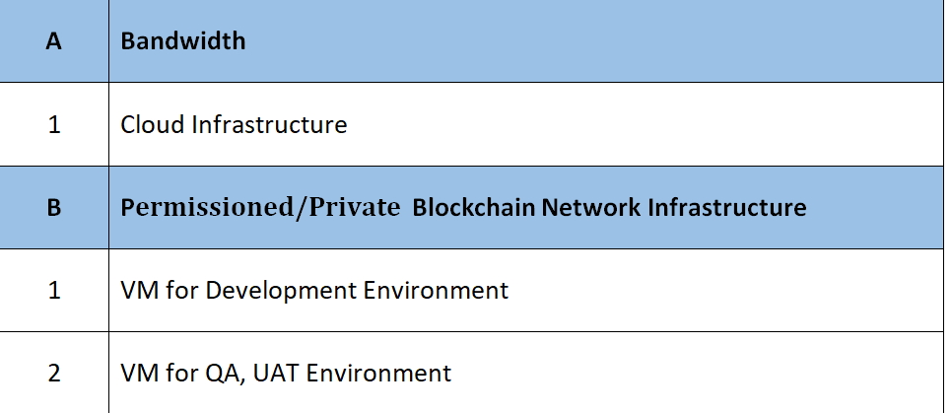
Infrastructure Requirement

Slide 33
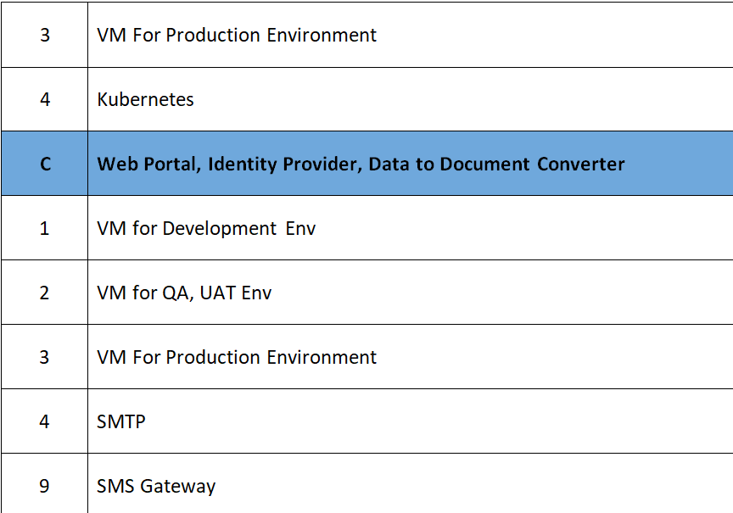

Slide 34
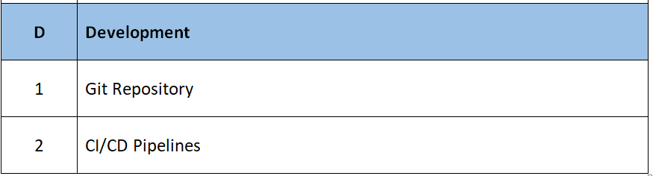

Slide 35
Prerequisites
UGC/ ERNET
To recommend the Universities with whom a PoC implementation can be done
To provide space for hosting the platform
To set out the success criteria of the PoC.
Coordination with Universities and affiliated colleges.
Nomination of a SPOC with complete understanding of the Business logic
To conduct acceptance testing of the implemented solution.
2. UNIVERSITIES
To provide us an understanding of the existing process for certificate issuance and verification
To provide the data points for building the APIs.
To provide support in installing and placing the compatible hardware and software required
To conduct acceptance testing of the implemented solution.

Slide 36

THANK YOU

