Slide 1
Saloni Redij
Capgemini Programming Assessment
Title : Simple Expense Tracker Application
Java17 (Spring Boot) + HTML & Bootstrap & JS
Live application URL : expense-tracker-website | GitHUB Repo url: github.com/saloniredij/expense-tracker

Slide 2
Problem Statement & Goals
Problem
Build a simple application that -
Allows users to record expenses (category, amount, date)
Provides useful insights into spending behavior
Uses in-memory or file-based storage (no database)
Goals
Clean, maintainable backend design
Persistent storage without a database
Simple and intuitive user interface
Easy to run and evaluate locally or in deployment

Slide 3
High-Level Approach & Architecture
Client:
  HTML + Bootstrap pages
  Charts rendered via JS (Chart.js bundled via Node/npm)
Backend (Spring Boot):
  REST controller exposes endpoints for CRUD + analytics
  Service layer calculates totals, trends, highest/lowest categories
Persistence:
  FileExpenseRepository reads/writes expenses.json
  Also responsible for loading seed data if file missing
Export:
  Apache POI used to generate .xlsx file on demand

Slide 4
Key Design Decisions
Why File-Based Storage?
Meets assessment requirement (no DB needed)
JSON is human-readable and easy to inspect
Persists data across restarts
Easily replaceable with DB in future

Slide 5
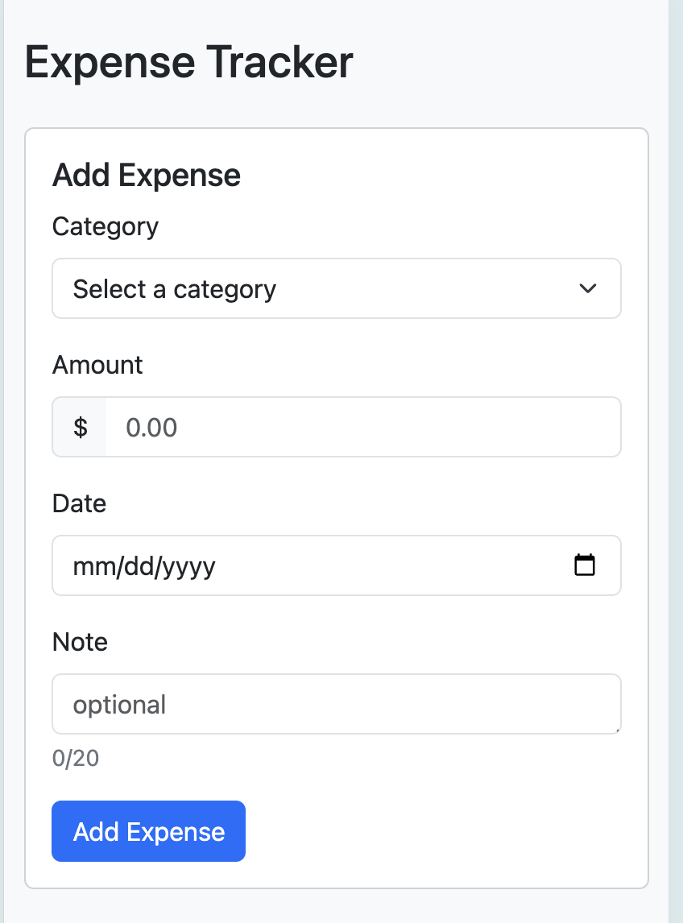
Key Screens & Features
1) Add expense:
Category, amount, date, optional note
Basic validation (required fields, positive amount, past and current dates only)

Slide 6
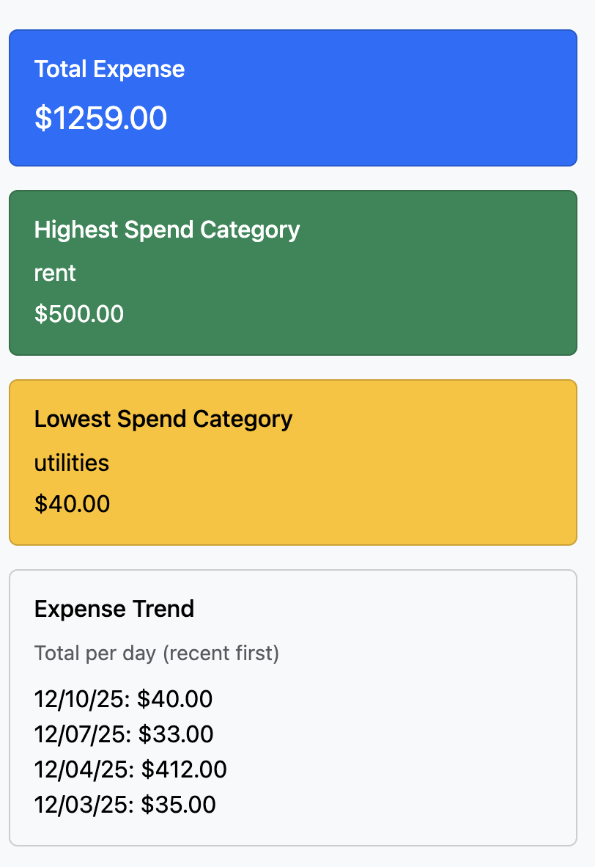
Key Screens & Features
2) Category, amount, date, optional note
Total Expense
Highest Spend Category
Lowest Spend Category
3) Expense trend (recent per-day totals)

Slide 7
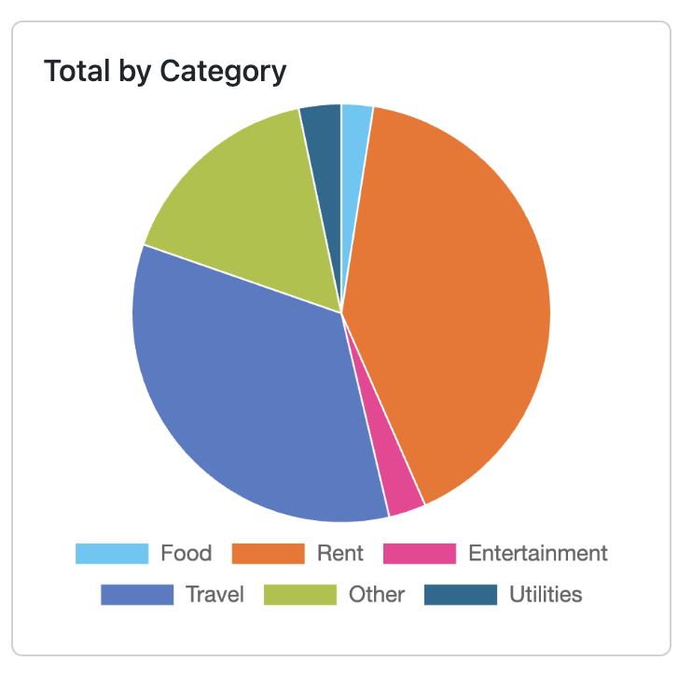
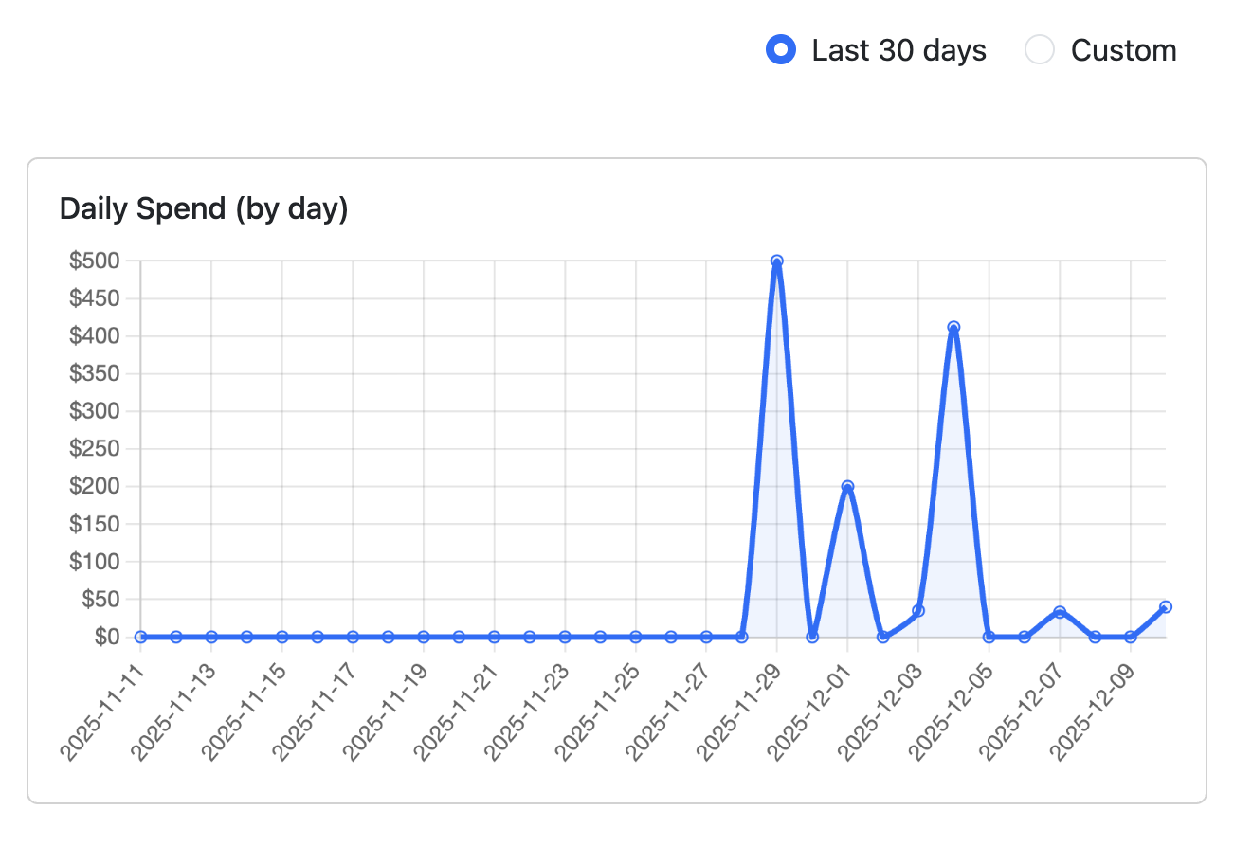
Analytics & Charts
Total by Category (pie chart)
  Visual breakdown of categories (Food, Travel, Utilities, etc.)
Daily Spend (line chart)
  Plots spend per day over last N days
  Charts implemented using Chart.js loaded via Node
  Backend supplies pre-aggregated data via JSON endpoints

Slide 8
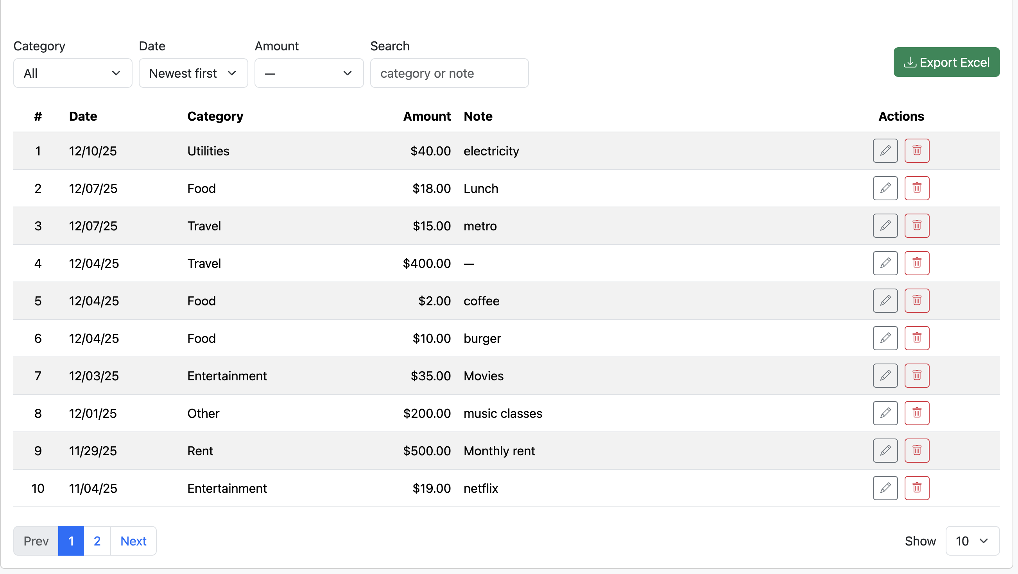
Expenses Table, Filters & Actions
Filtering:
  By category, date order, amount range, and search text
Table:
  Paginated list of expenses (index, date, category, amount, note)
Actions:
  Edit existing expense
  Delete expense
“Export Excel” button on the same screen

Slide 9
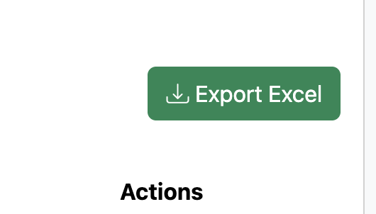
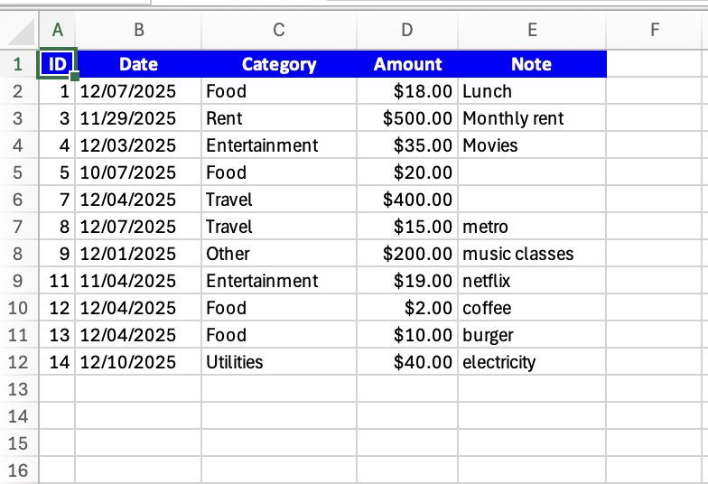
Excel Export (Apache POI)
Backend endpoint /export/excel
Implementation:
  Uses Apache POI to create an .xlsx workbook
  Writes header row + all expenses from repository
  Sets correct data types (date, numeric amount, text)
Frontend:
  “Export Excel” button triggers file download

Slide 10

Key Files & Folders
src/main/java/com/saloni/expensetracker/
  ExpenseTrackerApplication.java – Spring Boot entry point
  model/Expense.java – domain model
  repository/FileExpenseRepository.java – JSON file persistence
  repository/ExpenseRepository.java – Definition
  service/ExpenseService.java – business logic & aggregations
  controller/ExpenseController.java – REST endpoints
src/main/resources/
  templates/index.html etc. – HTML/Bootstrap views
  application.properties – app config
Root:
  expenses.json – seed/test data
  build.gradle – dependencies & build
  Dockerfile – containerization

Slide 11
Test Data & Seed data
Seed file: expenses.json in project root
  Contains a realistic mix of categories:
    Food, Rent, Entertainment, Travel, Utilities, Other,etc
  Mix of:
    Small daily expenses (coffee, bus, snacks)
    Large monthly bills (rent, utilities)
Repository behavior:
  On startup:
    If expenses.json exists → load existing data
    If not → initialize demo data from fallback and write file
This ensures:
  App is usable immediately after deployment
  Charts, trend, and summaries look meaningful on first load

Slide 12
How to Run, Test & Verify
Locally (without Docker)
  /gradlew bootRun
  Open http://localhost:8080
Verify:
  Add a few expenses
  Check total/highest/lowest numbers update
  Look at charts and filters
  Click Export Excel (wait for a bit) and open the downloaded file
Using Docker
  docker build -t expense-tracker .
  docker run -p 8080:8080 expense-tracker
  Same verification steps as above

Slide 13
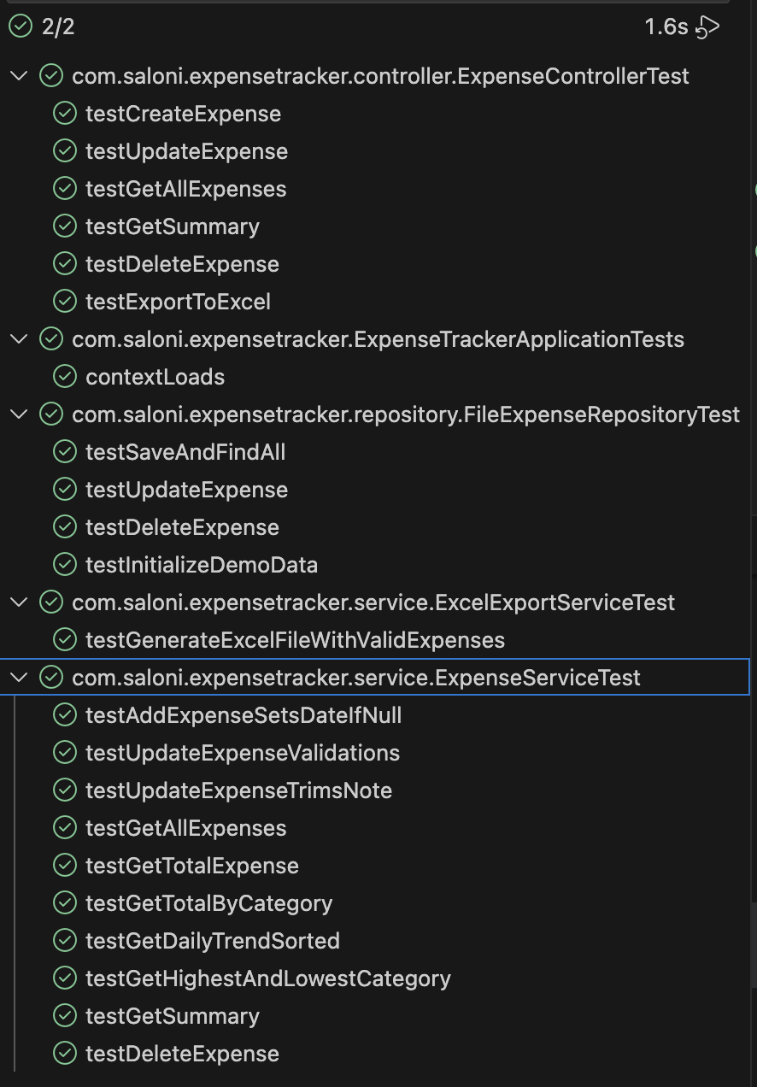
Testing & Verification Strategy
Testing Approach
  Tests written using JUnit
  Focus on functional correctness, validation and edge cases
  Clear separation of test layers:
    Controller tests
    Service tests
    Repository tests
    Export functionality tests

Slide 14
Summary & Future Improvements
Met all requirements:
  Total expense
  Per-category totals
  Trend over time
  Highest & lowest spend categories
  Optional UI + Excel export
Clean architecture with clear layers and file persistence
Visualizations, Export feature, Filters
Possible next steps:
  Switch to a DB (PostgreSQL)
  Authentication & multi-user support
  Sharing and splitting expenses between multiple users
  Adding bank accounts and credit/debit cards to sync expenses in real-time without manual intervention
  More advanced filters (monthly, yearly exports)
  More advanced analytics (budgets, alerts, recurring expenses)

Slide 15
Thank You ☺

