Slide 1



ANNAPURNA
Fresh Food, Simplified.

Slide 2
Our Team : TechSouls
Saloni Sanjay Sawant
Ashish Subhash Gangurde
Pritam Panduranga Patil
Akshay Keshav Bargaje
Pranay Sinha
Chirag Agrawal
Kandukuri Sree Sai Sampat Gupta
Rahul P

Slide 3

Overview
Problem statement
Problem Description
Features and Functionality
Key Learning
Conclusion

Slide 4
Problem Statement
The app is designed to be a web application for managing a subscription-based e-commerce platform specializing in food products. The application aims to streamline the process of subscribing to, managing, and canceling food product deliveries, offering a variety of subscription plans to meet customers' needs.

Slide 5
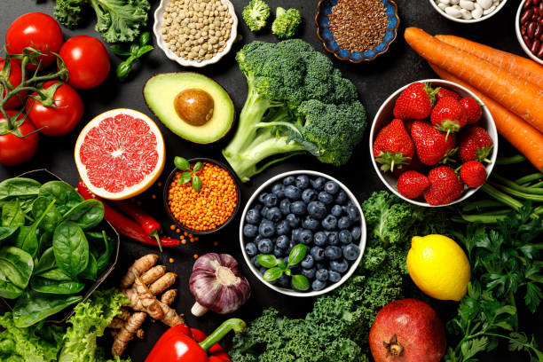
Project Description
This project is a subscription-based e-commerce application called "Annapurna" that allows customers to subscribe to products for delivery. The application manages users, products, subscriptions, and addresses.

Slide 6
Features and Functionality
Application Features
Customer Functionality
Admin Functionality
User authentication (registration and login)
Role-based access (admin and customer)
Product management
Subscription management
Address management
Database integration using JDBC
Register and login
View available products
Subscribe to products with customizable plans (Weekly/Biweekly/Monthly)
Specify delivery days
Manage addresses
View active subscriptions
Cancel subscriptions
Add new products
Update existing products
Delete products
View all products
View active subscriptions across all users

Slide 7
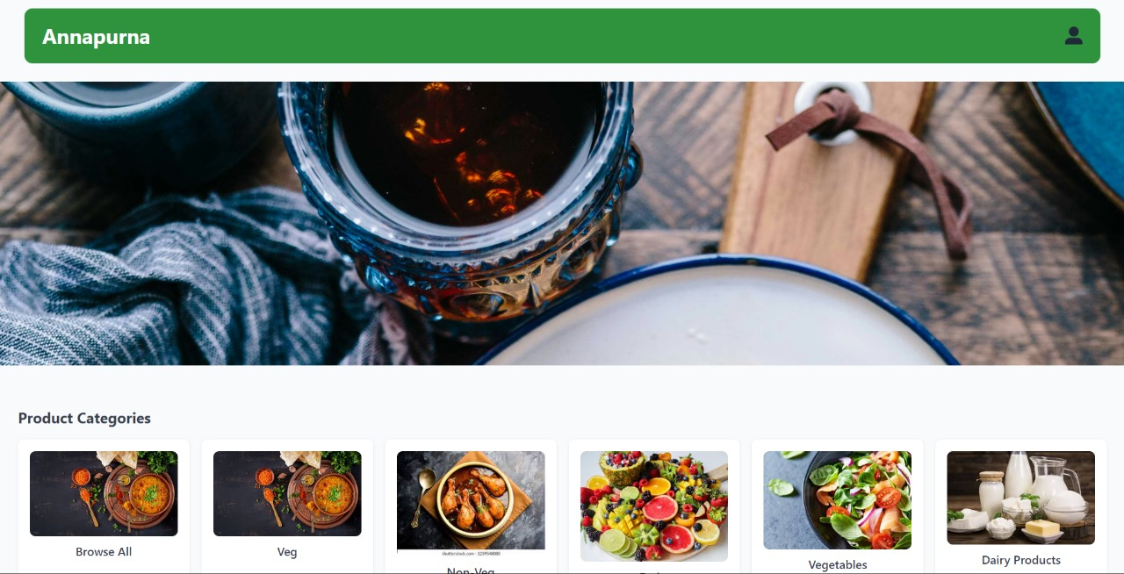
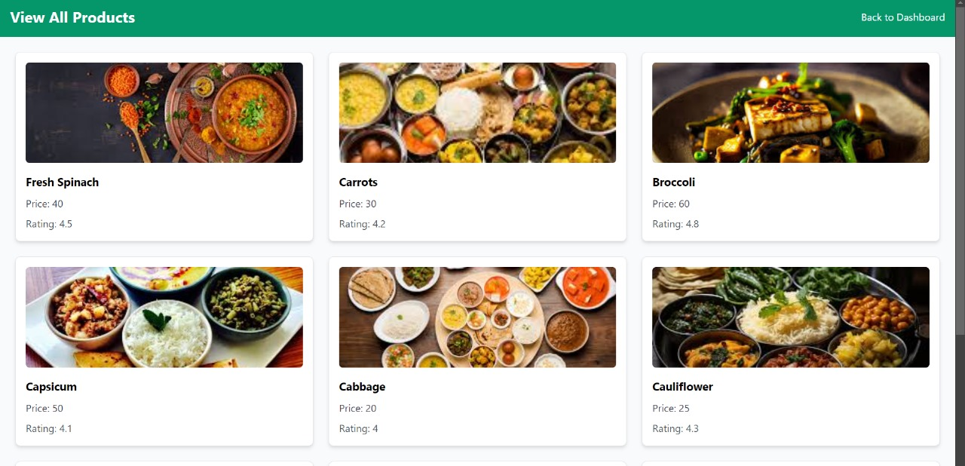
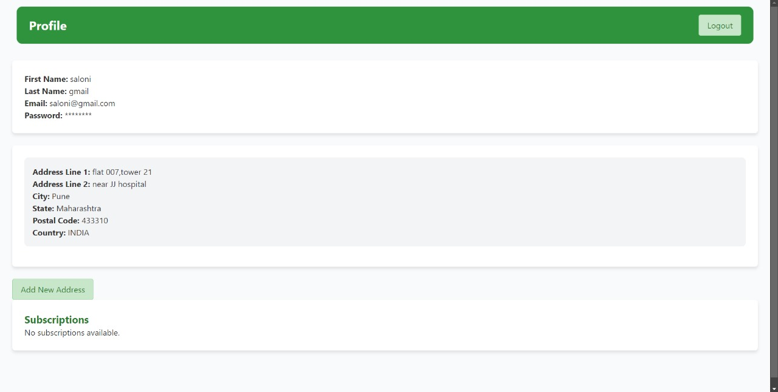
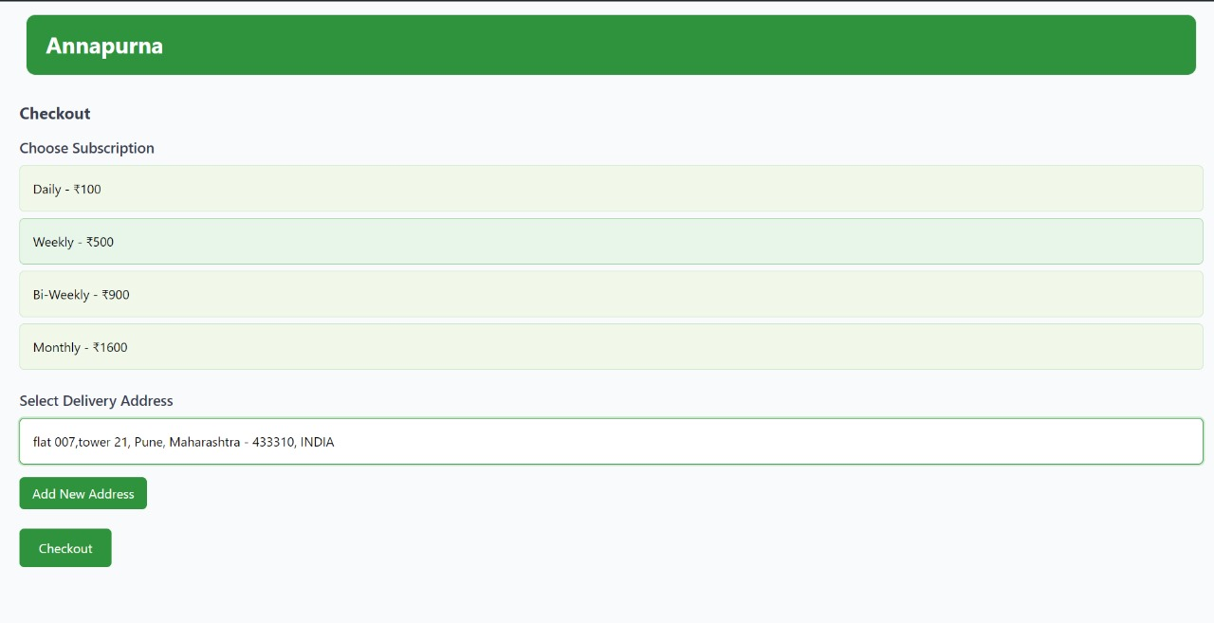
User Interface Design

Slide 8
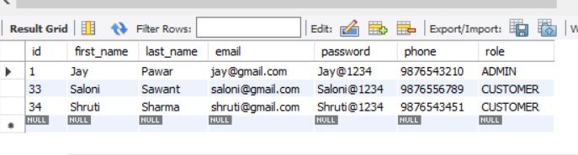
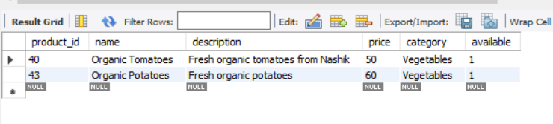
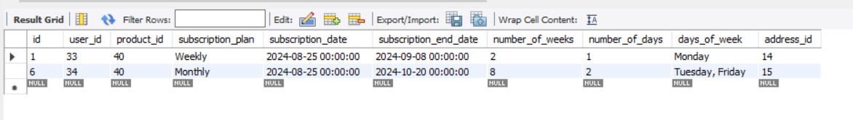
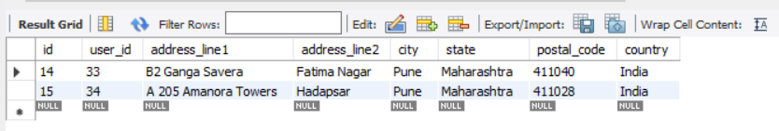
Database Schema

Slide 9
Key Learnings
Concept
Tools & Technologies
Java programming
Object-Oriented Programming (OOP) concepts
JDBC (Java Database Connectivity) for database operations
MySQL database integration
DAO (Data Access Object) pattern for database operations
Service layer architecture
Gained a deeper understanding of subscription-based e-commerce models.
Implemented replenishment and auto-ship features.
Developed user and admin interface designs to support flexible subscription plans.

Slide 10
Conclusion
This application allows customers to subscribe to regular food deliveries with flexible plans, while admins manage products, monitor subscriptions, and oversee deliveries through a dashboard.

Slide 11
THANK YOU

