Slide 1

Data Mining and Analysis
5DMACP11
UNITED NATIONS MILLENNIUM DEVELOPMENT GOALS
Name | Roll No | USN
Saloni Shah | 363 | 01FE18BCS183
Samarth Mummigatti | 364 | 01FE18BCS184
Samarth R | 365 | 01FE18BCS185
Sanjana Kambar | 370 | 01FE18BCS190

Slide 2
Problem Statement
The member states of United Nations has set goals to measure the progress of global development which aims to increase standards of living around the world by emphasizing human capital, infrastructure and human rights.
The Data is been aggregated from 1972-2007 on over 1200 macroeconomic indicators in 214 countries around the world.
Given the data from 1972-2007 we need to predict a specific indicator for the goals in 2008 and 2012.

Slide 3
Data Pre-processing
There is a fair amount of missing data from the training dataset , and strategies need to be devised for dealing with the missing data. Missing values are labeled with NaN.
Different methods used in filling missing values includes:
Last Observation Carried Forward
Next Observation Carried Backward
Multivariate Imputation by Chained Equation

Slide 4
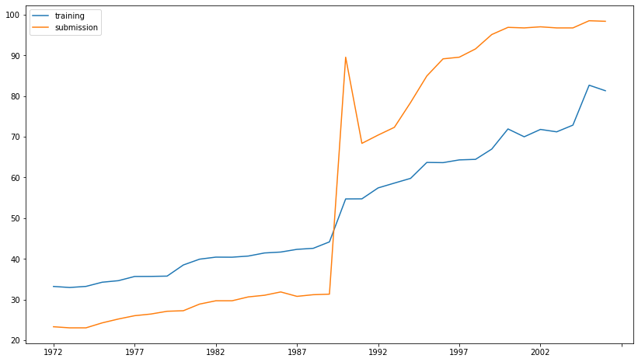
Non Nan Values

Slide 5
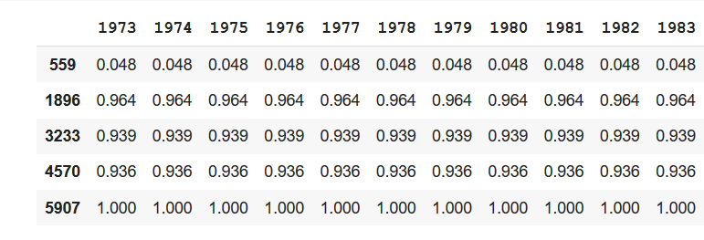
Data Pre-processing
1. Last observation carried forward (LOCF) or Forward Filling :
Last observation carried forward (LOCF) is a method of imputing missing data in longitudinal studies. Replaces each missing value with the most recent present value prior to it. LOCF is used to maintain the sample size and to reduce the bias.

Slide 6
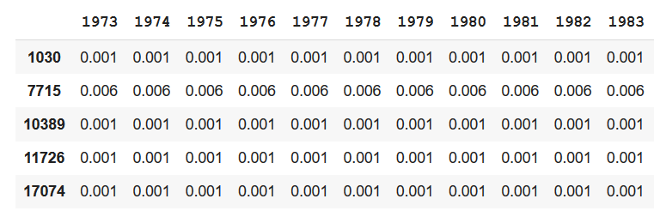
Data Pre-processing
2. Next observation carried backward (NOCB) or Backward Filling:
Next observation carried backward (NOCB) is a method of imputing missing data in longitudinal studies. Replaces each missing value with the most recent present value from the back.

Slide 7
Data Pre-processing
3. Imputation Iterative/Multiple- Imputation:
Iterative imputation refers to a process where each feature is modeled as a function of the other features, e.g. a regression problem where missing values are predicted. Each feature is imputed sequentially, one after the other, allowing prior imputed values to be used as part of a model in predicting subsequent features.
Pros:
No biases (if imputation model is correct).
Cons:
Have to think about imputation model in addition to analysis model.

Slide 8
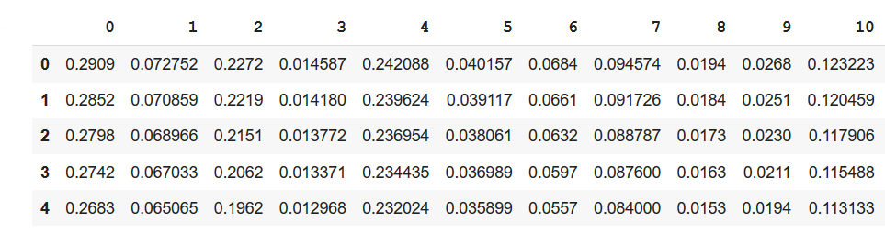
Imputation using MICE

Slide 9
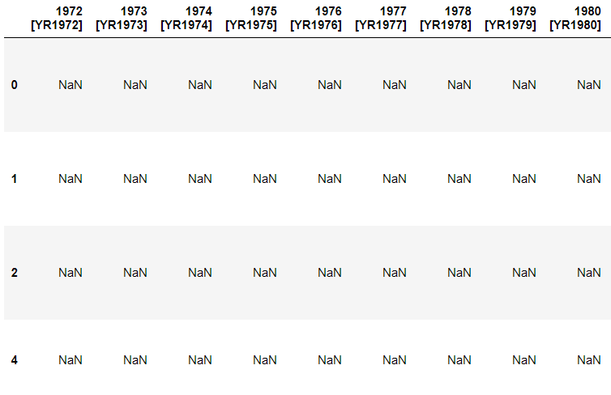
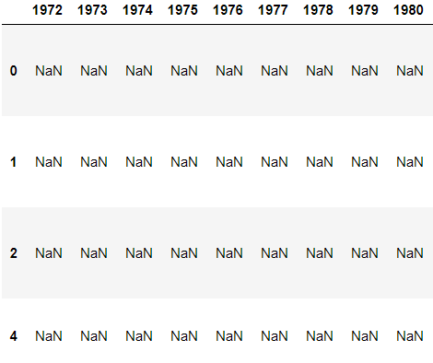
Change in the format of year

Slide 10
Learning Models

Slide 11
Linear Regression
Linear regression is a linear approach to modelling the relationship between a scalar response and one or more explanatory variables.
Linear regression attempts to model the relationship between two variables by fitting a linear equation to observed data. One variable is considered to be an explanatory variable, and the other is considered to be a dependent variable.

Slide 12
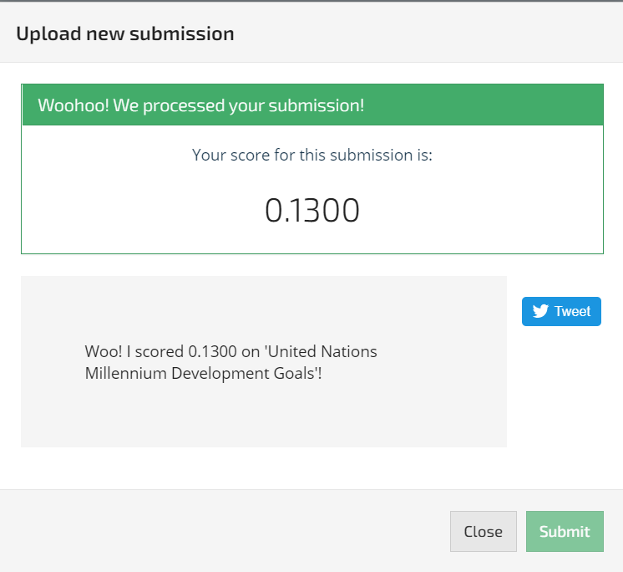
Forward and Backward Filling
Forward filling means fill missing values with previous data.
Backward filling means fill missing values with next data point.

Slide 13
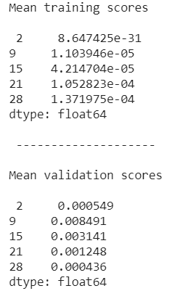
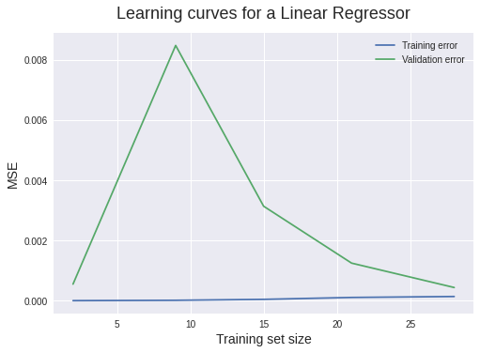
Model Evaluation

Slide 14
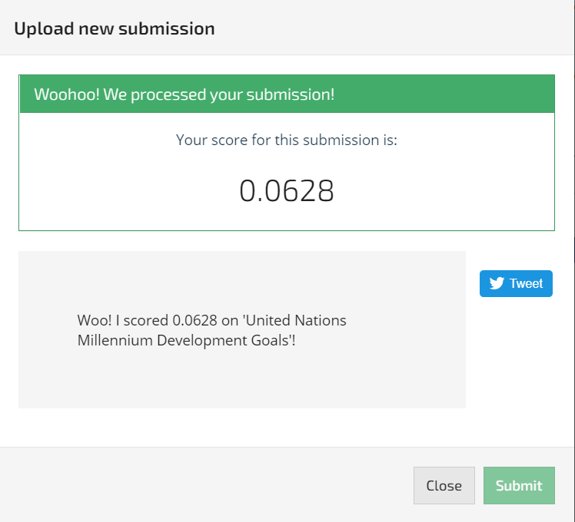
Multivariate Imputation by Chained Equation (MICE)
MICE is a multiple imputation method used to replace missing data values in a data set under certain assumptions about the data missingness mechanism (e.g., the data are missing at random, the data are missing completely at random).

Slide 15


Slide 16
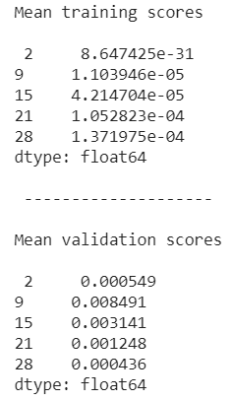
Model Evaluation

Slide 17
Ridge Regression
Ridge regression is a way to create a parsimonious model when the number of predictor variables in a set exceeds the number of observations, or when a data set has multicollinearity (correlations between predictor variables).
The simplest way to answer the question is “Variation of Linear Regression”.

Slide 18
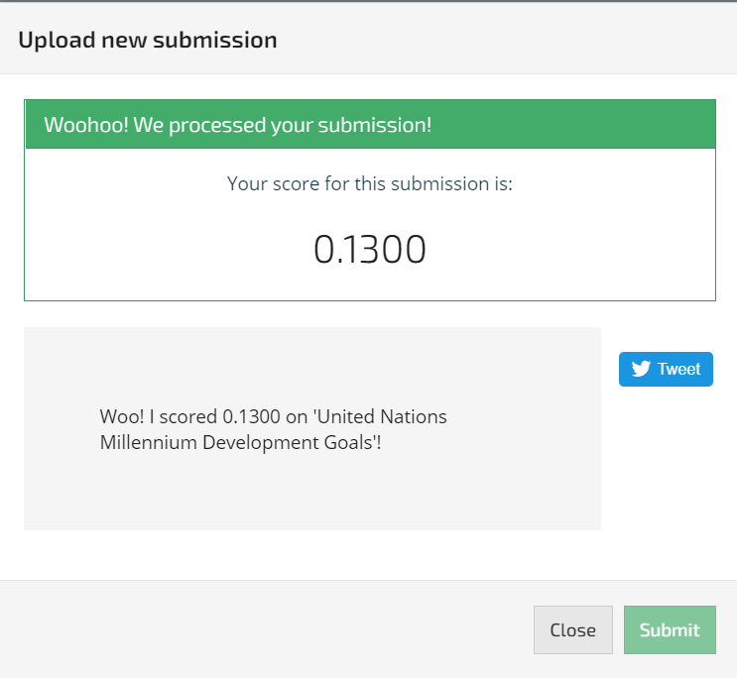
Forward and Backward Filling
Forward filling means fill missing values with previous data.
Backward filling means fill missing values with next data point.

Slide 19
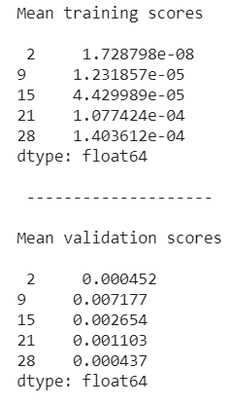
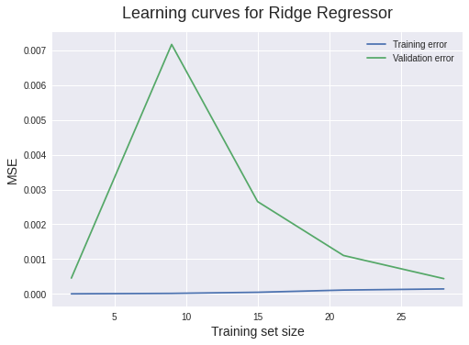
Model Evaluation

Slide 20

Multivariate Imputation by Chained Equation (MICE)
MICE is a multiple imputation method used to replace missing data values in a data set under certain assumptions about the data missingness mechanism (e.g., the data are missing at random, the data are missing completely at random).

Slide 21
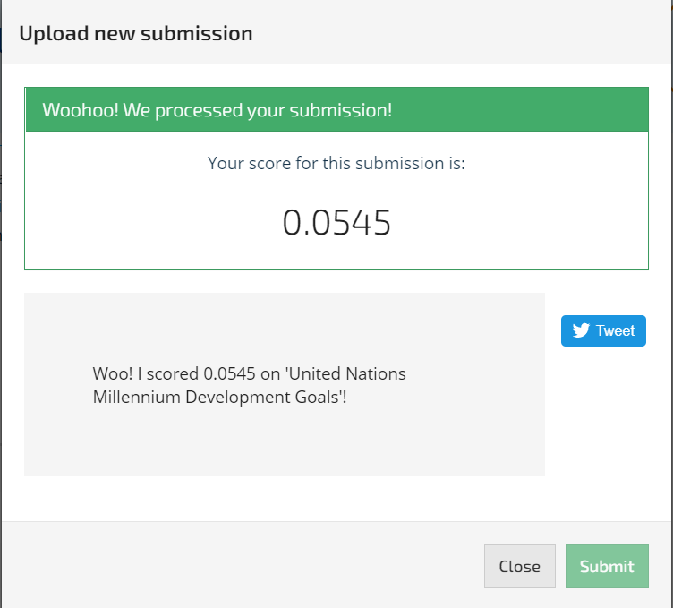

Slide 22
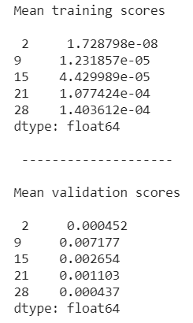
Model Evaluation

Slide 23
ARIMA Model ( AutoRegressive Integrated Moving Average)
A model that can forecast a time series using the series past values.
The term Auto Regressive(AR) means it is a linear regression model that uses its own lags as predictors.
A Moving Average(MA) model is a linear combination of the past white noise terms.
Combination of Autoregressive(AR) and Moving Average (MA) model.

Slide 24
WHY ARIMA Model?
Most common method used in forecasting variables.
Uses the information from variables obtained from the variables itself to forecast the trend.
The variable is regressed on its past values.
Since, the data provided is non-Stationary, we use ARIMA model instead of ARMA model.

Slide 25
Implementation Methods used:
Global Average
Averages is considered Globally (all the countries without segregation) with linear interpolation for pre-processing.
Continental Average
Averages is considered Continent (country wise segregation) wise with linear interpolation for pre-processing.
Vector Autoregression
A variation of ARIMA, where in other features excluding time-series is also considered.

Slide 26
RMSE Values obtained from variations in ARIMA model:
Global Average
Interpolation (Pre-processing): 0.0505
Backward and Forward Filling (Pre-Processing) : 0.0494
Continental Average
Interpolation (Pre-processing): 0.0615
Backward and Forward Filling (Pre-Processing) : 0.0494
Vector Autoregression
Interpolation (Pre-processing): 0.0492
Backward and Forward Filling (Pre-Processing) : 0.0493

Slide 27
The eight goals (to measure the progress of global development ) are:
To eradicate extreme poverty and hunger
To achieve universal primary education
To promote gender equality and empower women
To reduce child mortality
To improve maternal health
To combat HIV/AIDS, malaria, and other diseases
To ensure environmental sustainability
To develop a global partnership for development

Slide 28
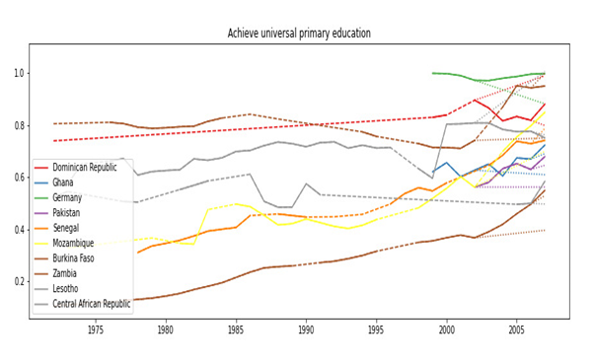
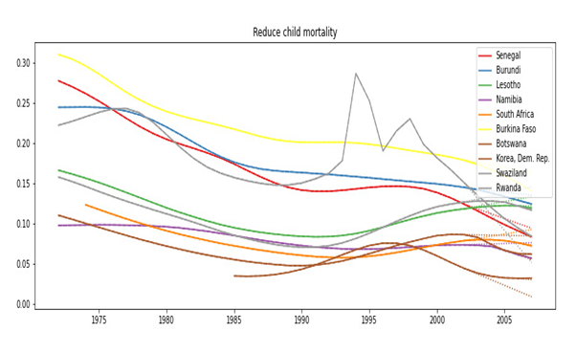
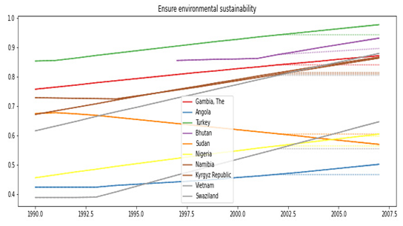
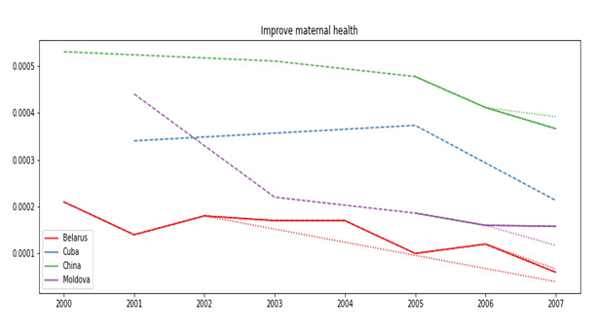

Slide 29
Using Alpha Beta-Filter
An alpha beta filter presumes that a system is adequately approximated by a model having two internal states, where the first state is obtained by integrating the value of the second state over time. Measured system output values correspond to observations of the first model state, plus disturbances.
The alpha and beta coefficients refer to the two scaling factors, where g is the scaling we used for the measurement, and h is the scaling for the change in measurement over time .

Slide 30
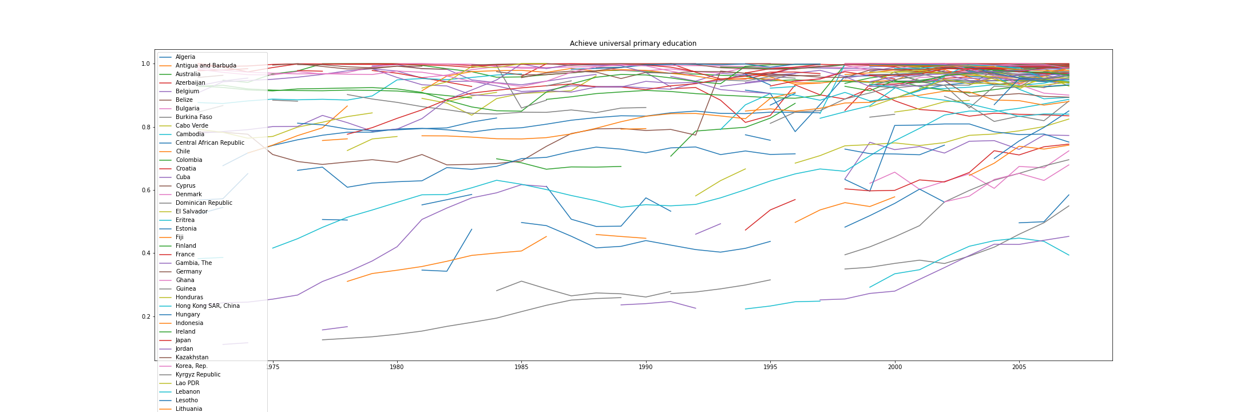
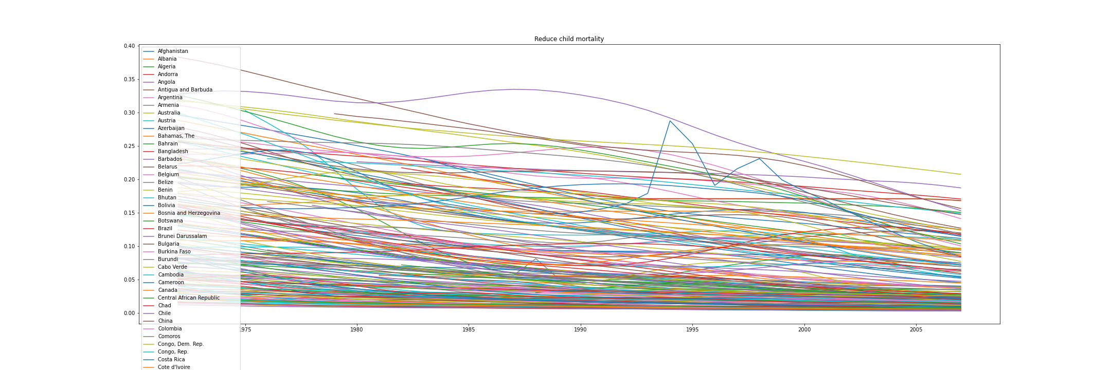

Slide 31
Individual Contribution:
Understanding the problem -
The entire exploratory data analysis was done together by virtual meets.
Data Pre-processing -
This phase also includes equal contribution from every member.
Each one of us worked on at least one preprocessing technique.
Learning Models -
Since we had to try out different combinations of data filling methods and learning models, we discussed on various models and filling methods and what to decide.
Then we split team into size of 2 and we are implementing various combinations of the filling methods and models, by adopting pair programming technique.

Slide 32
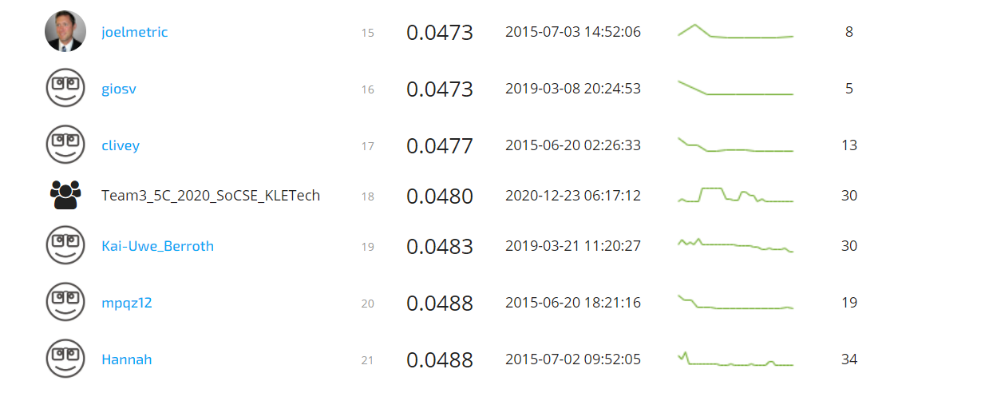
Leaderboard Ranking : 18 ( Out of 3229 )

Slide 33
Results:
Linear Models like Linear Regression and Ridge Regression did considerably well on the data. ARIMA model being a model preferred for time series data, did much better to predict the values for the years 2008 and 2012. A further variation of ARIMA used, Vector AutoRegression provided a lesser RMSE score with different pre-processing techniques.
The final model uses Kalman-filter which is alpha-beta filter or also known as gh filter.
Conclusions:
As there is a fair amount of missing data in the training dataset, the main step was to fill in the missing data, for which we used different techniques.
Indicators being the factor determining the progress, is considered to build different models and obtain results.

Slide 34
Thankyou.

