Slide 1

Data Mining and Analysis
5DMACP11
UNITED NATIONS MILLENNIUM DEVELOPMENT GOALS
Name | Roll No | USN
Saloni Shah | 363 | 01FE18BCS183
Samarth Mummigatti | 364 | 01FE18BCS184
Samarth R | 365 | 01FE18BCS185
Sanjana Kambar | 370 | 01FE18BCS190

Slide 2
Introduction
The member states of United Nations has set goals to measure the progress of global development which aims to increase standards of living around the world by emphasizing human capital, infrastructure and human rights.
The Data is been aggregated from 1972-2007 on over 1200 macroeconomic indicators in 214 countries around the world.
Given the data from 1972-2007 we need to predict a specific indicator for the goals in 2008 and 2012.
Competition End Date : Feb. 5,2021

Slide 3
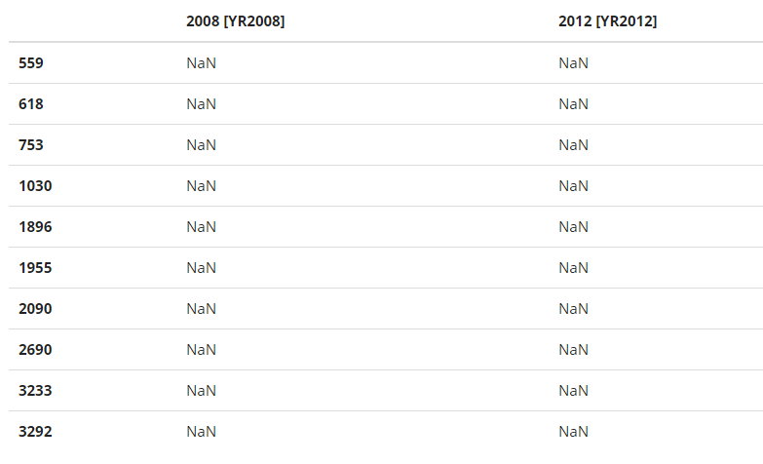
Test Data
Given in the file SubmissionRows.csv
Index of the columns to be predicted for the year 2008 and 2012
Shape = (737,2)

Slide 4
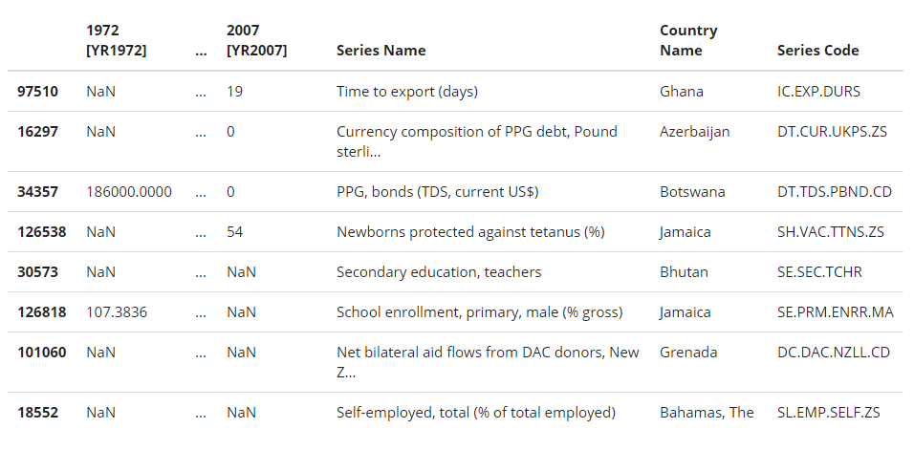
Training Data
Given in the file TrainingSet.csv
Quantitative values of various measures of each country from 1972 to 2007
Shape of the data = (195402,40)
Implies
Size of the data = 195402
Number of Columns = 40
1st column - index
2nd to 37th - years (1972-2007)
38th - Country Name
39th - Series Code
40th - Series Name
Each Row

Slide 5
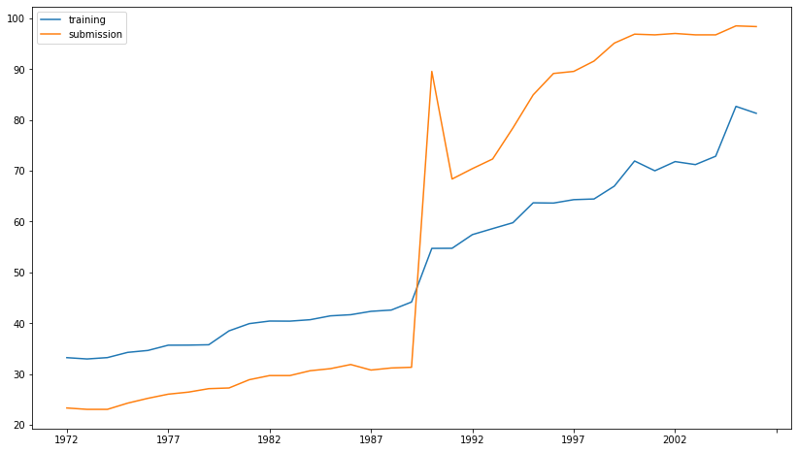
Non Nan Values

Slide 6
Learning Models

Slide 7
Linear Regression
Linear regression is a linear approach to modelling the relationship between a scalar response and one or more explanatory variables.
Linear regression attempts to model the relationship between two variables by fitting a linear equation to observed data. One variable is considered to be an explanatory variable, and the other is considered to be a dependent variable.

Slide 8
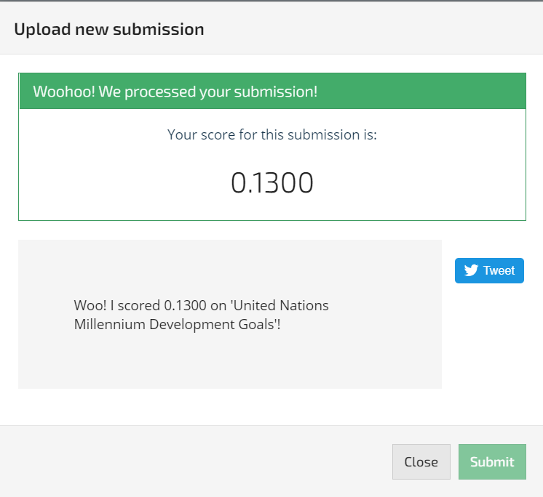
Forward and Backward Filling
Forward filling means fill missing values with previous data.
Backward filling means fill missing values with next data point.

Slide 9
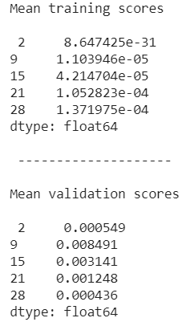
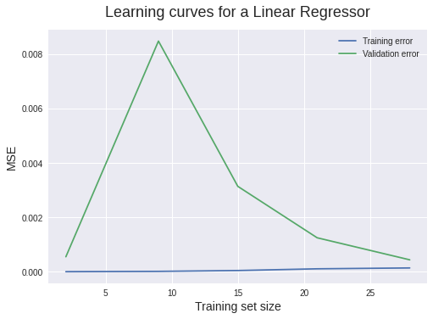
Model Evaluation

Slide 10
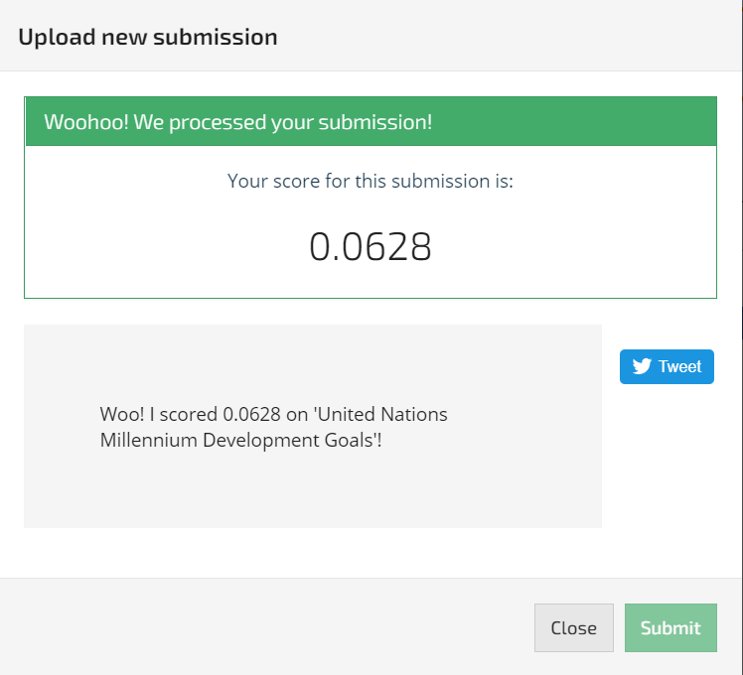
Multivariate Imputation by Chained Equation (MICE)
MICE is a multiple imputation method used to replace missing data values in a data set under certain assumptions about the data missingness mechanism (e.g., the data are missing at random, the data are missing completely at random).

Slide 11


Slide 12
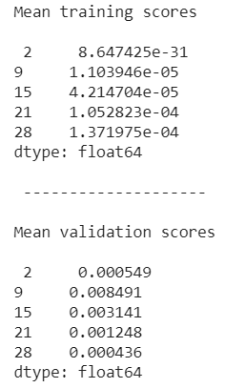
Model Evaluation

Slide 13
Ridge Regression
Ridge regression is a way to create a parsimonious model when the number of predictor variables in a set exceeds the number of observations, or when a data set has multicollinearity (correlations between predictor variables).
The simplest way to answer the question is “Variation of Linear Regression”.

Slide 14
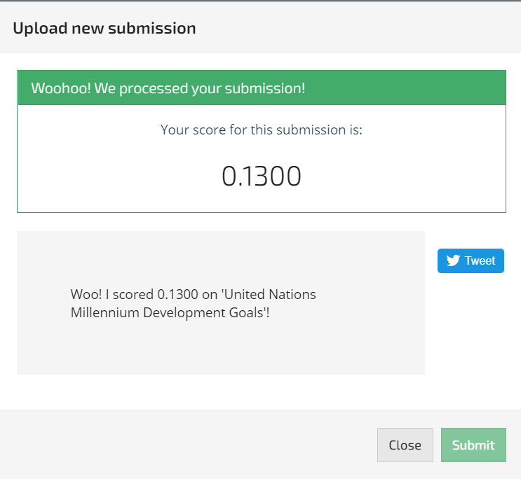
Forward and Backward Filling
Forward filling means fill missing values with previous data.
Backward filling means fill missing values with next data point.

Slide 15
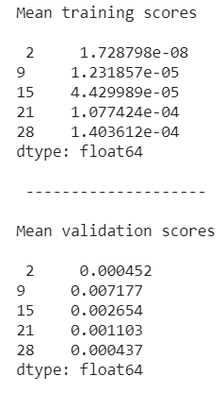
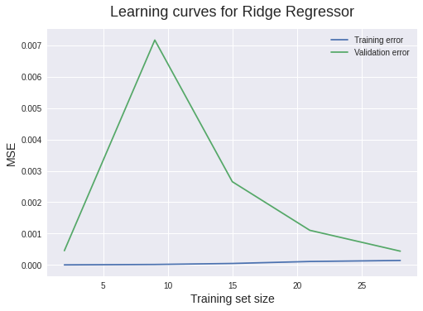
Model Evaluation

Slide 16

Multivariate Imputation by Chained Equation (MICE)
MICE is a multiple imputation method used to replace missing data values in a data set under certain assumptions about the data missingness mechanism (e.g., the data are missing at random, the data are missing completely at random).

Slide 17
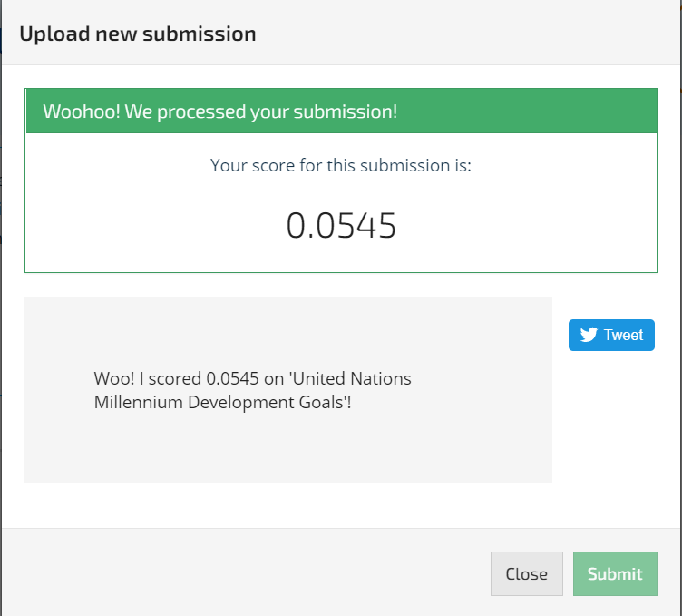

Slide 18
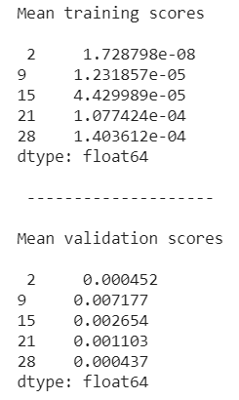
Model Evaluation

Slide 19
ARIMA Model ( AutoRegressive Integrated Moving Average)
A model that can forecast a time series using the series past values.
The term Auto Regressive(AR) means it is a linear regression model that uses its own lags as predictors.
A Moving Average(MA) model is a linear combination of the past white noise terms.
Combination of Autoregressive(AR) and Moving Average (MA) model.

Slide 20
WHY ARIMA Model?
Most common method used in forecasting variables.
Uses the information from variables obtained from the variables itself to forecast the trend.
The variable is regressed on its past values.
Since, the data provided is non-Stationary, we use ARIMA model instead of ARMA model.

Slide 21
Implementation Methods used:
Global Average
Averages is considered Globally (all the countries without segregation) with linear interpolation for pre-processing.
Continental Average
Averages is considered Continent (country wise segregation) wise with linear interpolation for pre-processing.
Vector Autoregression
A variation of ARIMA, where in other features excluding time-series is also considered.

Slide 22
RMSE Values obtained from variations in ARIMA model:
Global Average
Interpolation (Pre-processing): 0.0505
Backward and Forward Filling (Pre-Processing) : 0.0494
Continental Average
Interpolation (Pre-processing): 0.0615
Backward and Forward Filling (Pre-Processing) : 0.0494
Vector Autoregression
Interpolation (Pre-processing): 0.0492
Backward and Forward Filling (Pre-Processing) : 0.0493

Slide 23
The eight goals (to measure the progress of global development ) are:
To eradicate extreme poverty and hunger
To achieve universal primary education
To promote gender equality and empower women
To reduce child mortality
To improve maternal health
To combat HIV/AIDS, malaria, and other diseases
To ensure environmental sustainability
To develop a global partnership for development

Slide 24
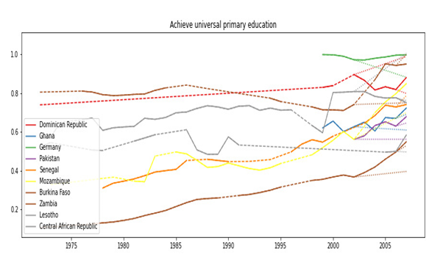
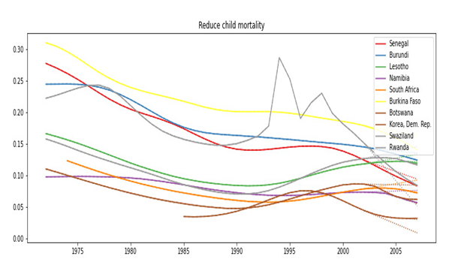
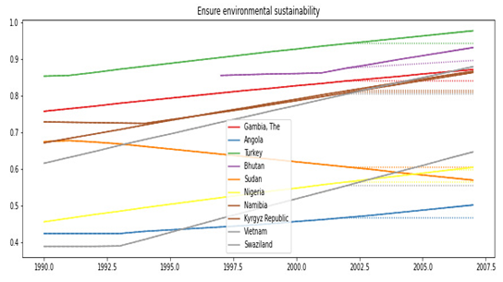
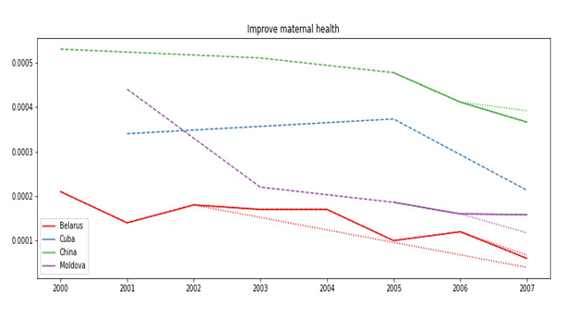

Slide 25
Individual Contribution:
Understanding the problem -
The entire exploratory data analysis was done together by virtual meets.
Data Pre-processing -
This phase also includes equal contribution from every member.
Each one of us worked on at least one preprocessing technique.
Learning Models -
Since we had to try out different combinations of data filling methods and learning models, we discussed on various models and filling methods and what to decide.
Then we split team into size of 2 and we are implementing various combinations of the filling methods and models, by adopting pair programming technique.

Slide 26
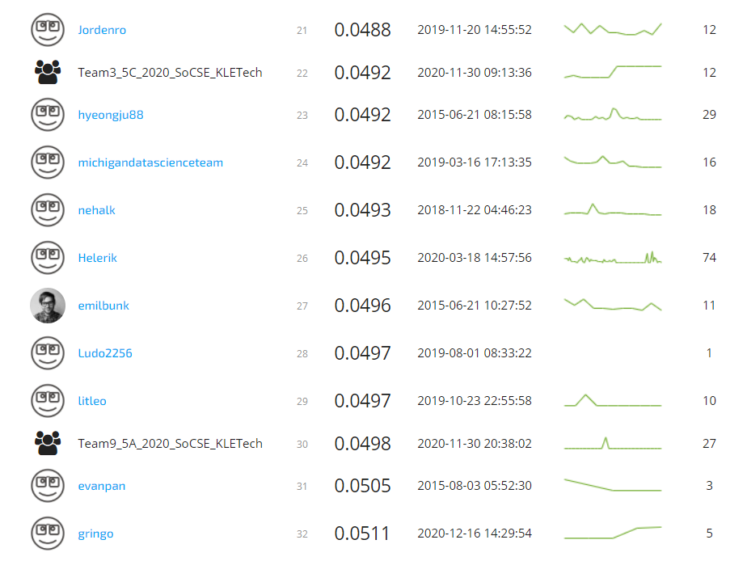
Leaderboard Ranking : 22

Slide 27
Thankyou.

