Slide 1

Data Mining and Analysis
5DMACP11
UNITED NATIONS MILLENNIUM DEVELOPMENT GOALS
Name | Roll No | USN
Saloni Shah | 363 | 01FE18BCS183
Samarth Mummigatti | 364 | 01FE18BCS184
Samarth R | 365 | 01FE18BCS185
Sanjana Kambar | 370 | 01FE18BCS190

Slide 2
Introduction
The member states of United Nations has set goals to measure the progress of global development which aims to increase standards of living around the world by emphasizing human capital, infrastructure and human rights.
The Data is been aggregated from 1972-2007 on over 1200 macroeconomic indicators in 214 countries around the world.
Given the data from 1972-2007 we need to predict a specific indicator for the goals in 2008 and 2012.
Competition End Date : Feb. 5,2021

Slide 3
Indicators
There are 7 unique series code in the row ids provided in the submission.csv
array(['7.8', '8.16', '4.1', '6.1', '2.1', '5.1', '6.7'], dtype=object)
Each of these numbers are indicators towards the developmental goals:
environmental sustainability - 7.8
global partnership among nations - 8.16
reduced child mortality - 4.1
combat HIV - 6.1
ensure primary education - 2.1
maternal healthcare - 5.1
combat malaria and other diseases - 6.7

Slide 4
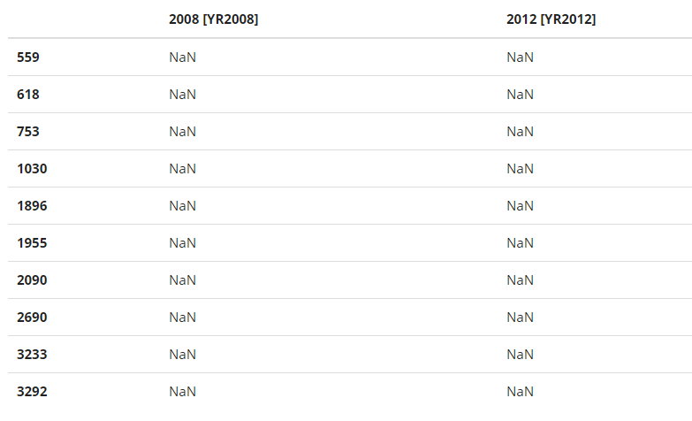
Test Data
Given in the file SubmissionRows.csv
Index of the columns to be predicted for the year 2008 and 2012
Shape = (737,2)

Slide 5
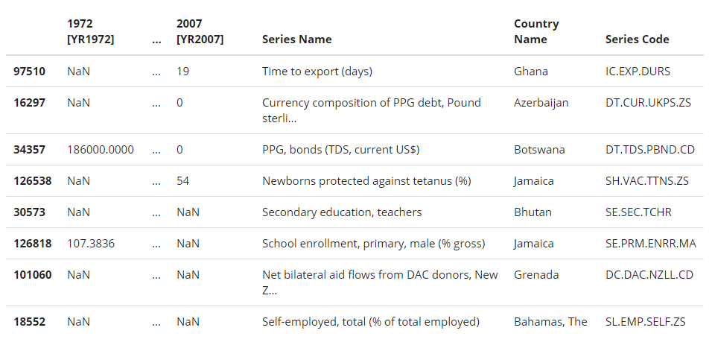
Training Data
Given in the file TrainingSet.csv
Quantitative values of various measures of each country from 1972 to 2007
Shape of the data = (195402,40)
Implies
Size of the data = 195402
Number of Columns = 40
1st column - index
2nd to 37th - years (1972-2007)
38th - Country Name
39th - Series Code
40th - Series Name
Each Row

Slide 6
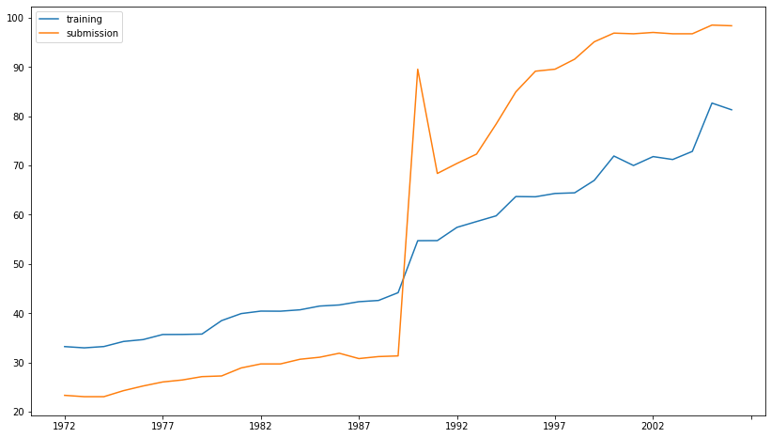
Non Nan Values

Slide 7
Data Pre-Processing
Data Cleaning
I. Handling Missing Values.
2. Data Reduction
The available training dataset has already underwent data reduction process by removing the rows which has all the values filled with NaN.

Slide 8
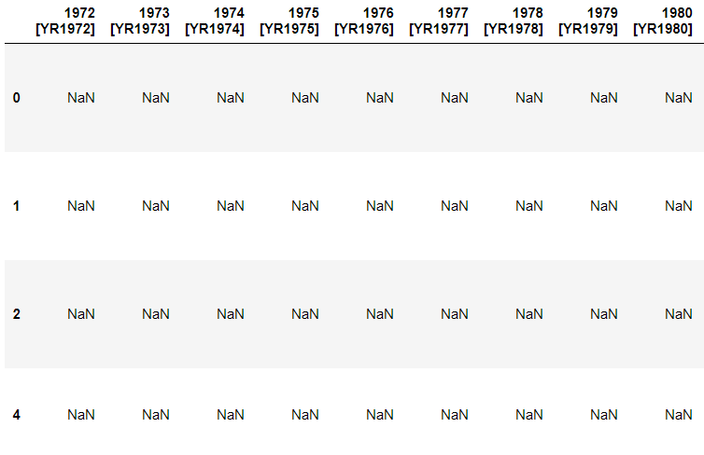
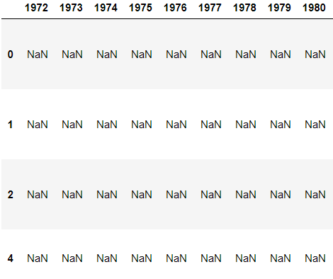
3. Data Transformation
Change in the format of year

Slide 9
Data Cleaning
Imputation using (mean/median) values:
This works by calculating the mean/median of the non-missing values in a column and then replacing the missing values within each column separately and independently from the others. It can only be used with numeric data.
Pros:
Easy and fast.
Works well with small numerical datasets.
Cons:
Doesn’t factor the correlations between features. It only works on the column level.
Not very accurate.
Doesn’t account for the uncertainty in the imputations.

Slide 10
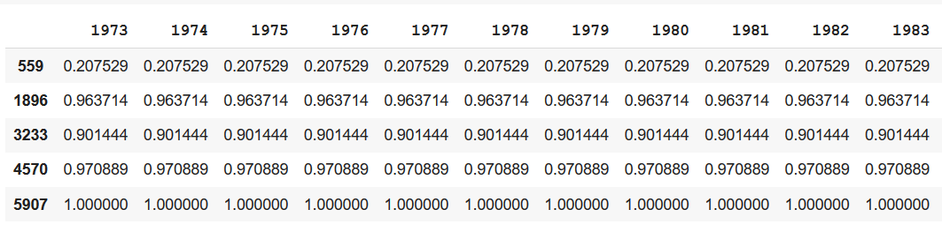
Imputation using mean values
environmental_sustainability_numeric2.head()

Slide 11
Data Cleaning
2. Imputation Iterative/Multiple- Imputation:
Iterative imputation refers to a process where each feature is modeled as a function of the other features, e.g. a regression problem where missing values are predicted. Each feature is imputed sequentially, one after the other, allowing prior imputed values to be used as part of a model in predicting subsequent features.
Pros:
No biases (if imputation model is correct).
Cons:
Have to think about imputation model in addition to analysis model.

Slide 12
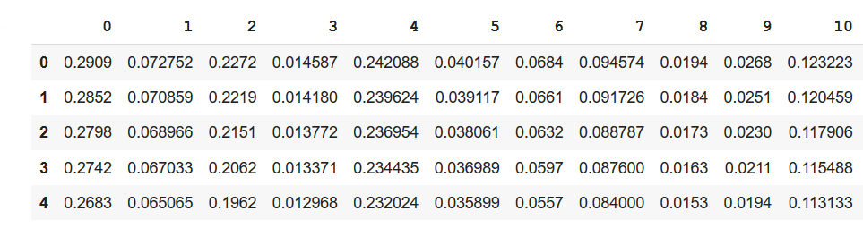
Imputation using MICE

Slide 13
Data Cleaning
3. Last observation carried forward (LOCF) or Forward Filling :
Last observation carried forward (LOCF) is a method of imputing missing data in longitudinal studies. Replaces each missing value with the most recent present value prior to it. LOCF is used to maintain the sample size and to reduce the bias.

Slide 14
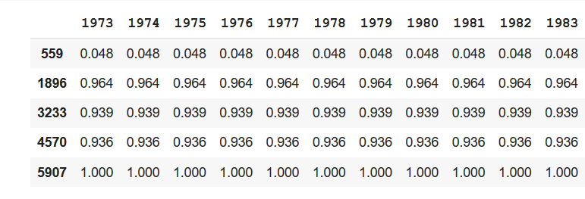
Imputation using LOCF:
environmental_sustainability_numeric2.head()

Slide 15
Data Cleaning
4. Next observation carried backward (NOCB) or Backward Filling:
Next observation carried backward (NOCB) is a method of imputing missing data in longitudinal studies. Replaces each missing value with the most recent present value from the back.

Slide 16
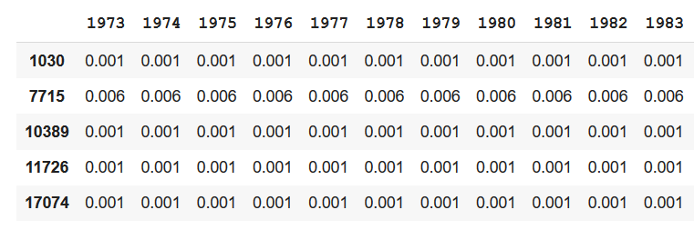
Imputation using NOCB:
combat_HIV_numeric2.head()

Slide 17
Data Cleaning
5. Imputation Using k-NN:
k-NN imputes the missing attribute values on the basis of nearest K neighbour. Neighbours are determined on the basis of distance measure. Once K neighbours are determined, missing value are imputed by taking mean/median or mode of known attribute values of missing attribute.
Pros:
Can be much more accurate than the mean, median or most frequent imputation methods.
Cons:
Computationally expensive. KNN works by storing the whole training dataset in memory.
K-NN is quite sensitive to outliers in the data

Slide 18
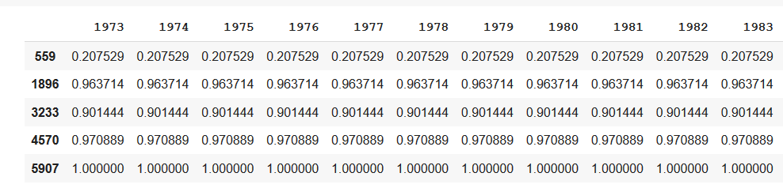
Imputation using K-NN:
environmental_sustainability_numeric

Slide 19
Thankyou.

