Slide 1

Data Mining and Analysis
5DMACP11
UNITED NATIONS MILLENNIUM DEVELOPMENT GOALS
Name | Roll No | USN
Saloni Shah | 363 | 01FE18BCS183
Samarth Mummigatti | 364 | 01FE18BCS184
Samarth R | 365 | 01FE18BCS185
Sanjana Kambar | 370 | 01FE18BCS190

Slide 2
Introduction
The member states of United Nations has set goals to measure the progress of global development which aims to increase standards of living around the world by emphasizing human capital, infrastructure and human rights.
The Data is been aggregated from 1972-2007 on over 1200 macroeconomic indicators in 214 countries around the world.
Given the data from 1972-2007 we need to predict a specific indicator for the goals in 2008 and 2012.
Competition End Date : Feb. 5,2021

Slide 3
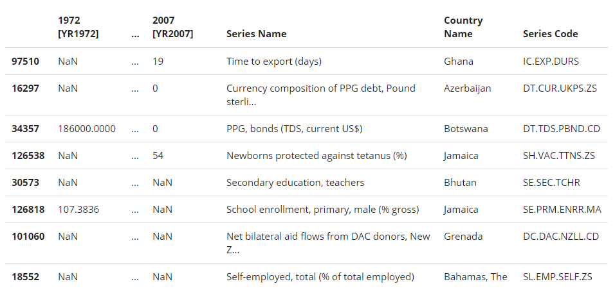
Training Data
Given in the file TrainingSet.csv
Quantitative values of various measures of each country from 1972 to 2007
Shape of the data = (195402,40)
Implies
Size of the data = 195402
Number of Columns = 40
1st column - index
2nd to 37th - years (1972-2007)
38th - Country Name
39th - Series Code
40th - Series Name
Each Row

Slide 4
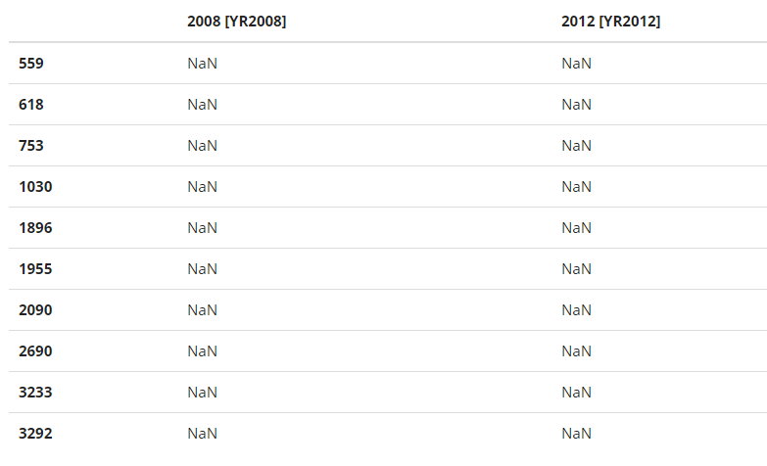
Test Data
Given in the file SubmissionRows.csv
Index of the columns to be predicted for the year 2008 and 2012
Shape = (737,2)

Slide 5
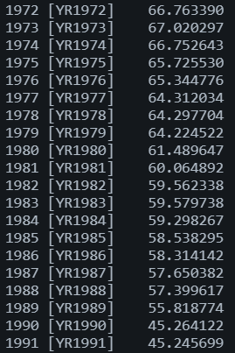
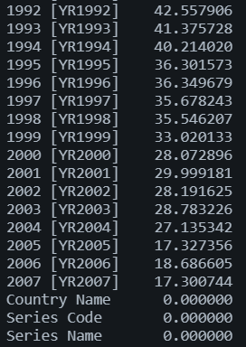
Missing Values (in each column)

Slide 6
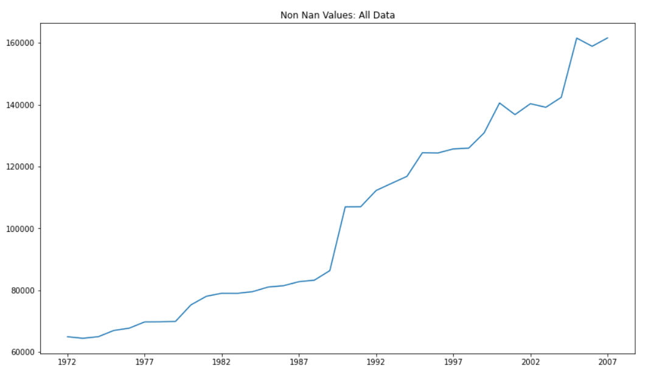

Slide 7
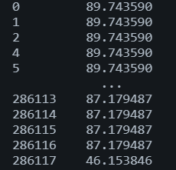
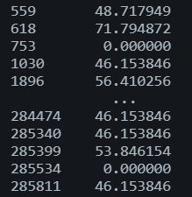
Missing Values (in each row)

Slide 8
Ways of dealing with missing values
Drop the rows/columns with null values (any or all)
Filling null values with 0
Filling null values with previous values
Filling null values with next values
Replace the value with mean
Replace the value with median
Replace the value with mode
Interpolate the missing values

Slide 9
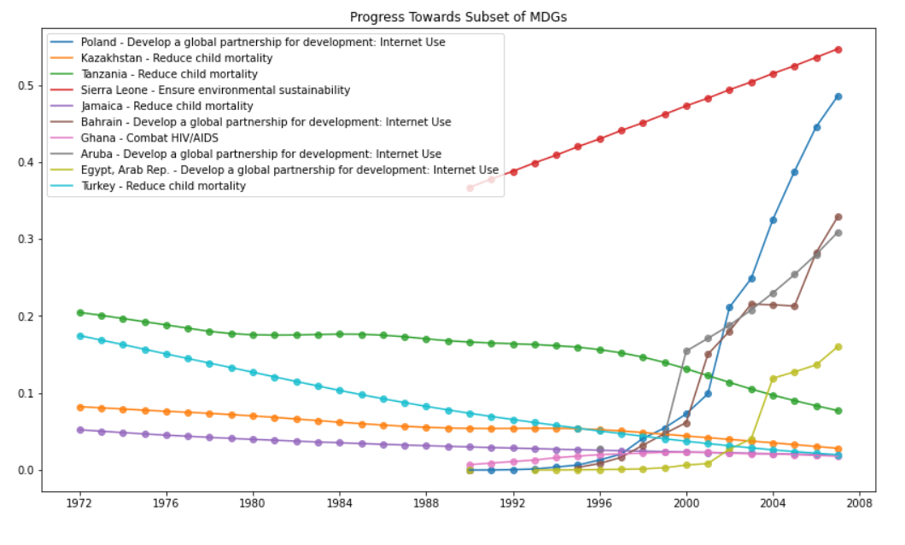
Trends of some of the attributes to be predicted

