Slide 1

Improving Term Deposit Subscription Rates through Data-Driven Customer Segmentation and Campaign Optimization
A BDM Capstone Project using Secondary Data Analysis
Saloni Singh
Roll Number: 24DS1000028
IITM Online BS Degree Program

Slide 2
Metadata & descriptive statistics
Variable | Description | Data Type | Range / Values
age | Age of the customer | Numeric | 18 to 95
job | Type of job | Categorical | ‘admin.’, ‘unknown’, ‘unemployed’, ‘management’, ‘retired’, ‘housemaid’, ‘entrepreneur’, ‘student’, ‘blue-collar’, ‘self-employed’, ‘technician’, ‘services’
marital | Marital status | Categorical | ‘married’, ‘divorced’, ‘single’
education | Education level | Categorical | ‘unknown’, ‘secondary’, ‘primary’, ‘tertiary’
default | Has credit in default? | Binary | ‘yes’, ‘no’
balance | Average yearly balance | Numeric | -6847 to 81204 (in Euros)
housing | Has housing loan? | Binary | ‘yes’, ‘no’
loan | Has personal loan? | Binary | ‘yes’, ‘no’
contact | Communication type | Categorical | ‘unknown’, ‘telephone’, ‘cellular’
day | Last contact day | Numeric | 1 to 31
month | Last contact month | Categorical | ‘jan’, ‘feb’, ..., ‘dec’
duration | Last contact duration | Numeric | 2 to 3881 (in seconds)
campaign | Number of contacts during this campaign | Numeric | 1 to 63
pdays | Days since last contact | Numeric | -1 to 854 (-1= never contacted)
previous | Number of contacts before this campaign | Numeric | 0 to 58
poutcome | Outcome of previous marketing campaign | Categorical | ‘unknown’, ‘other’, ‘failure’, ‘success’
deposit | Target variable: Subscribed to deposit? | Binary | ‘yes’, ‘no’
Feature | Mean | Median | Std Dev | Min | Max
Age | 41.2 | 39.0 | 11.9 | 18.0 | 95.0
Balance (€) | 1528.5 | 550.0 | 3225.4 | -6847.0 | 81204.0
Duration (s) | 372.0 | 255.0 | 347.1 | 2.0 | 3881.0
Campaign | 2.5 | 2.0 | 2.7 | 1.0 | 63.0
Pdays | 51.3 | -1.0 | 108.8 | -1.0 | 854.0
Previous | 0.8 | 0.0 | 2.3 | 0.0 | 58.0

Slide 3
Organization Background and dataset details
A Portuguese banking institution ran direct marketing campaigns to promote term deposit subscriptions via phone calls.
The project uses a secondary dataset: the Bank Marketing Dataset from the UCI Machine Learning Repository, sourced in its balanced form from Kaggle (11,162 records, 17 variables).
Dataset includes features like age, job, marital status, education, contact type, balance, loan history, number of contacts, call duration, month of contact and past campaign outcomes.
The target variable is whether the customer subscribed to a term deposit (deposit = yes/no).
📂 Dataset Links: UCI Repository | Balanced version: Kaggle
📎 Metadata & Descriptive Statistics

Slide 4



Problem Statement and Objectives
Problem Statement
How can business data management methods be used to improve the targeting and efficiency of telemarketing campaigns aimed at increasing term deposit subscriptions?
Project Objectives
Analyse customer and campaign data to identify key factors influencing subscription behavior.
Derive actionable insights on optimal campaign timing, communication channels, and customer segmentation.
Develop predictive models to support data-driven decision-making and future campaign planning.

Slide 5
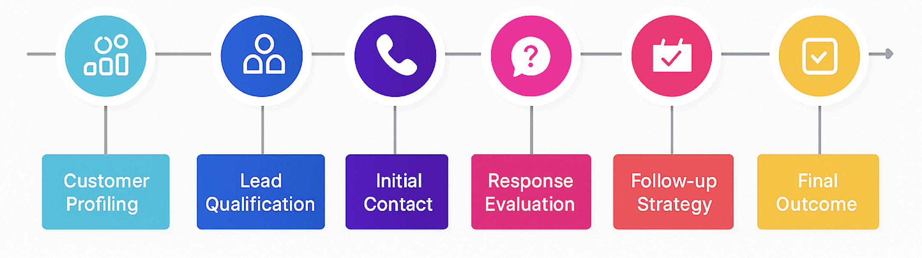
Data Preparation & Analytical Approach
Data Preparation
Handled “unknown” values as valid categories, not dropped.
One-hot encoded nominal features; label encoded binary variables.
Created engineered features: age_group, duration_bucket, month_quarter.
Analytical Approach
Business Process Mapping as seen in the adjacent figure.
EDA with visualizations: grouped bar charts, bubble charts, histograms.
Models: Logistic Regression (feature impact), Decision Tree (rule-based splits).
Customer segmentation: Combining demographic and behavioral attributes to define high/low-performing profiles.
Defined KPIs: success rate, temporal conversion rate, segment-wise conversion.
Tools: Python (Pandas, Seaborn, Scikit-learn) in Google Colab.

Slide 6
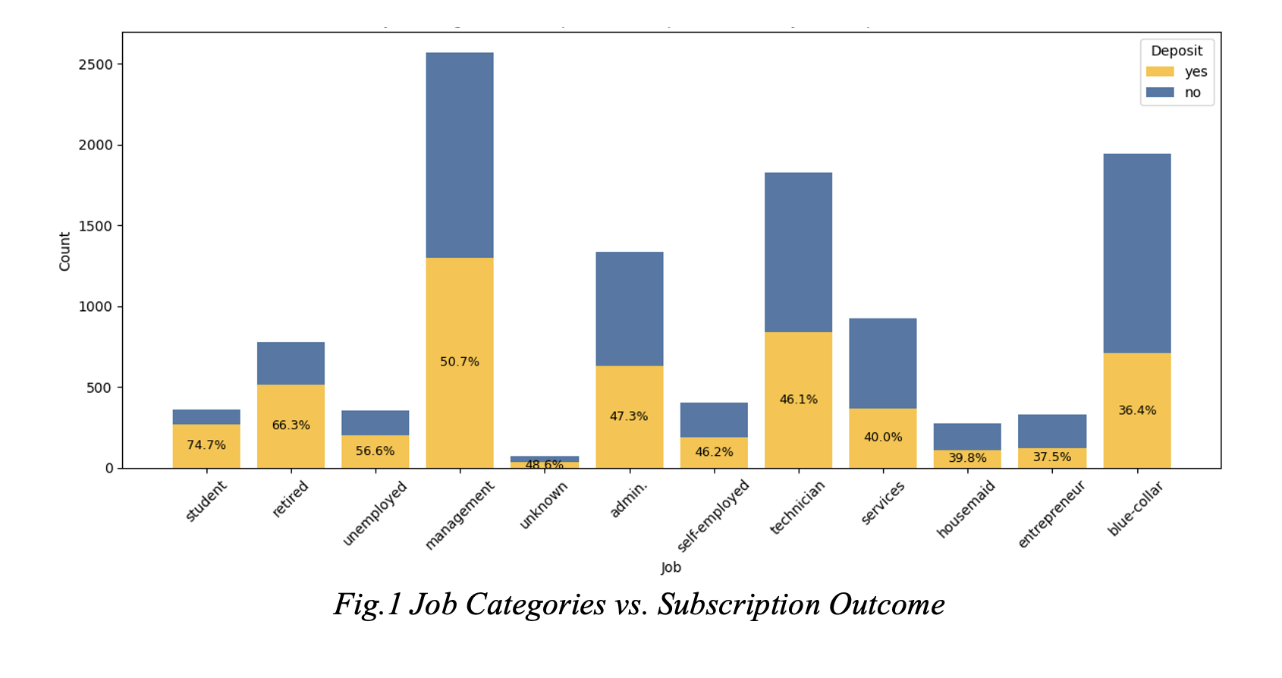
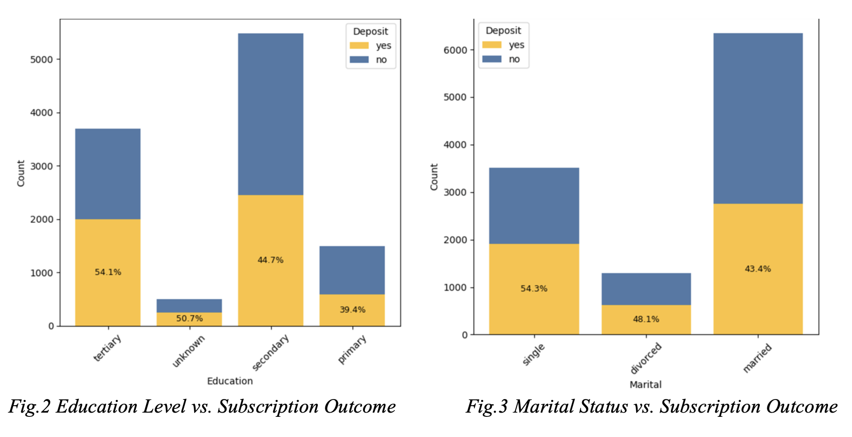

Demographic insights
Students (74.7%) and retired (66.3%) convert highest; Blue-collar underperforms despite size.
Management, admin, and technicians convert moderately but represent sizeable customer groups.
Entrepreneurs, services, and housemaids perform consistently low.
Tertiary-educated convert best; lower education shows weaker response.
Single customers outperform married and divorced in conversion.
Higher balance links to higher subscription; very low balances convert rarely.

Slide 7
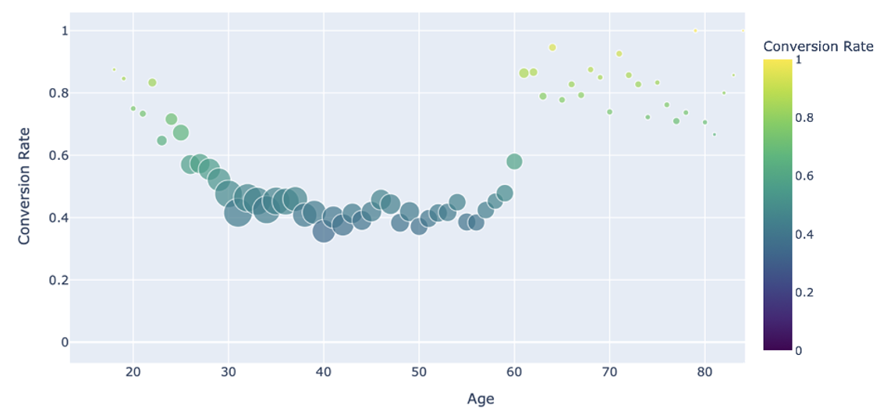
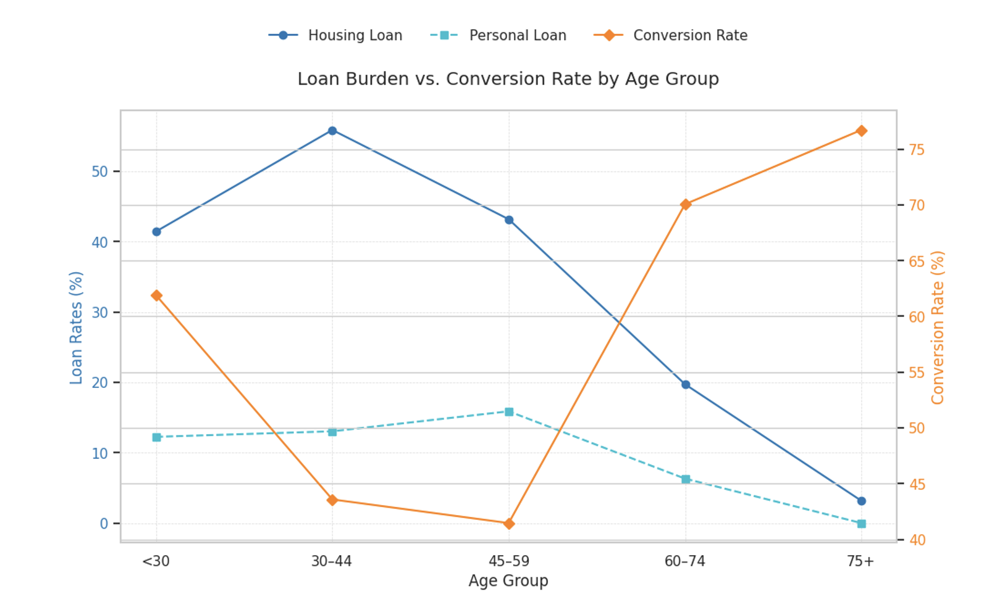
Age & Financial Liability
60+ Segment
Highest conversion rate (~76%), smaller demographic
Minimal debt burden (both housing and personal loans)
Under-30 Segment
High conversion, Smallest segment, Moderate debt
30–44 Segment (Focused Analysis)
Largest demographic (~39% of contacted customers)
Lowest conversion rate (~43%)
Over 55% carry housing loans; highest across all groups
Personal loan exposure also elevated
Frequently appears as a low-performing terminal node in decision tree
45–59 Segment
Moderate-to-large in size, Conversion mirrors 30–44 group, Notable liabilities

Slide 8
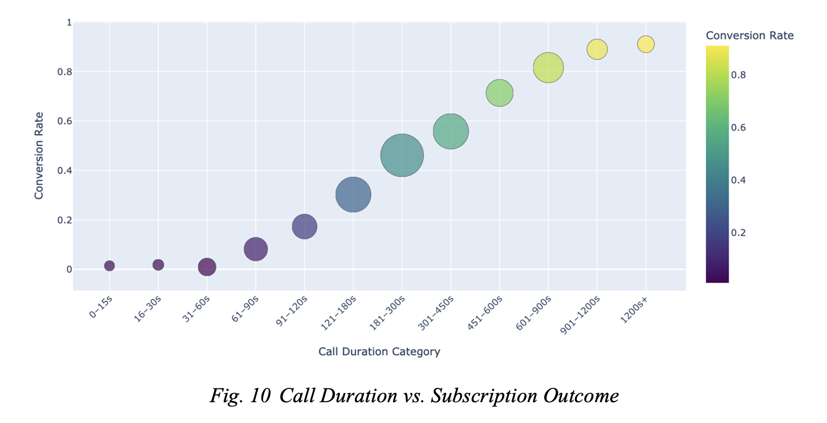
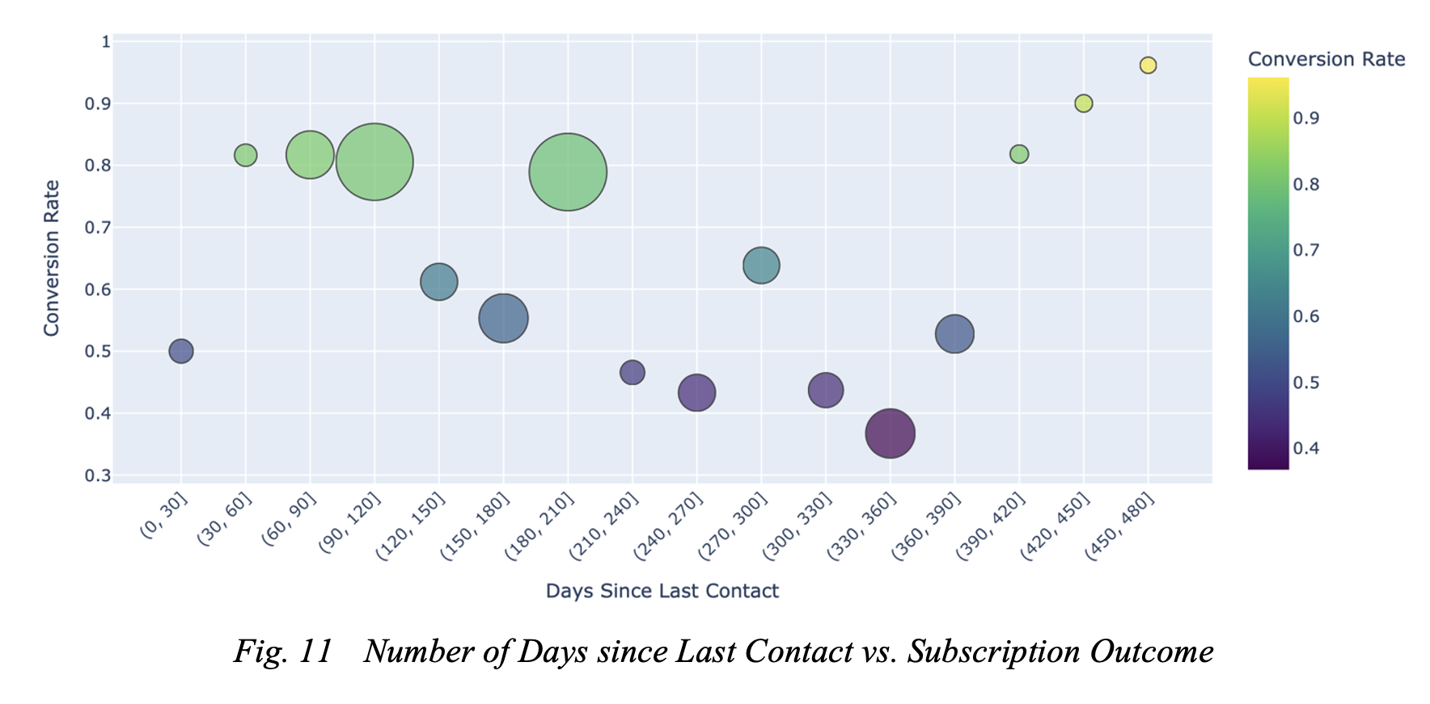
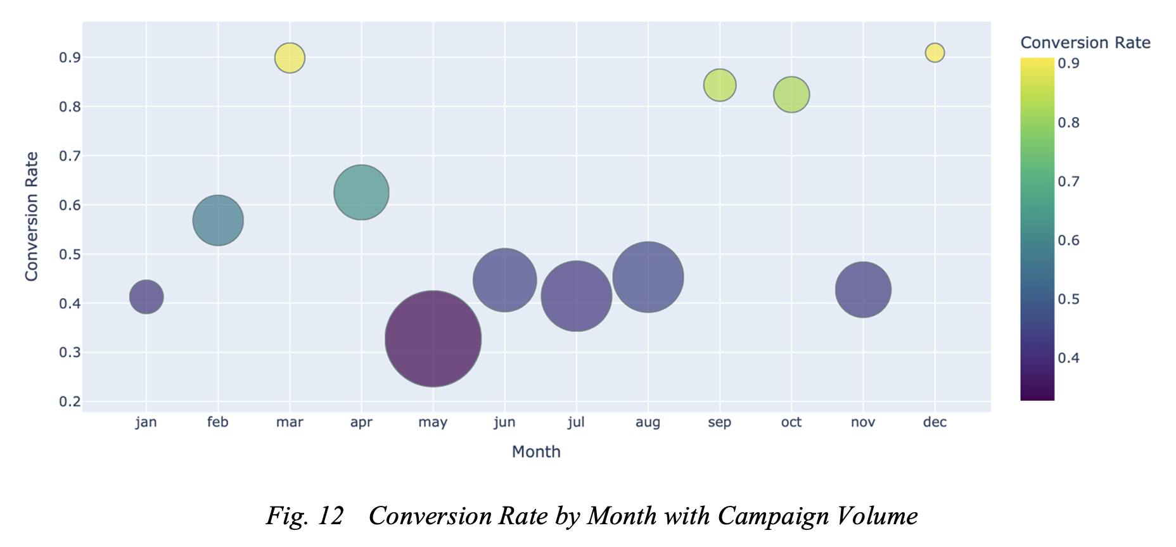
Campaign Strategy &
Call Effectiveness
Call Duration
Conversion rate increases with duration; best results after 180 s.
Calls under 60 seconds rarely convert; too short to convey value
Days Since Last Contact (Pdays)
Spikes at 90 and 180 days suggest effective scheduled follow-ups.
420+ day dormant leads still convert well; valuable to re-engage
Number of Contacts
2–3 attempts yield most conversions
Beyond that, conversion drops; indicating fatigue
Conversion by Month
Top months: December (91%), March (89.9%), September (84.3%), October (82.4%) — high return, low outreach
May: Most contacts but lowest conversion (32.8%)
High-volume months like June–August & Nov showed poor ROI
Notes:
Value -1 (no prior contact) excluded for clarity

Slide 9
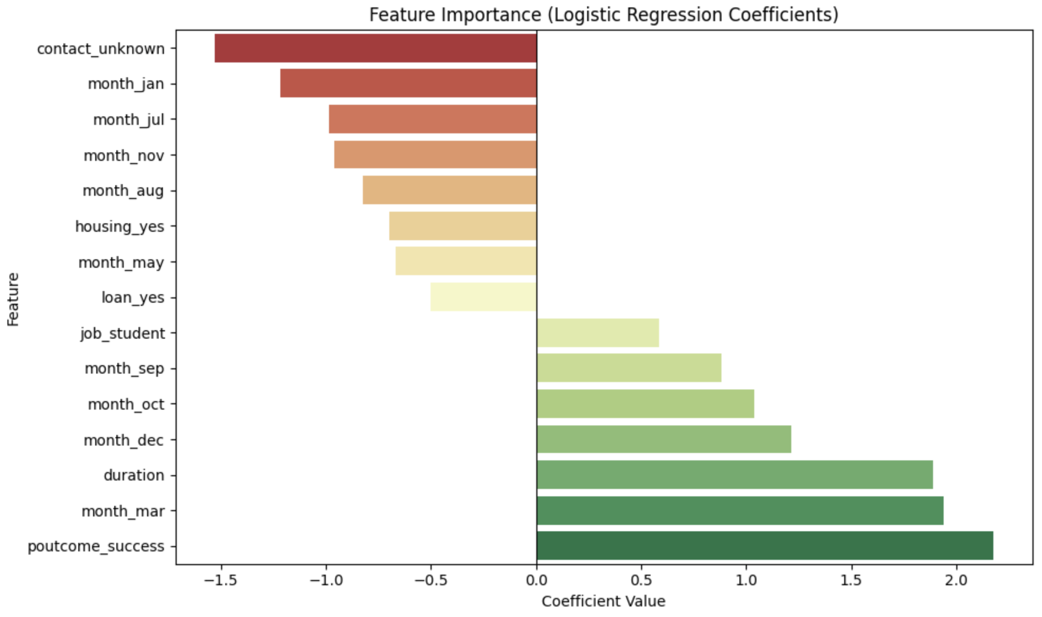
Predictive Modeling for Campaign Optimization
Built predictive models to support strategic, data-driven planning and improve targeting efficiency
Validated patterns seen during EDA using interpretable models to quantify feature impact
Logistic regression highlighted top influencers— past success, call duration, and campaign timing Sep/Oct/Dec/Mar boosted conversion, while unknown contact type, loans, and Jan/Jul/Nov campaigns reduced it.
Decision tree revealed high-conversion paths — long calls, past success, cellular contact, age 60+ — and dead-end patterns like medium calls + unknown contact + age 30–44 etc.
Identified top-performing segments to create actionable campaign profiles for future use

Slide 10
STRATEGIC RECOMMENDATIONS
Leverage High-Converting Segments
To maximize early returns focus on:
Segment-Specific Messaging and Call Strategies
Deprioritize efforts where multiple weak traits overlap
Strategic Engagement of the 30–59 Age Segment
Introduce flexible term deposits with easy withdrawal/top-up
Retired and Student Profiles
Highly Educated Individuals
Long Call Duration (>360s)
Customers with Previous Campaign Success
Senior Customers (Age 60+)
premium deposit schemes,
loyalty-based incentives
Strategically use:
personalized outreach,
A/B test messaging in low-performing but large segments
Reframe short calls to focus on objections and schedule follow-ups
Focus on quick rapport-building and clarity of product value
Test new scripts in borderline segments to unlock untapped potential (E.g.: Blue-collar workers)
Offer loan-linked products for better returns to borrowers
Promote tax-saving deposit schemes
Encourage micro-savings via digital salary-linked tools
Frame campaigns around life goals and milestones
Segment represents over 60% of contacts but shows low conversion

Slide 11
STRATEGIC RECOMMENDATIONS
Timing Optimization
Prioritize March, September, October, December — high conversion despite moderate outreach
Data Quality Enhancement
Continuous Feedback & Monitoring
Integrate predictive models into CRM to auto-score leads for real-time targeting
Reduce campaigns during May, June, July — poor returns despite effort
Conduct controlled experiments in peak months to identify success drivers
Align campaign timing with responsive months to reduce fatigue and improve ROI
Investigate sources of “unknown” data and vet low-quality acquisition channels
Impute or cluster “unknown” entries to reclassify them into useful segments
High proportion of “unknown values” linked to low conversion, so Improved data will directly enhance model precision and targeting
Capture customer feedback & agent insights post-call for continuous refinement
Track KPIs like conversion rate, segment performance, contact-to-conversion ratios
Create a structured process to document what worked (or didn’t) in each cycle
Enforce mandatory data capture via CRM prompts

