Slide 1


Purdue University
Prepared by :-
● Student name: Saloni Trivedi
● Roll no: 201
● Enrollment no: 22002171220100
● Batch: B6
● Branch :CSE

Slide 2
Agenda
Introduction
Technologies used
Functionalities
Output

Slide 3
Introduction
Purdue University website is made using HTML, CSS, and JavaScript and is designed and developed using three different programming languages. HTML (Hypertext Markup Language) is used for creating the structure and content of the website, CSS (Cascading Style Sheets) is used for styling and formatting the website, and JavaScript is used for adding interactive elements and dynamic functionality to the website.

Slide 4
Technologies used
HTML
CSS
JavaScript
HTML is used to
Create the basic structure of the website
Organizing content
Embedding multimedia content
Creating hyperlinks
CSS is used to
Define the visual design and layout
Responsive
Consistency
Add animation and effects
JavaScript is used to validate form data and ensure that users input the correct data types, such as validating email addresses and phone numbers. This helps to improve the accuracy and completeness of form submissions.

Slide 5
Functionalities
Home page
This includes navigation bar through which user can go to different pages, brief introduction of courses offered, regional campuses with hover effect, top three facilities using grid system, and footer.
About page
This has navigation bar, background image, photo of university along with basic introduction of university,.
Course page
This shows courses offered by Purdue University along with number of courses for each branch. You can also send queries by filling the form.
Contact page
This has map of main campus’ city, address of main campus, along with a form to send message with form validation.

Slide 6
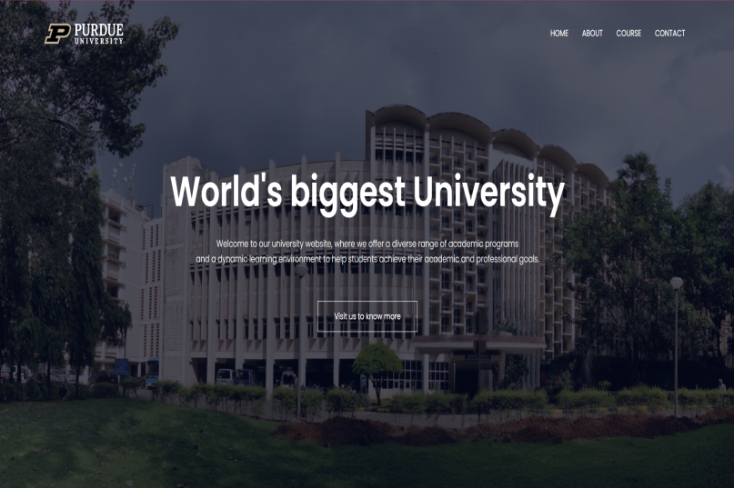
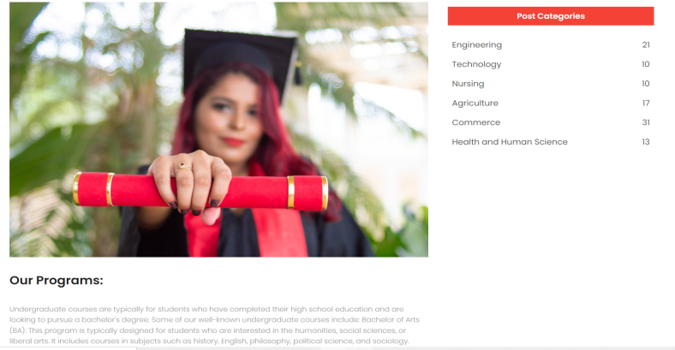
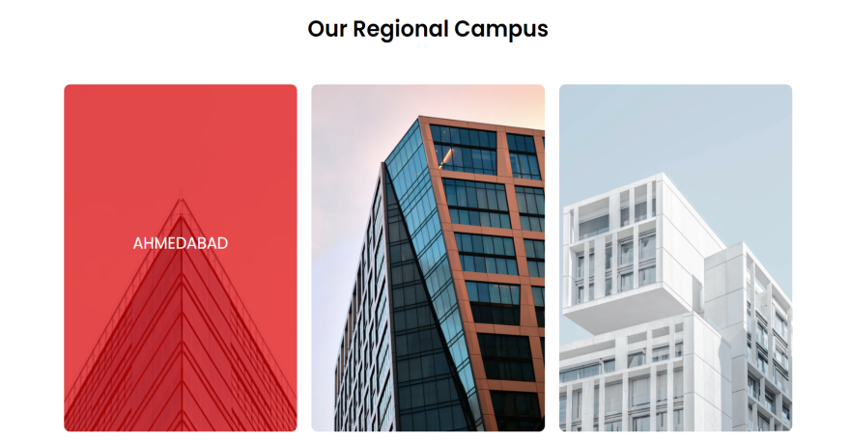
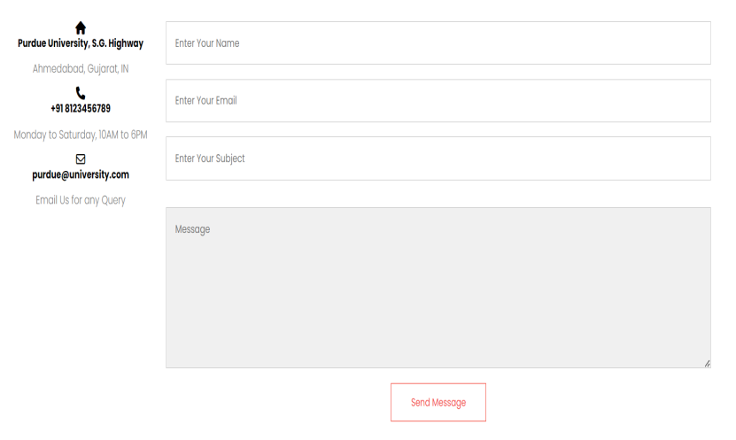
Output
Home
Course
Contact

Slide 7
THANK YOU

