Slide 1
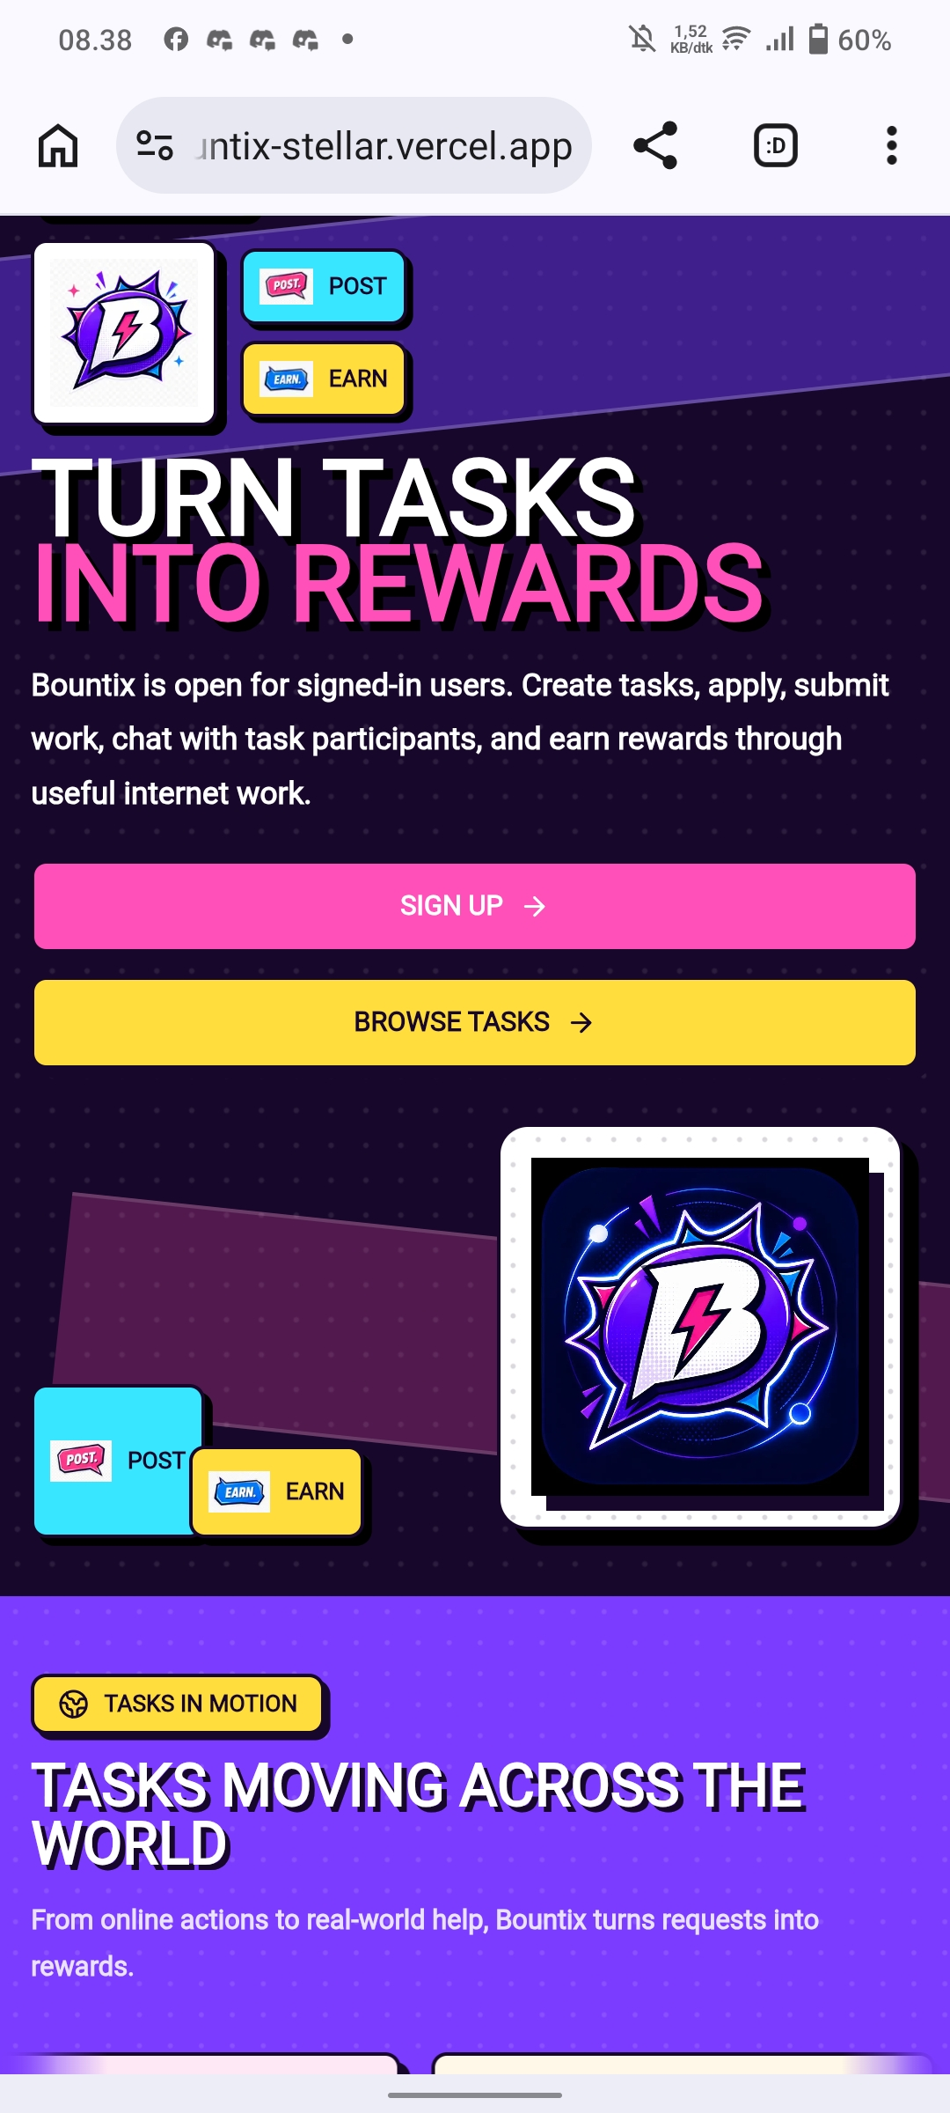
Bountix
Flexible task and service marketplace powered by Stellar escrow
Request help, offer services, coordinate work, and settle payments in one product
Built for micro-work, errands, local services, personal shopping assistance, and community tasks
Uses Stellar USDC escrow to make flexible work safer, trackable, and easier to trust
Marketplace Home
Bountix / 1

Slide 2
The Problem
Everyday work and service requests in SEA often happen through chat groups and social media
Requesters and taskers rely on informal trust instead of clear payment protection
Taskers risk delayed or unpaid work, while requesters risk paying before completion
Most platforms are too rigid for mixed real-world tasks, local services, and personal shopping
Bountix / 2

Slide 3
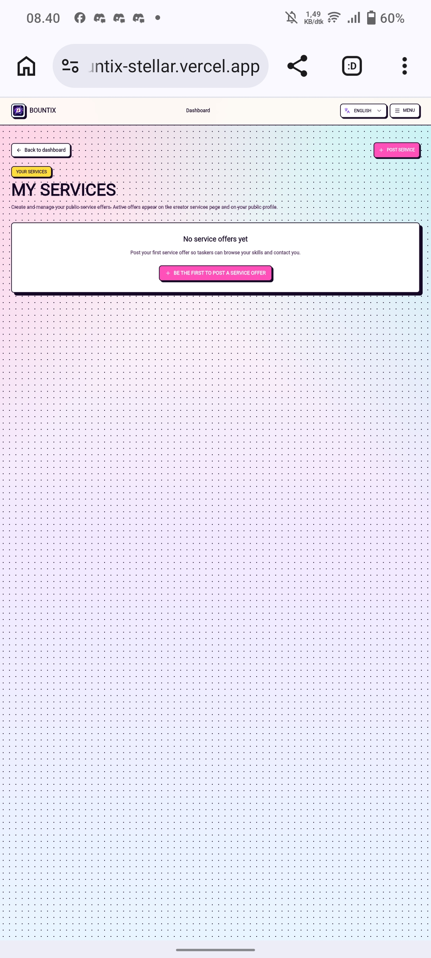
Our Solution
Bountix turns informal task and service requests into secure, trackable transactions
Requesters can post tasks, while creators and taskers can also publish service offers
Accepted participants coordinate work with chat, notifications, and task status tracking
Escrow is released only after completion is approved by the requester or admin
Service Offers
Bountix / 3

Slide 4
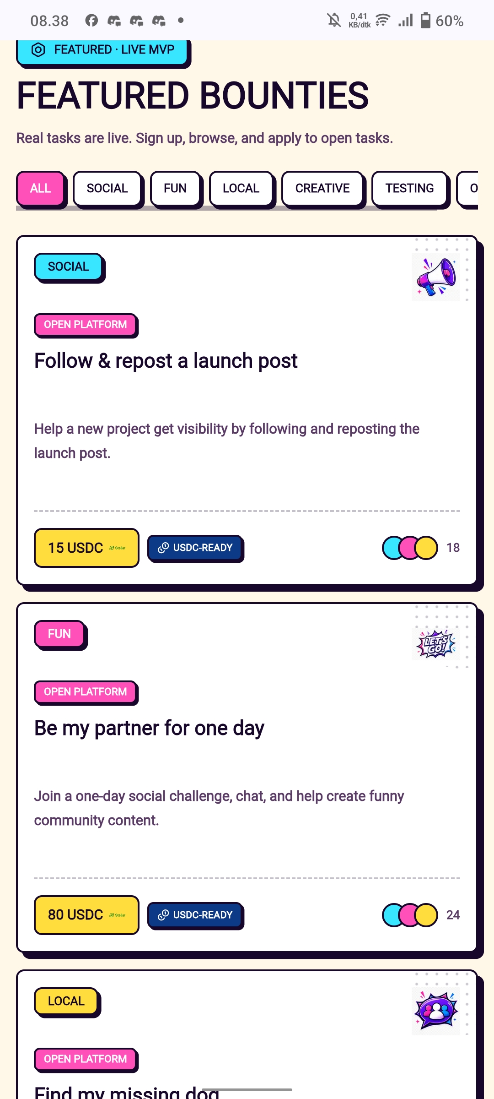
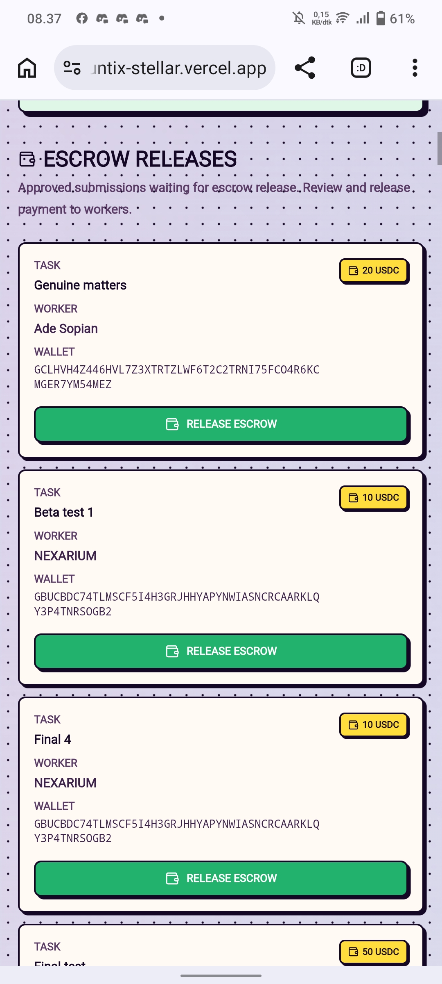
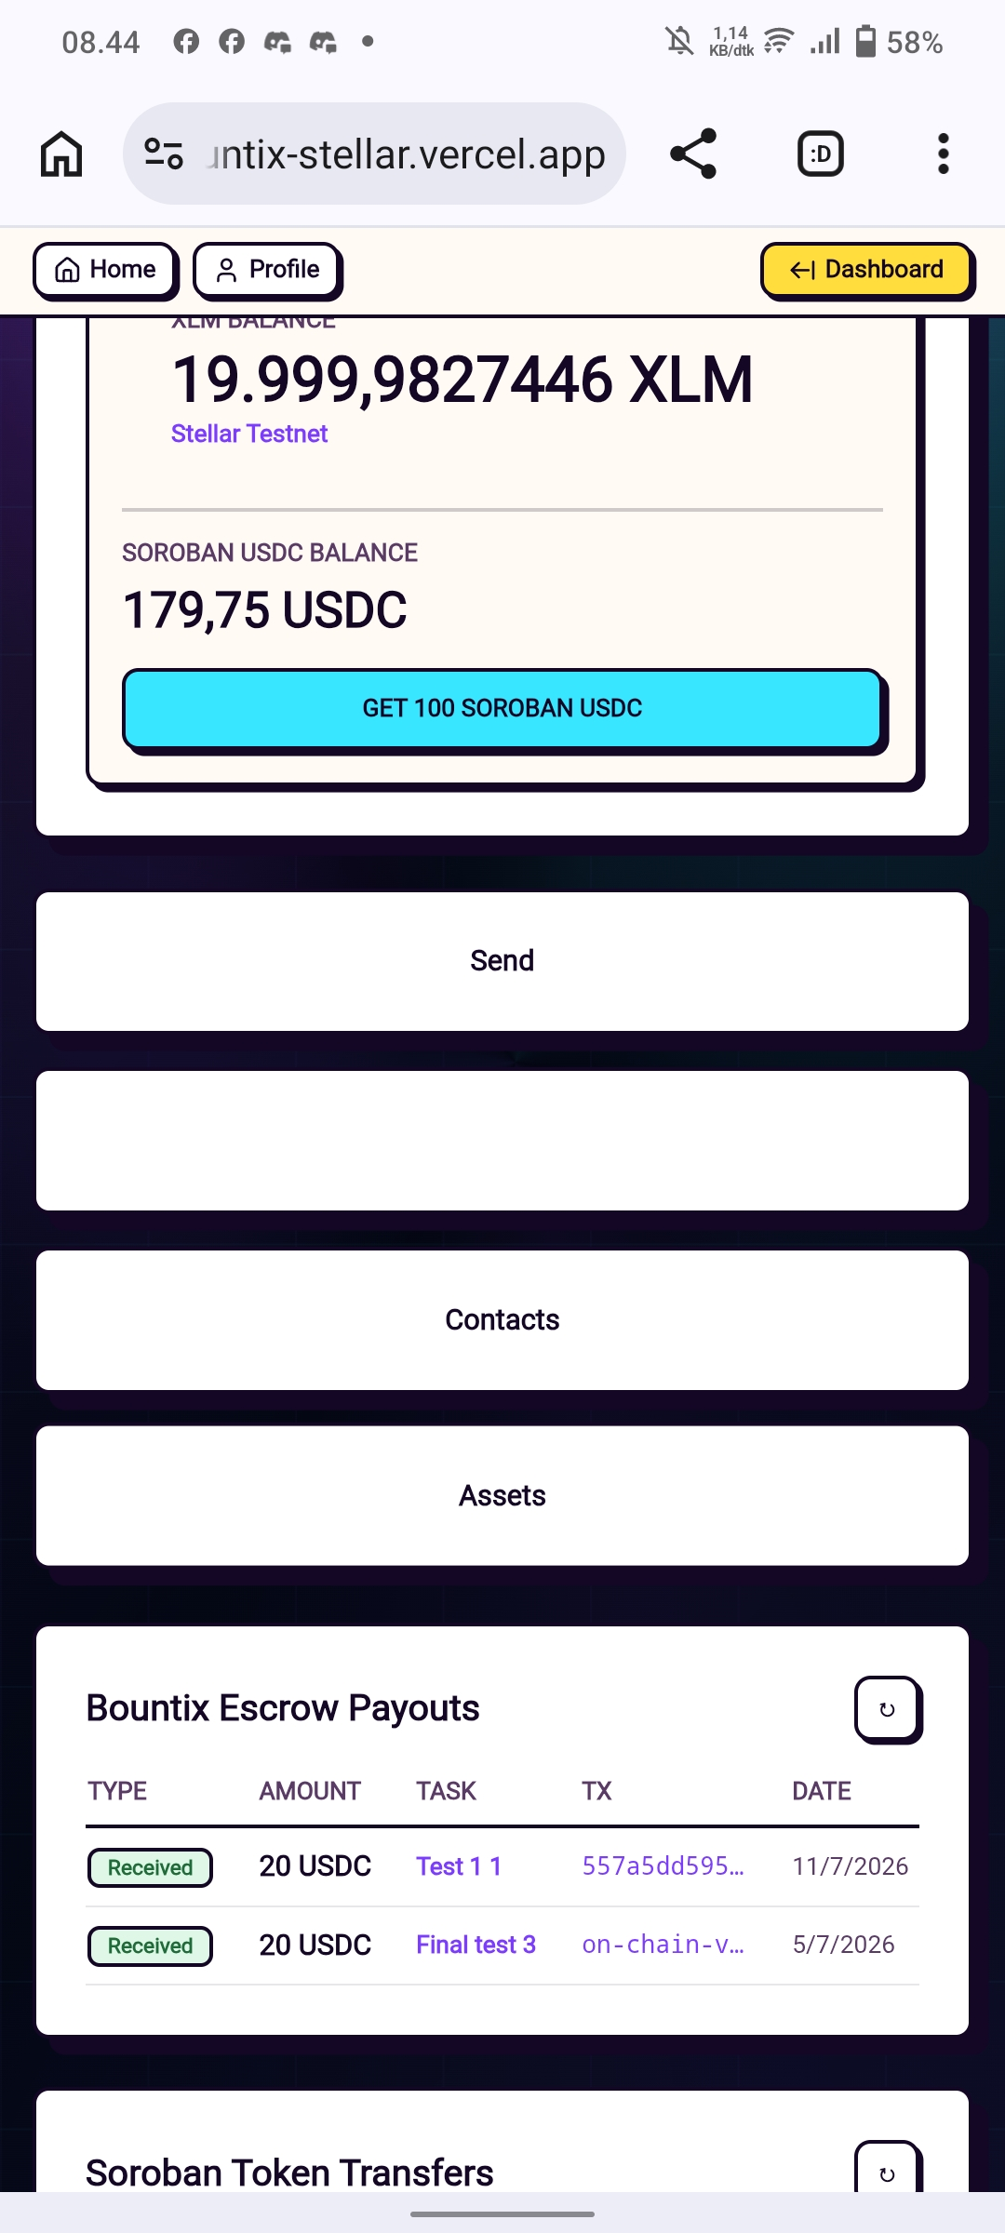
Product Flow
Create a task with reward, category, deadline, and requirements
Taskers apply, requester reviews applicants, and one tasker is accepted
Requester funds the task escrow using USDC on Stellar
Accepted participants coordinate in task chat and complete the work
Requester or admin releases escrow and the tasker sees the payout in wallet history
Browse Tasks
Release Escrow
Payout History
Bountix / 4

Slide 5
Why Stellar
Fast and low-cost USDC settlement fits small task payments
Escrow makes payment trust programmable instead of verbal
On-chain release records improve transparency for both sides
Wallet onboarding and payout readiness hide Stellar complexity from everyday users
Stellar creates a practical payment rail for real-world consumer applications
USDC Payouts
Bountix / 5

Slide 6
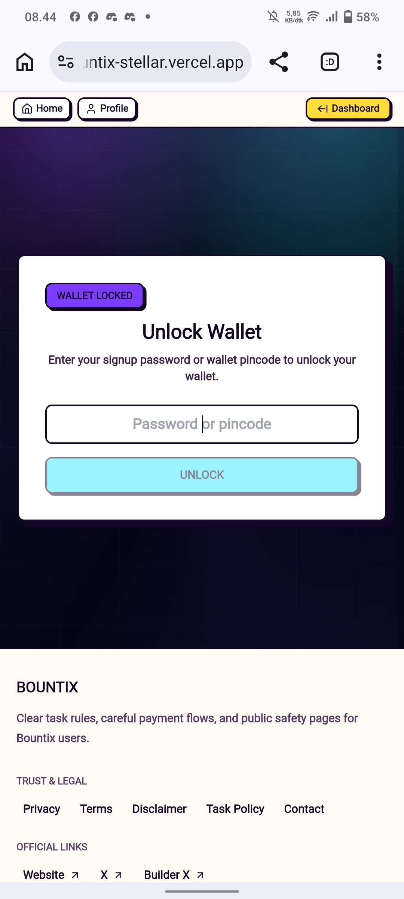
Built Prototype
Task creation, browsing, applications, acceptance flow, and service offers
Stellar wallet onboarding, USDC payout readiness, escrow funding, and release
Participant-only Tencent Chat for accepted task conversations
Notifications for applications, task updates, escrow events, and payouts
Admin moderation with task removal reason and wallet transaction history
Home
Tasks
Services
Wallet Unlock
Bountix / 6

Slide 7
Target Users
Requesters who need flexible help with online or real-world tasks
Taskers and service providers who want short-term income with clearer payment protection
Students, freelancers, creators, small businesses, and community organizers
SEA communities where informal work already exists but payment trust is still manual
Bountix / 7

Slide 8
Demo Highlights
Google login creates a wallet automatically for new users
Requester creates a task, receives applications, and accepts a tasker
Accepted participants can use private task chat
Requester funds Stellar USDC escrow and admin/requester releases payout
Tasker wallet shows recent transaction history after release
Tasks
Admin Release
Wallet
Bountix / 8

Slide 9
Impact & Market Fit
Reduces payment risk in informal task work
Makes digital dollar payouts accessible through a familiar task marketplace UX
Supports broad task and service categories instead of one narrow vertical
Turns Stellar escrow into a real consumer workflow for SEA users
Bountix / 9

Slide 10
Next Steps
Add dispute resolution and evidence review
Build reputation, tasker profiles, and completion history
Integrate fiat on-ramp and off-ramp partners for easier USDC access
Improve mobile-first UX for field tasks and local services
Expand moderation, service discovery, payout reporting, compliance, and security
Bountix / 10

