Slide 1
Introduction to Core Database Concepts
Getting started with Databases and Structure Query Language (SQL)

Slide 2
Objectives
Define Databases
Discuss the functionality of relational database management systems.
comparison between the three RDBMS

Slide 3
What is a Database (db)?
A Database (db) is an organized collection of data, typically stored in electronic format.
It allows you to input, manage, organize and retrieve data quickly.
Traditional databases are organized by records (rows), fields (columns) stored in tables which are stored in database files.
It’s a file used to store information.
A database table is a collection of rows and columns that is used to organize information about a single topic or object. Each row within a table corresponds to a single record and contains several different attributes that describe the row.
A database table is the most common and simplest form of data storage in a relational database.
Notes:
Data is the most important part of a database.

Slide 4
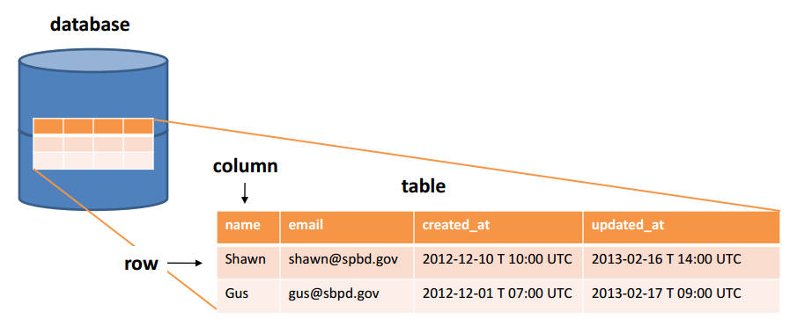
What is a Database (db)?
Notes:
Every table is broken up into smaller entities called fields. The fields in the table are: name, email, created_at, updated_at.
A field is a column in a table that is designed to maintain specific information about every record in the table.
A record, also called a row of data, is each individual entry that exists in a table. For example there are (2) records in the table.
A column is a vertical entity in a table that contains all information associated with a specific field in a table. For example, Name represents the name of the user.

Slide 5
What is a Database (db)?
A relational database is a collection of tables of data all of which are formally described and organized according to the relational model. Each table must identify a column or group of columns, called the Primary Key, to uniquely identify each row.
Entity
Object comprised of various pieces of data.
Attribute
Piece of information (data) that describes an entity.

Slide 6
What is a Database (db)?
Database Management System (DBMS) is a software application/tool used by end users to access the data stored in the database files. A DBMS is also used to perform administrative tasks on the database and objects contained within the database.
DBMS is a collection of applications that allow users and other programs to capture and analyze data by providing additional functionality like reporting services to help you create, deploy and manage reports for your organization.
This application is responsible for handling data requests, committing changes to the data and enforcing the structure of the database including:
Ensuring data is stored properly and that rules for defining data are not violated.
Providing a level of disaster recovery by which data can be restored to a consistent state.
Maintaining relationships between data entities residing in the database.

Slide 7
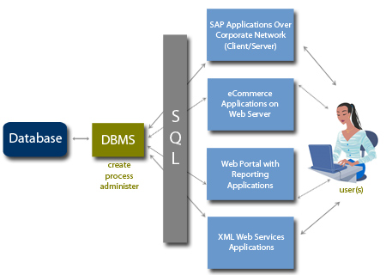
What is a Database (db)?

Slide 8
What is a Database (db)?
Relational Database Management Software (RDBMS) is a software system designed to allow the definition, creation, querying and updating of data stored in a relational database.
A few examples of RDBMS include:
Microsoft SQL Server
Microsoft Access
MYSQL
Oracle
Notes:
Today’s advanced RDBMS is actually much more than data, they also manage data, restricting the kind of data that can go into the system, and facilitating getting data out of the system.

Slide 9
What is a Database (db)?
An instance of an RDBMS such as SQL Server contains many objects.
The database itself
Transaction Log
Tables
Indexes
Filegroups
Views
Stored Procedures
Users/Roles

Slide 10
What is a Database (db)?
The main differences between DBMS and RDBMS are:
A DBMS has to provide some uniform methods independent of a specific application accessing the information that is stored in the tables.
RDBMS adds the additional condition that the system supports a tabular structure for the data, with enforced relationships between the tables.
DBMS does not impose any constraints or security with regard to data manipulation, while RDBMS does utilize an internal security model.
RDBMS is the basis for Structured Query Language (SQL).

Slide 11
comparison between the three RDBMS
MySQL allows partitioning databases with hashing functions in order to distribute data among several nodes. Developers can generate a specific partition key that will define the data location. Hashing permits avoiding bottlenecks and simplifying maintenance.
PostgreSQL allows making LIST and RANGE partitions where the index of a partition is created manually. Developers need to identify children and parent column before assigning a partition for them.
SQL Server also provides access to RANGE partitioning, where the partition is assigned to all values that fall into a particular range. If the data lies within the threshold, it will be moved to the partition.

