Slide 1
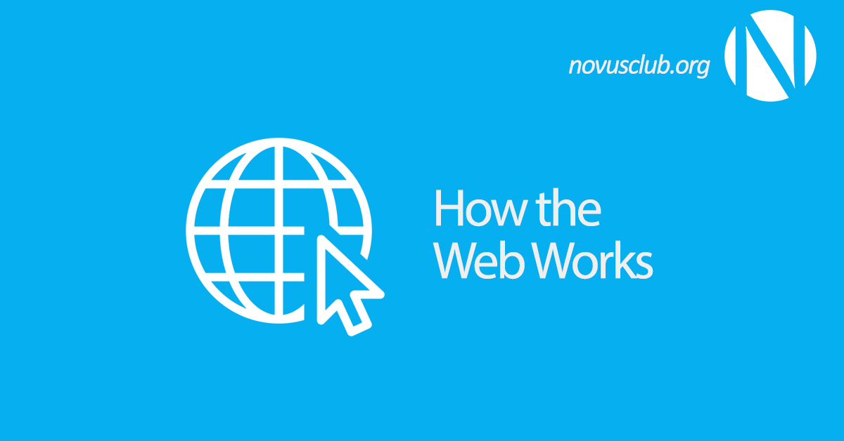

Slide 2
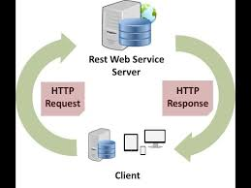

Slide 3
We have seen how a Web client - server interaction happens. We can summarize these steps as follows −
A user enters a URL into a browser (for example, Google.com. This request is passed to a domain name server.
The domain name server returns an IP address for the server that hosts the Website (for example, 68.178.157.132).
The browser requests the page from the Web server using the IP address specified by the domain name server.
The Web server returns the page to the IP address specified by the browser requesting the page. The page may also contain links to other files on the same server, such as images, which the browser will also request.
The browser collects all the information and displays to your computer in the form of Web page.

Slide 4
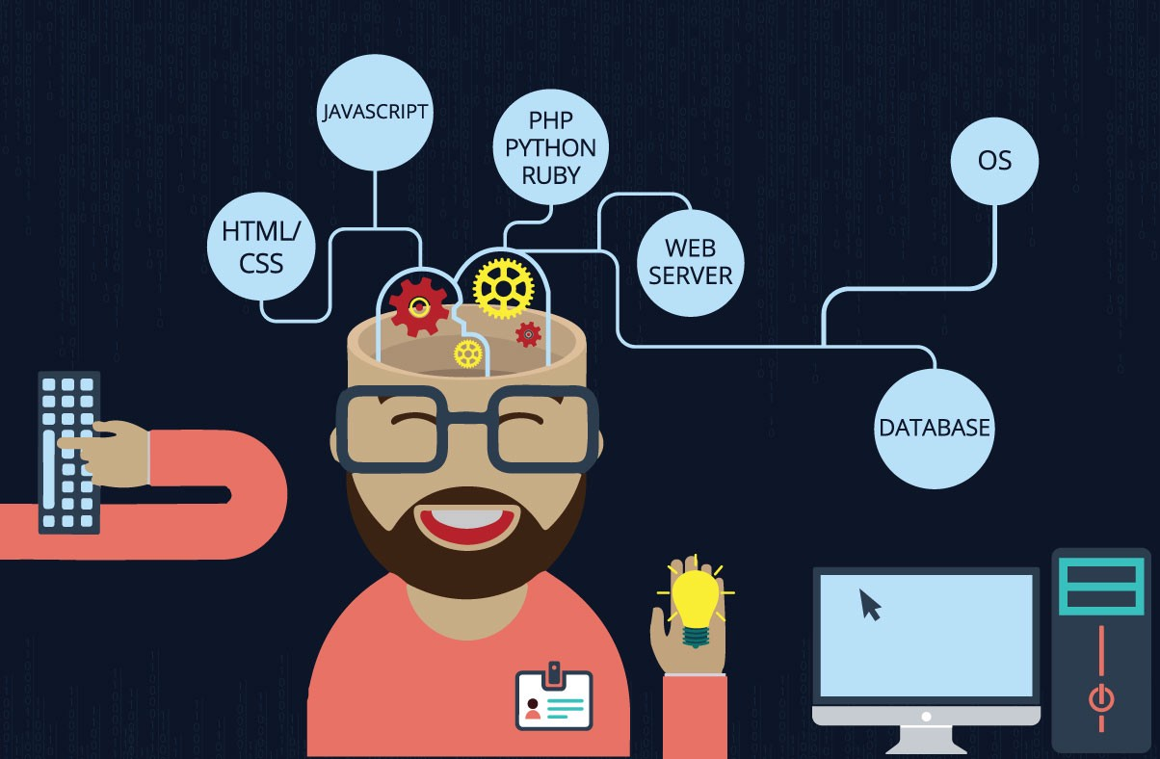
What do you need to be a web developer?

Slide 5
What is the role of a web developer?
Web developers design and build websites. They are typically responsible for the appearance, of the site and technical aspects, such as site speed and how much traffic the site can handle. Web developers may also create site content that requires technical features.
They are sometimes known as web designers or full-stack developers if they can do both front-end and back-end development.

