Slide 1
Project Spotlight
Lauren Bradshaw
Salvador Salazar III

Slide 2

Project Proposoal
The aim of our project is to explore machine learning processes used within the music industry. To do so, we use metrics taken from Spotify's API, directly and from a curated dataset from Kaggle.
Basing our training data off of a playlist made from among the class's favorite songs, we're able to get recommendations that fit into more specific criteria than the standard algorithm, as well as create visualizations representing the personalities of the tracks.

Slide 3
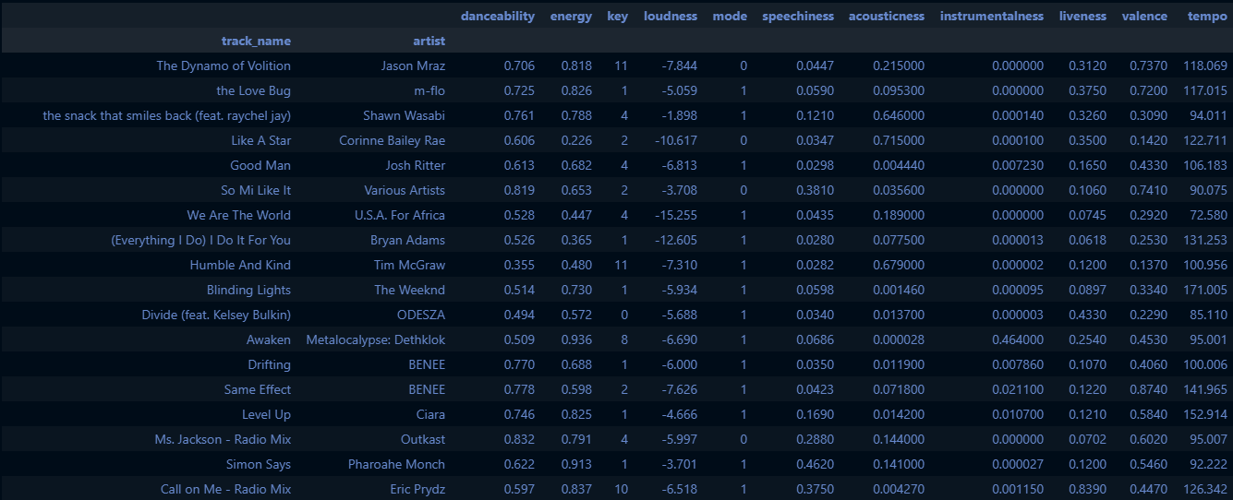
Spotify’s Metrics
Along with artists, tracks, and genre, the Spotify API provides several metrics that describe a song, which Spotify uses for its own recommendation algorithm:
Acousticness
Danceability
Energy
Instrumentalness
Key
Liveness
Loudness
Mode
Popularity
Speechiness
Tempo
Signature
Valence

Slide 4
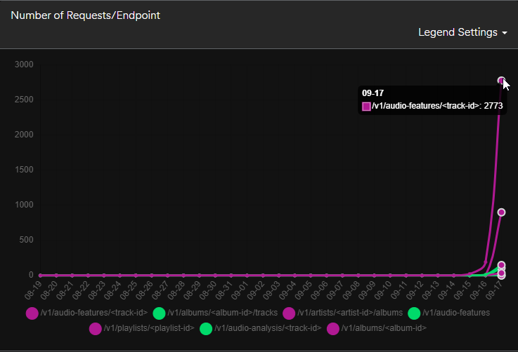
Spotify for Developers Dashboard
Spotify also provides metric data on how you (and your team) are utilizing the API
This is important given that there are limits on the number of requests that can be sent depending on what data is being accessed

Slide 5
Data Exploration
Some data is publicly available, while others require access tokens
Using access tokens allow a user to go through their own account, and grant access to their private library. This includes the ability to create and modify playlists
The Spotify API has several endpoints, and they open up more over time
Depending on the endpoint used, there can be differences in the data that is returned

Slide 6
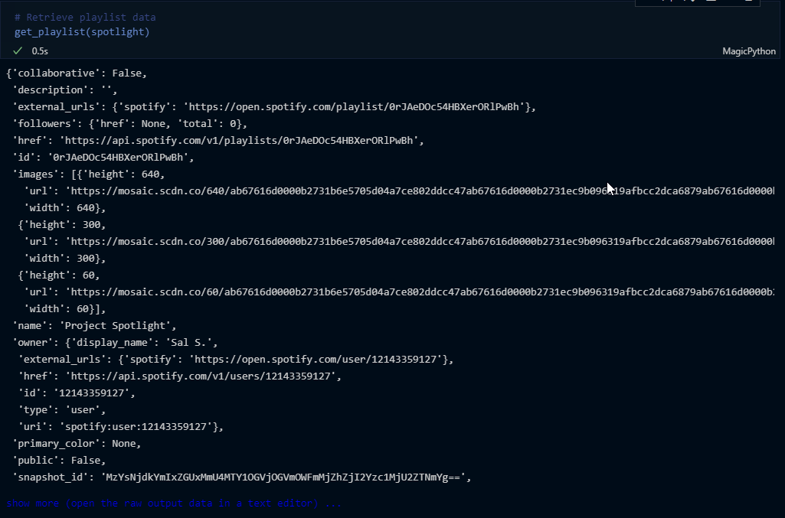
Data Cleanup
The JSON data is nested with several layers that also differs depending on the endpoint
Functions were created for repetitive tasks, such as extracting a song’s URI (Uniform Resource Indicator, i.e. Spotify’s ID system) and its audio features and analysis data

Slide 7
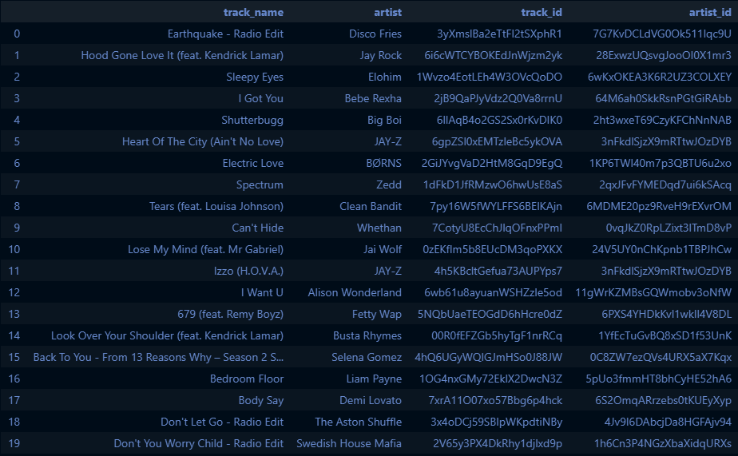
Song Recommendations
By using the metrics extracted from the API, song recommendations can be catered more specifically than the default algorithm used by the Spotify platform
The metrics used to generate these recommendations were:
One random artist and track
Genres: pop, rock, indie, and dance
Target Danceability: 0.60 (mean of the original playlist)
Minimum Energy: 0.67 (mean of the original playlist

Slide 8
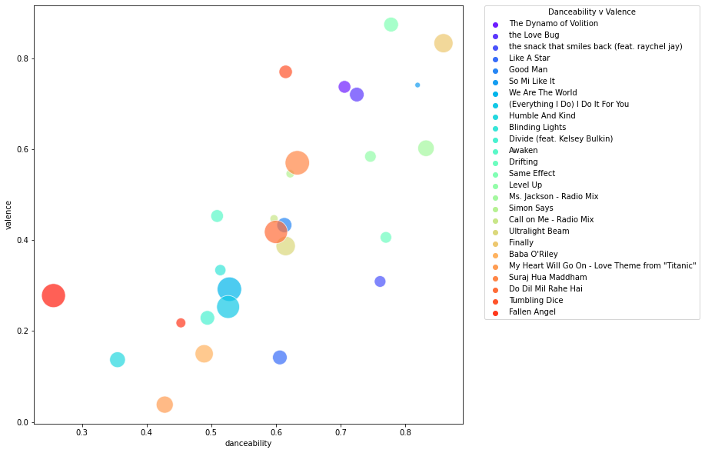
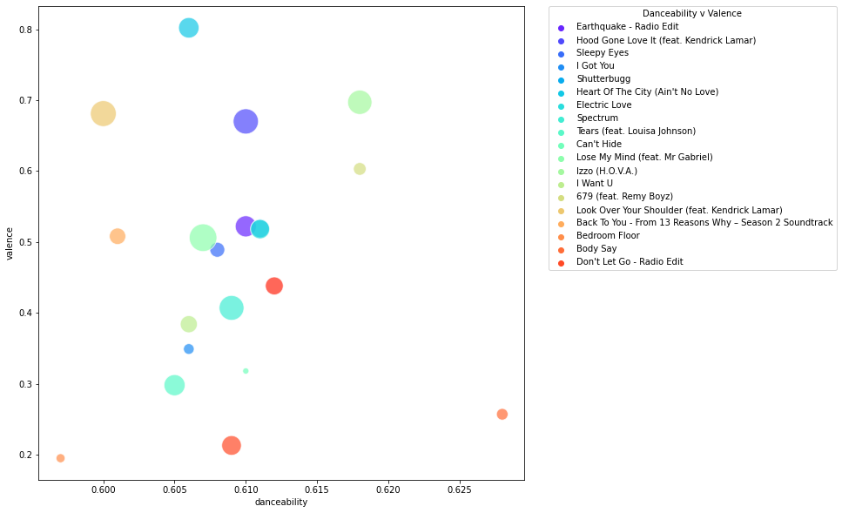
Visualizations
Scatter plots of the relation between danceability and valence for the original playlist, the recommendations
Original Playlist
Recommendations

Slide 9
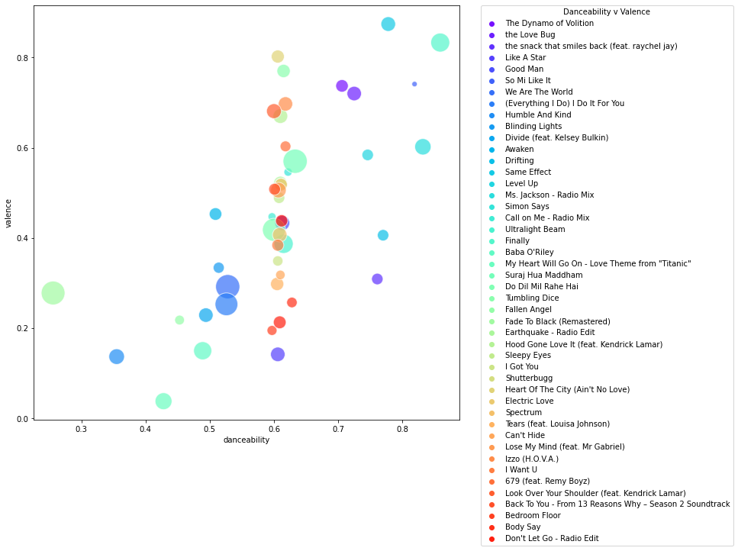
Visualizations
Scatter plots of the relation between danceability and valence for the original playlist, the recommendations
Expanded Playlist

Slide 10
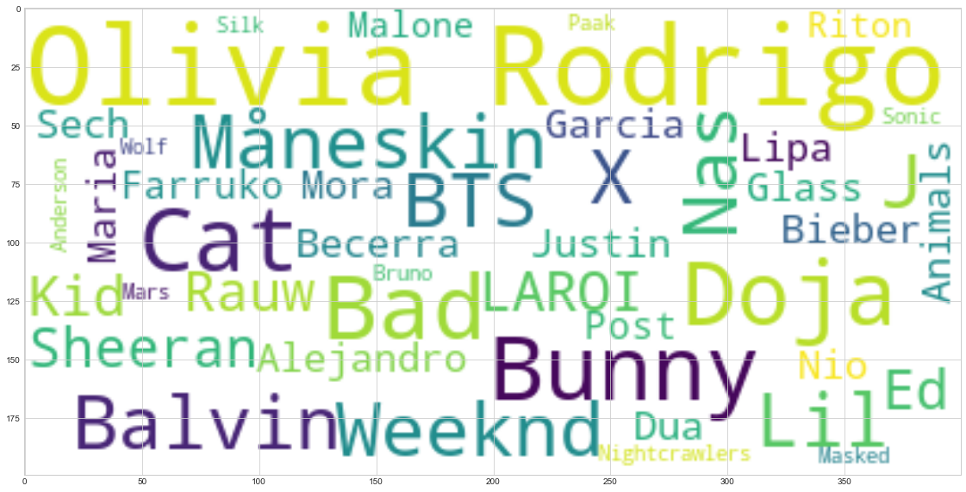
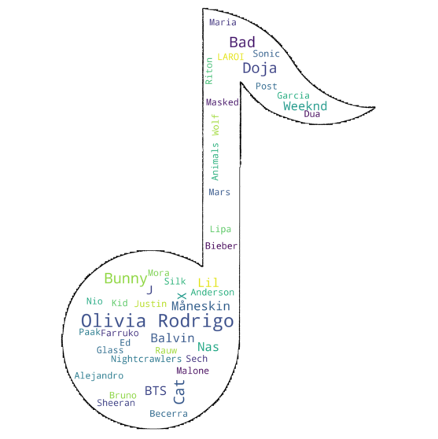
NLP
Using a curated dataset from Kaggle, a WordCloud is generated showing the top streamed artists on Spotify
The WordCloud is then outfitted within an image

