Slide 1
Numerical Optimization
Optimal Scheduling of Household Appliances under Time-Variable Electricity Tariffs
Suzan Alsayek

Slide 2
Numerical Optimization
Project Goal
electricity prices during the day
appliance energy consumption
allowed working time and household power limit
The goal of this project is to create an application that helps a household reduce electricity cost by choosing the best operating time for appliances.
The application calculates an optimized 24-hour schedule based on:

Slide 3
Numerical Optimization
MAIN IDEA
The user enters household and appliance data.
The program then decides when each appliance should work so that the total electricity cost is as low as possible.
The result is shown visually through charts, schedule blocks and summary cards.

Slide 4
Numerical Optimization
01
02
low and high electricity tariff
household connection capacity in kW
03
04
appliance energy demand
tariff profile
05
06
Input data
appliance duration
earliest start time and latest finish time
07
appliance active/inactive status
The application uses the following input data:

Slide 5
Numerical Optimization
OPTIMIZATION MODEL
The optimization problem is modeled as a linear programming problem.
The objective is to minimize: total electricity cost = appliance power x tariff price x scheduled time
The optimizer must respect:
each appliance must complete its required duration
appliance can work only inside allowed time window
total household power must not exceed the connection limit
schedule values are between 0 and 1

Slide 6
Numerical Optimization
Implemented Appliances
The project includes four household appliances:
Washing machine
Dishwasher
Water heater
Storage heater
Each appliance has its own energy demand, duration and allowed operating period.

Slide 7
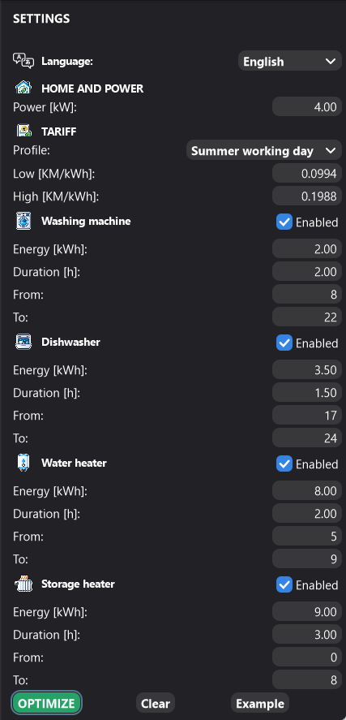
Numerical Optimization
Application Interface
The interface is divided into two main parts:
Right side: user input settings
Left side: optimization results and visual dashboard
The dashboard shows:
optimized cost
savings
peak power
total energy
electricity tariff chart
appliance schedule
household power graph
optimization insights

Slide 8
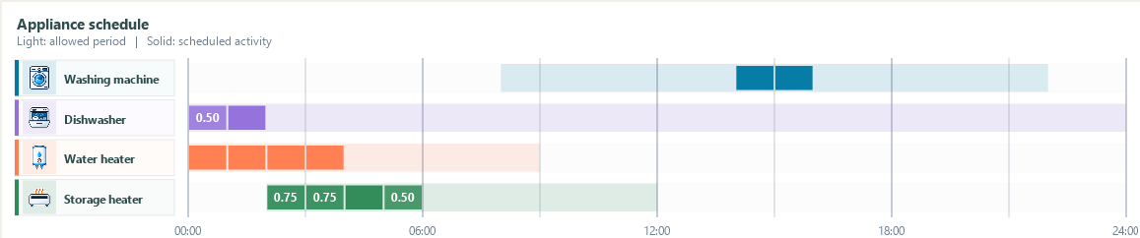
Visualization of Results
Numerical Optimization
The appliance schedule uses two types of colors:
light color shows the allowed working period
strong color shows the optimized scheduled activity
This makes it easy to see when an appliance is allowed to work and when the optimizer actually placed it.

Slide 9
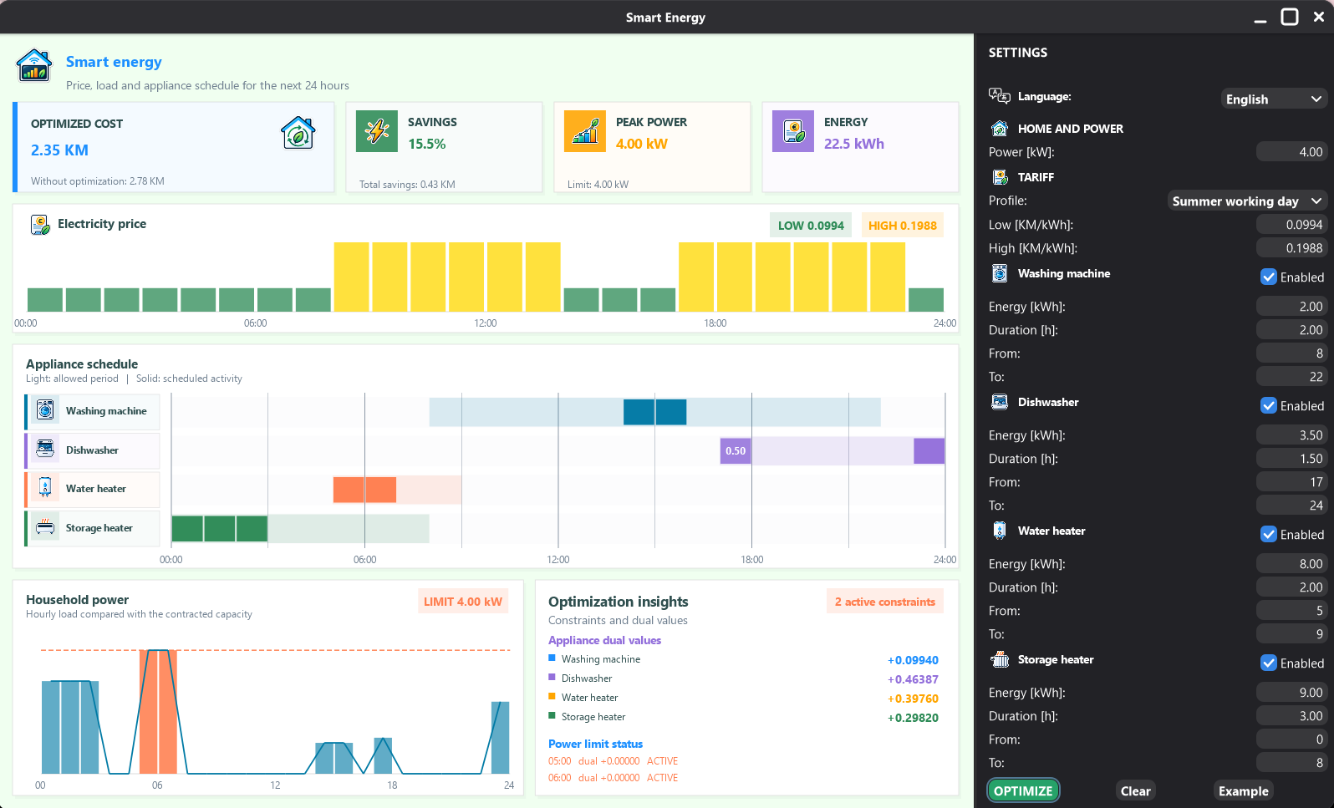

Slide 10
Numerical Optimization
CONCLUSION
This project demonstrates how mathematical optimization can be used in a practical smart home energy system.
The application helps the user plan appliance usage, reduce electricity cost and understand household power consumption through a simple visual interface.

