Slide 1


Sweet Storage SLOs with Frosting
Andrew Wang, Shivaram Venkataraman,
Sara Alspaugh, Ion Stoica, Randy Katz

Slide 2




Exploratory drill-down
Batch analytics
Interactive web-serving
HBase
HDFS
MySQL
Notes:
Three different types of workloads hitting three different, segregated storage systems. This is the state of the world today. However, there are a lot of downsides here.

Slide 3

Exploratory drill-down
Batch analytics
Interactive web-serving
Copy
HBase
HDFS
MySQL
Notes:
Data is often duplicated across these systems, meaning increased provisioning costs and big copy jobs to move fresh data around. This is inefficient, leads to stale analysis, and requires extra management overhead.

Slide 4
Exploratory drill-down
Batch analytics
Interactive web-serving
Copy
HBase
HDFS
MySQL
Notes:
Data is often duplicated across these systems, meaning increased provisioning costs and big copy jobs to move fresh data around. This is inefficient, leads to stale analysis, and requires extra management overhead.

Slide 5
Exploratory drill-down
Batch analytics
Interactive web-serving
HBase
HDFS
MySQL
Notes:
Another problem is load spikes. If the number of interactive web-serving requests increases (which can happen for any number of reasons), those extra requests can’t be easily shunted to the other systems. This requires another degree of overprovisioning, and reduces overall cluster utilization.

Slide 6
Today’s Clusters
Segregated storage systems
Downsides
Delayed reaction time from analytics
Increased provisioning costs ($$$)
Reduced cluster utilization
Duplication of data
Ideally, all apps share a single storage system!

Slide 7

Exploratory drill-down
Batch analytics
Interactive web-serving
Storage layer is not aware of each application’s SLO!
Unified Storage Layer

Slide 8
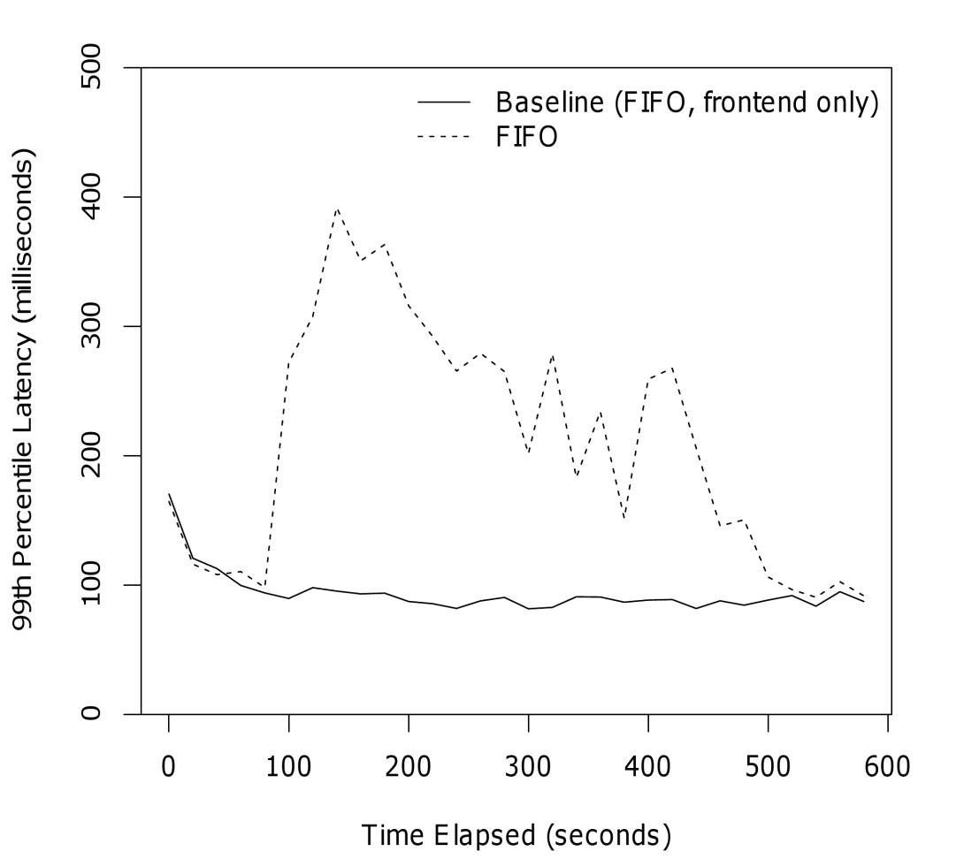
Mixing Front-end and Batch

Slide 9
High-percentile Latency SLOs
Metric of merit for latency
95th or 99th percentile
Important with request fan-out
Stragglers affect overall latency
Growing importance for complex pages
Status updates, profile pics, friend requests, etc.

Slide 10
Problem
Want to multiplex front-end and batch workloads
Also need 99th percentile latency guarantees for front-end storage system operations

Slide 11
Existing solutions
Mismatch between apps and storage systems
Apps think about key-value or row operations
Storage systems think about disks
Need to manually tune low-level parameters
MB/s, IOPS, etc.
Use average latency, not 99th percentile

Slide 12
Goals of Frosting
Enable a single, shared storage layer
High-level service-level objectives (SLOs) specified directly to the storage system
“my gets will finish in 200 ms, 99% of the time”
No manual tuning by the app programmer

Slide 13
Deep Software Stacks
Client
HBase
BigTable-like
Distributed column store
Get, put, scans on rows
HDFS
GFS-like
Distributed filesystem
OS
Interfaces with hardware
HBase
HDFS
OS

Slide 14
Deep Software Stacks
Client
Clean layered architecture
Request processing traverses software stack
Hard to debug latency!
Lots of code
Complex interactions
HBase
HDFS
OS

Slide 15
Frosting Architecture
Client
Try the simple approach
HBase
HDFS
OS

Slide 16
Frosting Architecture
Client
Try the simple approach
Insert scheduling at the top layer (HBase)
Proportional share among HBase clients
Dynamically adjust shares to enforce client SLOs
Frosting
HBase
HDFS
OS

Slide 17
High-level SLO Enforcement
Feedback loop
Measure each client’s performance
Compare with SLO
Increase or decrease allocation accordingly
Scheduler
Performance measurements
Allocation optimizer

Slide 18
Evaluation
HBase cluster on c1.xlarge EC2 nodes
8 CPU cores
4 local disks
Yahoo! Cloud Serving Benchmark clients
Frontend: 1-row gets, high priority
Batch: 500-row scans, low priority

Slide 19
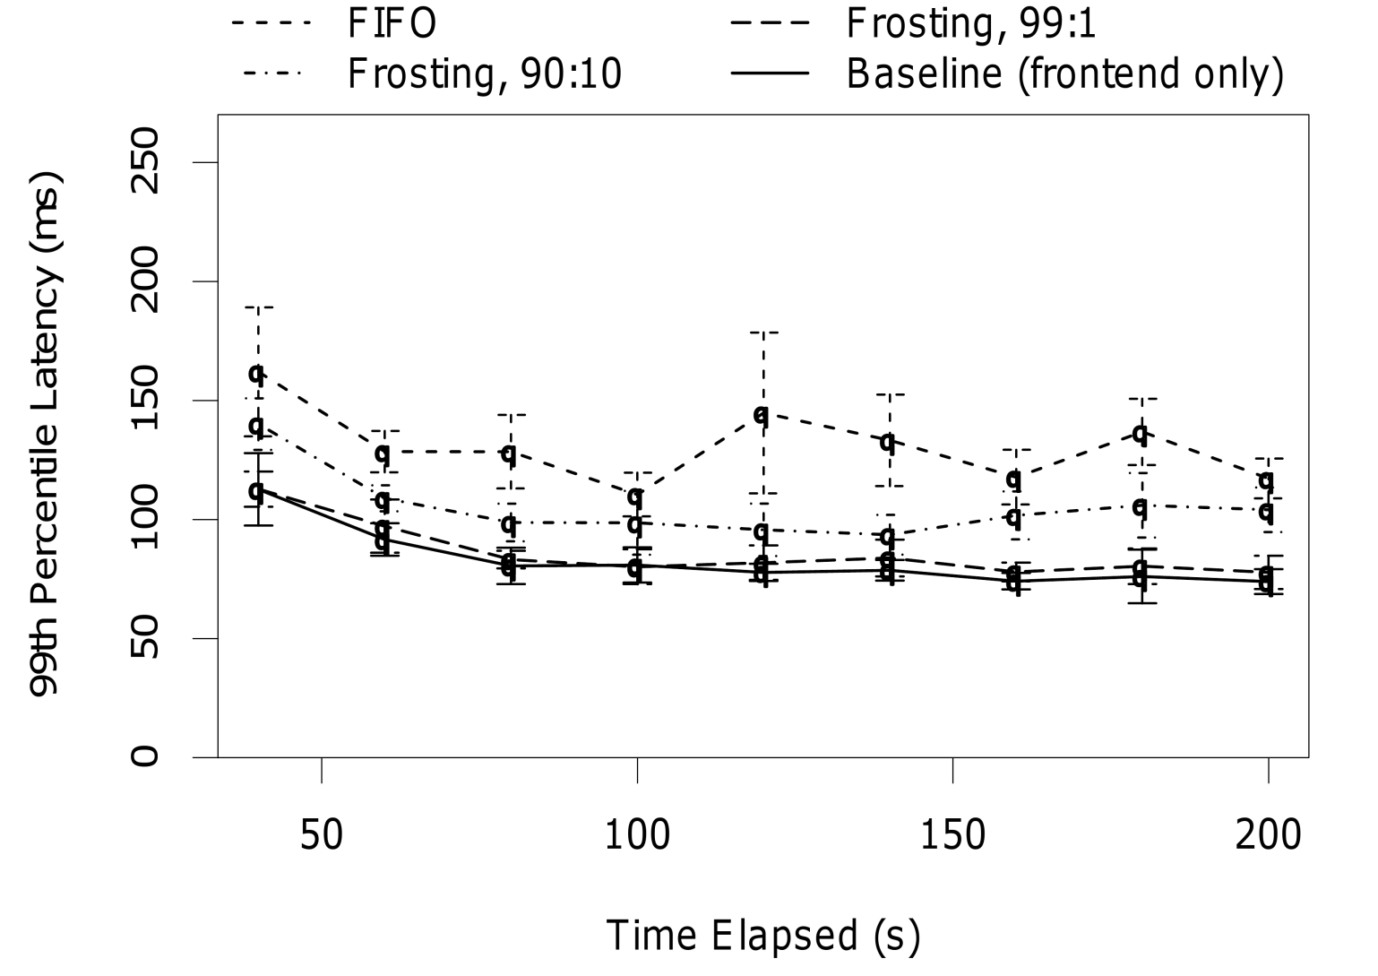
Evaluation

Slide 20
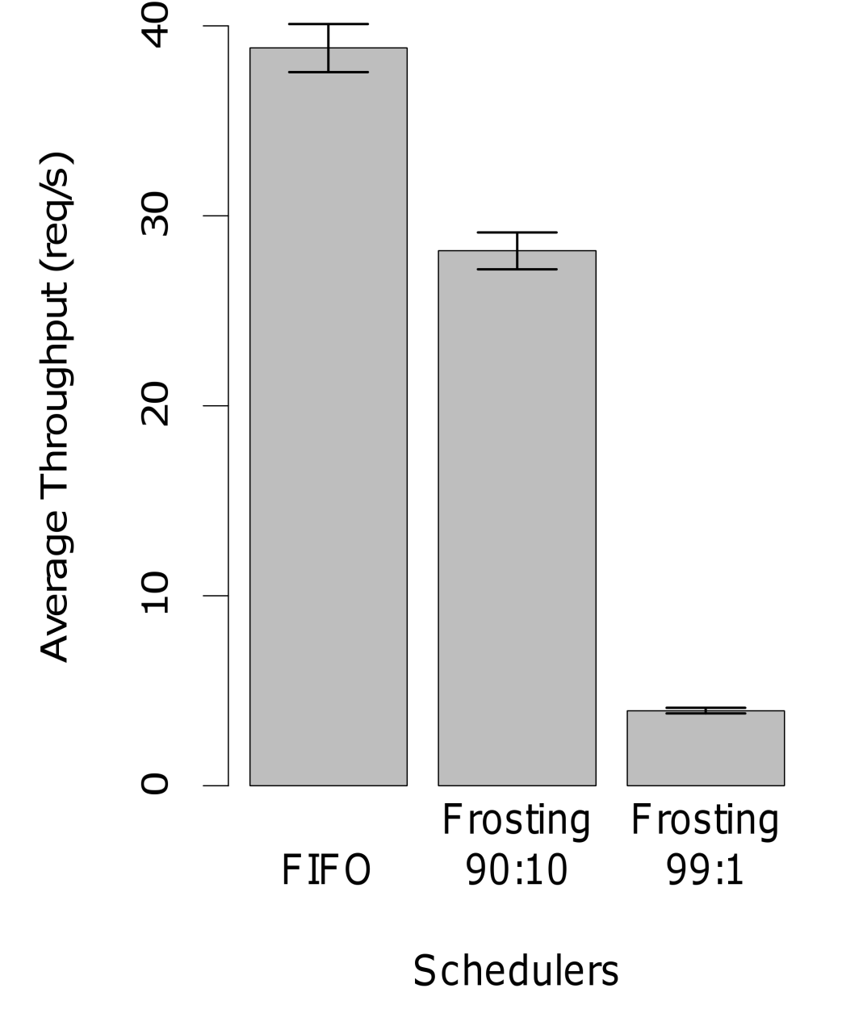
Evaluation

Slide 21
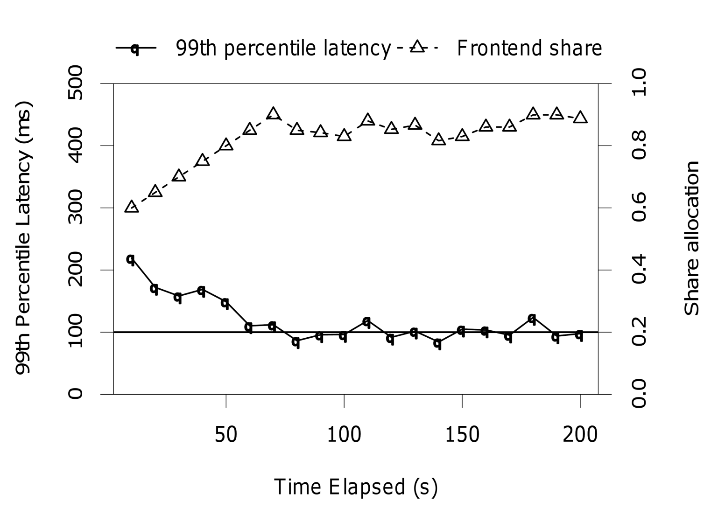
Evaluation

Slide 22
Conclusion
Fundamental latency vs. throughput tradeoff
High-level SLOs can be enforced directly and automatically by the storage system
Ideas can be applied to existing systems

