Slide 1
Palm Beach Ballot Problems
Marti Hearst

Slide 2
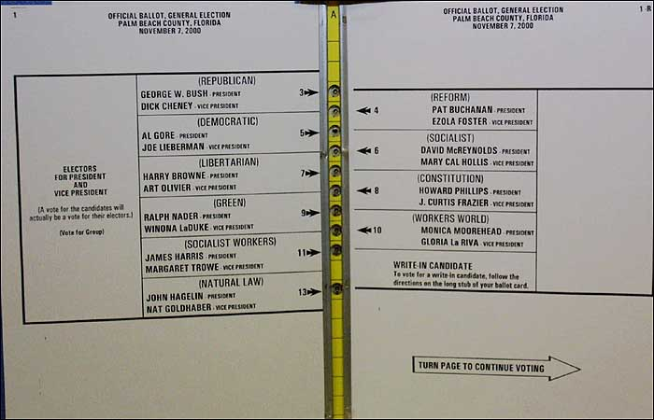
The Palm Beach,FL Ballot
November, 2000

Slide 3
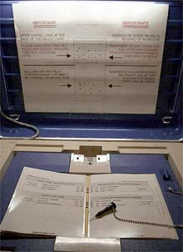

Slide 4
Problems
The instructions are misleading
  Use of the phrase “vote for group” is misleading
    Should say “vote for one”
  Instructions only on lefthand side
    Implies righthand side is different
The interleaving of holes is misleading
  Only the president page has this layout
  Other offices are one per page (with appropriate instructions)
The sample ballot looks different
  No holes – the source of the problem
  Did not lead to complaints

Slide 5
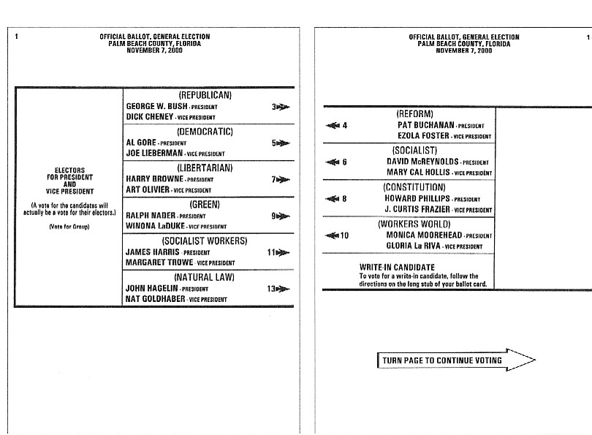

Slide 7
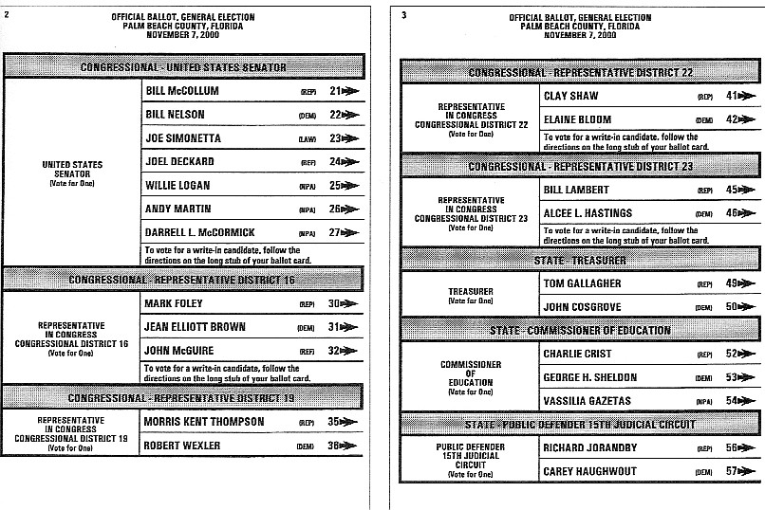

Slide 8
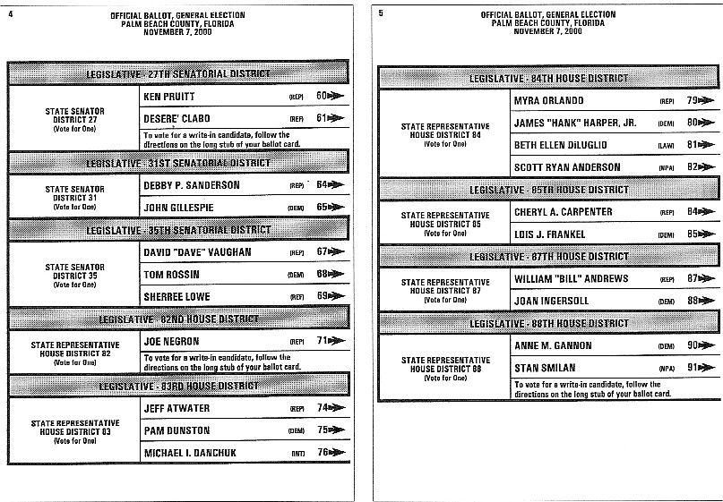

Slide 9
Other Issues
People vote infrequently
  Have to re-learn the system each time
Rushed, uncomfortable circumstances
Palm Beach Demographics: Elderly

Slide 10
An Informal Usability Study
Barbara Jacobowitz, CHI-WEB, Nov 10, 2000
“I was able to print 10 different sample ballots from various sources. Last night, I ran them all by my mother (81) and a group of her friends (70-something to 80's). All are bright, literate, and none are legally blind.
They did reasonably well on 9 of the ballots. On one, 6 marked it incorrectly and didn't realize it, 2 did it correctly, but very slowly, and 2 had to ask me what to do. Guess which ballot it was?.”
Summary of a more formal study of punch-card voting:
  http://www.osu.edu/units/research/archive/votedes.htm

Slide 11
Josephine Scott, CHI-Web, Nov 10, 2000
“I spent fifteen years making the voting process accessible and usable for all…
Usability standards must be higher for voting than any other function for the most obvious reasons. Users--in this case, voters, share the need for the clearest of design and instruction to cast a vote properly. Many do not speak English well, or see well, or are able to decipher difficult design cognitively, but they may be able to make as informed a choice for president as our snobbish "experts" who don't see a problem. …
Bad design like this exacerbates the problem. The glib notion that "there is no problem because you can see the arrow" or that voters who made this mistake must be stupid shows a lack of compassion. Let me suggest that it is simple compassion for the user that informs usability expertise. …”

Slide 12
More evidence that the ballot is misleading (New York Times, Nov 9, 2000)
Percent of ballots thrown out in Palm Beach County for the error of "overvoting" on Presidential candidates: 4.1% (19,120)
Percent of ballots thrown out in Palm Beach County for the error of "overvoting" on Senatorial candidates: 0.8% (3,783)
Percent of ballots thrown out in Sacramento County (CA) for the error of "overvoting" on Presidential candidates: 0.29% (1,147)
Percentage of (unofficial) re-count votes in Gore's favor: 70% (2,520)
Percentage of (unofficial) re-count votes in Bush's favor: 30% (1,063)

Slide 13
Related Articles
http://news.bbc.co.uk/1/hi/world/americas/1016089.stm
http://www.polsci.wvu.edu/PolyCy/psrecount.html

