Slide 1
C 라이브러리

Slide 2
URL
출처
Walkthrough: Create and use your own Dynamic Link Library (C++) | Microsoft Docs
https://docs.microsoft.com/en-us/cpp/build/walkthrough-creating-and-using-a-dynamic-link-library-cpp?redirectedfrom=MSDN&view=msvc-170

Slide 3
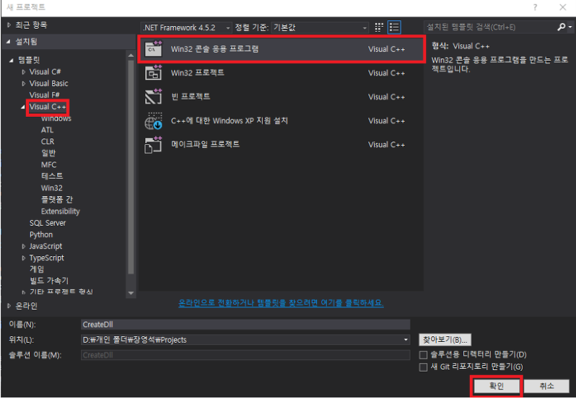
라이브러리

Slide 4
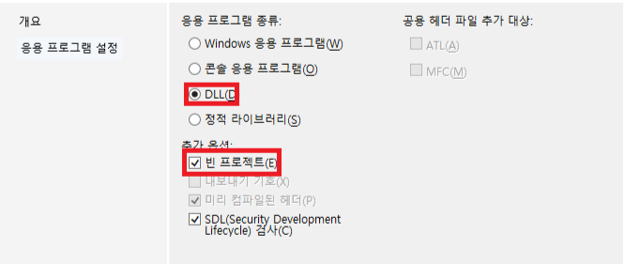
라이브러리

Slide 5
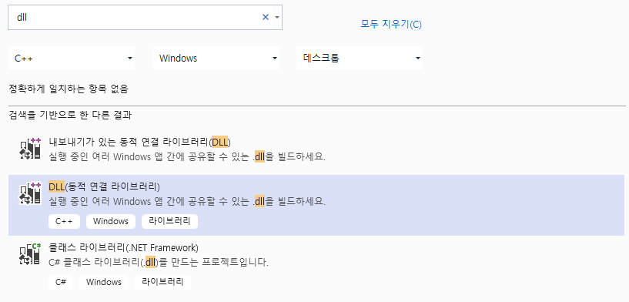
라이브러리

Slide 6
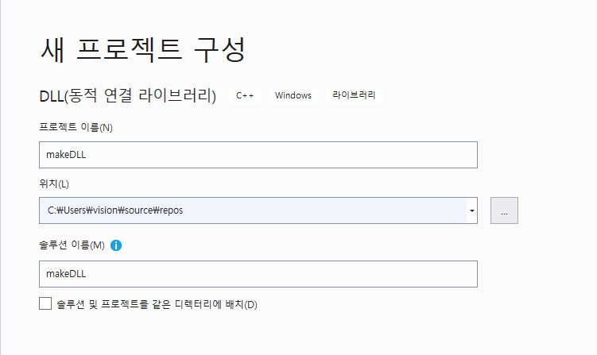
라이브러리

Slide 7
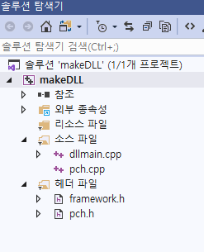
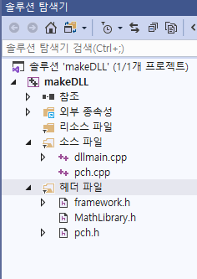
라이브러리

Slide 8
라이브러리
MathLibrary.h
#pragma once
extern "C" __declspec(dllimport) int add(int, int);
extern "C" __declspec(dllimport) int sub(int, int);

Slide 9
라이브러리
dllmain.cpp
#include "pch.h"
#include "MathLibrary.h"
BOOL APIENTRY………
extern "C" __declspec(dllexport) int add(int x, int y)
{
int sum;
return sum = x + y;
}
extern "C" __declspec(dllexport) int sub(int x, int y)
{
int sum;
return sum = x - y;
}

Slide 10
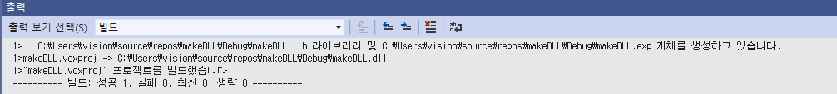
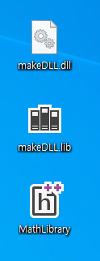
라이브러리
컴파일만
실행하면 안됨

Slide 11
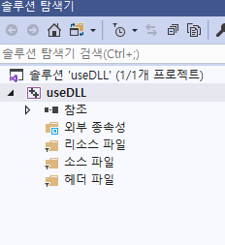
라이브러리
#include<iostream>
#include "MathLibrary.h"
using namespace std;
void main() {
int x = 20, y = 10;
int sum = 0;
sum = add(x, y);
cout << sum << endl;
sum = sub(x, y);
cout << sum << endl;
}

Slide 12
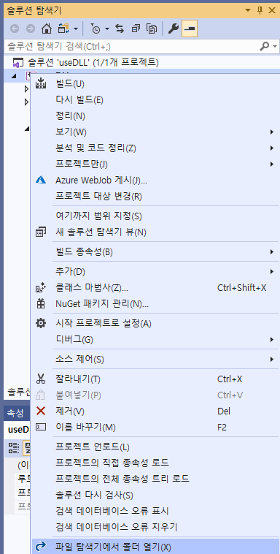
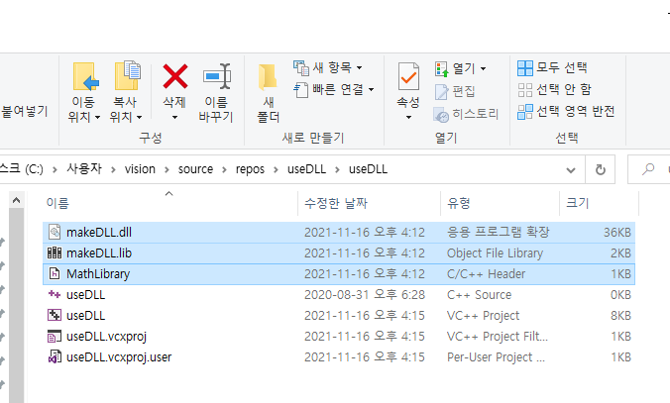
라이브러리

Slide 13
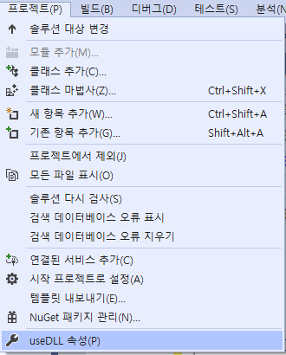
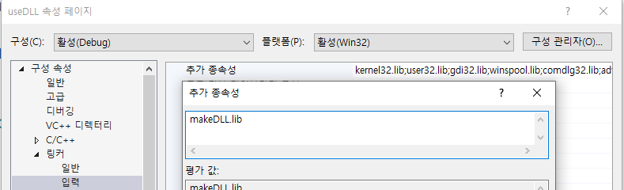
라이브러리

Slide 14
CLASS 라이브러리
MathLibrary.h
#pragma once
#ifdef MATHFUNCSDLL_EXPORTS
#define MATHFUNCSDLL_API __declspec(dllexport)
#else
#define MATHFUNCSDLL_API __declspec(dllimport)
#endif
namespace MathFuncs
{
class MythFuncs
{
public:
// Returns a + b
static MATHFUNCSDLL_API double Add(double a, double b);
// Returns a - b
static MATHFUNCSDLL_API double Subtract(double a, double b);
// Returns a * b
static MATHFUNCSDLL_API double Multiply(double a, double b);
// Returns a / b
// Throws const std::invalid_argument& if b is 0
static MATHFUNCSDLL_API double Divide(double a, double b);
};
}

Slide 15
CLASS 라이브러리
dllmain.cpp
#include "MathFuncsDll.h"
#include <stdexcept>
using namespace std;
namespace MathFuncs
{
double MythFuncs::Add(double a, double b)
{
return a + b;
}
double MythFuncs::Subtract(double a, double b)
{
return a - b;
}
double MythFuncs::Multiply(double a, double b)
{
return a * b;
}
double MythFuncs::Divide(double a, double b)
{
if (b == 0)
{
throw invalid_argument("b cannot be zero!");
}
return a / b;
}
}

Slide 16
CLASS 라이브러리
#include<iostream>
#include "MathLibrary.h"
using namespace std;
void main()
{
double a = 7.4;
int b = 99;
cout << "a + b = " <<
MathFuncs::MythFuncs::Add(a, b) << endl;
cout << "a - b = " <<
MathFuncs::MythFuncs::Subtract(a, b) << endl;
cout << "a * b = " <<
MathFuncs::MythFuncs::Multiply(a, b) << endl;
cout << "a / b = " <<
MathFuncs::MythFuncs::Divide(a, b) << endl;
try
{
cout << "a / 0 = " <<
MathFuncs::MythFuncs::Divide(a, 0) << endl;
}
catch (const invalid_argument& e)
{
cout << "Caught exception: " << e.what() << endl;
}
}

Slide 17
감사합니다.

