Slide 1
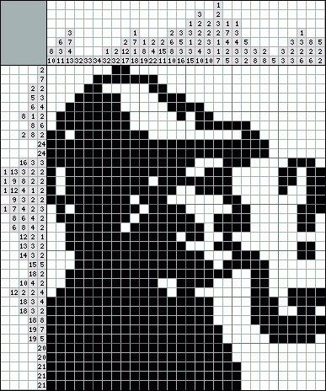
Picross Detective
Michael Salter
Image credit: japonskie.ru

Slide 2
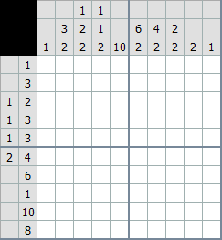
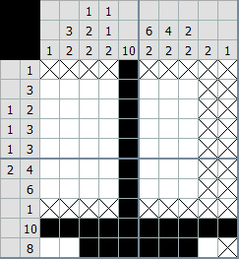
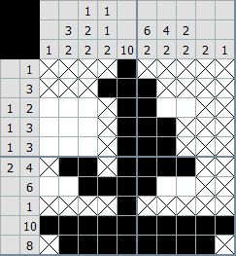
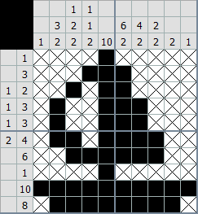
Picross? (a.k.a. Nonograms, Hanjie, Griddlers, etc.)
Grid-based logic puzzles
Ideally the solution creates a nice picture
5x5 – 10x10 common for beginners ( < 5 min )
15x15 – 50x50 common overall ( 5 min to several hours )
100x100+ rare
Image credit: japonskie.ru

Slide 3
What’s Picross Detective?
Tool to solve picross puzzles
Finds all possible solutions… eventually
Puzzle entry by command line or by file
Can save puzzle to file

Slide 4
Target Audience
Who are they?
Picross puzzle authors
Frustrated picross puzzle players
Maladjusted loners and/or weirdos
How are their needs met?
Allows entry of puzzles
Finds solutions to puzzles
Is entertaining to watch (when Human-like solving implemented)
https://raw.githubusercontent.com/salterm/PicrossDetective/master/presentation/PicrossDetective_Demo.mp4

Slide 5
The Competition
Solving it yourself:
Pen and paper
Web-platforms, mobile apps, handheld and console games, etc.
Having something else solve it:
Web-based and downloadable solvers: myriad, many algorithms and implementations

Slide 6
Design Choices
Console application
Easy to implement
User interaction is mostly data entry
Output is a formatted grid
“Random” Algorithm
Easy naïve solution is pretty terrible
“Best” is depth-first search of possible valid rows
Some optimizations possible
Slow (O(n^2))
No idea when a solution will be found, no indicator of progress
“Human-like” Algorithm
Very complicated
Slower in general
Can get stuck
Returns partial results quickly for most puzzles
Hybrid Algorithm
Slower
Partial results early
Always solves puzzle, eventually
Even more complicated, but “glue” is minimal

Slide 7
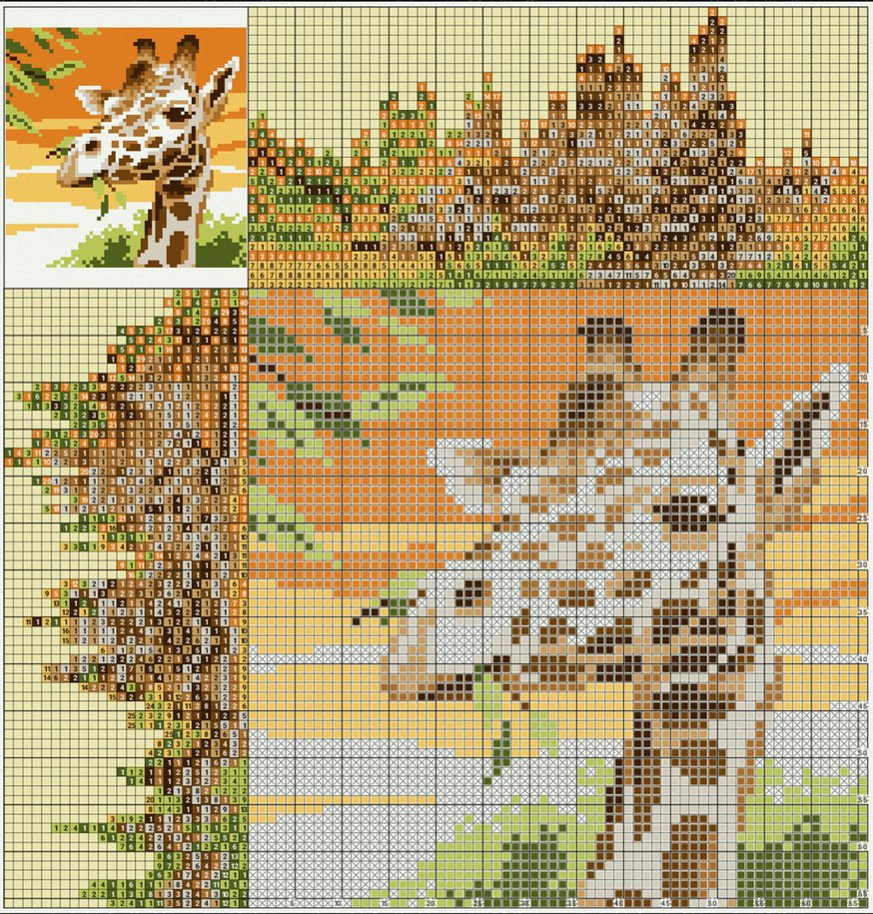
Improvements
GUI application
Allow user to create and save puzzles graphically
Connection to online puzzle database(s)
Multiple puzzle colors
Show solver progress / estimate
Option to generate puzzle from an existing image (OpenCV?)
Human-like logical solving
Hybrid solving
Image credit: doomdutch.deviantart.com

Slide 8
Contact
GitHub Repository:
https://github.com/salterm/PicrossDetective
Contact:
salterm@pdx.edu

