Slide 1



Understanding JavaScript
Event-Based Interactions
Saba Alimadadi
Sheldon Sequeira
Ali Mesbah
Karthik Pattabiraman

Slide 2

Motivation
JavaScript
Widely used, very popular
Event driven, dynamic, asynchronous
Difficult to understand the dynamic behavior and the control flow
Lower level events
Their interactions

Slide 3
Challenge 1: Event Propagation
html
bar() triggered
head
body
body
P
div
a
div
div
foo() triggered
p
h1
table
p
table
qux() triggered
caption
tr
User
Click
td
baz() triggered
td
label
input
table
textarea
button
button
bar() triggered

Slide 4
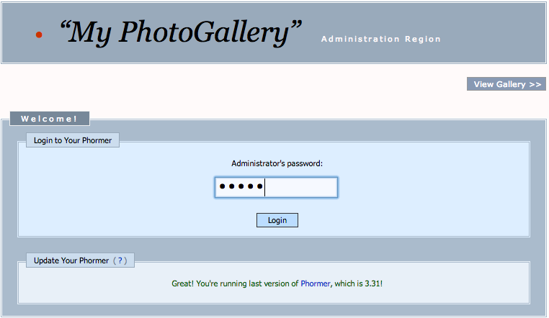
Challenge 2: Asynchronous Events
Timeout for page expiry
Server request for login
Server response for login
User logs in

Slide 5
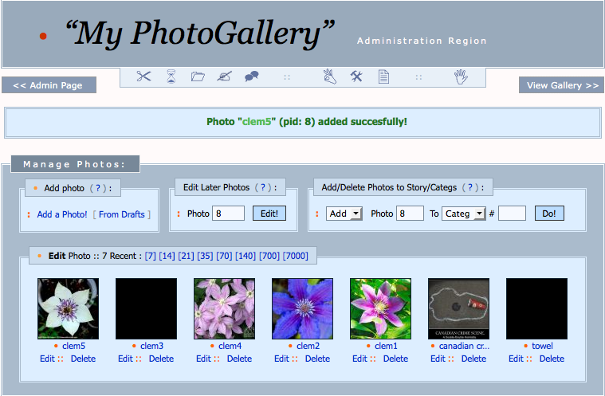
Challenge 2: Asynchronous Events
Timeout for page expiry
View gallery
Server request for login
Server response for login
Server request
Server request
Server response
Server response

Slide 6
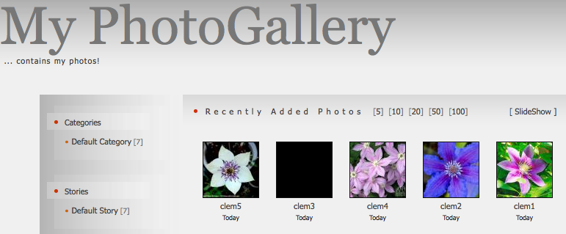
Challenge 2: Asynchronous Events
Timeout for page expiry
Server request for login
Server response for login
View slideshow
Server request
Server request
Server response
Server response
Timeout for next image

Slide 7
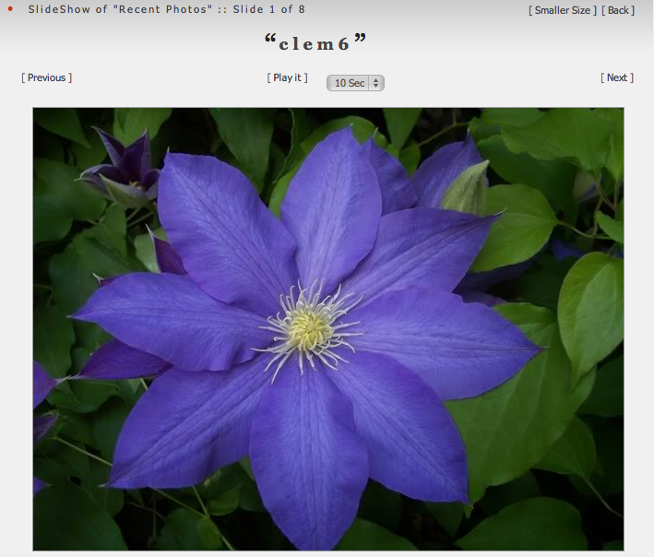
Challenge 2: Asynchronous Events
Timeout for page expiry
Server request for login
Server response for login
Server request
Server request
Server response
Server response
Timeout for next image
Server request image
Server response
Timeout callback
Timeout callback page expiry

Slide 8
Challenge 3: DOM State
function submissionHandler(e) {
$('#regMsg').html("Submitted!");
html
var email = $('#email').val();
if (isEmailValid(email)) {
informServer(email);
head
Body
$('#submitBtn').attr("disabled", true);
}
}
P
div
a
srvrMsg
. . .
function informServer(email) {
p
$.get('/register/', { email }
regMsg
div
, function(data) {
$(’#srvrMsg').append(data);
caption
form
});
}
label
input
submitBtn

Slide 9
Summary of Challenges
Event propagation
Asynchronous events
Implications of events

Slide 10
Approach
JavaScript Transformation
Trace
Collection
Model
Visualization
Behavioral Model Creation

Slide 11
JavaScript Transformation
Interposing on DOM events
Capturing timeouts and XHRs
Recording function traces
Extracting DOM mutations
JavaScript Transformation
Trace
Collection
Model
Creation
Model
Visualization

Slide 12
Trace Collection
Interposing on DOM events
Capturing timeouts and XHRs
Recording function traces
Extracting DOM mutations
=> Detailed Trace
JavaScript Transformation
Trace
Collection
Model
Creation
DOM events
functions
timeouts
XHRs
DOM mutations
Model
Visualization

Slide 13
Behavioral Model Creation
Customized graph
Nodes: episodes
Links: temporal and causal
JavaScript Transformation
Trace
Collection
Model
Creation
Model
Visualization

Slide 14
Model: Episodes
A period of JavaScript execution
Start and end points

Slide 15
Model: Links
Temporal
Causal

Slide 16
Model: Story

Slide 17
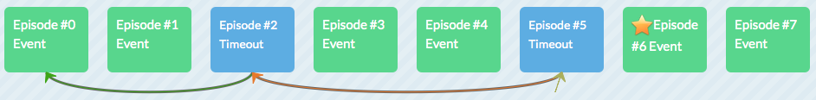
Visualization: Overview
JavaScript Transformation
Trace
Collection
Model
Creation
Model
Visualization

Slide 18
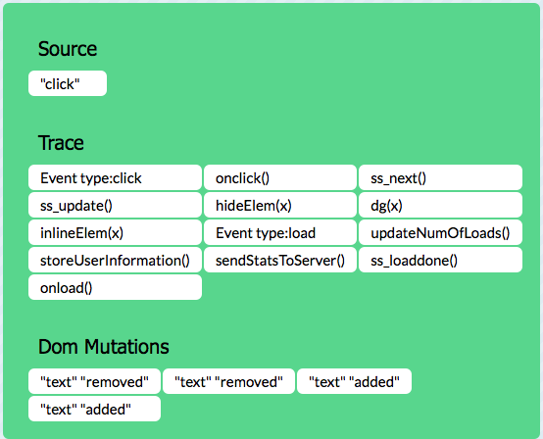
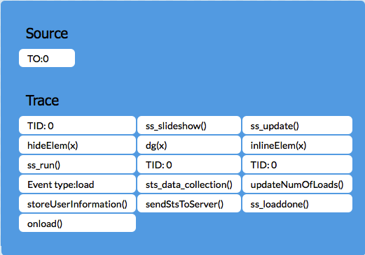
Visualization: Zoom Level 1

Slide 19
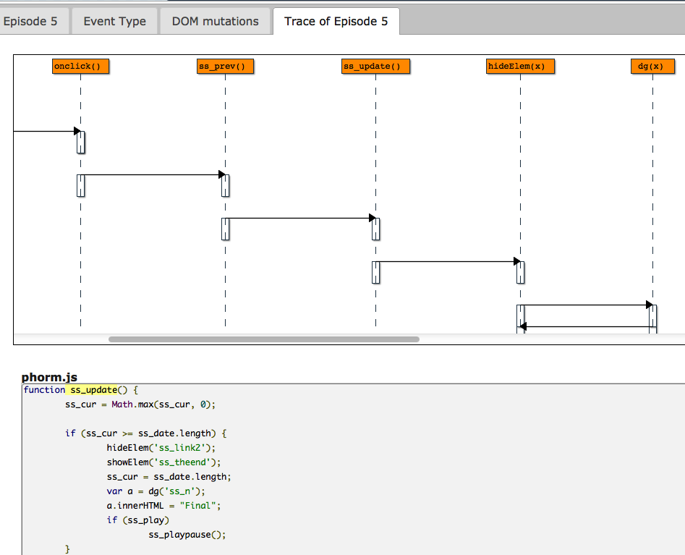
Visualization: Zoom Level 1
Visualization: Zoom Level 2

Slide 20
Implementation
Clematis
https://github.com/saltlab/clematis
Languages: Java, JavaScript
Transform JavaScript & inject toolbar via proxy
Provide a RESTful API for retrieving data
Render a web-based visualization

Slide 21
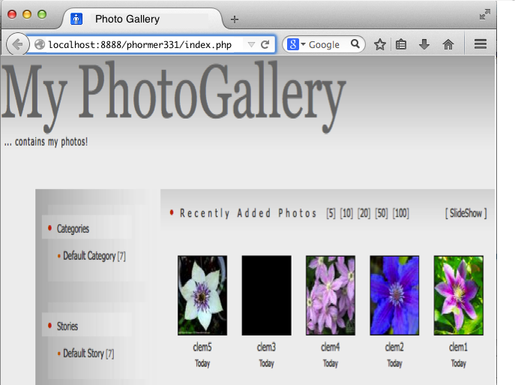
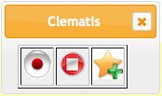
Usage Scenario

Slide 22
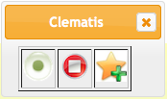
Usage Scenario

Slide 23
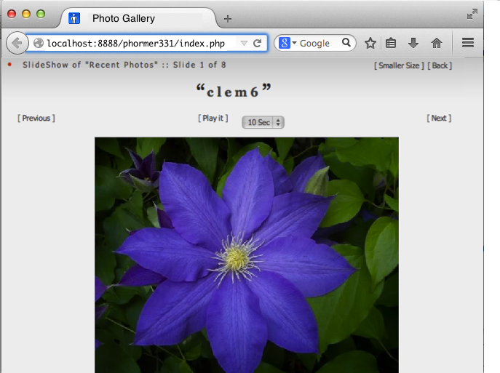
Usage Scenario

Slide 24
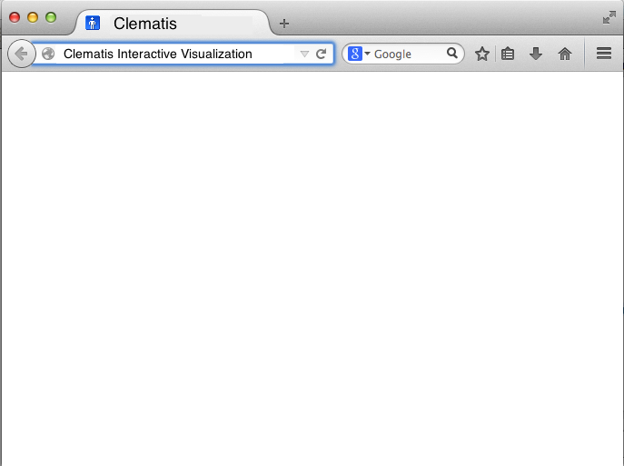
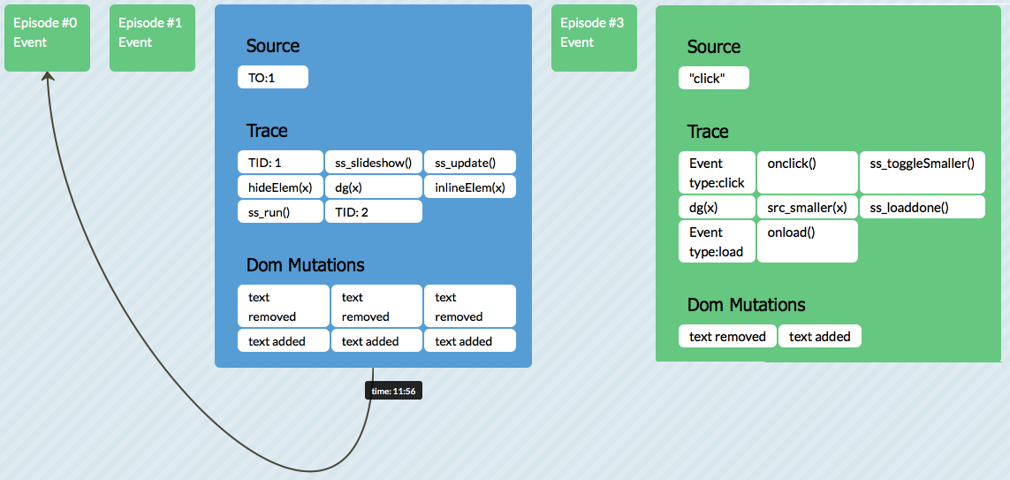
Usage Scenario

Slide 25
Evaluation
RQ1) Does using Clematis decrease the task completion duration for web application comprehension?
RQ2) Does using Clematis increase the task completion accuracy for web application comprehension?
RQ3) Are there any certain categories of tasks for which Clematis improves the performance most?

Slide 26
Industrial Controlled Experiment
Participants
20 software developers (from a large SW company)
Experimental group: Clematis
Control group: Chrome, Firefox & Firebug
Procedure
5 minute tutorial on Clematis
Tasks: control flow, feature location, DOM mutations, …
Data collection
Task completion duration & accuracy

Slide 27

Results: Duration
Average Time (mm:ss) Per Task
Average Time (mm:ss) in Total
Task | Clematis |  | Other
T1 | 7:00 | << | 11:27 | (39%⬆)
T2 | 3:51 | << | 7:27 | (48%⬆)
T3 | 2:02 | << | 6:18 | (68%⬆)
T4 | 2:44 | < | 4:00 | (32%⬆)
Task | Clematis |  | Other
All | 15:37 | << | 29:12 | (47%⬆)

Slide 28
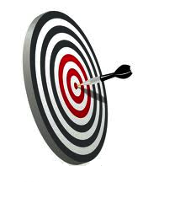
Results: Accuracy
Average Accuracy (%) Per Task
Average Accuracy (%) in Total
Task | Clematis |  | Other
T1 | 84 | >> | 28 | (67%⬆)
T2 | 97 | >> | 57 | (41%⬆)
T3 | 100 | > | 80 | (20%⬆)
T4 | 95 | >> | 30 | (68%⬆)
Task | Clematis |  | Other
All | 90 | >> | 35 | (61%⬆)

Slide 29
Results
Duration
Accuracy
Task | Improvement
T1 | (39%⬆)
T2 | (48%⬆)
T3 | (68%⬆)
T4 | (32%⬆)
Task | Improvement
T1 | (67%⬆)
T2 | (41%⬆)
T3 | (20%⬆)
T4 | (68%⬆)
Task | Description
T1 | Following control flow in presence of asynchronous events
T2 | Finding DOM mutations caused by a DOM event
T3 | Locating the implementation of a malfunctioning feature
T4 | Detecting control flow in presence of event propagation

Slide 30
Consistent Performance
Duration (mm:ss)
Accuracy (%)

Slide 31
