Slide 1




Kartik Bajaj, Karthik Pattabiraman, Ali Mesbah
Mining Questions Asked by
Web Developers
Electrical and Computer Engineering
University of British Columbia
Vancouver, BC, Canada
{kbajaj, karthikp, amesbah}@ece.ubc.ca

Slide 2
Kartik Bajaj, Karthik Pattabiraman, Ali Mesbah
Mining Questions Asked by
Web Developers
Electrical and Computer Engineering
University of British Columbia
Vancouver, BC, Canada
{kbajaj, karthikp, amesbah}@ece.ubc.ca

Slide 3
Problem Statement
Web applications are becoming popular over time
[Jazayeri et al., FOSE 2007]
Complex integration of JavaScript, CSS, and HTML
JavaScript code often experiences errors
[Ocariza et al., ISSRE 2011]
Notes:
prior work has shown the prevalence of javascript errors in productions web sites..
and also demonstrated the ad-hoc nature of css files…

Slide 4
Existing Work
Static Checkers
Dynamic Checkers
Console Messages
Bug Reports
Notes:
no work has been that focus on analyzing what web developers discuss and talk about
new developments or existing technologies
How is the discussion being affected by the advancement in technology

Slide 5
Existing Work
Static Checkers
Dynamic Checkers
Console Messages
Bug Reports
No attempt to understand developer’s misconception
Notes:
We basically focus on analyzing what web developers discuss and talk about?
new developments or existing technologies?
How is the discussion being affected by the advancement in technology?

Slide 6
Goal
Understand the common challenges and/or misconceptions among web developers
Notes:
We want to take the words spoken by a developer and analyze the root cause of the understanding.
Talk about the following points here:
how are the results gonna be used
becoming more popular
after the application has been released
can we understand developer's misconceptions

Slide 7
Background
Stack Overflow
QA website for programmers
Started in 2008
4,125,638 questions asked from Jan’09 to Dec’12
500,000+ questions related to web development
Questions directly asked/answered by developers
Followed by discussion in comments

Slide 8
Background
Stack Overflow
QA website for programmers
Started in 2008
4,125,638 questions asked from Jan’09 to Dec’12
500,000+ questions related to web development
Questions directly asked/answered by developers
Followed by discussion in comments
StackOverflow provides sufficient data for analysis

Slide 9
Straw man Approach
Categorization based on tags attached to each question
Can provide an overview of major topics of discussion

Slide 10
Straw man Approach
Categorization based on tags attached to each question
Can provide an overview of major topics of discussion
How appropriate are tags?

Slide 11
Tags
What is known to developer while tagging?
Platform
Target Device
What is unknown to developer?
Possible ways to solve the problem
Correct topic of discussion
Notes:
developers are aware of the target platform they are developing the application, therefor high level tagging is correct

Slide 12
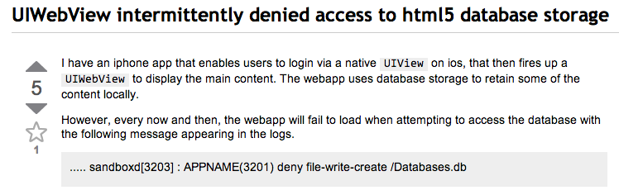

Example

Slide 13
Natural Language Analysis
Analyzing the text provided in the questions and answers provided by developers
Data Collection
Data Cleaning
Data Processing
Notes:
----- Meeting Notes (2014-05-16 15:23) -----
add over all methodology here
skip everything

Slide 14
Datasets
Notes:
In total there are more than 500 thousand questions available on stack overflow pertaining to web applications

Slide 15
RQ1: Categorization of topics of discussion

Slide 16
RQ1: Categorization of topics of discussion
Cross Browser related discussions have gained maximum attention from web developers.
Notes:
What are we missing in this finding?
How does a web developer search for solution?
In some scenarios solution is readily available online
so there is no more discussion related to these topics..
How to count these factors?

Slide 17
RQ2: Hot topics of discussion
Technology | Hot Topics
JavaScript | Document Structure, File Handling, Cross-Browser, jQuery, DOM
HTML5 | Media, Browser Support, HTML5 Elements, Canvas API, Offline Web
CSS | CSS3, Fonts, JavaScript, Box-Model, Layout

Slide 18
RQ2: Hot topics of discussion
Technology | Hot Topics
JavaScript | Document Structure, File Handling, Cross-Browser, jQuery, DOM
HTML5 | Media, Browser Support, HTML5 Elements, Canvas API, Offline Web
CSS | CSS3, Fonts, JavaScript, Box-Model, Layout
View counts provide a hint towards recurrent issues faced by web developers.

Slide 19
RQ3: Temporal trends over time
Notes:
In finding 1 we saw the prevalence of cross browser related issues..
but here we can see that discussions related to cross browser issues are declining over time
either browsers are becoming consistent or solutions are readily available over the internet.
----- Meeting Notes (2014-05-16 15:23) -----
top 20
how are the results gonna be used
becoming more popular
after the application has been released
can we understand developer's misconceptions
avoid like, so, etc
1414
look at audience
MSR

Slide 20
RQ3: Temporal trends over time
Cross-browser compatibility issues have seen a sharp decline in the recent past.
Further, CSS3 and HTML5 discussions are gaining popularity.

Slide 21
RQ4: Prevalence of web in mobile development

Slide 22
RQ4: Prevalence of web in mobile development
Discussions related to Mobile development are seeing an increasing share of web technologies.

Slide 23
Popularity
Questions that gained maximum attention from the community
Post Score
Up votes
Down votes

Slide 24
Popularity
Questions that gained maximum attention from the community
Post Score
Up votes
Down votes
Is post score accurate representation of user participation?

Slide 25
StackOverflow Post Score
Missing details
How many users up voted or down voted the question?
How many users tried to answer the question?
Is there an accepted answer for this question?
How many users are following the question?
How many users are participating in the discussion?

Slide 26
StackOverflow Post Score
Missing details
How many users up voted or down voted the question?
How many users tried to answer the question?
Is there an accepted answer for this question?
How many users are following the question?
How many users are participating in the discussion?
We devised a new metric to rank Stack Overflow questions based on these factors.

Slide 27

RQ5: Technical challenges
Notes:
Here we present anecdotal examples that represent the type of challenges faced by developers…

Slide 28
RQ5: Technical challenges
Programmers get confused about new features, suggesting that the available API resources for these features is far from ideal.
Maintaining web code, such as CSS, is complex without proper tool support.

Slide 29
Implications
Finding 1, 3 (Categorization and temporal trends)
Developers can shift their focus away from cross browser issues.
Finding 4 (Prevalence of mobile applications)
Can guide tool developers to build better mobile development tools.
Finding 5 (Technical Challenges)
Can guide standardization communities to focus on areas that need improvement.

Slide 30
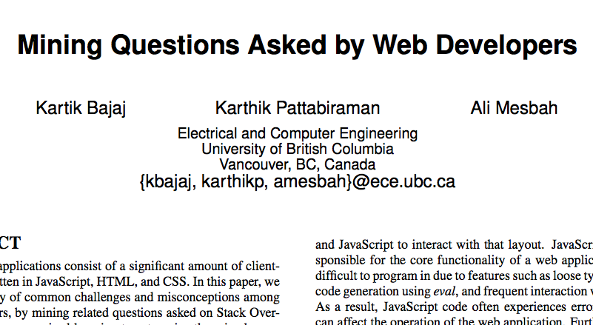
Thank You!!
Contributions
Categorized web related discussions.
Identified temporal trends.
Devised a metric to rank StackOverflow questions.
Analyzed Data: http://www.ece.ubc.ca/~kbajaj/so/data.zip

