Slide 1
Repatha™ Indications and Usage
INDICATIONS
Primary Hyperlipidemia
Repatha™ is indicated as an adjunct to diet and maximally tolerated statin therapy for the treatment of adults with heterozygous familial hypercholesterolemia (HeFH) or clinical atherosclerotic cardiovascular disease (CVD), who require additional lowering of low density lipoprotein cholesterol (LDL-C)
Homozygous Familial Hypercholesterolemia
Repatha™ is indicated as an adjunct to diet and other LDL-lowering therapies (e.g., statins, ezetimibe, LDL apheresis) for the treatment of patients with homozygous familial hypercholesterolemia (HoFH) who require additional lowering of LDL-C
LIMITATIONS OF USE
The effect of Repatha™ on cardiovascular morbidity and mortality has not been determined
LDL = low-density lipoprotein.
Repatha™ (evolocumab) Prescribing Information, Amgen.

Slide 2
Important Safety Information
Contraindication
Repatha™ is contraindicated in patients with a history of a serious hypersensitivity reaction to Repatha™
Allergic Reactions
Hypersensitivity reactions (e.g. rash, urticaria) have been reported in patients treated with Repatha™, including some that led to discontinuation of therapy. If signs or symptoms of serious allergic reactions occur, discontinue treatment with Repatha™, treat according to the standard of care, and monitor until signs and symptoms resolve
Adverse Reactions
The most common adverse reactions (> 5% of Repatha™ -treated patients and more common than placebo) were: nasopharyngitis, upper respiratory tract infection, influenza, back pain, and injection site reactions
Repatha™ (evolocumab) Prescribing Information, Amgen.

Slide 3
Objectives
Core Topics
Review recommendations and treatment data on LDL-C lowering
Understand how Repatha™ lowers LDL-C by inhibiting PCSK9
Review the clinical efficacy and safety profile of Repatha™
Describe dosing and administration of Repatha™
Additional Topics
Review profile of potential Repatha™ patient
Discuss RepathaReady™ personalized support services
PCSK9 = proprotein convertase subtilisin/kexin type 9.

Slide 4
LDL-C Reduction Remains Fundamental to Major Cholesterol Treatment Guidelines and Recommendations
Recommendations for Patients With Clinical ASCVD
LDL-C < 70 mg/dL
NLA
Recommendations⁴
d
AACE
Guidelines⁵
% LDL-C Reduction*
ACC/AHA
Guidelines^{1,2}
IAS
Recommendations⁶
ADA
Recommendations³
ESC/EAS
Guidelines^{7,†}
ASCVD = atherosclerotic cardiovascular disease; ACC = American College of Cardiology; AHA = American Heart Association; ADA = American Diabetes Association; NLA = National Lipid Association; AACE = American Association of Clinical Endocrinologists; IAS = International Atherosclerosis Society; ESC = European Society of Cardiology; EAS = European Atherosclerosis Society.
*Percent LDL-C reduction defines treatment intensity and assesses adherence;¹ †also includes percent LDL-C reduction as an efficacy metric.⁷
1. Stone NJ, et al. J Am Coll Cardiol. 2014;63:2889-2934. 2. Keaney JF, et al. N Engl J Med. 2014;370:275-278. 3. American Diabetes Association. Diabetes Care. 2015;38(suppl 1):S1-S94. 4. Jacobson TA, et al. J Clin Lipidol. 2014;8:473-488. 5. Jellinger PS, et al. Endocr Pract. 2012;18(suppl 1):1-78. 6. Expert Dyslipidemia Panel, Grundy SM. J Clin Lipidol. 2013;7:561-565. 7. Reiner Z, et al. Eur Heart J. 2011;32:1769-1818.

Slide 5
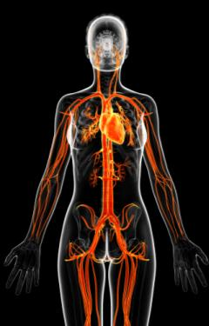

What Is Clinical ASCVD and FH?
Clinical ASCVD¹
Familial Hypercholesterolemia (FH)²⁻⁴
Defined in 2013 ACC/AHA guidelines as one or more of the following:^{1,2}
Inherited conditions characterized by elevated LDL-C and mutations in genes involved in LDL metabolism³
Coronary heart disease (CHD)
Acute coronary syndrome
History of myocardial infarction (MI)
Stable or unstable angina (UA)
Coronary or other arterial revascularization
Heterozygous FH
LDL-C ≥ 190 mg/dL^{3,*}
Identification⁴
Elevated LDL-C with physical findings or family history
OR
DNA-based evidence
Homozygous FH
LDL-C > 500 mg/dL^{5,}*†
CVD diagnosis on average at 20 years³
Stroke or transient ischemic attack
Peripheral arterial disease
DNA = deoxyribonucleic acid.
*Typical levels when untreated; †LDL-C level indicative, lower levels do not exclude HoFH.
1. Stone NJ, et al. J Am Coll Cardiol. 2014;63:2889-2934. 2. National Cholesterol Education Program (NCEP) Expert Panel on Detection, Evaluation, and Treatment of High Blood Cholesterol in Adults (Adult Treatment Panel III). Circulation. 2002;106:3143-3421. 3. Robinson JG. J Manag Care Pharm. 2013;19:139-149. 4. Austin MA, et al. Amer J Epidemiol. 2004;160:407-420. 5. Raal FJ, et al. Atherosclerosis. 2012;223:262-268.

Slide 6
Despite Treatment Many US Adults With CHD* Are Not Achieving Prespecified LDL-C Levels
Treated Patients From NHANES
Achieving
LDL-C < 70 mg/dL
Not achieving LDL-C < 70 mg/dL
NHANES = National Health and Nutrition Examination Survey. *NHANES defined CHD based on answers to questions about CHD, angina, and MI (patient survey).
Jones, PH, et al. J Am Heart Assoc. 2012;1:e001800.

Slide 7

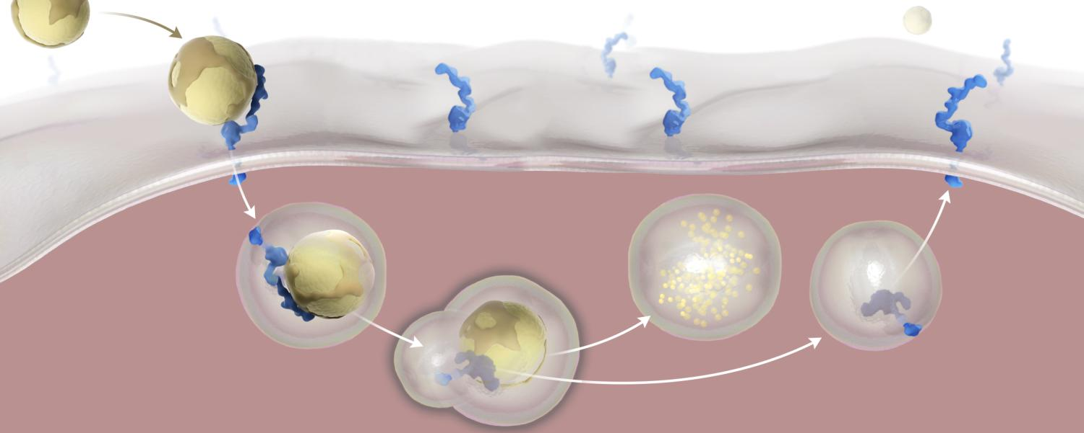
LDL Particles Are Cleared From the Plasma by Binding to LDL Receptors and Being Internalized by the Hepatocyte¹⁻³
1
LDL binds to LDL receptor
Intravascular
LDL degraded in lysosome
3
LDL/LDL receptor complex internalized by hepatocyte
2
4
LDL receptor recycled to cell surface
Hepatocyte
Recycled LDL receptors continue to clear plasma LDL
1. Brown MS, et al. Proc Natl Acad Sci U S A. 1979;76:3330-3337. 2. Brown MS, et al. Science. 1986;232:34-47. 3. Steinberg D, et al. Proc Natl Acad Sci U S A. 2009;106:9546-9547.

Slide 8
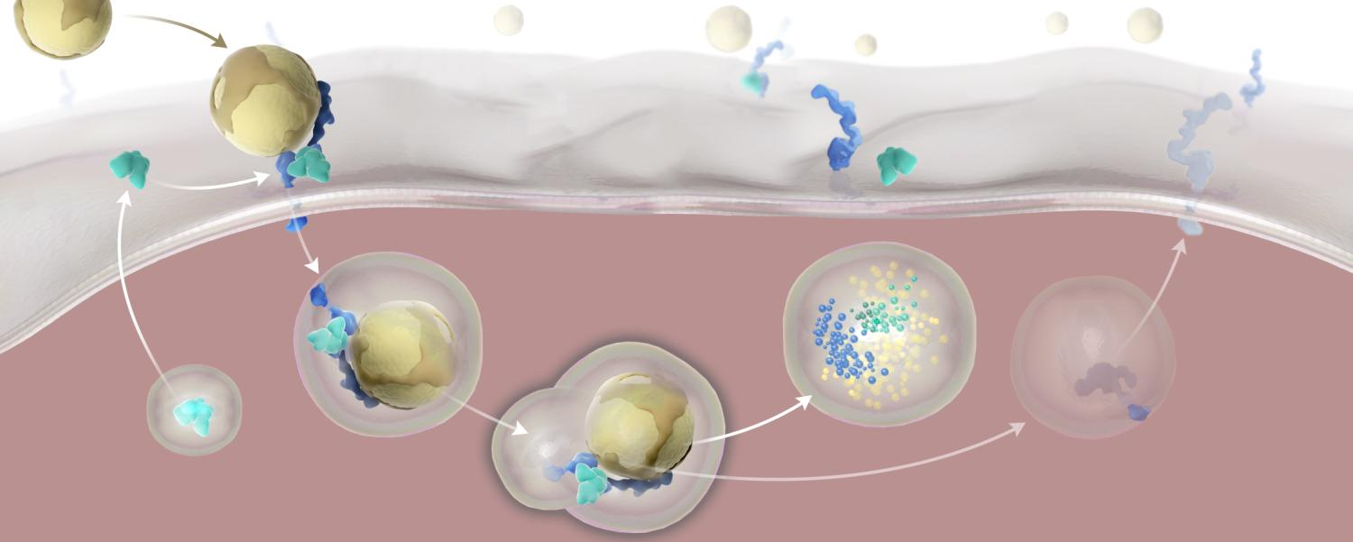
PCSK9 Binds to the LDL Receptor and Targets the LDL Receptor for Degradation¹⁻³
Intravascular
2
PCSK9 binds to LDL receptor
3
Internalization of entire complex
4
LDL receptor as part of entire complex is degraded
PCSK9: made in hepatocyte, secreted
X
1
5
LDL receptor not recycled
X
Hepatocyte
Fewer LDL receptors on hepatocyte surface result in increased plasma LDL
1. Abifadel M, et al. Hum Mutat. 2009;30:520-529. 2.Seidah NG, et al. Circ Res. 2014;114:1022-1036. 3. Steinberg D, et al. Proc Natl Acad Sci U S A. 2009;106:9546-9547.

Slide 9
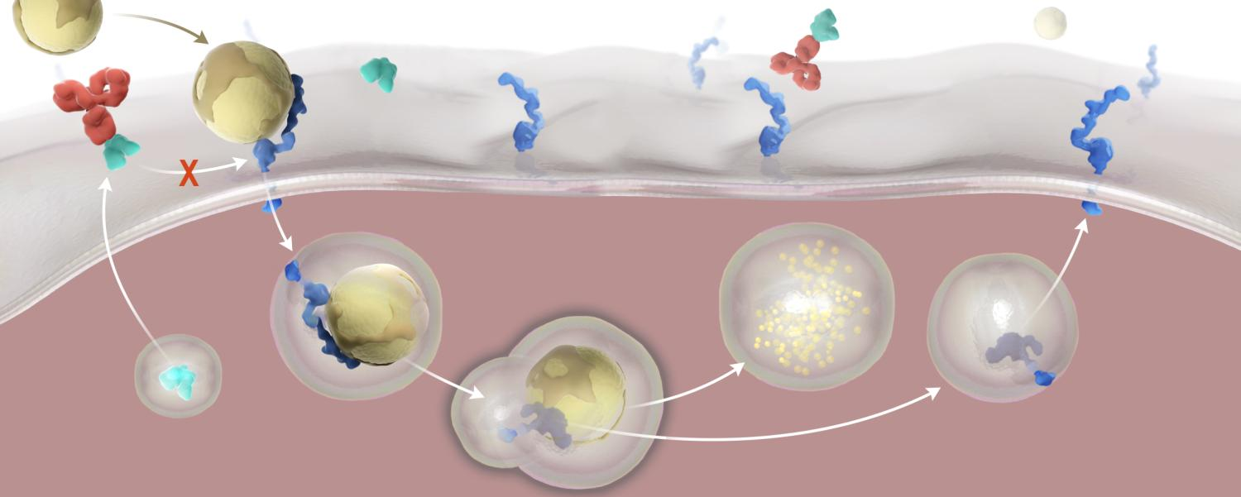
Repatha™ Binds to PCSK9, Preventing PCSK9 From Binding to the LDL Receptor^{1,2}
Intravascular
1
X
Repatha™ binds to PCSK9
2
Inhibits PCSK9 from binding to LDL receptor
3
LDL receptor recycled, not degraded
Hepatocyte
LDL receptors can recycle to hepatocyte surface to clear more plasma LDL
1. Repatha™ (evolocumab) Prescribing Information, Amgen. 2. Stein AE, et al. Drugs Future. 2013;38:451-459.

Slide 10
Amgen Uses Biotechnology to Design and Manufacture Repatha™ as a Human Monoclonal IgG2 Antibody¹
Pharmacokinetics (PK)/Pharmacodynamics (PD)
Maximum suppression of free PCSK9 occurs within 4 hours¹
No clinically meaningful drug-drug interaction with high-intensity statin therapy; other drug-drug interaction studies have not been performed^{1,*}
PK of Repatha™ not affected by age, gender, race, or creatinine clearance¹
Clearance
Not metabolized by the liver or excreted by the kidneys¹
Cleared predominately through saturable binding to target (PCSK9)¹
Large protein
Administered as a fixed dose, subcutaneous injection¹
Not expected to cross the blood-brain barrier²
IgG2 = immunoglobulin G2.
1. Repatha™ (evolocumab) Prescribing Information, Amgen. 2. Gabathuler R. Neurobiol Dis. 2010;37:48-57.

Slide 11



Across Four Clinical Trials, Repatha™ Demonstrated Significant LDL-C Reduction
as an adjunct to diet in: adults with HeFH or clinical ASCVD on maximally tolerated statin therapy*
OR patients with HoFH on other LDL-lowering therapies¹
COMBINATION
WITH STATIN THERAPY
IN CLINICAL ASCVD^{1,2}
52-WEEK EFFICACY AND SAFETY
52-Week efficacy and safety in Clinical ASCVD^{1,3}
FAMILIAL
HYPERCHOLESTEROLEMIA
HETEROZYGOUS (STUDY 3)^{1,4} HOMOZYGOUS (STUDY 4)^{1,5}
LAPLACE-2 (Study 1)
DESCARTES (Study 2)
RUTHERFORD-2 (Study 3) and TESLA (Study 4)
Mean Baseline LDL-C: 108 mg/dL N = 296
Mean Baseline LDL-C: 105 mg/dL N = 139
Mean Baseline LDL-C:
Study 3: 156 mg/dL, N = 329 Study 4: 349 mg/dL, N = 49
*Maximally tolerated includes patients who have been optimized on statins or cannot tolerate any statin type or dose.
1. Repatha™ (evolocumab) Prescribing Information, Amgen. 2. Robinson J, et al. JAMA. 2014;311:1870-1882. 3. Blom DJ, et al. N Engl J Med. 2014;370:1809-1819. 4. Raal FJ, et al. Lancet. 2015;385:331-334. 5. Raal FJ, et al. Lancet; 2015;385:341-350.

Slide 12
Across Four Clinical Trials, Repatha™ Demonstrated Significant LDL-C Reduction
as an adjunct to diet in: adults with HeFH or clinical ASCVD on maximally tolerated statin therapy*
OR patients with HoFH on other LDL-lowering therapies¹
COMBINATION
WITH STATIN THERAPY
IN CLINICAL ASCVD^{1,2}
52-WEEK EFFICACY AND SAFETY
52-Week efficacy and safety in Clinical ASCVD^{1,3}
FAMILIAL
HYPERCHOLESTEROLEMIA
HETEROZYGOUS (STUDY 3)^{1,4} HOMOZYGOUS (STUDY 4)^{1,5}
LAPLACE-2 (Study 1)
DESCARTES (Study 2)
RUTHERFORD-2 (Study 3) and TESLA (Study 4)
Mean Baseline LDL-C: 108 mg/dL N = 296
Mean Baseline LDL-C: 105 mg/dL N = 139
Mean Baseline LDL-C:
Study 3: 156 mg/dL, N = 329 Study 4: 349 mg/dL, N = 49
*Maximally tolerated includes patients who have been optimized on statins or cannot tolerate any statin type or dose.
1. Repatha™ (evolocumab) Prescribing Information, Amgen. 2. Robinson J, et al. JAMA. 2014;311:1870-1882. 3. Blom DJ, et al. N Engl J Med. 2014;370:1809-1819. 4. Raal FJ, et al. Lancet. 2015;385:331-334. 5. Raal FJ, et al. Lancet; 2015;385:341-350.

Slide 13
Repatha™ Was Studied With the Most Common Statin Types^{1,2}
COMBINATION
WITH STATIN THERAPY
STUDY 1
4-Week, Lipid- Stabilization Period
Double-Blind, 12-Week Study Period‡
Randomization to Study Drug†
Randomization to Statin*
Repatha™ Q2W 140 mg SC (fixed dose) + Statin
Patients who needed additional LDL lowering
STATIN THERAPY
Atorvastatin 80 mg QD Rosuvastatin 40 mg QD
Simvastatin 40 mg QD
Placebo Q2W SC + Statin
Primary Endpoint
Mean percent change from baseline in LDL-C at week 12
Secondary Endpoints
Included percent of patients achieving LDL-C < 70 mg/dL and percent change from baseline in other lipid parameters at week 12
QD = once daily; Q2W = every 2 weeks; SC = subcutaneous. *Key exclusion criteria: patients who experienced one of the following within prior 6 months were excluded: MI/UA, percutaneous coronary intervention (PCI), coronary artery bypass graft (CABG), or stroke and planned cardiac surgery or revascularization;³ †baseline was measured after the lipid-stabilization period and before administration of first dose of study drug;³ ‡patients with clinical ASCVD on QD doses of atorvastatin 80 mg, rosuvastatin 40 mg, or simvastatin 40 mg; n = 296.¹
1. Repatha™ (evolocumab) Prescribing Information, Amgen. 2. Robinson J, et al. JAMA. 2014;311:1870-1882. 3. Robinson J, et al. Clin Cardiol. 2014;37:195-203.

Slide 14
Baseline Characteristics for Patients With Clinical ASCVD on Maximum Dose of Statin Therapy
COMBINATION
WITH STATIN THERAPY
STUDY 1
 |  | All Patients With Clinical ASCVD (n = 296)
Age (years), mean |  | 63
Age ≥ 65 (%) |  | 45
Female (%) |  | 33
Male (%) |  | 67
Race: White (%) |  | 98
LDL-C (mg/dL), mean |  | 108
Repatha™ (evolocumab) Prescribing Information, Amgen.

Slide 15
Repatha™ + a Statin Achieved Intensive LDL-C Reduction Up to 77% vs Placebo^{1,2}
COMBINATION
WITH STATIN THERAPY
STUDY 1
Repatha™ 140 mg Q2W + or
Placebo +
Atorvastatin 80 mg
Rosuvastatin 40 mg
Simvastatin 40 mg
13%
– 1%
2%
Mean % Change in LDL-C From Baseline to Week 12
– 64%
– 65%
– 64%
–63%
–66%
–77%
TREATMENT DIFFERENCE
TREATMENT DIFFERENCE
TREATMENT DIFFERENCE
Estimates based on a multiple imputation model that accounts for treatment adherence.¹
N = 147
Repatha™ 140 mg Q2W + statin
Placebo + statin
P < 0.0001 for all arms represented
1. Repatha™ (evolocumab) Prescribing Information, Amgen. 2. Data on file, Amgen.

Slide 16
Repatha™ Helped Up to 90% of Patients Achieve LDL-C < 70 mg/dL
COMBINATION
WITH STATIN THERAPY
STUDY 1
Repatha™ 140 mg Q2W +
Atorvastatin 80 mg
Rosuvastatin 40 mg
Simvastatin 40 mg
Percent of patients achieving LDL-C < 70 mg/dL at week 12
90%
88%
87%
N = 95
Repatha™ provided intensive, predictable LDL-C reduction regardless of statin type studied
Data on file, Amgen.

Slide 17
Repatha™ + Statin Had an Additional Impact on Key Lipid Parameters
COMBINATION
WITH STATIN THERAPY
STUDY 1
LDL
Non–HDL-C
ApoB
TC
7%
5%
4%
2%
Mean % Change in LDL-C From Baseline to Week 12¹
–38%
–49%
–56%
–42%
–64%
TREATMENT DIFFERENCE
–55%
–58%
TREATMENT DIFFERENCE
–71%
TREATMENT DIFFERENCE
TREATMENT DIFFERENCE
Repatha™ 140 mg Q2W + statin (n = 105)
Placebo + statin (n = 42)
P < 0.0001²
Estimates based on a multiple imputation model that accounts for treatment adherence.¹
HDL-C = high-density lipoprotein cholesterol; ApoB = apolipoprotein B; TC = total cholesterol.
Pooled analysis of lipid parameters in patients with ASCVD from Study 1
1. Repatha™ (evolocumab) Prescribing Information, Amgen. 2. Data on file, Amgen

Slide 18
Across Four Clinical Trials, Repatha™ Demonstrated Significant LDL-C Reduction
as an adjunct to diet in: adults with HeFH or clinical ASCVD on maximally tolerated statin therapy*
OR patients with HoFH on other LDL-lowering therapies¹
COMBINATION
WITH STATIN THERAPY
IN CLINICAL ASCVD^{1,2}
52-WEEK EFFICACY AND SAFETY
52-Week efficacy and safety in Clinical ASCVD^{1,3}
FAMILIAL
HYPERCHOLESTEROLEMIA
HETEROZYGOUS (STUDY 3)^{1,4} HOMOZYGOUS (STUDY 4)^{1,5}
LAPLACE-2 (Study 1)
DESCARTES (Study 2)
RUTHERFORD-2 (Study 3) and TESLA (Study 4)
Mean Baseline LDL-C: 108 mg/dL N = 296
Mean Baseline LDL-C: 105 mg/dL N = 139
Mean Baseline LDL-C:
Study 3: 156 mg/dL, N = 329 Study 4: 349 mg/dL, N = 49
*Maximally tolerated includes patients who have been optimized on statins or cannot tolerate any statin type or dose.
1. Repatha™ (evolocumab) Prescribing Information, Amgen. 2. Robinson J, et al. JAMA. 2014;311:1870-1882. 3. Blom DJ, et al. N Engl J Med. 2014;370:1809-1819. 4. Raal FJ, et al. Lancet. 2015;385:331-334. 5. Raal FJ, et al. Lancet; 2015;385:341-350.

Slide 19

Intensive LDL-C Reduction With Repatha™ Was Maintained Over 52 Weeks
52-Week efficacy and safety
STUDY 2
Percent Change in LDL-C at Week 52: Placebo vs Repatha™
20
10
0
2%
–10
–20
Placebo QM + background therapy*
Mean % Change in LDL-C From Baseline to Week 52
–54%
–30
Repatha™ 420 mg QM + background therapy*
TREATMENT DIFFERENCE
–40
–50
–52%
–60
–70
Baseline
Week 12
Week 24
Week 36
Week 52
Study Week
N = 139
P < 0.0001
Multicenter, double-blind, randomized, placebo-controlled, 52-week study of Repatha™ in 139 patients with clinical ASCVD
In this study, Repatha™ was administered as the 420 mg once monthly dose. The 140 mg every 2 weeks or 420 mg once monthly doses yield similar reductions in LDL-C
QM = once monthly.
Error bars indicate 95% CI; LDL-C measured via ultracentrifugation; Estimates based on a multiple imputation model that accounts for treatment adherence.
*Atorvastatin 80 mg with or without 10 mg ezetimibe daily.
Repatha™ (evolocumab) Prescribing Information, Amgen.

Slide 20
Across Four Clinical Trials, Repatha™ Demonstrated Significant LDL-C Reduction
as an adjunct to diet in: adults with HeFH or clinical ASCVD on maximally tolerated statin therapy*
OR patients with HoFH on other LDL-lowering therapies¹
COMBINATION
WITH STATIN THERAPY
IN CLINICAL ASCVD^{1,2}
52-WEEK EFFICACY AND SAFETY
52-Week efficacy and safety in Clinical ASCVD^{1,3}
FAMILIAL
HYPERCHOLESTEROLEMIA
HETEROZYGOUS (STUDY 3)^{1,4} HOMOZYGOUS (STUDY 4)^{1,5}
LAPLACE-2 (Study 1)
DESCARTES (Study 2)
RUTHERFORD-2 (Study 3) and TESLA (Study 4)
Mean Baseline LDL-C: 108 mg/dL N = 296
Mean Baseline LDL-C: 105 mg/dL N = 139
Mean Baseline LDL-C:
Study 3: 156 mg/dL, N = 329 Study 4: 349 mg/dL, N = 49
*Maximally tolerated includes patients who have been optimized on statins or cannot tolerate any statin type or dose.
1. Repatha™ (evolocumab) Prescribing Information, Amgen. 2. Robinson J, et al. JAMA. 2014;311:1870-1882. 3. Blom DJ, et al. N Engl J Med. 2014;370:1809-1819. 4. Raal FJ, et al. Lancet. 2015;385:331-334. 5. Raal FJ, et al. Lancet; 2015;385:341-350.

Slide 21
Repatha™ Provided Additional Lowering of LDL-C in Two Studies of Patients With FH
FAMILIAL
HYPERCHOLESTEROLEMIA
STUDIES 3 & 4
HeFH (Study 3)¹
HoFH (Study 4)¹
Trial Design: Multicenter, double-blind, randomized, placebo-controlled, 12-week trial
Population: 329* patients with HeFH diagnosed by Simon Broome criteria† on statins with or without other lipid-lowering therapies
38% had clinical ASCVD
Baseline LDL-C: 156 mg/dL
Results: Mean % change in LDL-C vs placebo: –61% (P < 0.0001) in Q2W group (n = 164)
Trial Design: Multicenter, double-blind, randomized, placebo-controlled, 12-week trial
Population: 49 patients with HoFH‡
Not on lipid-apheresis therapy
Baseline LDL-C: 349 mg/dL
Results: Mean % change in LDL-C vs placebo: –31% (P < 0.0001)
The safety and effectiveness of Repatha™ have not been established in pediatric patients with primary hyperlipidemia or HeFH
The safety and effectiveness of Repatha™ have not been established in pediatric patients with HoFH who are younger than 13 years old
*QM and Q2W population; †in adults, the Simon Broome criteria include an LDL-C of ≥ 190 mg/dL (without therapy) plus clinical criteria (including patient or family history of tendon xanthomas, family history of early CAD, or family history of TC ≥ 290 mg/dL);^{2,3 ‡}diagnosis made by genetic confirmation or a clinical diagnosis based on a history of an untreated LDL-C concentration > 500 mg/dL together with either xanthoma before 10 years of age or evidence of HeFH in both parents.¹
1. Repatha™ (evolocumab) Prescribing Information, Amgen. 2. Scientific Steering Committee. BMJ. 1991;303:893-896. 3. Austin MA, et al. Amer J Epidemiol. 2004;160:407-420.

Slide 22
Important Safety Information
Contraindication
Repatha™ is contraindicated in patients with a history of a serious hypersensitivity reaction to Repatha™
Allergic reactions
Hypersensitivity reactions (e.g., rash, urticaria) have been reported in patients treated with Repatha™, including some that led to discontinuation of therapy. If signs or symptoms of serious allergic reactions occur, discontinue treatment with Repatha™, treat according to the standard of care, and monitor until signs and symptoms resolve
Adverse reactions
The most common adverse reactions (> 5% of Repatha™-treated patients and more common than placebo) were: nasopharyngitis, upper respiratory tract infection, influenza, back pain, and injection site reactions
Repatha™ (evolocumab) Prescribing Information, Amgen.

Slide 23
Repatha™ Safety Profile in One 52-Week Controlled Trial*
Adverse reactions occurring in ≥ 3% of Repatha™-treated patients and more frequently than with placebo |  | Repatha™ (n = 599) |  | Placebo (n = 302)
Nasopharyngitis |  | 10.5% |  | 9.6%
Upper respiratory tract infection |  | 9.3% |  | 6.3%
Influenza |  | 7.5% |  | 6.3%
Back pain |  | 6.2% |  | 5.6%
Injection site reactions† |  | 5.7% |  | 5.0%
Cough |  | 4.5% |  | 3.6%
Urinary tract infection |  | 4.5% |  | 3.6%
Sinusitis |  | 4.2% |  | 3.0%
Headache |  | 4.0% |  | 3.6%
Myalgia |  | 4.0% |  | 3.0%
Dizziness |  | 3.7% |  | 2.6%
Musculoskeletal pain |  | 3.3% |  | 3.0%
Hypertension |  | 3.2% |  | 2.3%
Diarrhea |  | 3.0% |  | 2.6%
Gastroenteritis |  | 3.0% |  | 2.0%
Adverse reactions led to discontinuation of treatment in 2.2% of Repatha™-treated patients and 1.0% of placebo-treated patients. The most common adverse reaction that led to Repatha™ treatment discontinuation and occurred at a rate greater than placebo was myalgia (0.3% versus 0% for Repatha™ and placebo, respectively).
*Repatha™ 420 mg QM; †includes erythema, pain, bruising.
Repatha™ (evolocumab) Prescribing Information, Amgen.

Slide 24
Repatha™ Safety Profile Based on Adverse Reactions from a Pool of Seven 12-Week Trials*
Adverse reactions occurring in > 1% of Repatha™-treated patients and more frequently than with placebo¹ |  | Repatha™ (n = 2,052) |  | Placebo (n = 1,224)
Nasopharyngitis |  | 4.0% |  | 3.9%
Back pain |  | 2.3% |  | 2.2%
Upper respiratory tract infection |  | 2.1% |  | 2.0%
Arthralgia |  | 1.8% |  | 1.6%
Nausea |  | 1.8% |  | 1.2%
Fatigue |  | 1.6% |  | 1.0%
Muscle spasms |  | 1.3% |  | 1.2%
Urinary tract infection |  | 1.3% |  | 1.2%
Cough |  | 1.2% |  | 0.7%
Influenza |  | 1.2% |  | 1.1%
Contusion |  | 1.0% |  | 0.5%
Adverse reactions led to discontinuation of treatment in 1.7% of Repatha™-treated patients and 1.7% of placebo-treated patients.² *Repatha™ 140 mg Q2W and 420 mg QM combined.
1. Repatha™ (evolocumab) Prescribing Information, Amgen. 2. Data on file, Amgen.

Slide 25
Important Safety Information: Adverse Reactions From a Pool of the 52-week Trial and Seven 12-Week Trials
Local injection site reactions
Local injection site reactions occurred in 3.2% and 3.0% of Repatha™-treated and placebo-treated patients, respectively. The most common injection site reactions were erythema, pain, and bruising. The proportions of patients who discontinued treatment due to local injection site reactions in Repatha™-treated patients and placebo-treated patients were 0.1% and 0%, respectively
Allergic reactions
Allergic reactions occurred in 5.1% and 4.6% of Repatha™-treated and placebo-treated patients, respectively. The most common allergic reactions were rash (1.0% versus 0.5% for Repatha™ and placebo, respectively), eczema (0.4% versus 0.2%), erythema (0.4% versus 0.2%), and urticaria (0.4% versus 0.1%)
Neurocognitive events
Neurocognitive events were reported in less than or equal to 0.2% in Repatha™-treated and placebo-treated patients
Repatha™ (evolocumab) Prescribing Information, Amgen.

Slide 26
Important Safety Information: Adverse Reactions From a Pool of the 52-week Trial and Seven 12-Week Trials
Musculoskeletal adverse reactions
Musculoskeletal adverse reactions were reported in 14.3% of Repatha™-treated patients and 12.8% of placebo-treated patients. The most common adverse reactions that occurred at a rate greater than placebo were back pain (3.2% versus 2.9% for Repatha™ and placebo, respectively), arthralgia (2.3% versus 2.2%), and myalgia (2.0% versus 1.8%)
Immunogenicity
Repatha™ is a human monoclonal antibody. As with all therapeutic proteins, there is a potential for immunogenicity with Repatha™
Repatha™ (evolocumab) Prescribing Information, Amgen.

Slide 27
Low LDL-C Levels
In a pool of placebo- and active-controlled trials, as well as open-label extension studies that followed them, a total of 1,609 patients treated with Repatha™ had at least one LDL‑C value < 25 mg/dL¹
Changes to background lipid-altering therapy were not made in response to low LDL-C values, and Repatha™ dosing was not modified or interrupted on this basis¹
Although adverse consequences of very low LDL-C were not identified in these trials, the long-term effects of very low levels of LDL-C induced by Repatha™ are unknown¹
An integrated analysis of phase 2 and 3 randomized, placebo- and active-controlled studies of Repatha™ for up to 52 weeks’ duration²
 |  | Any LDL-C < 25 mg/dL |  | Any LDL-C < 40 mg/dL |  | All LDL-C ≥ 40 mg/dL
 |  | Repatha™ + SoC n = 1,609 |  | Repatha™ + SoC n = 2,565 |  | Repatha™ + SoC n = 1,339 |  | SoC n = 2,038
AEs |  | 51.3% |  | 51.0% |  | 52.0% |  | 50.0%
Serious AEs |  | 2.9% |  | 2.7% |  | 2.6% |  | 2.0%
SoC = standard of care; AE = adverse event.
1. Repatha™ (evolocumab) Prescribing Information, Amgen. 2. Data on file, Amgen.

Slide 28
Repatha™ Safety Profile in Patients With HoFH Based on a 12-Week Controlled Trial*
Adverse reactions occurring in at least two (6.1%) Repatha™-treated patients and more frequently than with placebo |  | Repatha™ (n = 33) |  | Placebo (n = 16)
Upper respiratory tract infection |  | 9.1% |  | 6.3%
Influenza |  | 9.1% |  | 0%
Gastroenteritis |  | 6.1% |  | 0%
Nasopharyngitis |  | 6.1% |  | 0%
*Repatha™ 420 mg QM.
Repatha™ (evolocumab) Prescribing Information, Amgen.

Slide 29
Based on Phase 2, Dose-Ranging Studies, a SC Regimen of 140 mg Q2W Was Identified as the Appropriate Dose to Move to Phase 3
Repatha™ Q2W
200
150
Placebo
Mean (± SD) Calculated LDL-C
From Week 8 to Week 12
100
70
70 mg
50
140 mg
0
0
1
9
10
11
12
8
Dosing
Study Week
140 mg Q2W provided LDL lowering with less intrapatient and interpatient variability when compared to lower doses
SD = standard deviation.
Data on file, Amgen Inc; [Pharmacokinetic substudies].

Slide 30
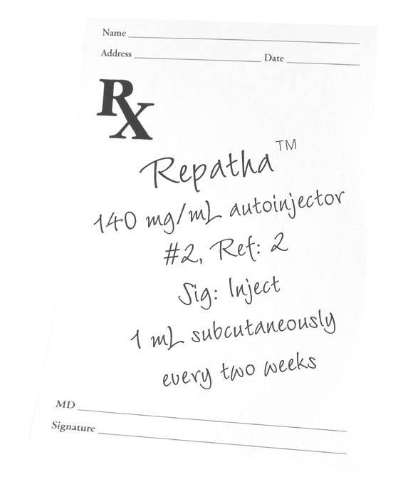
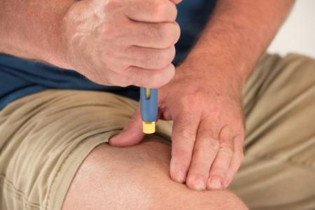
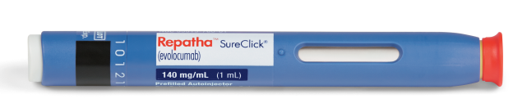
One Fixed, 140 mg Dose Q2W for Intensive, Predictable* LDL-C Response
Dosage and Administration¹
Self-administered subcutaneously via a SureClick® single-use, prefilled autoinjector
Hidden 27-gauge needle
Keep Repatha™ refrigerated. Prior to use, may be kept at room temperature (up to 25°C [77°F]) in the original carton for up to 30 days
Allow to warm to room temperature for 30 minutes prior to use
No dose adjustment necessary for patients with mild to moderate renal or hepatic impairment
No overall differences in safety or effectiveness were observed between patients ≥ 65 years old and younger patients
ONE
140 MG/ML
DOSE
EVERY TWO
WEEKS
*In Study 1, patients achieved 63% to 77% LDL-C reduction across all statin types.²
1. Repatha™ (evolocumab) Prescribing Information, Amgen. 2. Data on file, Amgen.

Slide 31
Repatha™ Dosing and Administration for Patients with HoFH
In patients with HoFH, the recommended subcutaneous dosage of Repatha™ is 420 mg QM
Measure LDL-C levels 4 to 8 weeks after starting Repatha™, since response to therapy will depend on the degree of LDL-receptor function
To administer the 420 mg dose, give 3 Repatha™ injections consecutively within 30 minutes
Keep Repatha™ refrigerated. Prior to use, may be kept at room temperature (up to 25°C [77°F]) in the original carton for up to 30 days
Allow to warm to room temperature for 30 minutes prior to use
Repatha™ (evolocumab) Prescribing Information, Amgen.

Slide 32
Repatha™ Is a PCSK9 Inhibitor for Significant Reduction of LDL-C in Patients With Clinical ASCVD and FH
Repatha™ delivers intensive, predictable LDL-C reduction¹
Repatha™ + a statin lowered LDL-C up to 77% more than placebo + statin²
Repatha™ + a statin helped up to 90% of patients achieve LDL-C < 70 mg/dL²
The efficacy and safety profile of Repatha™ has been established over 52 weeks¹
Significant LDL-C lowering in patients with HeFH or HoFH¹
In patients with ASCVD and FH, Repatha™ has an established safety profile compared with placebo¹
Common adverse reactions in clinical trials (> 5% of patients treated with Repatha™ and occurring more frequently than placebo): nasopharyngitis, upper respiratory tract infection, influenza, back pain, and injection site reactions
Repatha™ is given as one fixed dose of 140 mg Q2W and is self-administered subcutaneously via a prefilled, single-use SureClick® autoinjector¹
Please see accompanying Full Prescribing Information
1. Repatha™ (evolocumab) Prescribing Information, Amgen. 2. Data on file, Amgen.

Slide 33

Additional Topics
Potential Profile for a Patient With Clinical ASCVD*
Information on Provider and Patient Support Services
RepathaReady™
*Hypothetical patient profiles.

Slide 34
Potential Patient Profile: Add Repatha™ for Further LDL-C Lowering in Appropriate Patients^{1,2}
COMBINATION
WITH
STATIN THERAPY
STUDY 1
60-year-old white man s/p MI 6 years ago; coronary stent 6 months ago
Has been adherent on rosuvastatin 40 mg QD for primary hyperlipidemia x 8 years
LDL-C remains at 114 mg/dL*
TC (mg/dL) |  | HDL-C (mg/dL) |  | non–HDL-C (mg/dL) |  | LDL-C (mg/dL)
191 |  | 54 |  | 137 |  | 114
Clinical characteristics that make this a potentially appropriate patient for Repatha™
Established clinical ASCVD
Persistently elevated LDL-C, despite maximally tolerated statin therapy
Can potentially benefit from further LDL-C reduction
Additional Topics
Please see accompanying Full Prescribing Information
s/p = status post.
*Patient profile is representative of baseline lipid values in the LAPLACE-2 trial.
1. Repatha™ (evolocumab) Prescribing Information, Amgen. 2. Robinson J, et al. Clin Cardiol. 2014;37:195-203.

Slide 35
Additional Topics
Potential Profile for a Patient With Clinical ASCVD*
Information on Provider and Patient Support Services
RepathaReady™
*Hypothetical patient profiles.

Slide 36
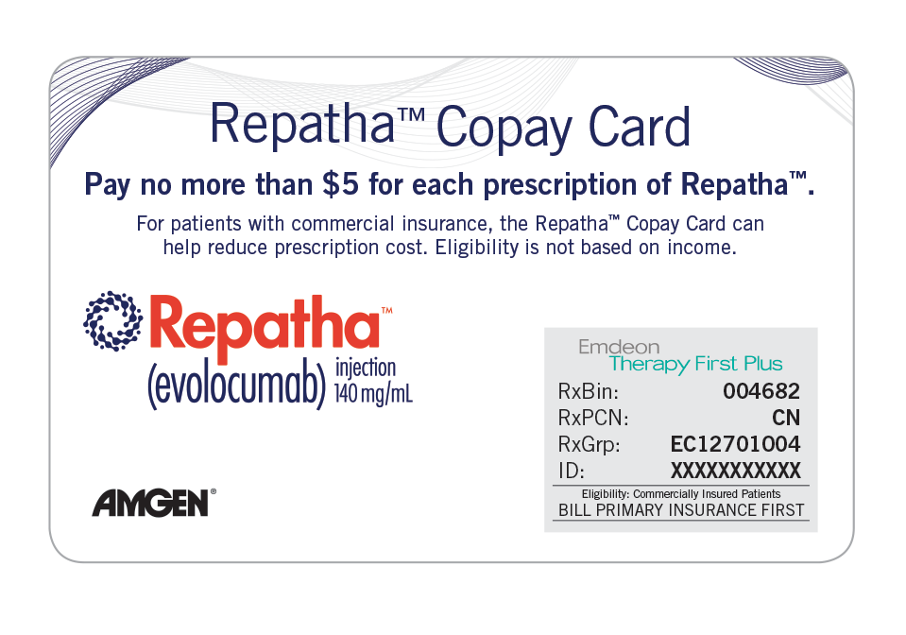



RepathaReady™ Personalized Support Services for Patients and Providers
Call 1-844-REPATHA and our live counselors can help your office and your patients with
REPATHA COPAY CARD*
Eligible, commercially insured patients pay $5 for each prescription of Repatha™, regardless of income. The card may cover out-of-pocket costs for Repatha™, up to an annual maximum
Applies to deductible, coinsurance, and/or copay for Repatha™
*This program is not open to patients receiving prescription reimbursement under any federal, state, or government-funded healthcare program, such as Medicare, Medicare Advantage, Medicare Part D, Medicaid, Medigap, Veterans Affairs (VA), the Department of Defense (DoD) or TRICARE® or where prohibited by law.
REPATHA PATIENT START PROGRAM
Patients may be eligible for one or more months of free Repatha™ after an initial coverage denial
SIMPLIFIED INSURANCE SUPPORT
Personalized support with prior authorizations, insurance verifications, and more
Repatha™ Access Specialists can come to your office to provide reimbursement assistance
REPATHAREADY™ NURSES
Registered nurses can come to your office or to your patient's home to provide injection training
ADDITIONAL FINANCIAL ASSISTANCE
Referrals to financial support programs for eligible patients
Additional Topics
Please see accompanying Full Prescribing Information

