Slide 1
MODULE 1: Increasing Understanding of the Condition
Excess Abdominal Fat in HIV –infected Patients with Lipodystrophy (Abdominal Lipohypertrophy)
Copyright © 2015. All Rights Reserved. Property of Theratechnologies Inc
Notes:
Welcome to this presentation on increasing understanding of excess abdominal fat in HIV-infected patients with lipodystrophy. I am speaking today on behalf of Theratechnologies and their product, EGRIFTA or tesamorelin for injection that was approved by the FDA in November 2010 and became commercially available in January of 2011.

Slide 2
Modules Available in this Series
Module 1: Increasing Understanding of the Condition
Module 2: Increasing Understanding of Treatment with EGRIFTA® (tesamorelin for injection)
Module 3: Increasing Understanding of Management of Patient on EGRIFTA® (tesamorelin for injection) in a Clinical Setting
Copyright © 2015. All Rights Reserved. Property of Theratechnologies Inc
Notes:
This presentation is part of a series that includes 3 modules:
Today’s module “Increasing Understanding of the Condition”
Module 2: Increasing Understanding of Treatment with EGRIFTA® (tesamorelin for injection), and
Module 3: Increasing Understanding of Management of Patient on EGRIFTA® (tesamorelin for injection) in a Clinical Setting
Today’s module will provide an overview of HIV-associated abdominal lipohypertrophy.

Slide 3
Changing Landscape of Treatment for Human Immunodeficiency Virus (HIV)
Marked reductions in AIDS-related mortality as a consequence of highly active antiretroviral therapy (HAART) ¹
HIV has become a chronic manageable infection²
By 2015, > 50% of HIV-infected patients in the United States will be ≥50 years old ^{3,4}
Management of HIV has increasingly focused on adverse effects of HIV infection and treatment, including abdominal lipohypertrophy²
1.Chow DC, et al. IAPAC Mon. 2006; 12:302-317; 2. Moyle G et al. AIDS Rev 2010:12:3-14; 3. Luther VP, Clin Geriatr Med. 2007: 23: 567-583 4. Effros RB, et al. Clin Infect Dis. 2008;47:542-543
Copyright © 2015. All Rights Reserved. Property of Theratechnologies Inc
Notes:
First, there have been marked reductions in HIV-associated morbidity and mortality as a consequence of highly active antiretroviral therapy (HAART), including:
Significant virologic suppression
Delayed progression to AIDS
Reductions in hospitalization rates
Sustained decrease in mortality
The HIV-infected population is aging with success in treating HIV. It has been estimated that by 2015, more than 50% of HIV-infected patients in the US will be 50 years old or older.
With increased longevity, HIV has become a chronic manageable infection, and management has increasingly focused on adverse effects of HIV infection and its treatment, including abdominal lipohypertrophy.
References:
Chow DC, et al., IAPAC Mon. 2006.
Moyle G et al., AIDS Rev 2010.
Luther VP, Clin Geriatr Med 2007.
Effros RB, et al. Clin Infect Dis 2008.

Slide 4
HIV-associated Lipodystrophy
The term “lipodystrophy” comprises several potential conditions: lipohypertrophy, lipoatrophy, mixed syndrome ¹
Physical Features
Lipohypertrophy – Fat accumulation
↑ Visceral adipose tissue
Enlargement of dorsocervical fat pad (buffalo hump)
↑ Breast size (gynecomastia)
Lipoatrophy – Fat loss
Loss of fat in the face
Loss of fat in arms, legs, buttocks
Lichtenstein KA, JAIDS 2005.
Copyright © 2015. All Rights Reserved. Property of Theratechnologies Inc
4
Notes:
HIV-associated lipodystrophy refers to changes in body composition and can present as lipohypertrophy, lipoatrophy or mixed lipohypertrophy and lipoatrophy in the same patient, the mixed syndrome. Lipohypertrophy means accumulation of fat and can present in any of the following ways – an increase in visceral adipose tissue, enlargement of the dorsocervical pad (also known as buffalo hump) and an increase in breast size (also known as gynecomastia).
Lipoatrophy refers to fat loss and can present as loss of fat in the face or extremities.
References:
Lichtenstein, JAIDS 2005.

Slide 5
Pathogenesis of HIV-associated Lipodystrophy
Multiple contributing factors
The virus itself (HIV)
Antiretroviral therapy (not class-specific)
Abnormalities in adipocyte differentiation
Host factors (baseline body composition)
Endocrine alterations (hypogonadism, low vitamin D, anomalies of the GH/IGF-1 axis, growth hormone resistance)
Falutz J., Curr HIV/AIDS Rep 2011; Agarwal N et al., Sci Transl Med 2013.
Copyright © 2015. All Rights Reserved. Property of Theratechnologies Inc
5
Notes:
The pathogenesis of HIV-associated abdominal lipohypertrophy is not well understood but appears multifactorial. Research to date suggests that factors implicated in the pathogenesis of this condition include the virus itself, antiretroviral medications, abnormalities in adipocyte differentiation, patient-related factors such as baseline body composition, as well as endocrine alterations, including hypogonadism, low vitamin D, anomalies of the growth hormone/IGF-1 axis, and growth hormone resistance.
Abdominal lipohypertrophy has not been related to specific antiretroviral drugs or to specific antiretroviral classes. Mechanisms by which antiretroviral drugs are believed to contribute the pathogenesis of this condition include the induction of oxidative stress, as well as glucocorticoid activation through inflammation.
References:
Falutz J., Curr HIV/AIDS Rep 2011.
Agarwal N et al., Sci Transl Med 2013.

Slide 6
Prevalence of Abdominal Lipohypertrophy¹
Prevalence varies widely. A Median prevalence of 30% was reported in a paper by Cofrancesco^{1,2}
Patient populations
Duration of antiretroviral therapy
Various treatment regimens
Determination of prevalence confounded by variable methodologies employed in clinical studies⁵
Measures of body shape change
¹Cofrancesco J, AIDS Patient Care and STDs. 2009; ²Nguyen A et al ., HIV Med. 2008; ³McComsey G et al., CROI 2015, Seattle, Abstract 140; ⁴Martinez E et al., Clin Infect Dis 2015; ⁵Lichtenstein K.A., JAIDS 2005;
Copyright © 2015. All Rights Reserved. Property of Theratechnologies Inc.
6
Notes:
The prevalence of abdominal lipohypertrophy has varied greatly across clinical studies. A prevalence rate ranging between 13 and 58%, with a median prevalence value of 30%, has been reported in a paper by Dr. Cofrancesco.
The variability in the prevalence estimates for HIV-associated abdominal lipohypertrophy is likely the result of different diagnostic criteria in the studies, as well as differences in demographics, HIV treatment practices, and disparities between patient and physician assessments for visceral adipose tissue and abdominal lipohypertrophy.
References:
Cofrancesco J, AIDS Patient Care and STDs 2009
Nguyen A et al ., HIV Med 2008.
McComsey G et al., CROI 2015, Seattle, Abstract 140.
Martinez E et al., Clin Infect Dis 2015.
Lichtenstein K.A., JAIDS 2005.

Slide 7
Changes in Body Composition Parameters with Newer ART
 | Atazanavir/ritonavir | Darunavir/rr
Limb fat, gr 48w | +707 (2036) | -17 (3319)
96w | +1235 (2824)* | -168 (2863)*
Trunk fat, gr 48w | +990 (2825) | +240 (4620)
96w | +1566 (2707) | +541 (4615)
SAT, cm² 48w | +17.8 (73.6) | +7.1 (72.0)
96w | +38.8 (75.0) # | +14.9 (71.4) #
VAT, cm² 48w | +16.5 (45.8) | +14.4 (44.3)
96w | +38.5 (66.2) | +30.1 (60.0)
TAT, cm² 48w | +34.2 (92.0) | +21.5 (86.6)
96w | +77.3 (106.7)¶ | +45.1 (98.8)¶
Data are mean (SD)
*P=0.007; # P=0.036; ¶ P=0.062
Martinez E et al., Clin Infect Dis 2015.
Notes:
Data from the ATADAR Study, a phase 4, open-label, multicenter, randomized clinical study in ART-naïve HIV-infected patients showed that treatment with atazanavir or darunavir boosted with ritonavir for 96 weeks was associated with a significant increase from baseline in visceral adipose tissue (VAT). The change in VAT was not significantly different between the two ART regimens.
References:
Martinez et al., Clin Infect Dis 2015.

Slide 8
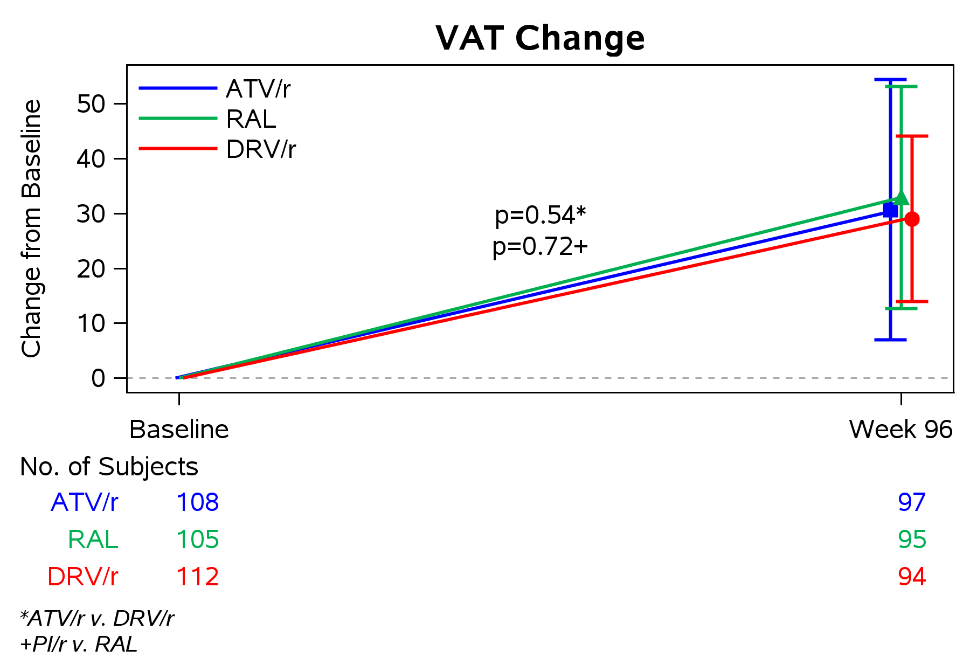
Similar VAT Gain with New Antiretroviral Regimens
ATV/r 31%
RAL 33%
DRV/r 29%
McComsey G et al. , CROI 2015, Seattle, Abstract 140.
8
Notes:
Similarly, data from the ACTG A5260s study show that patients starting antiretroviral therapy containing raltegravir and those starting boosted atazanavir or darunavir experienced similar increases from baseline in visceral adipose tissue. Changes in VAT were not significantly different between the boosted atazanavir and darunavir treatment groups (P=0.52) and between the protease inhibitors and the raltegravir treatment groups (P=0.72).
Taken together, data from the ATADAR and the ACTG 5260 studies indicate that abdominal lipohypertrophy continues to be seen in HIV-infected patients, despite the use of metabolically friendly antiretroviral drugs.
References:
McComsey et al., CROI 2015.

Slide 9
Diagnosis of HIV-associated Abdominal Lipohypertrophy
Patient self-diagnosis
Physician diagnosis (inspection)
Anthropometric measurements (waist circumference)
Imaging techniques (computed tomography (CT) scan, magnetic resonance imaging (MRI), dual energy X-ray absorptiometry (DXA))
Wohl D.A. et al., Clin Infect Dis 2006.
9
Notes:
Several methods are used to diagnose abdominal lipohypertrophy in HIV-infected patients.
Patient can self diagnose central fat accumulation by noticing an increased abdominal girth, which may be accompanied by symptoms such as gastro-intestinal pain, shortness of breath, and difficulty bending over.
Physicians often base their diagnosis on patient self-report, physical examination (for characteristic body-shape changes), and patient symptoms. Anthropometric measurements, including waist circumference, are also used in the clinical setting to diagnose abdominal lipohypertrophy and may offer value assessing visceral adipose tissue.
Imaging of visceral adipose tissue by CT scan and MRI is costly and not generally feasible in everyday clinical practice. DXA scans can also be used to quantify trunk fat. However, DXA cannot differentiate visceral adipose tissue from subcutaneous adipose tissue, although DXA-derived trunk fat has been shown to correlate well with both CT and MRI-derived visceral adipose tissue.
Reference:
Wohl D.A. et al., Clin Infect Dis 2006

Slide 10
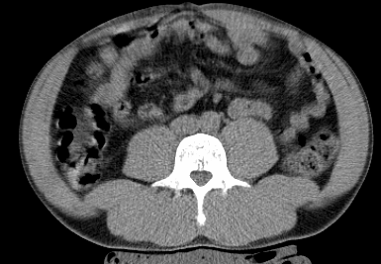
Excess Abdominal Fat in HIV-Infected Patients with Lipohypertrophy
VAT
Unlike subcutaneous adipose tissue (SAT), which is found just beneath the skin, visceral adipose tissue (VAT) is a deep layer of adipose tissue that surrounds abdominal organs
Excess abdominal fat consists of both visceral adipose tissue (VAT) and subcutaneous adipose tissue (SAT), however VAT is of more concern because it is associated with higher levels of metabolic risk compared with SAT^{1,2}
Computed tomography (CT) image at L4-L5³
SAT
¹Després JP et al., Nature. 2006 ; ²Britton KA et al. Circulation. 2011.
Copyright © 2015. All Rights Reserved. Property of Theratechnologies Inc.
10
Notes:
A significant physical feature of HIV-associated abdominal lipohypertrophy is abdominal fat accumulation, which manifests clinically as increased abdominal girth and is due to an increase in visceral adipose tissue, shown here by CT scan, which is a deep layer of adipose tissue that surrounds abdominal organs as opposed to SAT, which is found just beneath the skin.
References:
Després et al., Nature 2006.

Slide 11
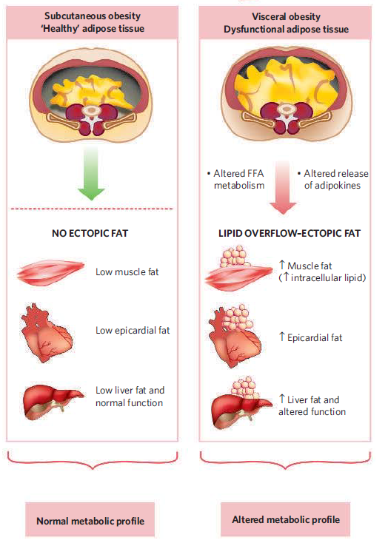

Excess VAT is a Marker of Dysfunctional Adipose Tissue
*
Adapted from Després J.P. and I. Lemieux, Nature 2006;444:881-87.
* « Ectopic » means located away from normal site.
11
Notes:
11
In the presence of « healthy » adipose tissue, i.e. when subcutaneous adipose tissue (SAT) functions normally (adequate adipogenesis), most of the body’s excess energy is stored as fat in this fat compartment, which acts as a sink. Under this condition, there is no ectopic fat deposition, i.e. fat is not stored away from the SAT as shown on the left panel of this cartoon.
When the SAT is unable to store excess energy, i.e. in the presence of dysfunctional adipose tissue, energy overflow will accumulate as fat in the visceral compartment and in non-adipose tissues, such as the skeletal muscle, the heart and the liver as shown on the right panel of this cartoon.
A good correlation has been reported between VAT accumulation and ectopic fat accumulation. This is the reason why excess VAT is considered as a surrogate marker of dysfunctional SAT.
References:
Després et al., Nature 2006.

Slide 12
Inflammation Contributes to Visceral Adiposity-Associated Vasculopathy and Cardiovascular Risk
Endothelial dysfunction
Development of insulin resistance
Induction of dyslipidemia
Inhibition of fibrinolysis
Induction of a prothrombotic state
Mathieu P et al., Clinical Pharmacology & Therapeutics 2010; Berg AH et al., Circ Res 2005.
12
Notes:
Chronic low-grade inflammation has been reported to be a key player in the development of visceral adiposity-associated vasculopathy and cardiovascular disorders, including atherosclerosis. Mechanisms by which inflammation contributes to increased cardiometabolic risk include endothelial dysfunction, development of insulin resistance, induction of dyslipidemia, inhibition of fibrinolysis, and induction of a prothrombotic state.
References:
Mathieu P et al., Clinical Pharmacology & Therapeutics 2010.
Berg AH et al., Circ Res 2005.

Slide 13
Potential Consequences of HIV-Associated
Abdominal Lipohypertrophy
Physical and Psychosocial
Clinical
Copyright © 2015. All Rights Reserved. Property of Theratechnologies Inc
Notes:
This section will deal with the potential consequences of HIV-associated abdominal lipohypertrophy, including clinical, physical, and psychosocial consequences.

Slide 14
Potential Clinical Consequences of HIV-associated abdominal lipohypertrophy
Dyslipidemia (↑Trigycerides, ↓HDL-cholesterol)^{1,2}
Ectopic fat deposition (e.g, liver, heart)⁴⁻⁶
↑ Atherosclerotic risk⁷⁻⁹
Increased mortality¹²
Insulin resistance, Type 2 diabetes³
Neurocognitive disorders^{10,11}
* EGRIFTA® is not approved to remove or reduce all these risks.
¹Grinspoon S and Carr A, N Engl J Med 2005; ²Hadigan C et al., Clin Infect Dis 2001; ³Wohl et al., JAIDS 2008; ⁴Guaraldi G et al., Clin Infect Dis 2008; ⁵Lo J et al., AIDS 2010; ⁶Guaraldi G et al., AIDS 2011; ⁷Freitas P et al., BMC Infect Dis 2014; ⁸Lake JE et al., AIDS Care 2011; ⁹Guaraldi G et al., Atherosclerosis 2010; ¹⁰McCutchan JA et al., Neurology 2012; ¹¹Sattler F et al., J Acquir Immune Defic Syndr 2015; ¹²Sherzer R et al., AIDS 2011;
Copyright © 2015. All Rights Reserved. Property of Theratechnologies Inc
Notes:
HIV-associated abdominal lipohypertrophy is associated with metabolic abnormalities, such as dyslipidemia, insulin resistance, and type 2 diabetes.
Excess visceral adipose tissue (VAT) in HIV-infected patients may also lead to ectopic fat deposition, i.e. deposition of fat in organs such as the liver, the skeletal muscle, the heart, and the kidney.
Increasing evidence indicate that metabolic abnormalities and ectopic fat deposition seen in HIV-infected patients with abdominal lipohypertrophy result in increased cardiovascular risk and mortality.
Please note that EGRIFTA is not indicated to remove or reduce all the risks shown on this slide.
References:
Grinspoon S and Carr A, N Engl J Med 2005.
Hadigan C et al., Clin Infect Dis 2001.
Wohl et al., JAIDS 2008.
Guaraldi G et al., Clin Infect Dis 2008.
Lo J et al., AIDS 2010.
Guaraldi G et al., AIDS 2011.
Freitas P et al., BMC Infect Dis 2014.
Lake JE et al., AIDS Care 2011.
Guaraldi G et al., Atherosclerosis 2010.
McCutchan JA et al., Neurology 2012.
Sattler F et al., J Acquir Immune Defic Syndr 2015.
Sherzer R et al., AIDS 2011.

Slide 15
Patients With HIV-Associated Lipodystrophy : Higher Incidence of CVD Risk Factors*
* EGRIFTA® is not approved to reduce CV risk*
60
57.1%
57.1%
50
45.7%
43.3%
40
35.2%
Incidence (%)
30
21.8%
20
16.7%
13.3%
10
6.9%
5.6%
0
Total
Cholesterol
(>200 mg/dL)
LDL-C
(>160 mg/dL)
HDL-C
(<35 mg/dL)
Triglycerides
(>200 mg/dL)
2-Hour
Glucose
(>140 mg/dL)
HIV+ LIPO
Age and BMI-matched Framingham subjects
Hadigan C et al. Clin Infect Dis 2001.
*The long-term cardiovascular safety and potential long-term cardiovascular benefit of EGRIFTA® treatment have not been studied and are not known.
Copyright © 2015. All Rights Reserved. Property of Theratechnologies Inc
15
Notes:
This slide shows metabolic abnormalities in HIV-infected patients with lipodystrophy compared to age- and BMI-matched subjects from the Framingham offspring cohort. As you can see, patients with lipodystrophy were more likely than Framingham control subjects to have hypercholesterolemia, high LDL-cholesterol, low HDL-cholesterol, hypertriglyceridemia, and glucose intolerance.
Please note that EGRIFTA is not indicated to reduce CV risk. The long-term cardiovascular safety and potential long-term cardiovascular benefit of EGRIFTA treatment have not been studied and are not known.
Reference:
Hadigan et al., Clin Infect Dis 2012.

Slide 16
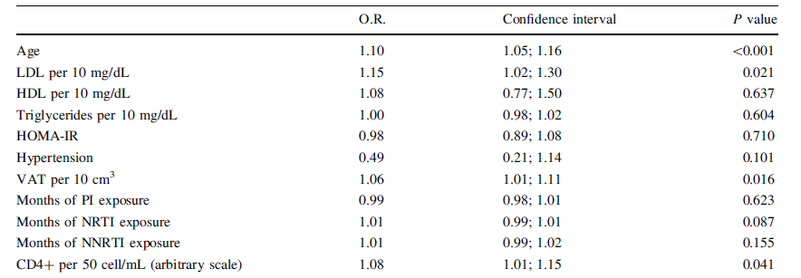
VAT is Positively Associated with Absolute Coronary Artery Calcium (CAC) Progression in HIV-Infected Patients
VAT:
1325
CAC
O.R.: Odds Ratio
132 HIV+ patients receiving ART
Progression of CAC assessed by CT scan at an average interval of 11 months (range 6-36)
45 patients (34%) showed absolute progression of CAC.
EGRIFTA® is not approved to reduce CV risk*
Guaraldi G. et al., Int. J Cardiovasc Imaging 2011.
*The long-term cardiovascular safety and potential long-term cardiovascular benefit of EGRIFTA® treatment have not been studied and are not known.
16
Notes:
Progression of coronary artery calcium (CAC), a sensitive marker of atherosclerosis, has been assessed in a prospective, observational study involving 132 HIV-infected men receiving antiretroviral therapy by the group of Dr. Guaraldi at the University of Modena in Italy. During the mean follow up period of 11 months (range 6-36), 45 patients (34%) showed absolute progression of CAC, calculated according to the Agatston method, and 34 of them showed a yearly percent increase in CAC > 15%, a threshold that has been associated with a high risk of myocardial infarction in the general population. Visceral adipose tissue (VAT) was significantly associated with CAC progression.
References:
Guraldi et al., Int J Cardiovasc Imaging 2011.

Slide 17
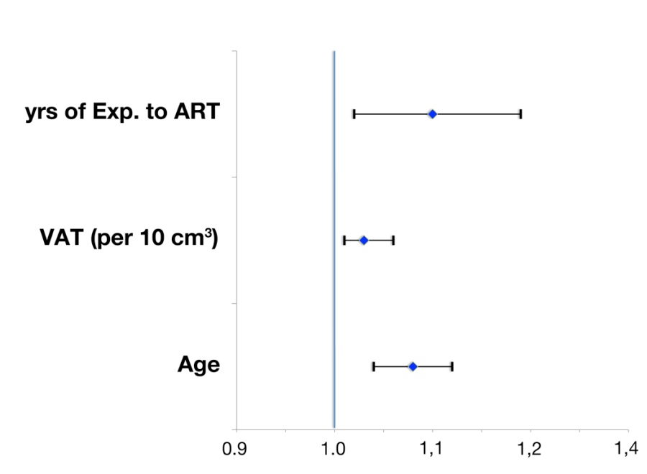
* EGRIFTA® is not approved to reduce CV risk
VAT: Independently Related to Prevalent Cardiovascular Events*
N=1325 HIV+ patients
IRR: 1.03, 95% CI:1.01; 1.06, per 10 cm², p=0.023.
Multivariable stepwise Poisson regression analysis including: BMI, Waist girth, VAT, previous AIDS diagnosis, ApoB/ApoA1, HOMA-IR, cumulative exposure to NRTIs, NNRTIs, PIs; IRR: independent Relative Risk.
*The long-term cardiovascular safety and potential long-term cardiovascular benefit of EGRIFTA® treatment have not been studied and are not known.
Guaraldi G et al., CROI 2010
17
Notes:
Dr. Guaraldi’s group also studied the association of general measures of adiposity (body mass index, waist circumference) and visceral adipose tissue (VAT) with prevalent cardiovascular disease (CVD), including prior myocardial infarction, stroke, and peripheral vascular disease in a cohort of HIV-infected men. Patients' mean age was 48.5 ± 8.1 years, and prior CVD was present in 51 out of 1325 patients. VAT, but not general adiposity, was independently associated with CVD on multivariable analyses (Independent Relative Risk = 1.05, 95% CI: 1.00 to 1.10, per 10 cm²), i.e. for every 10cm² increase in visceral adipose tissue, the relative risk for CVD increased by 5% .
References:
Guaraldi et al., CROI 2010.

Slide 18
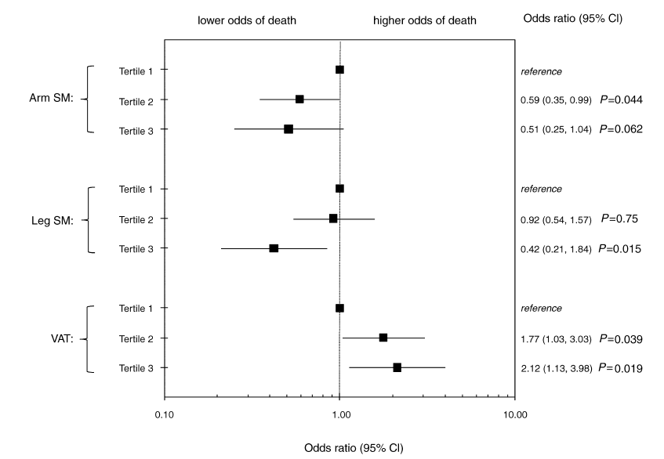
VAT: Associated with 5-Year All-cause Mortality in HIV+ Patients
* EGRIFTA® is not indicated to reduce the death rate in HIV infection.
Scherzer et al., AIDS 2011.
18
Notes:
Finally, investigators of the FRAM (Fat Redistribution and Metabolic Change in HIV infection) study found that central adiposity is associated with 5-year all-cause mortality in HIV infection. Specifically, they found that patients in the highest tertile of visceral adipose tissue (VAT) had 2.1-fold higher odds of death (95% CI 1.1-4.0) compared with the lowest VAT tertile.
EGRIFTA is not indicated to reduce the death rate in HIV infection.
References:
Scherzer et al., AIDS 2011.

Slide 19
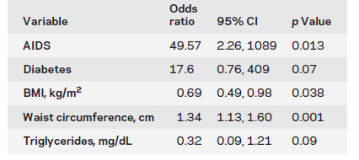
Central Adiposity Increases the Risk of Neurocognitive Impairment in HIV-infected Patients
* EGRIFTA® is not indicated to reduce waist circumference.
McCutchan JA et al., Neurology 2012.
Notes:
Abdominal fat accumulation has also been associated with mild cognitive impairment. In a cross-sectional substudy of the CNS HIV Antiretroviral Therapy Effects Research (CHART) cohort, neurocognitive impairment (NRI) was diagnosed in 40% of participants. Multiple logistic regression analyses demonstrated that central obesity, as assessed by waist circumference, increased the risk of neurocognitive impairment.
EGRIFTA is not indicated to reduce waist circumference.
References:
McCutchan JA et al., Neurology 2012

Slide 20
Physical and Psychosocial Consequences
Impaired physical functioning^{1,2}
Decline in physical health-related quality of life³
Inability to perform normal activities of daily life⁴
Less satisfaction with body image⁵
Increased stigmatization⁴⁻⁶
Increased anxiety and depression⁴⁻⁶
¹Blanch et al., Clin Inf Dis 2004; ²Plankey et al., AIDS Care 2013; ³Erlandson et al.,PLOS One DOI:10.1371, 2014; ⁴Casado et al., AIDS Care 2013; ⁵Collins et al., AIDS Read 2000; ⁶Oette et al., AIDS Patient Care 2002.
Notes:
In addition to metabolic abnormalities, HIV-associated abdominal lipohypetrophy is associated with substantial physical and psychological consequences, including impaired physical functioning, decline in physical functioning, inability to perform normal activities of daily life, less satisfaction with body image, and increased anxiety and depression, which is mostly due to increased stigmatization. In a recent study, Erlandson et al. found that the physical health-related quality of life of HIV-infected patients with moderate to severe self-perceived abdominal fat accumulation was similar to that of a normative population at least a decade older.
References:
1. Blanch et al., Clin Inf Dis 2004.
2. Plankey et al., AIDS Care 2013.
3. Erlandson et al.,PLOS One DOI:10.1371, 2014.
4. Casado et al., AIDS Care 2013.
5.Collins et al., AIDS Read 2000.
6. Oette et al., AIDS Patient Care 2002.

Slide 21
Clinical Strategies for HIV-associated Abdominal Lipohypertrophy
Lifestyle change (diet, exercise)^{1,2}
Short trials with small numbers of patients showing inconsistent results
Switching therapy
Inconsistent results³
Drug therapy
Various medications have been investigated for their effects on HIV-associated lipohypertrophy. None has been approved by the FDA for this use
EGRIFTA (tesamorelin for injection) is the only approved medication for the reduction of excess abdominal fat in HIV-infected patients with lipodystrophy
¹Panel on Antiretroviral Guidelines for Adults and Adolescents. Guidelines for the use on antiretroviral agents in HIV-infected adults and adolescents. December 1, 2009; ²Dhillon, Drugs 2011; ³Schambelan et al., J Acquir Immune Def Syndr 2002.
Notes:
Clinical strategies that have been evaluated for HIV-associated abdominal lipohypertrophy include diet and exercise, switching ART therapy, and drug therapy. A variety of medications have been studied for their effects on HIV-associated lipohypertrophy but EGRIFA® (tesamorelin for injection) is the only FDA approved medication for the treatment of this condition.
References:
Panel on antiretroviral guidelines for adults and adolescents. Guidelines for the use on antiretroviral agents in HIV-infected adults and adolescents. December 1, 2009.
Dhillon, Drugs 2011.
Schambelan et al., J Acquir Immune Def Syndr 2002.

Slide 22
EGRIFTA®: Indication and Usage
EGRIFTA® (tesamorelin for injection) is indicated for the reduction of excess abdominal fat in HIV-infected patients with lipodystrophy
Limitations of use:
Since the long-term cardiovascular safety and potential long-term cardiovascular benefit of EGRIFTA® treatment have not been studied and are not known, careful consideration should be given whether to continue EGRIFTA® treatment in patients who do not show a clear efficacy response as judged by the degree of reduction in visceral adipose tissue measured by waist circumference or CT scan.
EGRIFTA® is not indicated for weight loss management (weight neutral effect).
There are no data to support improved compliance with anti-retroviral therapies in HIV-positive patients taking EGRIFTA®.
Please see EGRIFTA® (tesamorelin for injection) full Prescribing Information, Patient Information and Patient Instructions for use
22
Copyright © 2015. All Rights Reserved. Property of Theratechnologies Inc.
Notes:
EGRIFTA® (tesamorelin for injection) was approved in November 2010 and is indicated for the reduction of excess abdominal fat in HIV-infected patients with lipodystrophy.
Limitations of use:
Since the long-term cardiovascular safety and potential long-term cardiovascular benefit of EGRIFTA® treatment have not been studied and are not known, careful consideration should be given whether to continue EGRIFTA® treatment in patients who do not show a clear efficacy response as judged by the degree of reduction in visceral adipose tissue measured by waist circumference or CT scan.
EGRIFTA® is not indicated for weight loss management (weight neutral effect).
There are no data to support improved compliance with anti-retroviral therapies in HIV-positive patients taking EGRIFTA®.

Slide 23
Key Take Away Points
Disease Overview
ART resulted in reductions in AIDS-related morbidity and mortality
HIV and ART are associated with VAT
Etiology of lipohypertrophy is not clear, but likely involves abnormalities in GH/IGF-1 axis
VAT is associated with metabolic abnormalities and markers of CV risk and CVD. The long-term cardiovascular safety and potential long-term cardiovascular benefit of EGRIFTA® treatment have not been studied and are not known.
Waist circumference relates to VAT and is a common measure of VAT in a clinical setting
EGRIFTA® is the only FDA-approved drug to reduce excess VAT in HIV-infected patients. Other possible strategies to reduce VAT not FDA-approved
HIV management is refocusing on addressing adverse effects of HIV infection and treatment, including abdominal lipohypertrophy
Copyright © 2015. All Rights Reserved. Property of Theratechnologies Inc.
Notes:
To summarize:
Use of highly active ART resulted in reductions in AIDS related morbidity and mortality with life expectancy in HIV-infected patients approaching their HIV-negative peers
HIV management is refocusing on addressing adverse effects of HIV infection and treatment, including abdominal lipohypertrophy
The virus itself, as well as antiretroviral drugs can cause visceral fat accumulation
The etiology of abdominal lipohypertrophy is not clear, but likely involves abnormalities in GH/IGF-1 axis
VAT is associated with metabolic abnormalities and is an independent marker of cardiovascular diseases. The long-term cardiovascular safety and potential long-term cardiovascular benefit of EGRIFTA treatment have not been studied and are not known.
Waist circumference is a common measure of VAT in a clinical setting
Other possible strategies to reduce VAT not FDA-approved
EGRIFTA® is the only FDA-Approved drug to reduce excess abdominal fat accumulation in HIV-infected patients with lipodystrophy.

Slide 24
Module 2: Increasing Understanding of Treatment with EGRIFTA® (tesamorelin for injection)
Module 3: Increasing Understanding of Patient Management on EGRIFTA® (tesamorelin for injection) in a clinical setting
Other Modules Available in this Series

