Slide 1





Disney+ Content Analytics Pipeline
AI-Powered Data Engineering Implementation
Team Members: Bhagya Puppala Janani Vakkanti Shriya Tarun

Slide 2












Three-Layer Data Pipeline
Raw Data
Structured Data
Business Insights
Bronze Layer
Silver Layer
Gold Layer
CSV Ingestion via COPY INTO
Snowflake Streams for incremental movement
Stream processing to Gold layer
Stored Procedure: Data Cleaning & AI Enrichment
Stored Procedure: Snowflake Schema Creation
Stored Procedure: 3 Business Use Cases
Primary Key: IMDB_ID enforcement
Dimensions, Facts, Bridge Tables
Aggregated Views for Reporting

Slide 3


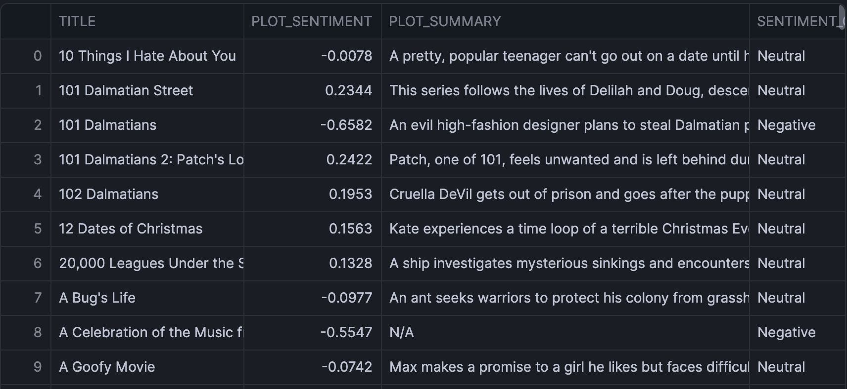





AI-Powered Data Enrichment – Bronze Layer
Sentiment Analysis
-1.0 (Neg)
0
+1.0 (Pos)
Cortex.SENTIMENT() on 894 plot descriptions
Enables emotional tone matching for recommendations
Text Summarization
Cortex.SUMMARIZE() creates one-sentence plots
Enhanced content discoverability for UI/UX
894
715
879
Total Rows
Valid Years
High-Quality Ratings

Slide 4






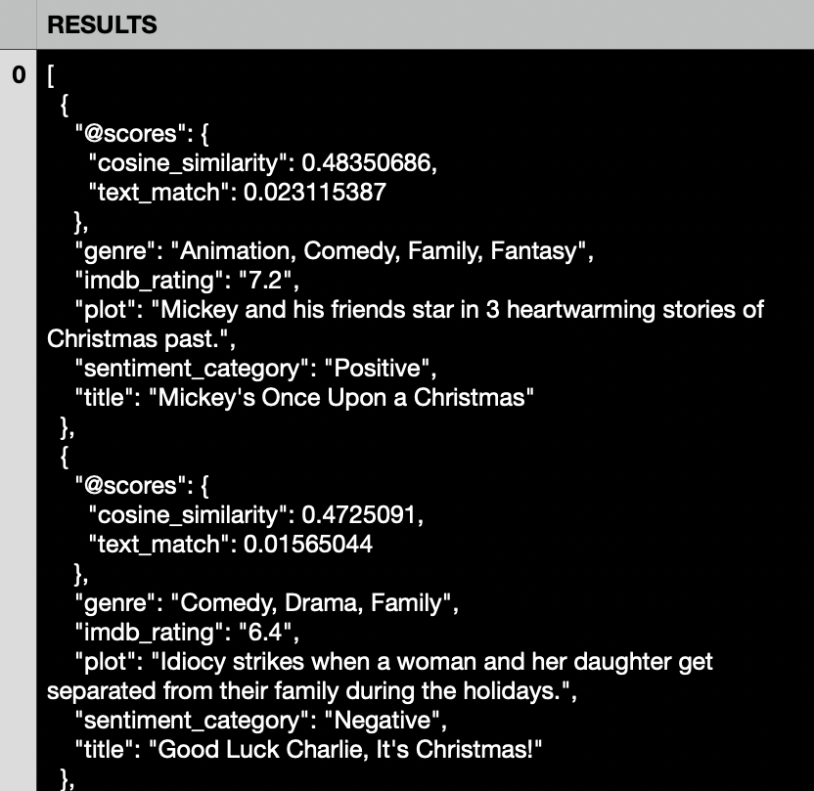


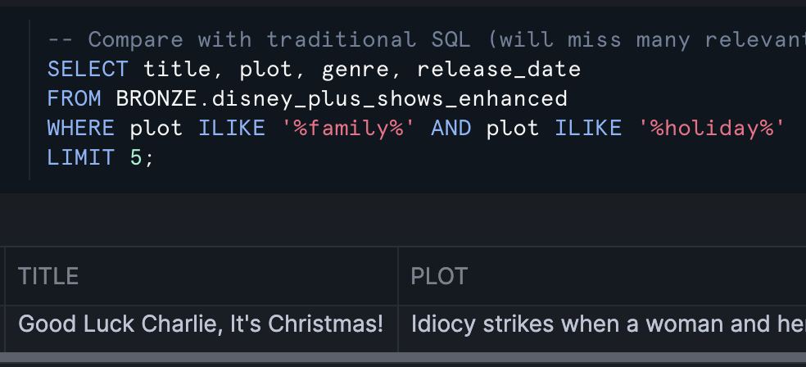


Cortex Search
Traditional SQL Search
Cortex Semantic Search
Limited to exact phrase matching
Understands concepts and themes
"family holiday" misses Christmas movies
"family holiday" finds Christmas, Thanksgiving
Low recall, manual filtering needed
High precision with contextual understanding
VS
EXAMPLES
"teenage romance"
"animated movie" + Genre
"superhero action"
Young love stories
Precision results
Marvel, DC, Origins

Slide 5


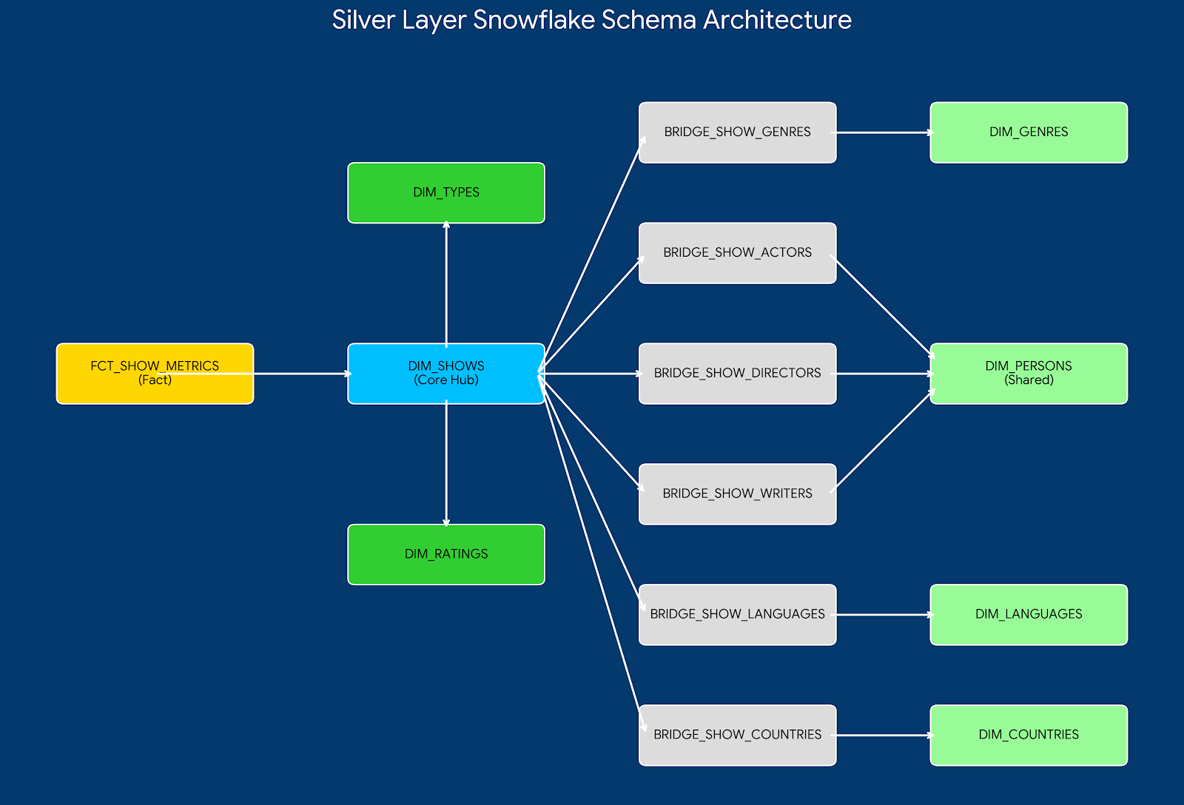
Silver Layer Architecture

Slide 6


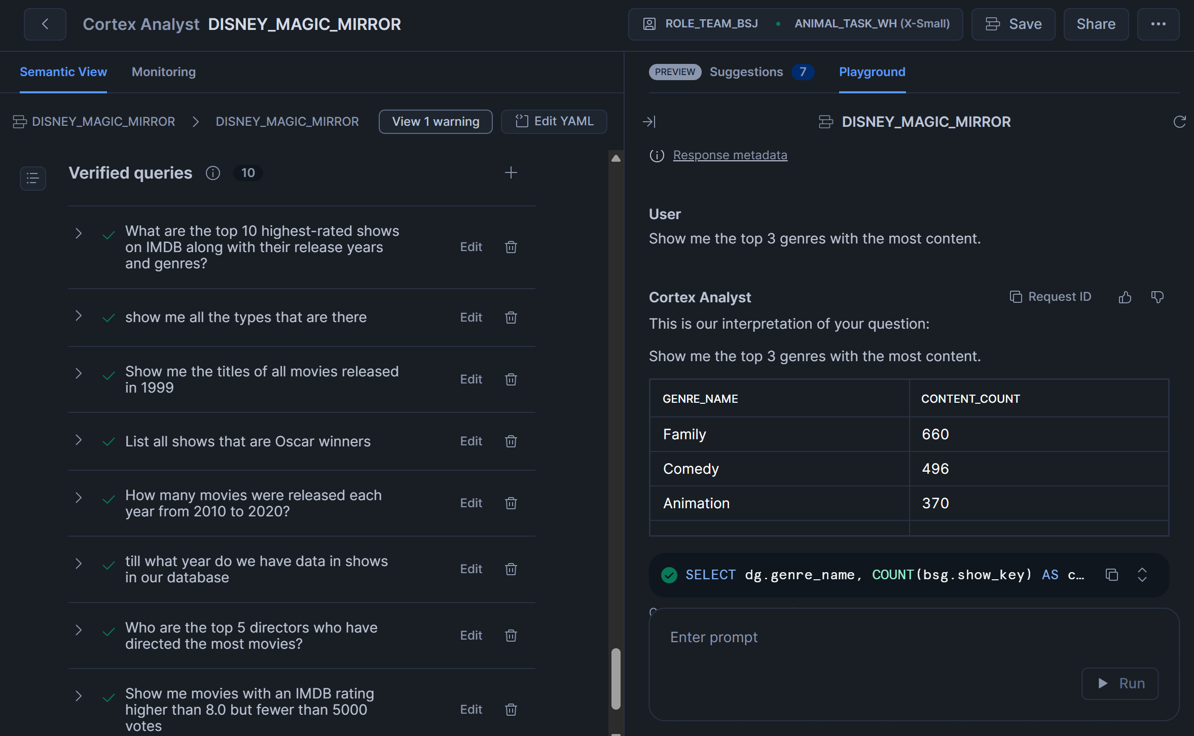

Cortex Analyst
User
"What are the highest rated action movies released in 2024?"
Non-Technical Empowerment
Cortex Analyst
Enables business users to query data without SQL knowledge.
Here are the top 3 action movies from 2024 based on IMDb ratings:
The Hero
9.5
Space War
8.8
Fast Cars
8.2
Real-Time Decision Support
Instant answers to complex questions accelerate strategy.
User
"Show me the trend of Oscar winners by release year."
Cortex Analyst
Conversational Analytics
Generating trend analysis visualization...
Natural dialogue drives deeper data exploration and adoption.
Found 12 matching records. Displaying distribution by decade.

Slide 7









Business Use Cases – Gold Layer
Genre Trends
Release Timing
Creative Synergy
Top 3 High-Performing Genres Per Decade
Optimal Release Schedule by Genre
Director-Writer Partnership Impact
Track rating & engagement evolution
Monthly/quarterly performance patterns
Individual vs collaborative performance
Content strategy across generations
Data-driven marketing planning
Successful creative combinations
Historical performance analysis
Seasonal content optimization
Talent acquisition strategy
DATA-DRIVEN CONTENT DECISIONS

Slide 8


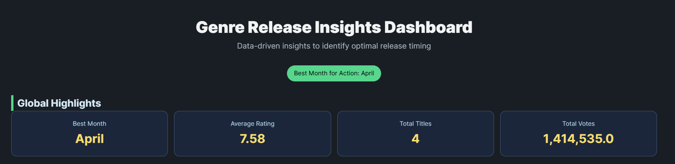

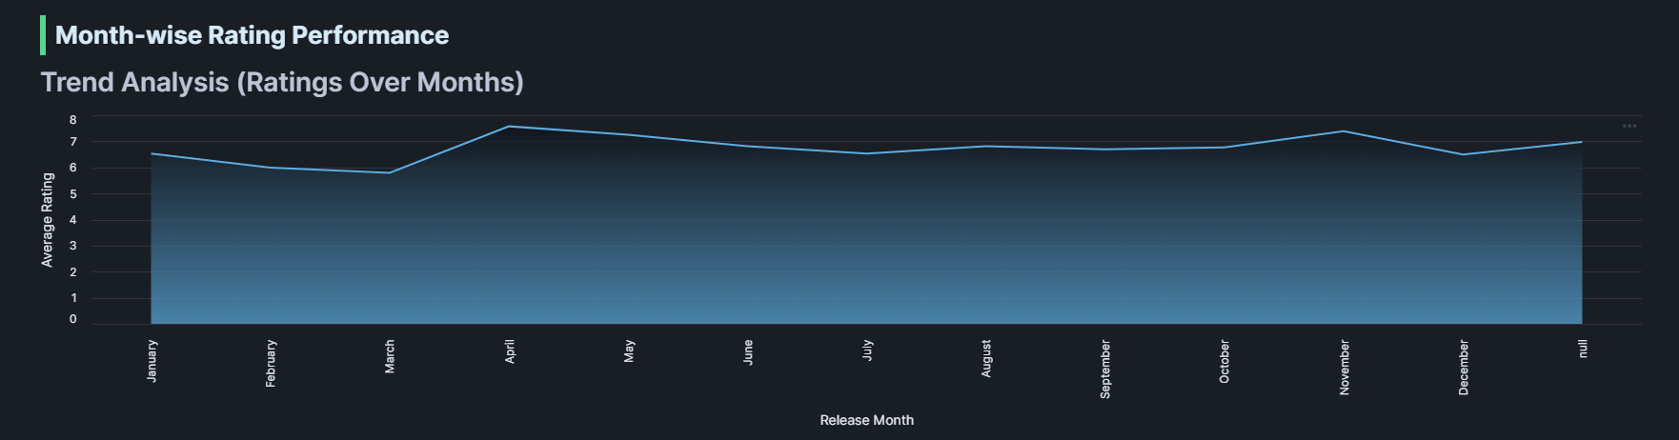
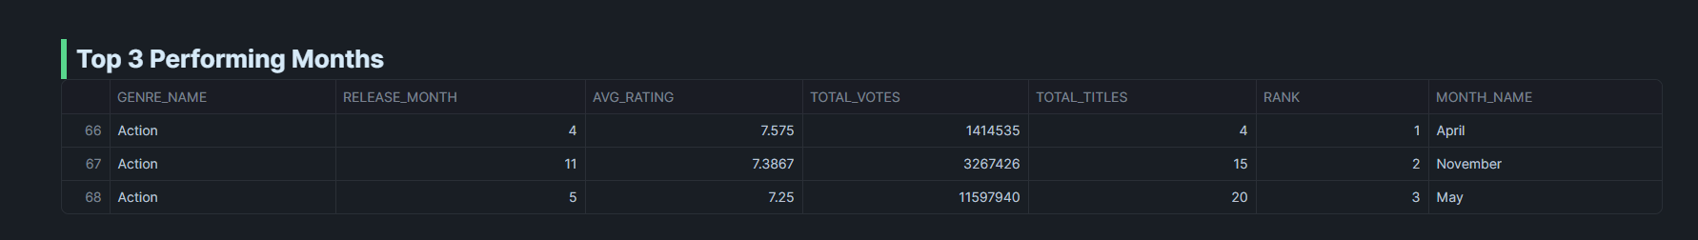
Use Case 1: Optimal Release Timing
Strategic Takeaways
Identified monthly performance for each genre using ratings, votes, and title volume.
Ranked months using a data-driven model to find the best release periods.
April shows the highest rating (7.58), making it the strongest month for Action releases.
November performs nearly as well, providing a strong secondary release window.
Trend analysis confirms April (mid-spring) and November (late-fall) as the most optimal months for major releases.

Slide 9


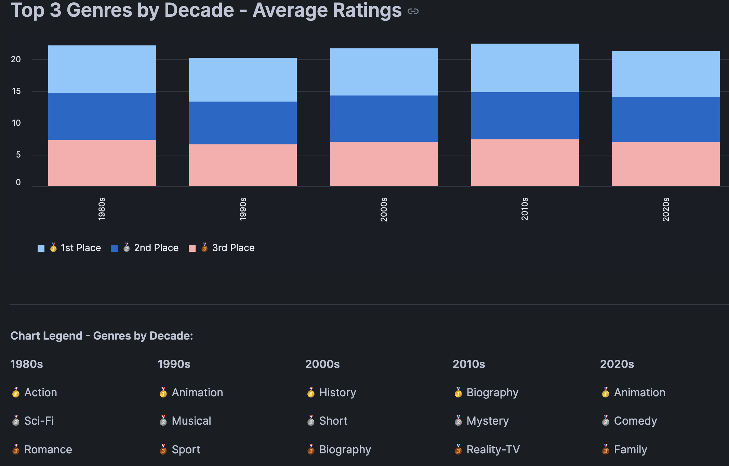

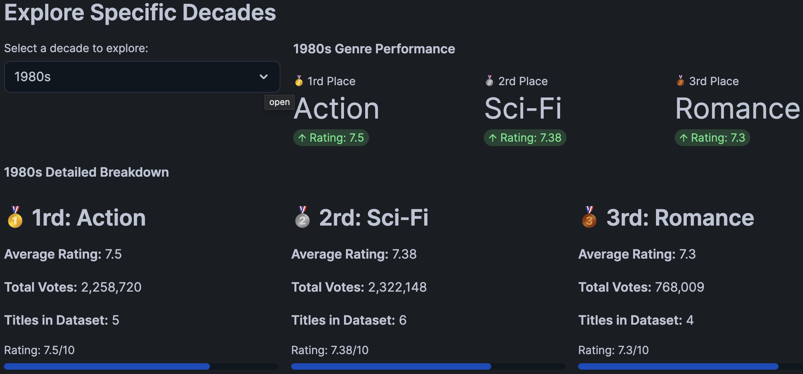
Use Case 2: Decade Wise Genre Trends
Strategic Takeaways
Track rating &
engagement evolution across
decades.
Identify emerging content
gaps for future production.
Content strategy must
adapt to generational shifts in
taste.

Slide 10


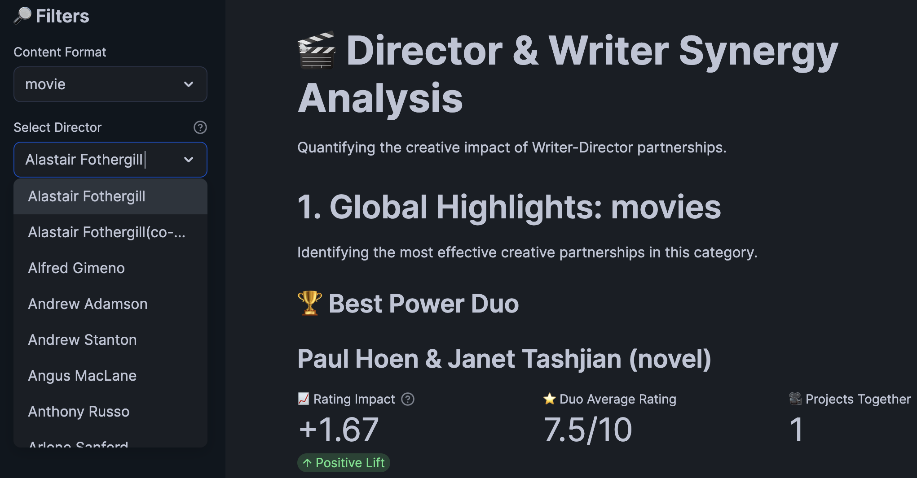
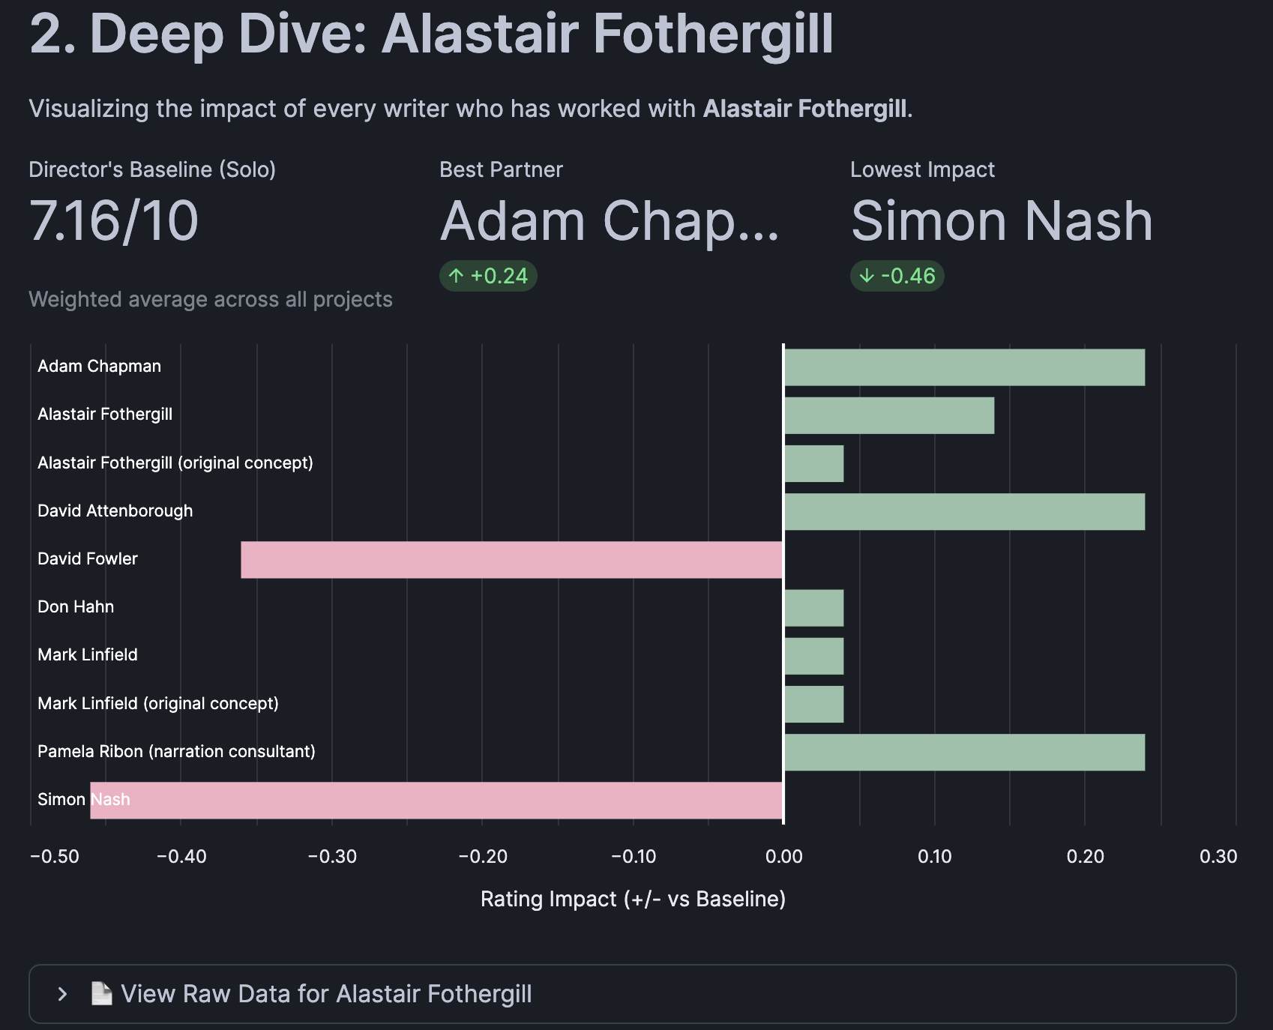
Use Case 3: Director-Writer Power Duo
Analysis & Strategy
Identify successful creative
combinations
Quantify the performance
uplift of collaborative vs.
individual projects.
Inform talent acquisition
strategy by targeting proven
synergies.
Performance is measured
by Metascore, IMDb Rating, and
Audience Engagement.

Slide 11







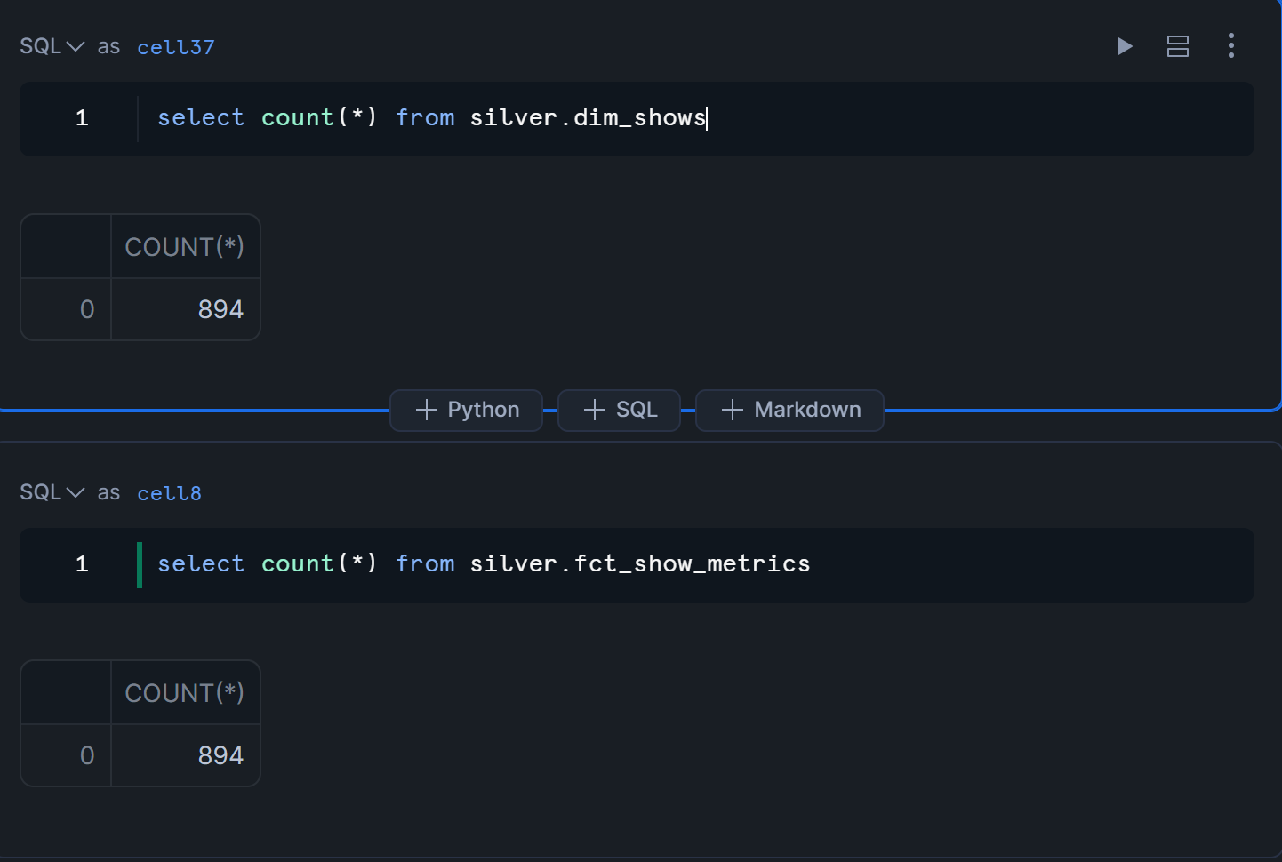
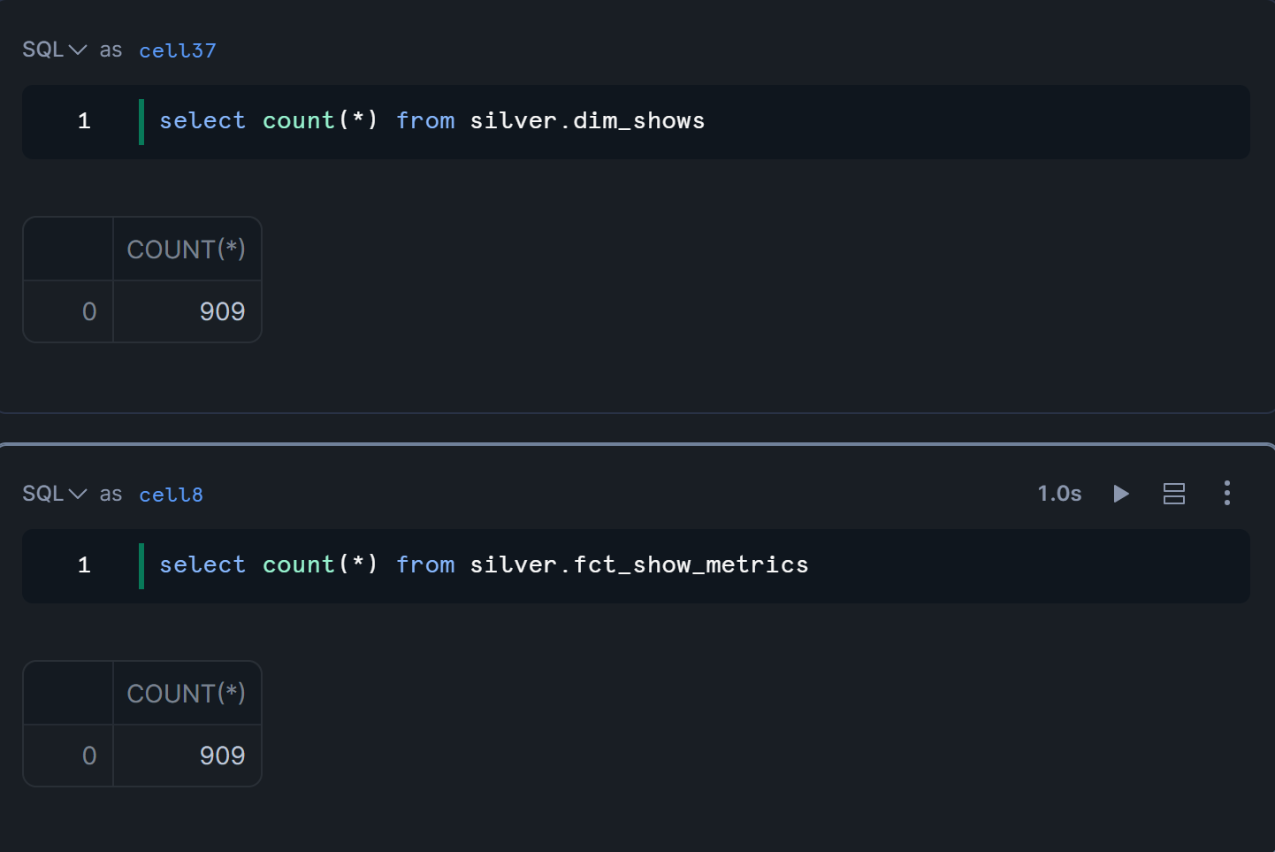

Incremental Data Pipeline using CDC: Stream Magic

Snowflake Stream


Destination (Tables)
Source (CSV)
Processing (SP)
+ New Data Indicator
Auto-Detect Changes
Transformation Logic
Updated Tables
Snowflake Streams automatically detect and record changes (INSERT, UPDATE, DELETE).
Stored procedure handles both initial load and subsequent incremental updates seamlessly.

Slide 12






Before & After: Incremental Load Results
Initial State
After Incremental Load
894
Rows Processed
+15
Rows Processed
GOLD.GENRE_RELEASE_TIMING_PERFORMANCE
272
278
GOLD.GENRE_RELEASE_TIMING_PERFORMANCE
GOLD.AUDIENCE_ENGAGEMENT_DECADE_SENTIMENT
188
199
GOLD.AUDIENCE_ENGAGEMENT_DECADE_SENTIMENT
GOLD.POWER_DUOS_PERFORMANCE
4097
4110
GOLD.POWER_DUOS_PERFORMANCE
< 2 minutes
Zero Downtime
Real-Time
Processing Time
During Updates
Insight Availability

Slide 13
THANK YOU

