Slide 1
Lync Meeting Transcript
Real-time transcripts of Lync meetings

Slide 2
Motivation
Lync is a great tool for communication and collaboration across various business units. It offers a wide variety of capabilities including conferencing. Lync conferences allows users to have application sharing, IM chats and video sharing during the meeting. But do you know whether a visually impaired person be able to see the instant messages that is coming across the meeting? Or will a hearing impaired person be able to hear what is discussed in the meetings? Or would it simply be nice to have a live-generated transcript of a current or past meeting to review what was discussed? Lync Meeting Transcript is created with the aim of helping Lync users to the generates real-time transcripts of Lync meetings.

Slide 3
Motivation
Add-in productivity tool for conferences
For “live” conferences, Allows late-joining participants to see what has been discussed so far
For past conferences, allows participants to review the transcript of what was covered in the meeting
Accessibility tool for hearing impaired
Real-time transcript of spoken content during conference
Diagnostic Tool
Captures and records “important” events on Conversation/ConferenceSession, ConversationParticipants, Call, and Flow in Meeting Transcript
Could be useful for troubleshooting/diagnosing call issues

Slide 4
Related Work
Lync Meeting Recorder
Allows client-side recording of Lync Meetings
Limitations:
Requires participants to start/stop recording upfront
Recording file is a “black box”. Need to watch the entire recording to see what was covered
IVR Applications
Call center applications using UCMA 4.0 SDK
Limitations:
Requires upfront training of Speech Recognition Engine (via grammar files)
Grammar files contain a finite set of recognizable words (not scalable for full conference translation)
Lync Client Application with Bing Translator Service
Lync client add-in tool that translates Instant Messages into desired language via Bing Translator Service
Limitations:
InstantMessaging modality only

Slide 5
Approach
Server bot application that accepts incoming calls or conference invites and joins as a trusted user endpoint
Subscribes to events on Conversation/Conference (i.e. user joins/leaves, modality change, state changes)
Subscribes to events on each ConversationParticipant (i.e. participant property changes)
Subscribes to Call/Flow events on each active modality (state change, message received, speech detected)
Supported modalities: AudioVideo, InstantMessaging
Generates messages for raised events and records as item in MeetingTranscript

Slide 6
Speech Recognition
Speech Recognition Engine attached to the active (dominant speaker) AudioVideoFlow that attempts to recognize when speech is detected
Microsoft.Speech.dll
Speech server engine is designed to accept telephone-quality audio for command & control applications
Scales better than Desktop counterpart (System.Speech.dll)

Slide 7
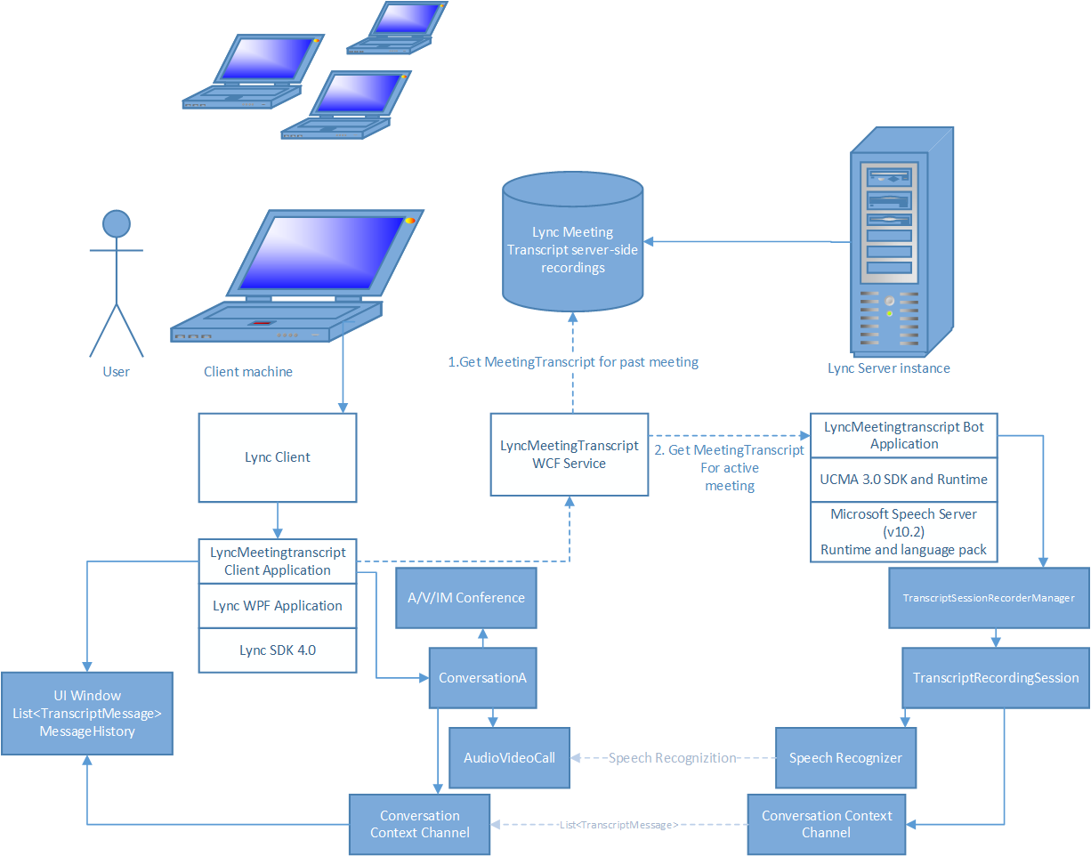

Slide 8
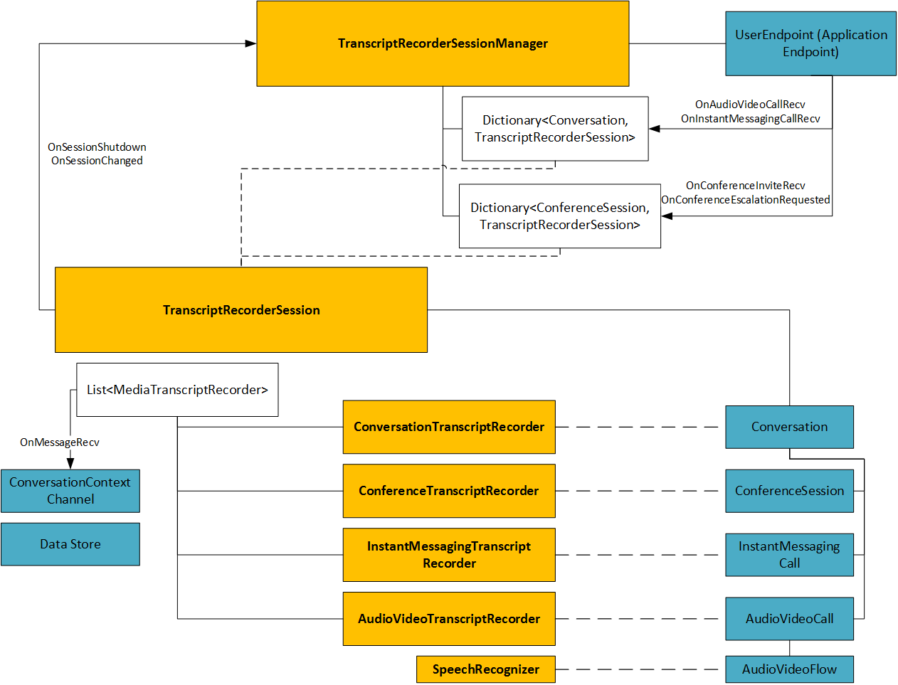

Slide 9
Demo

Slide 10
Sample BotApplication Output Transcript:
!Timestamp: 11/12/2014 8:11:09 PMConversation Id: c91d8b603c10436abef7f9ea42085654Direction: OutgoingMessage Type: ConferenceInfoMessage Content: AudioVideo Conversation/Conference Started.-----------------------------------------------Timestamp: 11/12/2014 8:11:10 PMConversation Id: c91d8b603c10436abef7f9ea42085654Direction: OutgoingMessage Type: ConversationInfoMessage Content: AudioVideo Conversation Participant Added.-----------------------------------------------Timestamp: 11/12/2014 8:11:10 PMConversation Id: c91d8b603c10436abef7f9ea42085654Direction: IncomingMessage Type: AudioMessage Content: AudioVideoCall Received. Inbound call state: Incoming-----------------------------------------------Timestamp: 11/12/2014 8:11:10 PMConversation Id: c91d8b603c10436abef7f9ea42085654Direction: OutgoingMessage Type: AudioMessage Content: The AudioVideo call with Local Participant: sip:samil@microsoft.com and Remote Participant: tel:4143050791;phone-context=enterprise has changed state. The previous call state was: Incoming and the current state is: Establishing-----------------------------------------------Timestamp: 11/12/2014 8:11:10 PMConversation Id: c91d8b603c10436abef7f9ea42085654Direction: OutgoingMessage Type: ConversationInfoMessage Content: Conversation state changed from Incoming to Establishing-----------------------------------------------Timestamp: 11/12/2014 8:11:10 PMConversation Id: c91d8b603c10436abef7f9ea42085654Direction: OutgoingMessage Type: AudioMessage Content: AV Flow Configuration Requested.-----------------------------------------------Timestamp: 11/12/2014 8:11:11 PMConversation Id: c91d8b603c10436abef7f9ea42085654Direction: IncomingMessage Type: ConversationInfoMessage Content: Conversation Participant Properties changed. Properties changed: System.String[]. Participant Property Values: Microsoft.Rtc.Collaboration.ConversationParticipantProperties.-----------------------------------------------Timestamp: 11/12/2014 8:11:11 PMConversation Id: c91d8b603c10436abef7f9ea42085654Direction: OutgoingMessage Type: AudioMessage Content: The AudioVideo call with Local Participant: sip:samil@microsoft.com and Remote Participant: tel:4143050791;phone-context=enterprise has changed state. The previous call state was: Establishing and the current state is: Established-----------------------------------------------Timestamp: 11/12/2014 8:11:11 PMConversation Id: c91d8b603c10436abef7f9ea42085654Direction: OutgoingMessage Type: ConversationInfoMessage Content: Conversation state changed from Establishing to Established-----------------------------------------------Timestamp: 11/12/2014 8:11:11 PMConversation Id: c91d8b603c10436abef7f9ea42085654Direction: OutgoingMessage Type: AudioMessage Content: AudioVideoCall Accepted. Call state: Established-----------------------------------------------Timestamp: 11/12/2014 8:11:11 PMConversation Id: c91d8b603c10436abef7f9ea42085654Direction: OutgoingMessage Type: AudioMessage Content: AudioVideoFlow changed from Idle to Active.-----------------------------------------------Timestamp: 11/12/2014 8:11:25 PMConversation Id: c91d8b603c10436abef7f9ea42085654Direction: OutgoingMessage Type: AudioMessage Content: SpeechRecognitionEngine has detected speech.-----------------------------------------------Timestamp: 11/12/2014 8:13:36 PMConversation Id: c91d8b603c10436abef7f9ea42085654Direction: OutgoingMessage Type: AudioMessage Content: SpeechRecognitionEngine has detected speech.-----------------------------------------------Timestamp: 11/12/2014 8:13:54 PMConversation Id: c91d8b603c10436abef7f9ea42085654Direction: OutgoingMessage Type: AudioMessage Content: SpeechRecognitionEngine has detected speech.-----------------------------------------------Timestamp: 11/12/2014 8:14:17 PMConversation Id: c91d8b603c10436abef7f9ea42085654Direction: OutgoingMessage Type: AudioMessage Content: SpeechRecognitionEngine has detected speech.-----------------------------------------------Timestamp: 11/12/2014 8:14:49 PMConversation Id: c91d8b603c10436abef7f9ea42085654Direction: OutgoingMessage Type: AudioMessage Content: SpeechRecognitionEngine has detected speech.-----------------------------------------------

Slide 11
Conclusions & Future Work
Client-side application to show transcript messages in real-time
Ability to filter/toggle different “types” of transcript items
Ability to search for content/topics discussed in meeting
Server-side recording and storage of transcripts in queryable data store
Smart meeting summary generation
Integration with Bing Speech Recognition Web Service
Integration with Lync Recording Manager
Support for multiple languages (one TranscriptRecorderSession per language group in a Lync Meeting)

Slide 12
Asking fewer things from life is actually a very powerful strategy for dealing with an adversarial world.

Slide 13
Resources
Skype Comm Fair Project Site:http://aka.ms/CommSF
Prototype: \\rtcfile1\public\SAMIL\prototypes\Lync Meeting Transcript\v1.0
Github: https://github.com/saluber/LyncMeetingTranscript/

Slide 14
Documentation
UCMA 3.0 General Reference: http://msdn.microsoft.com/en-us/library/office/hh347320(v=office.14).aspx
The complete SDK for the Microsoft Server Speech Platform 10.2 version is available at http://www.microsoft.com/downloads/en/details.aspx?FamilyID=1b1604d3-4f66-4241-9a21-90a294a5c9a4.
http://msdn.microsoft.com/en-us/magazine/cc163663.aspx
UCMA Managed API 2.0 Speech SDK Documentation
Microsoft Server Speech Platform 10.1 (Runtime, Language packs, and Server SDK)
UCMA Managed API 2.0 Core SDK Documentation
UCMA 2.0 Core SDK Documentation
UCMA 2.0 Workflow SDK Documentation
UCMA 2.0 Speech SDK Documentation
Speech Class Library: http://msdn.microsoft.com/en-us/library/dd167835(v=office.13).aspx

Slide 15
Downloads
Visual Studio 2010: http://www.visualstudio.com/downloads/download-visual-studio-vs
Microsoft Visual Studio 2008 SP1: http://www.microsoft.com/en-us/download/details.aspx?id=10986
Windows SDK for .NET Framework 3.5 SP1: http://www.microsoft.com/en-us/download/details.aspx?id=3138
UCMA 2.0 Speech Language Packs: http://www.microsoft.com/en-us/download/confirmation.aspx?id=19549
UCMA 3.0 SDK: http://www.microsoft.com/en-us/download/details.aspx?id=10566
UCMA 3.0 Runtime: http://www.microsoft.com/en-us/download/confirmation.aspx?id=20958

Slide 16
What is the difference between System.Speech.Recognition and Microsoft.Speech.Recognition?
The short answer is that Microsoft.Speech.Recognition uses the Server version of SAPI, while System.Speech.Recognition uses the Desktop version of SAPI.
The APIs are mostly the same, but the underlying engines are different. Typically, the Server engine is designed to accept telephone-quality audio for command & control applications; the Desktop engine is designed to accept higher-quality audio for both command & control and dictation applications.
You can use System.Speech.Recognition on a server OS, but it's not designed to scale nearly as well as Microsoft.Speech.Recognition.
The differences are that the Server engine won't need training, and will work with lower-quality audio, but will have a lower recognition quality than the Desktop engine.

