Slide 1
Lync Meeting Transcript
SamiL

Slide 2
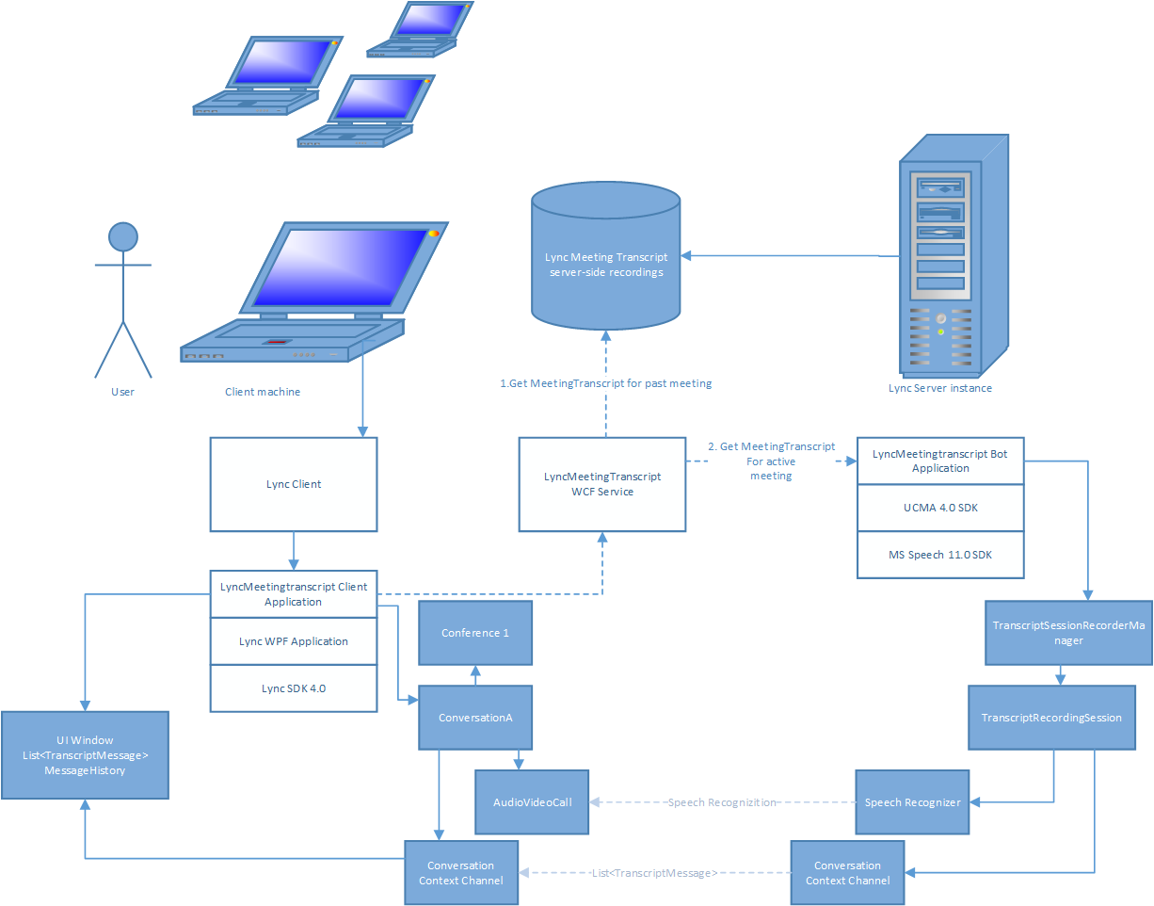

Slide 3
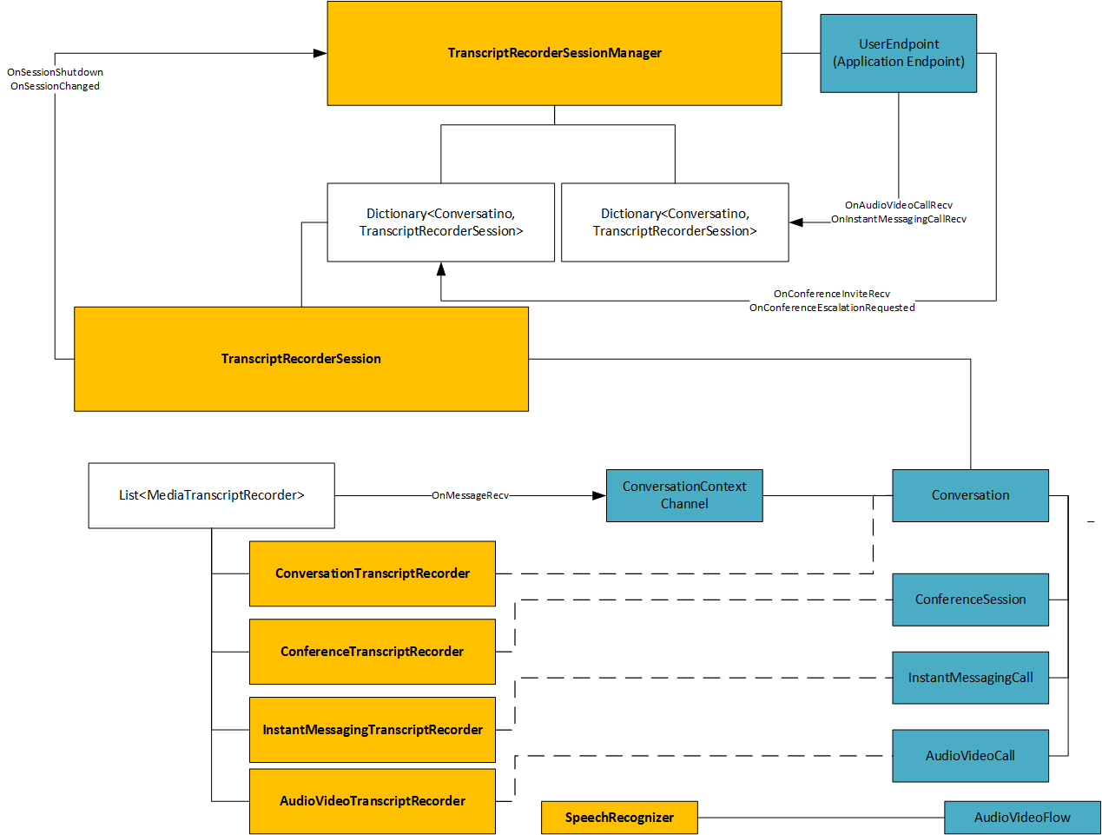

Slide 4
Sample BotApplication Output Transcript:

