Slide 1
ADMIN PORTAL FOR PROFF REVIEW
BY -JASKEERAT SINGH SALUJA
2019MT60752
PART OF DEV-CLUB-ASSIGNMENT

Slide 2
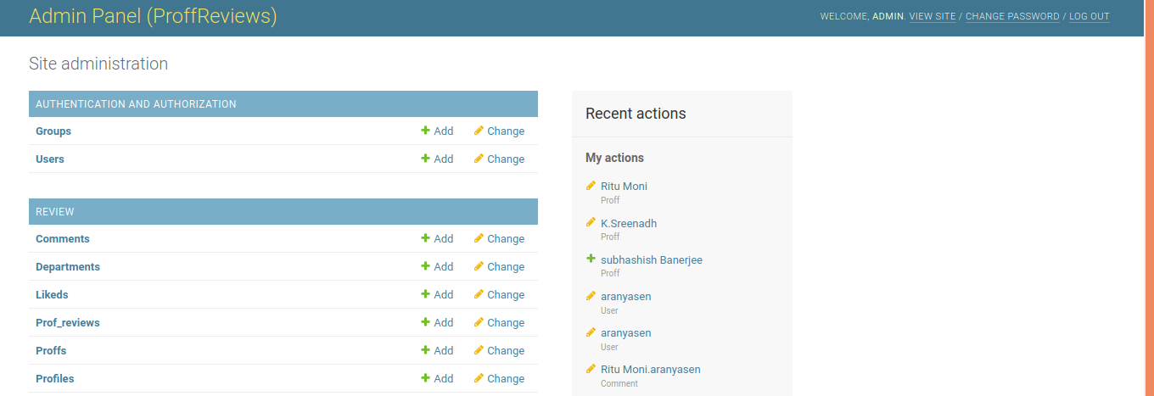
ADMIN PORTAL
1. http://127.0.0.1:8000/admin/ takes you to the admin portal for the website
2.It contains all the tables and users in it

Slide 3
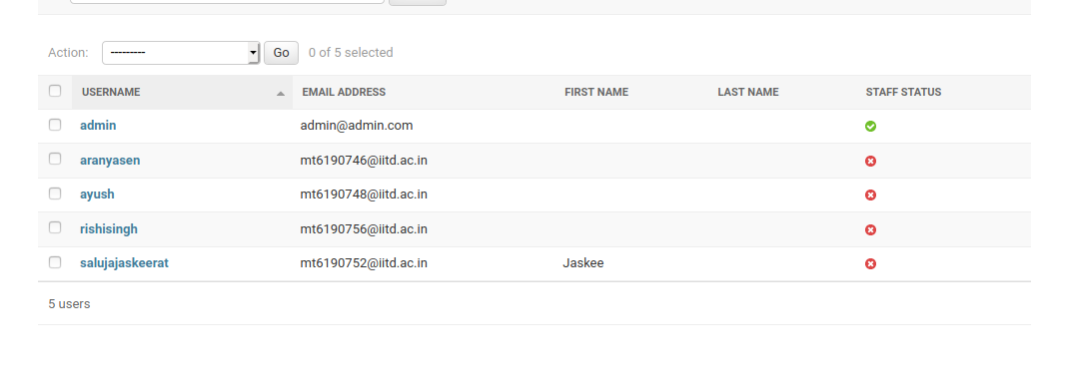
User-Table
User table.

Slide 4
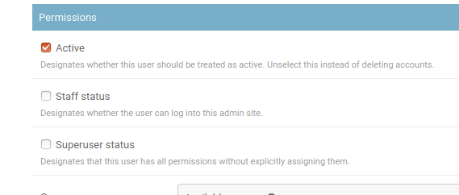
User table
A user can be banned from the the site by changing its active status.

Slide 5
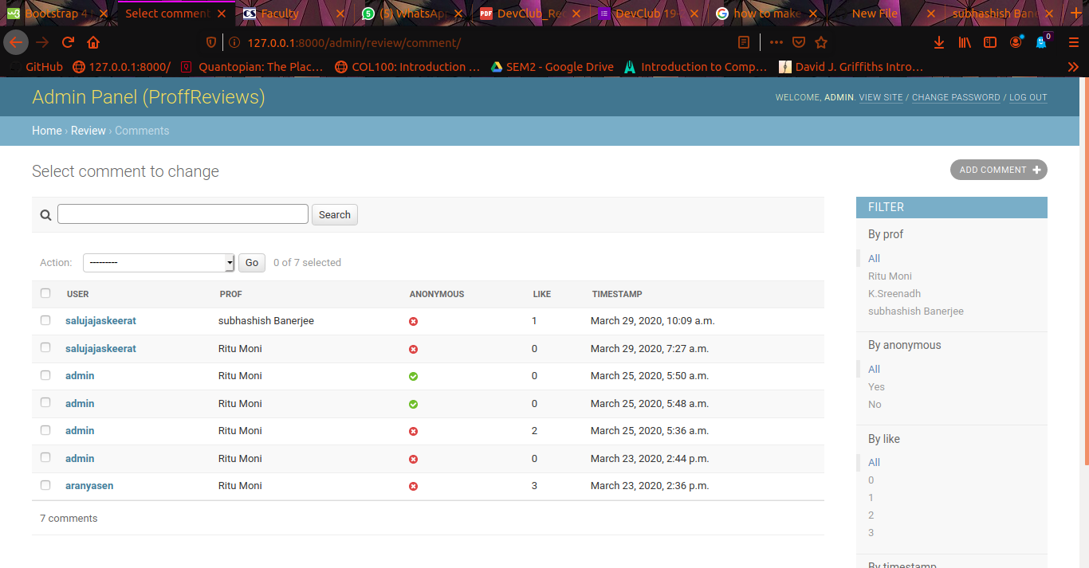
Comment Table

Slide 6
COMMENT TABLE
1. Admin can see all details of comments , user, prof , time , and the likes it has
2.He can filter comments on basis of Professor, time .

Slide 7
Ending
There are more tables which can seen .
Click on them to view the tables
Thank You

