Slide 1
Professor Review Site
Made by-JASKEERAT SINGH SALUJA

Slide 2
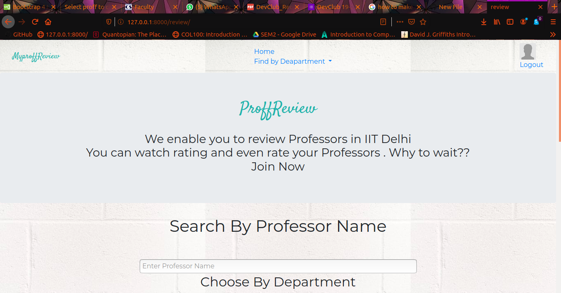
REVIEW SITE---HOME PAGE

Slide 3
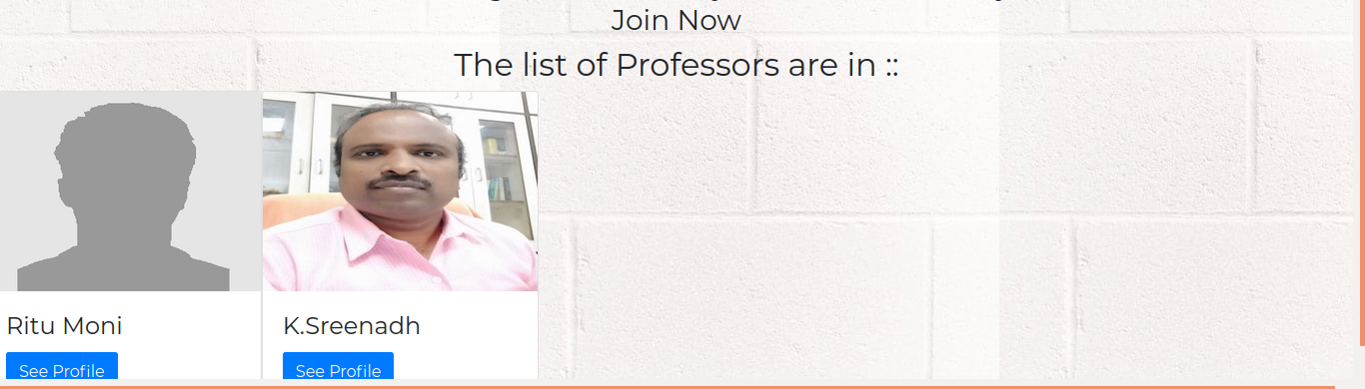
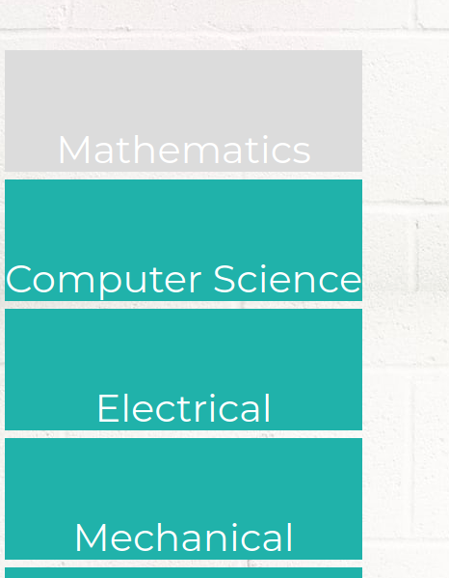
REVIEW SITE --HOMEPAGE
1. The site contains search bar , which makes dynamic search to find any professor easy to find.
2. Also it provides option to search Proffesor by department.

Slide 4
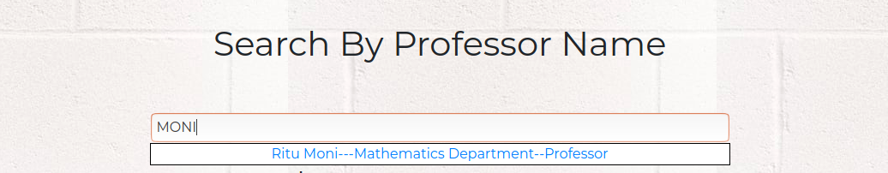
REVIEW SITE – DYNAMIC SEARCH
You can search for any professor , using the search tool bar on homepage..
It shows all search results related to the string Entered by you.
It is created using the filter function of django.models and renedered using AJAX

Slide 5
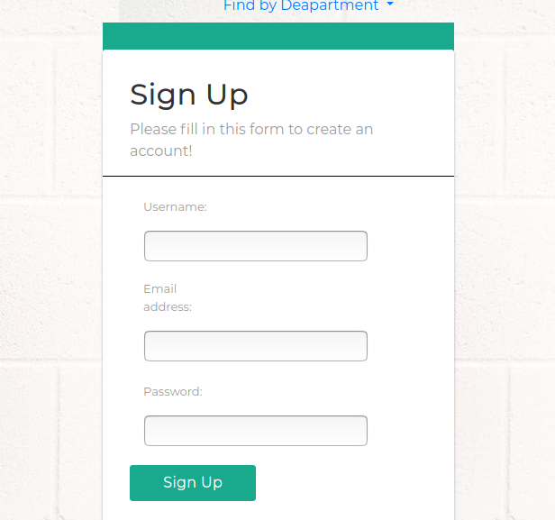
CREATE NEW ACCOUNT
1. cliking on signup button takes you to registration form.
2. The form only accepts email which is of type a valid IITD-webmail(trying to regiter using anyother type , it throws message)
3.If you have regitered using mt6xxxxxx@iitd.ac.in
And try to regiter using mt6xxxxxx@cse.iitd.ac.in
You will again not be able to do so.
4. On signing up you automatically gets Logged In. Click on profile Photo to change , your username or profile photo

Slide 6
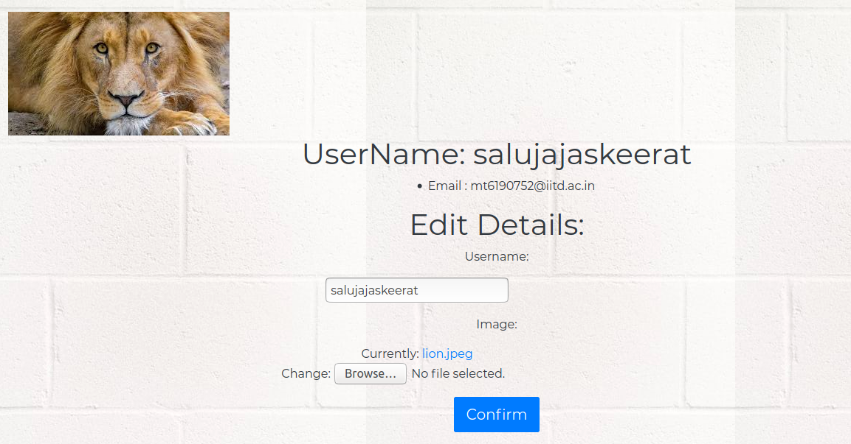
USER PROFILE

Slide 7
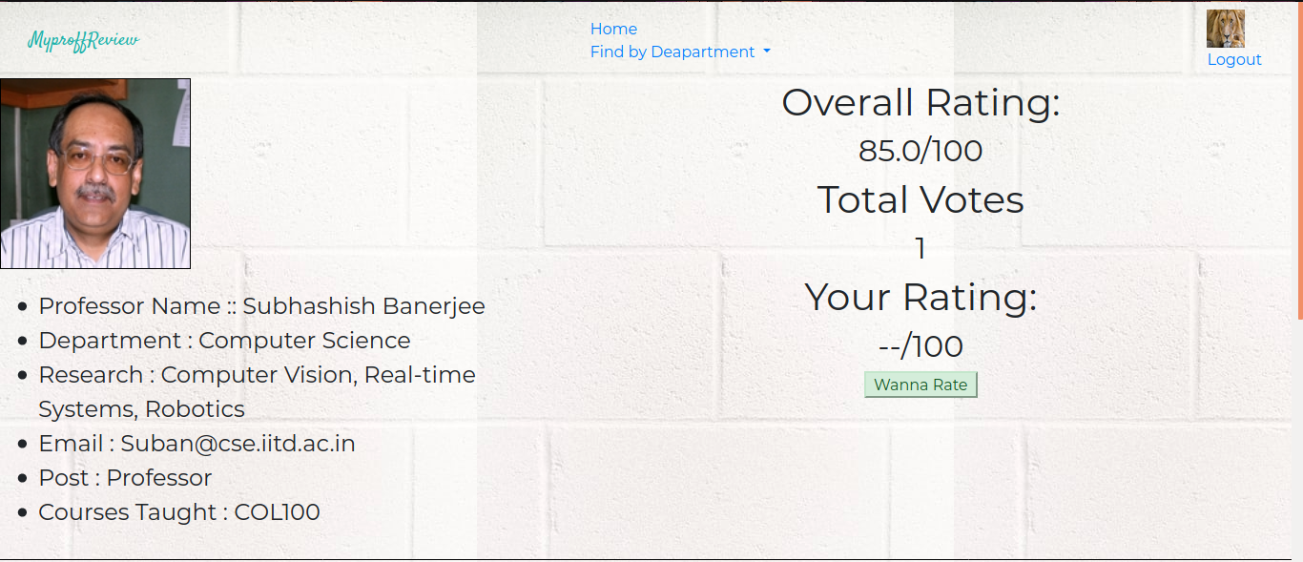
PROFESSOR DETAILS
On clicking the proff name you can open his details, as shown above an example
.You can see the Rating of proff out of 100.

Slide 8
PROFESSOR DETAILS
2. You can also rate a proff(once) , if you are logged in the site.
3. You can see proff details.
4. You can also see the comments of other user o prof which are sorted on basis of upvotes.
5. If user is logged in he can also comment and upvote other user’s comment.
6. comments can be made annonymously but it can be seen by the admin

Slide 9
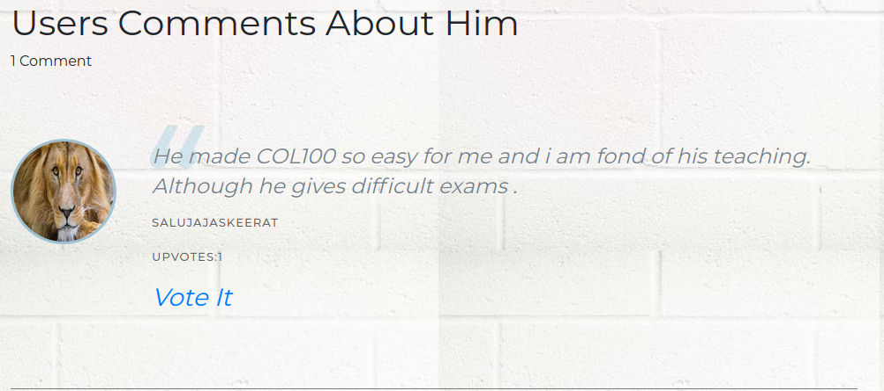
PROFF COMMENTS SECTION

Slide 10
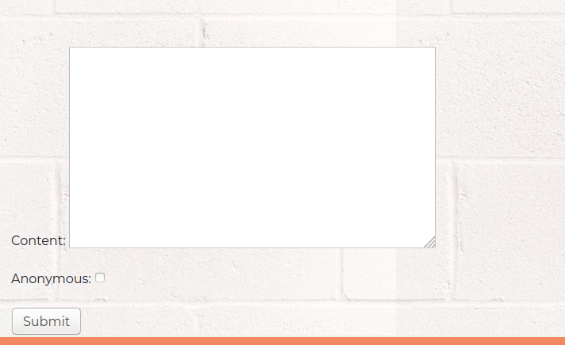
Add COmments

Slide 11
NOTE
1. Professor Cannot be added by users , but only by the admin
THANK YOU

