Slide 2
MRP Pyomo Model
Functional/Technical Overview

Slide 3
Contents

Slide 4
MRP Pyomo Model
  https://github.com/salvaGarciaRaro/mrp_pyomo
  This project implements a multi‑product, multi‑location MRP model in Pyomo.
  It supports make, buy, and transfer decisions, BOM‑driven dependent demand, resource‑based capacity, lead times, and lot sizing.
  Inputs are provided in Excel, and outputs are written to Excel

Slide 5
Model Scope
Multi-product, multi-location, multilevel BOM, Routing, Resource capacity constrained, lotsizes
Produce, Procure and transfer decision

Slide 6
Optimization Logic
Current optimization order
Minimize total backlog
Minimize total buy
Minimize total inventory
Minimize transfer usage by lane priority
Backlog is always minimized first.
Buy is minimized before inventory, so the model will use transfers (and make) to avoid buying whenever possible.
Transfers are only optimized by lane priority after backlog/buy/inventory are already fixed.

Slide 7
Optimization Logic
Example 1: Transfer vs Buy (no production possible)
Setup
Demand: 10 units of FG1 at L1 in P2. Production not possible (make not allowed or no capacity) .L2 has 10 units on hand. Transfer L2 → L1 allowed, lead time 0. Buying is allowed
Phase A (min backlog)
Backlog can be 0, so model must satisfy demand in P2.
Phase B (min buy)
Because transfer can cover demand, the model sets:
Buy = 0
Transfer = 10
Phase C (min inventory)
Given buy = 0, the model minimizes inventory. It will still keep transfer at 10 to meet demand (backlog constraint).
So result: transfer used, buy avoided.
Phase D (min lane priority)
If multiple transfer lanes exist, it picks the lane with lowest priority value.
✅ Result: transfer is preferred over buy.
Example 2: Transfer insufficient → buy fills the gap
Setup
Demand: 10 at L1. Transfer capacity from L2 is only 6. Buy is allowed
Phase A: backlog must be 0
Phase B: minimize buy, so:
Transfer = 6
Buy = 4
✅ Result: buy only covers what transfer can’t.
Example 3: Make possible → does it prefer make?
There’s no explicit “minimize make” or “maximize make” objective.
Make is used if it helps satisfy demand with lower buy (phase B) and lower inventory (phase C).
So if production can meet demand without increasing buy, it will be used.

Slide 8
Input
Time Periods -> buckets (undefined)
Products -> Scope
Locations
Proc Type -> “P” = production, “F” = external purchase, “X” = both
Purchasing_Capacity -> Can establish a limit of how much can be purchased by product / location / period
Resources
Resource_Capacity
BOM -> multilevel allowed. Includes ratio, lead time, minimum lotsize, lotsize rounding
Routing -> Reflects product / location / resource consumption
Purchasing -> Contains leadtime, min lotsize and rounding for external purchasing
Transportation Lanes -> defines what product can move from one location to another. Also contains lot size info and priorities
Transportation Capacity
Initital Inventory -> starting stock
Independent Demand

Slide 9
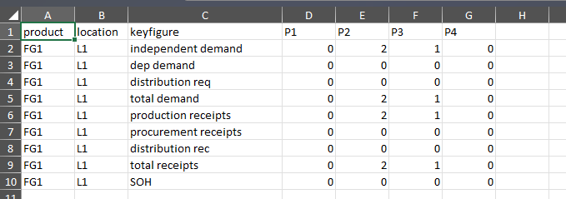
Output
Total Demand = independent demand + dep demand + distribution req.
Total Receipts = production receipts + procurement receipts + distribution rec.

Slide 10
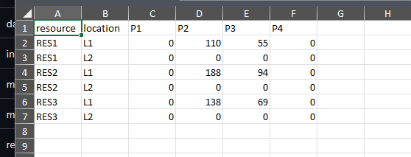
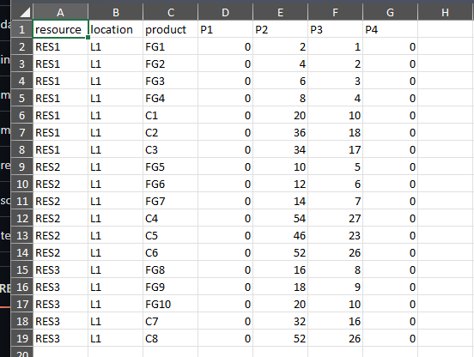
Output
Resource consumption aggregated by resource / location period and with the consumption detail by product.

Slide 11
Summary

