Slide 1
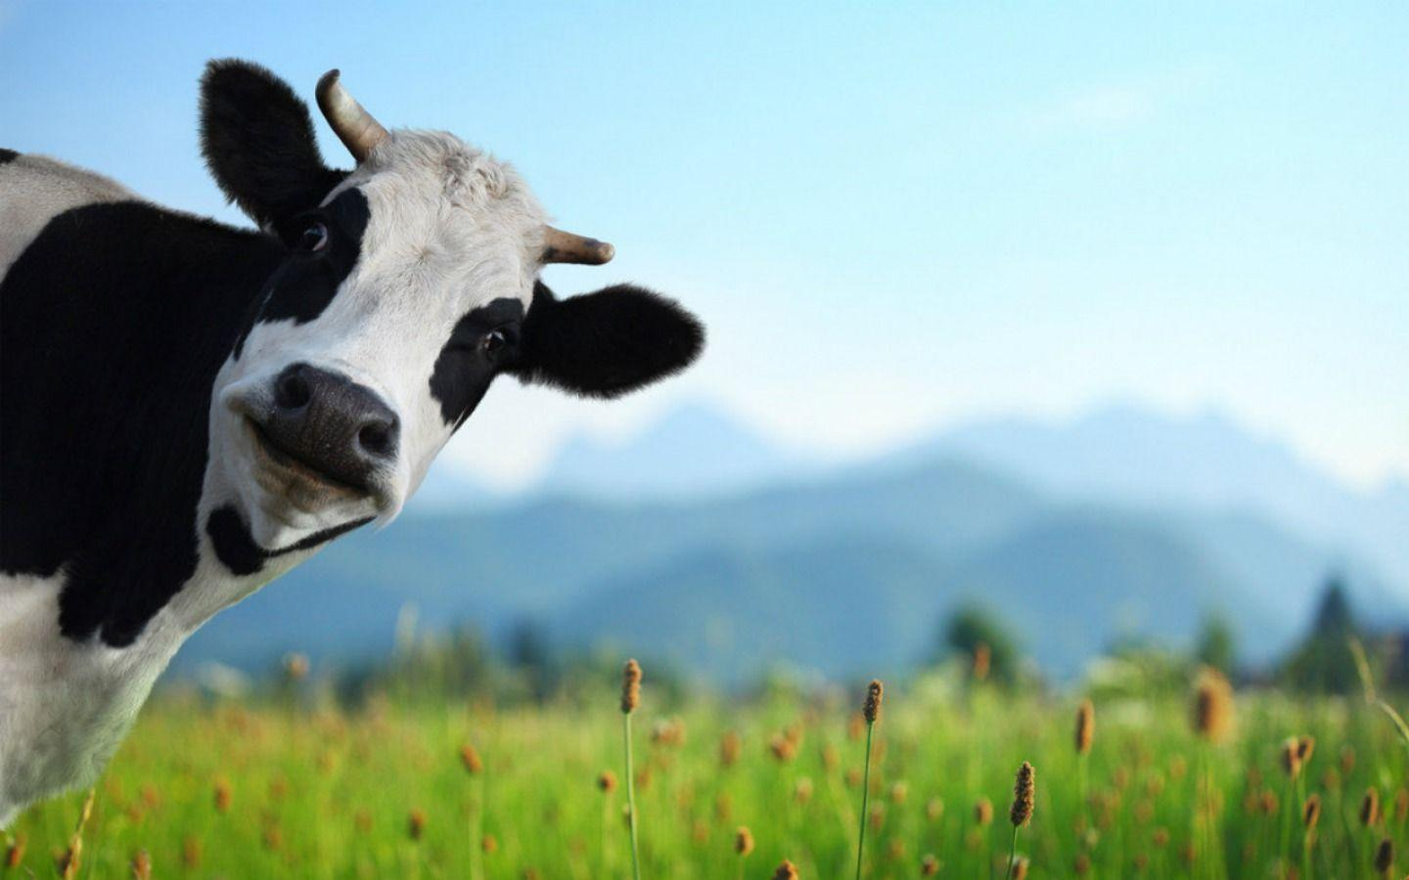
Noah A. Legall Committee Meeting
January 12th, 2021
University of Georgia
Institute of Bioinformatics
https://wallpapercave.com/cows-wallpapers

Slide 2
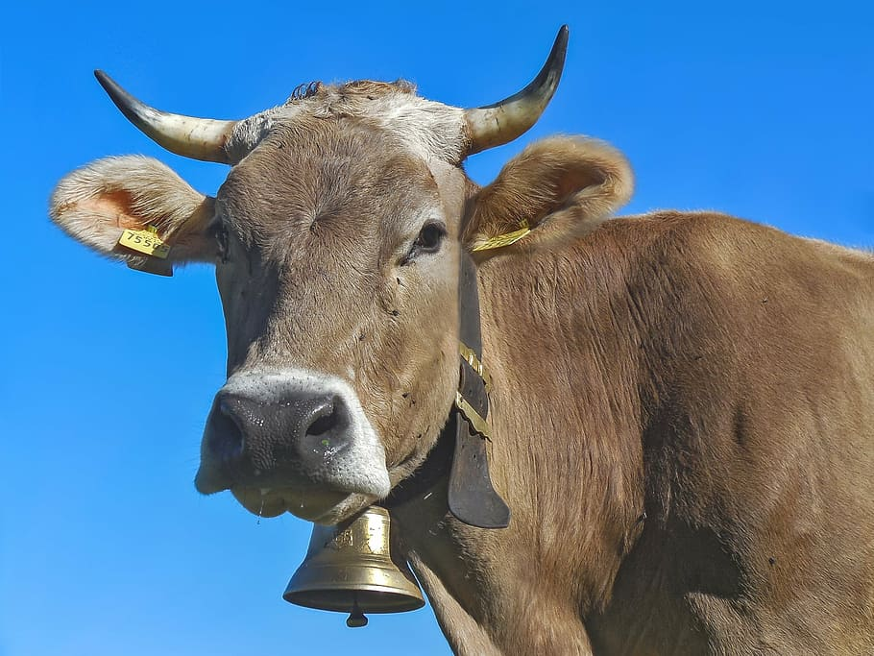
Outline
Introduction
Specific Aims
Preliminary Analysis
https://www.pxfuel.com/en/free-photo-euqgf

Slide 3
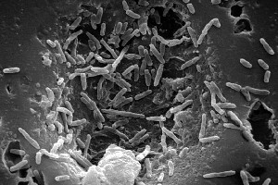
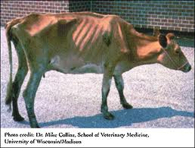
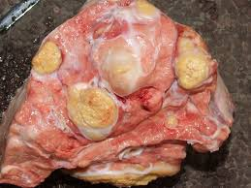
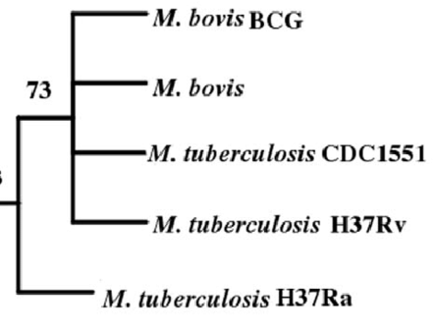
Mycobacterium bovis – Quick Facts
Introduction
Mycobacterium bovis is the bacterial pathogen that causes bovine tuberculosis (bTB)
Gram positive, rod shaped
Chronic respiratory complications, weight loss, lymphatic and lung lesions
Highly related to Mycobacterium tuberculosis
Wide host range
Notes:
Mycobacterium bovis picture: https://microbewiki.kenyon.edu/index.php/Mycobacterium_bovis
Cow picture: https://www.barfblog.com/2016/06/nz-tb-testing-important-for-food-safety/
Lesion picture: https://www.vetstream.com/treat/bovis/farmer-factsheets/tuberculosis
Phylogeny: Anchor-Based Whole Genome Phylogeny (ABWGP): A Tool for Inferring Evolutionary Relationship among Closely Related Microorganims

Slide 4


Consistent M. bovis transmission at wildlife-livestock interface
Introduction
Close spatial proximity leads to frequent exposure, spillover risk.
Reservoirs of infection: species populations that can transmit disease within itself as well as externally to other species populations.
Limits the effectiveness of control measures for bTB.
Critical need to limit transmission and reservoir formation

Slide 5
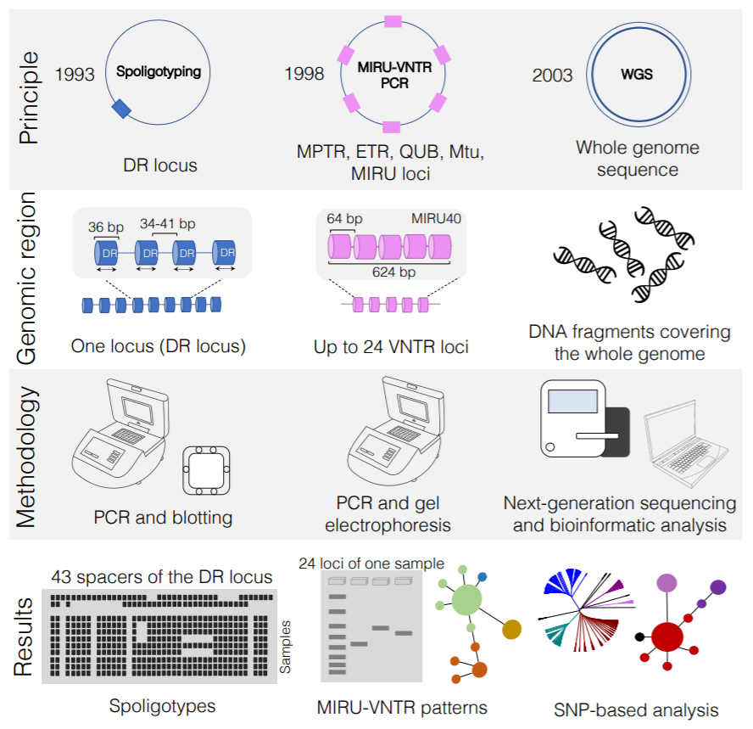
Genotyping M. bovis as a tool to track transmission
Introduction
Next generation sequencing (NGS) more commonplace, increasing resolution
Spoligotyping
MIRU-VNTR
Whole Genome Sequencing
Only highly conserved sequence info is used
Variable genomic elements overlooked

Slide 6





Phylodynamic framework to unravel factors affecting transmission
Introduction
Phylodynamics: the study of how epidemiological, immunological, and evolutionary processes act and potentially interact to shape phylogeny.
Bayesian framework
Host jumps, geographic diffusion.
Integration of ecological & environmental factors.
https://www.slideshare.net/torstenseemann/visualizing-the-pan-genome-australian-society-for-microbiology-tue-8-jul-2014

Slide 7
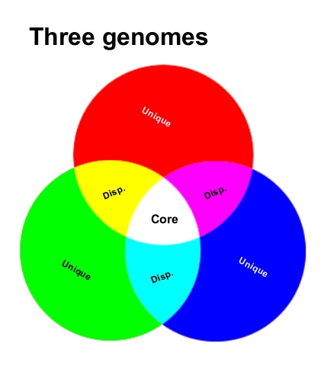
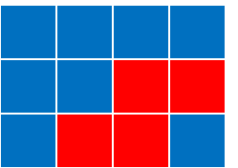
Pangenome framework for bTB analysis
Introduction
Pangenome analysis for M. bovis
Core genome
Accessory genome
Potential to link host-specific evolutionary signatures to reservoir formation
Genes
. . .
. . .
Isolates
. . .
https://www.slideshare.net/torstenseemann/visualizing-the-pan-genome-australian-society-for-microbiology-tue-8-jul-2014

Slide 8
M. bovis transmission knowledge gaps
Specific Aims
How can the inclusion of the core genome and accessory genome elevate current M. bovis transmission analyses?
What external factors influence geographic transmission of M. bovis?
Can a pangenomic framework be utilized to understand host specific evolutionary signatures that are precursory to reservoir formation?
https://www.slideshare.net/torstenseemann/visualizing-the-pan-genome-australian-society-for-microbiology-tue-8-jul-2014

Slide 9
Specific Aims
Specific Aims
Aim 1 – Develop a platform for the analysis, storage, and access of M. bovis pangenomic data
Aim 2 - Determine environmental, ecological, and geographic factors that contribute to M. bovis evolution and global spread.
Aim 3 - Use host associated M. bovis genomic data to find genomic signatures suggesting host adaptation.

Slide 10
Question 1
How can M. bovis genomic data be easily processed, stored, and utilized to accelerate genomic surveillance analyses?

Slide 11
Specific Aims
Specific Aims
Aim 1 – Develop a platform for the analysis, storage, and access of M. bovis pangenomic data
Aim 2 - Use Bayesian Phylodynamic framework to correlate ecological, environmental factors that contribute to M. bovis evolution and global spread.
Aim 3 - Use host associated M. bovis genomic data to find genomic signatures suggesting host adaptation.

Slide 12
Reference guided M. bovis pipeline vSNP
Specific Aims
Genome sequencing of M. bovis more commonplace, necessitates the automation of variant identification
USDA vSNP pipeline developed for variant calling for bTB & other livestock diseases
Pros:
Makes variant calling easier
Conventional bioinformatic tools for variant calling
Cons:
Not fully automated
Ignores accessory genome
M. bovis specific variant calling not benchmarked

Slide 13
Sub-questions (Aim 1)
Specific Aims
What combination of variant calling software leads to most accurate precision in M. bovis SNP identification?
How can we store SNP & gene data alongside auxiliary metadata to maintain scalability?
What are proper techniques of extracting stored pangenomic data to allow efficient dissemination of data?

Slide 14
Methods
Specific Aims
Variant Calling Simulation – Transphylo w/ M. bovis
Utilization of Relational Database Management System (RDBMS)
Hidden Markov Model integration (linear time alignment)
REST API for data interactions with end users.

Slide 15
Sub-questions (Aim 1)
Specific Aims
What combination of variant calling software leads to most accurate precision in M. bovis SNP identification?
Simulation benchmarking
How can we store SNP & gene data alongside auxiliary metadata to maintain scalability?
RDBMS + HMM
What are proper techniques of extracting stored pangenomic data to allow efficient dissemination of data?
REST API

Slide 16
Question 2
Do ecological and environmental factors such as land-use and climate data influence geographic transmission of M. bovis?

Slide 17
Specific Aims
Specific Aims
Aim 1 – Develop a platform for the analysis, storage, and access of M. bovis pangenomic data
Aim 2 – Use Bayesian Phylodynamic framework to correlate ecological, environmental factors that contribute to M. bovis evolution and global spread.
Aim 3 - Use host associated M. bovis genomic data to find genomic signatures suggesting host adaptation.

Slide 18
Question 3
How do specific genomic characteristics within the M. bovis genome assist in host species specificity?

Slide 19
Specific Aims
Specific Aims
Aim 1 – Develop a platform for the analysis, storage, and access of M. bovis pangenomic data
Aim 2 - Use Bayesian Phylodynamic framework to correlate ecological, environmental factors that contribute to M. bovis evolution and global spread.
Aim 3 - Use host associated M. bovis genomic data to find genomic signatures suggesting host adaptation.

Slide 20
M. bovis spillback leads to economic burden
Introduction
Spillover can lead to formation of two opposite outcomes:
Maintenance populations: transmission within the species population can be sustained
Dead-End hosts: transmission of disease occurs rarely within a species population
Maintenance populations that contribute to constant spillback are the focus of disease control programs.

Slide 21
Whole Genome Sequencing for bTB surveillance
Introduction
Mutations in the M. bovis genome can accumulate in a time frame that can be observable over a few years.
M. bovis Genetic similarity ~ Transmission dynamics
t₀
t₁
t₂
t₃
t₄
t₅
Time of Infection

Slide 22
Whole Genome Sequencing for bTB surveillance
Introduction
Whole Genome Sequencing (WGS) is utilized to track changes in individual nucleotides.
Compare to an established reference genome.
Infer a time rooted phylogenetic tree
The combination of genomic, temporal, spatial, and host metadata for a single M. bovis isolate help to define these dynamics.
Coalescent process
t₀
t₁
t₂
t₃
t₅
Time of Infection

Slide 23
What genomic changes facilitate maintenance transmission?
Research Questions
Genomic changes on the population level within a maintenance host population should accumulate.
Cattle
Badger

Slide 24
What factors contribute to spillover of M. bovis?
Research Questions
Anthropogenic, agricultural, and ecological factors might influence transmission dynamics.

Slide 25
What factors contribute to spillover of M. bovis?
Research Questions
Can analysis of the genomic variability of M. bovis isolates elucidate what factors across the molecular, population, and global scale affect spillover transmission?

Slide 26
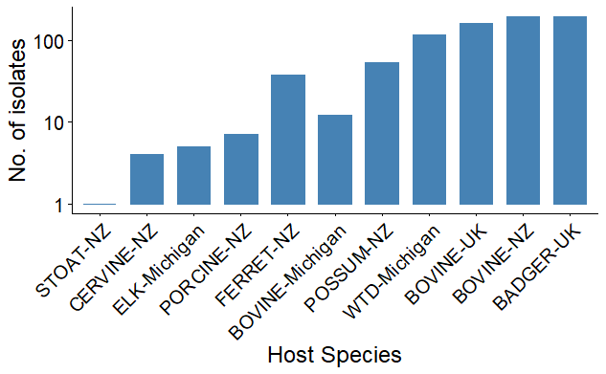
Preliminary Analysis Data
Preliminary Research
To understand if there was any relationship between genomic variability and host status, I pulled sequence data from three nations that have distinct maintenance hosts for M. bovis:
USA: white-tailed deer
UK: badger
NZ: bushtail possum

Slide 27
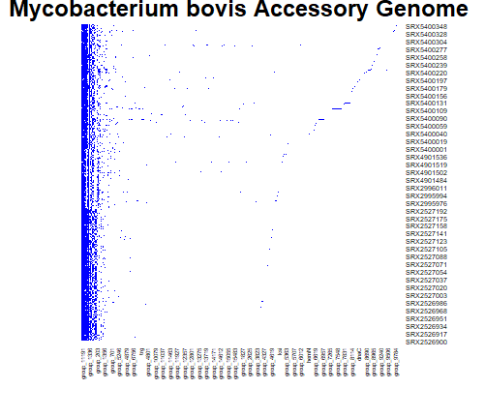
M. bovis Pangenomic Framework
Preliminary Research
Once the data was collected, inferring the pangenome was the next step to investigate genomic attributes.
Core Genome
Areas of Selection + Homologous Recombination
Maximum Likelihood Phylogenetic Tree
Accessory Genome
Principal Component Analysis (PCA) clustering

Slide 28
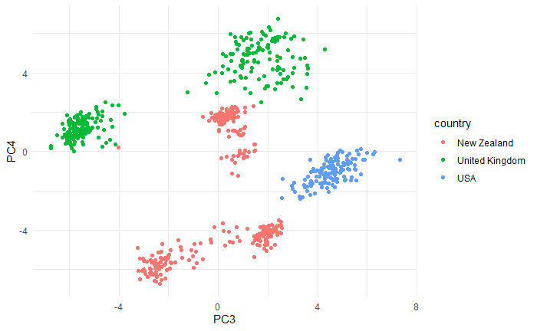
Regional clustering of accessory genome
Preliminary Research

Slide 29
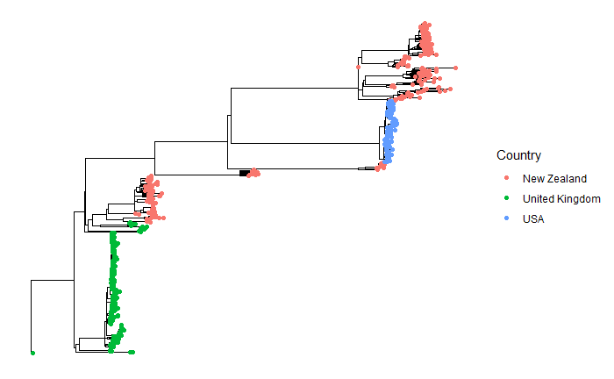
Regional clustering of core genomes
Preliminary Research

Slide 30
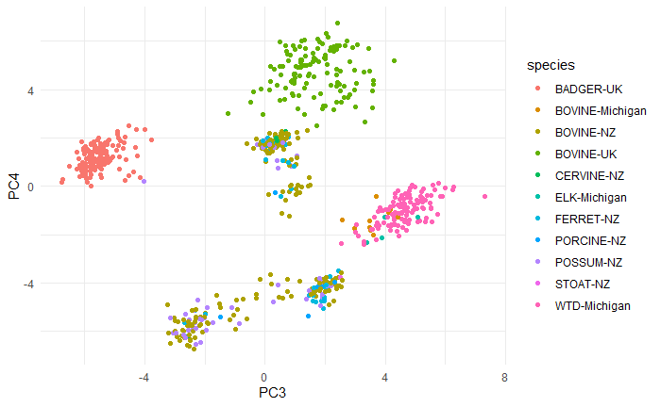
Multi-host clustering of accessory genome
Preliminary Research

Slide 31
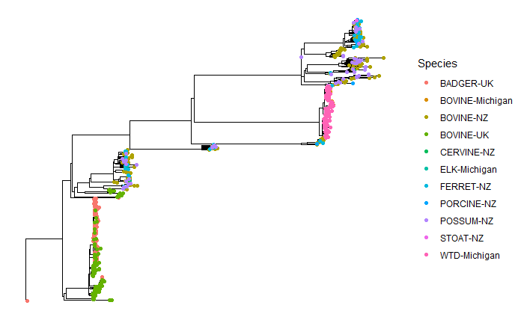
Multi-host clustering of core genomes
Preliminary Research

Slide 32
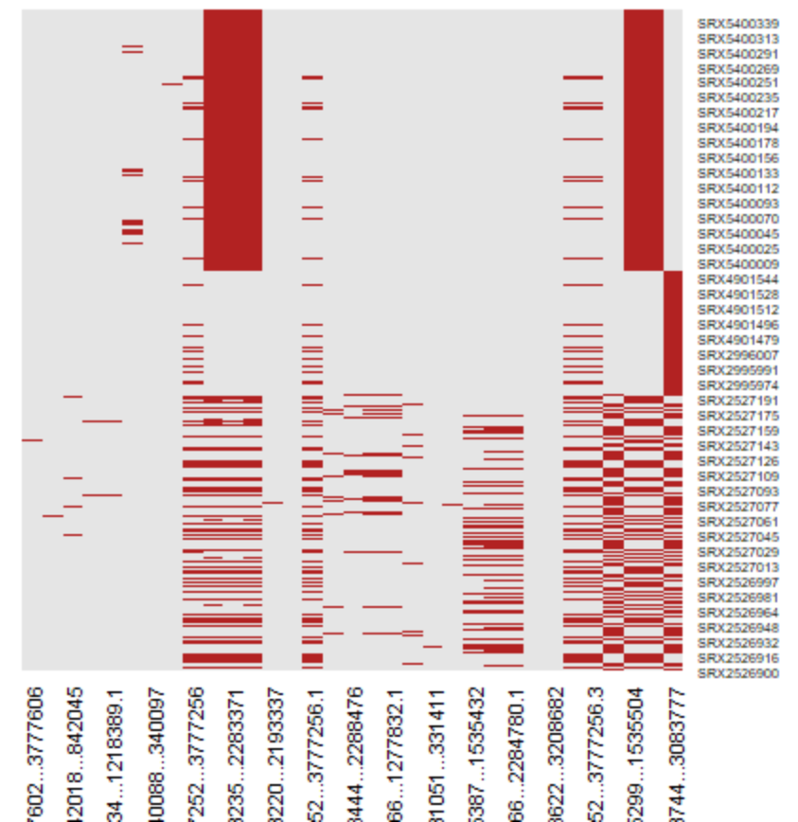
Limited regions of homologous recombination
Preliminary Research

Slide 33
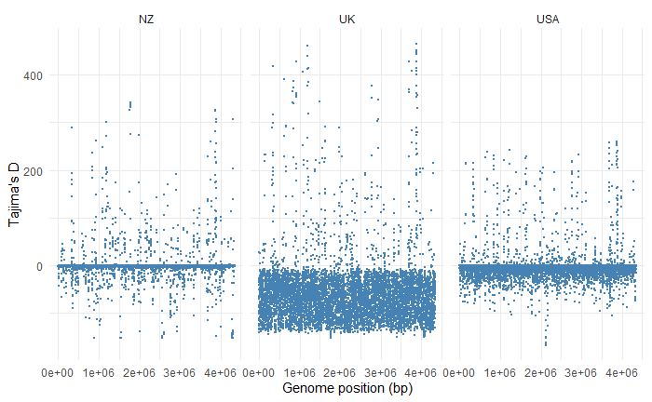
Conflicting signal from United Kingdom isolates
Preliminary Research

Slide 34
Preliminary Result discussion
Preliminary Research
Accessory genome clustering is distinct for nations and species in the United Kingdom (badgers and cattle).
The core genome phylogeny shows that there is some interaction between badgers and cattle.
Homologous recombination is rare, but can differentiate nation
Still investigating,

Slide 35
Aim 1
Specific Aims
Aim 1 - Apply a reference agnostic machine learning approach to find genes that are enriched for different species and regions.
Growing amount of literature that develop methods for analyzing pangenome data and using statistics to relate to host status
Anti-microbial Resistance
Host Range
My preliminary results suggest the accessory genome of M. bovis, in terms of gene presence & absence, is distinct based on geographic region and perhaps species (UK badgers & cattle).
Assess gene frequencies for key maintenance host/ geographic region genes
Mutual Information test
Bonferroni corrected Chi-squared test
Bonferroni corrected ANOVA F-test
Support Vector Machine Classification
Random Forest Classification

Slide 36
Aim 2
Specific Aims
Aim 2 - Develop a M. bovis WGS genotyping pipeline for continual pathogen surveillance.
WGS of M. bovis isolates will soon be a preferred way of characterizing isolates and surveilling transmission
USDA vSNP pipeline
Opportunity to improve
software benchmarking
Hidden Markov Model Alignment support (quicker reference based alignment)
pipeline management software
Automatic integration w/ NextStrain open source website
Develop this pipeline and make it available to M. bovis research community

Slide 37
Aim 3
Specific Aims
Aim 3 - Utilize a Bayesian framework to analyze a M. bovis time-tree for understanding anthropogenic and ecological factors that impact transmission.
Phylodynamics: defined as the study of how epidemiological, immunological, and evolutionary processes act and potentially interact to shape phylogeny.
Bayesian framework useful for outbreak investigation.
Transition rates between different states (Host jumps, geographic diffusion).
Integration of ecological & anthropogenic factors to see what influences these transitions.
For M. bovis, multiple studies employ phylodynamics, but literature review shows no study has investigated how these factors influence transmission dynamics.
Collect ecological data based on temporal, spatial parameters
Collect sequence data compiled from Aim 2
Utilize a generalized linear model approach to insinuate which factors contribute to transmission between regions. Judge them based on their respective bayes factor values

Slide 38
Timeline
Specific Aims
Time | Spring 2021 | Summer 2021 | Fall 2021 | Spring 2022 | Summer 2022
Aim 1
Aim 2
Aim 3

Slide 39




Thank you
Salvador Lab
Ruijie (Rachel) Xu
Rodrigo Campos
Ehsan Suez
Hind Azami, PhD
Bahl Lab
Jiani Chen
Lambo Damodaran
Zach Petty
Cody Dailey
Subhan Ullah
Swan Tan
Leke Lyu
Gabriella Veytsal
Ridwan Hossain
Committee
Liliana Salvador, PhD
Justin Bahl, PhD
Liang Liu, PhD
Douda Bensasson, PhD

